Slide 1
dVRK 2.0
January 2021
Tentative release date: ASAP

Slide 2
Motivation
User experience
Surgeon: “Feels like the real one”
Researcher: build, API, documentation…
Software
Robot’s state
PSM Tools
Control
…
System integration
Software
Firmware
Hardware

Slide 3
Arms homing
Homing is essentially encoder preload on FPGA using pots/joint limits
Homing can skip bias on potentiometers and MTM roll (faster start) until next controller power cycle
First homing
Subsequent homings
Notes:
Re. robot’s state

Slide 4
PSM tools
Support way more tools, including S/Si tools
So far: 5mm needle driver, large needle driver, permanent cautery spatula, cadiere forceps, long tip forceps, prograsp forceps, curved scissors, maryland bipolar forceps, resano forceps, debakey forceps, mega needle driver, small clip applier, fenestrated bipolar forceps, micro forceps, thoracic grasper, monopolar curved scissor
Ability to swap tools at runtime (vs. shut down the system, change configuration files and restart)
dVRK 1.x: Configuration file (fixed, similar to current dVRK)
dVRK 2.0: Via Qt (manual) or ROS (programmatic)
dVRK 2.0: Dallas chip inside instrument (automatic, requires updated firmware and hardware, prior to Build 7)

Slide 5
PSM tools: fixed tool type

Slide 6
PSM tools: setting type manually

Slide 7
PSM tools: automatic detection using Dallas chip

Slide 8
Arms
MTM:
Control platform orientation (redundant 4th DOF) to follow operator’s hand
Working on closed form inverse kinematics
ECM:
Added gravity compensation:
”Weightless” in manual mode
PID feed-forward
Higher maximum velocity
Support different endoscope angles: straight (0⁰), up and down (30⁰). Set via configuration file and/or runtime using Qt/ROS
Closed form inverse kinematics, better handling of joint limits
Notes:
Re. control

Slide 9
PSM teleoperation
Improved logic to detect operator and start teleoperating
Smoother transitions from start, clutch and ECM teleoperation
Use combination of roll and gripper angle
Jaw control
Better jaw angle control (rate limit with slower rate to catch up on MTM gripper angle)
Use MTM gripper and PSM jaw angle range to determine angle mapping (needed for all new tools supported)
Support camera motion while teleoperating, allows research on autonomous camera motion
Allow relative orientation between MTM and PSM
Publish orientation difference between MTM and PSM
Notes:
Re. control

Slide 10
Other software updates
More health checks, trigger warnings and errors:
Tasks periodicity
Amplifiers temperature
GUI improvements:
Main window shows each arm state
Widget to display in HRSV with arm/console/teleop state
Widget to control camera focus (using ISI focus controller)
Widget to move arm to joint position with option to set maximum speed (%)
OS Support:
New build instructions using wstool on Linux, lighter build and easier upgrades
Support for Ubuntu 16.04 with ROS kinetic, 18.04 with melodic and 20.04 with noetic
Git Workflow integration for cisst (Linux, MacOS, Windows) and dVRK stack ("badges"):

Slide 11
Other software updates
IO Level:
UDP support
Better velocity estimation with firmware 7
Enforce more units in configurations files
Extensive code cleanup
New script to calibrate PSM potentiometer for insertion joint
ROS service to query all forward kinematic frames
Teleoperation over ROS
SAW text-to-speech over ROS
Fixed velocity/acceleration ‘ratio’ for joint trajectories

Slide 12
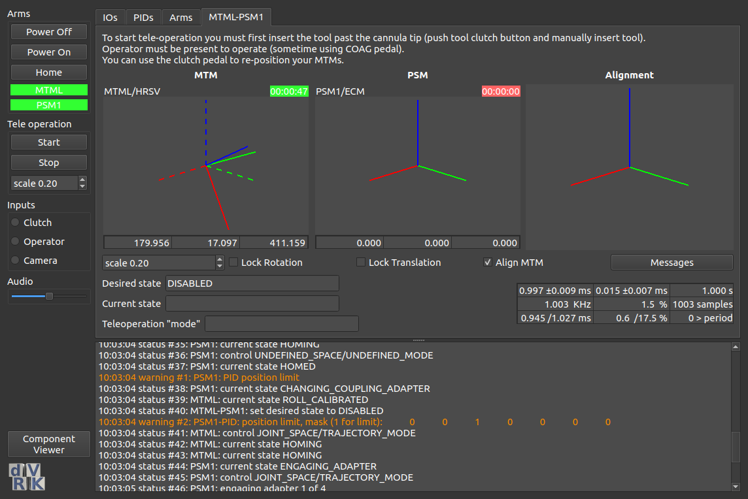
Dark mode

Slide 13
Collaborative Robotics ToolKit (CRTK): motivation
dVRK API grew “organically” since 2012…
API not easy to understand for new users, hard to write your own application
Inconsistent API across devices, hard to integrate/swap devices and develop shared tools
Inconsistent API within the dVRK code base, hard to maintain for us
C++ | ROS topic | Python Client | Matlab Client | CRTK
GetPositionCartesian | position_cartesian_current | get_current_position | position_current | measured_cp
GetPositionCartesianDesired | position_cartesian_desired | get_desired_position | position_desired | setpoint_cp
SetPositionCartesian | set_position_cartesian | move (interpolate = False) | move (interpolate = False) | servo_cp
SetPositionGoalCartesian | set_position_goal_cartesian | move | move | move_cp

Slide 14
CRTK: pros
Standardized and documented API for robot state, move commands and operating state:
https://github.com/collaborative-robotics/documentation/wiki/Robot-API
More options to swap arms (PSM vs. JHU Eye Robot, MTM vs Omni or ForceDimension)
General purpose clients (not dVRK specific and improved):
ROS Python: https://github.com/collaborative-robotics/crtk-python-client
ROS Matlab: https://github.com/collaborative-robotics/crtk-matlab-client
For cisst/SAW ”devices” (dVRK, Omni, Falcon, NDi, Atracsys…): ROS bridge, OpenIGTLink bridge, Qt Widgets...
ROS MoveIt! support (later release)
Note: cisst libraries are foundation libraries, SAW (Surgical Assistant Workstation) components are based on cisst libraries.

Slide 15
CRTK: cons
Major refactoring for dVRK internals
Time consuming
Might require fast release of 2.0.1, 2.0.2… to address newly introduced “issues”
Change of API for end-user applications
We provide a conversion table and script to update user code: https://github.com/jhu-cisst/cisst/tree/feature-crtk/utils/crtk-port

Slide 16
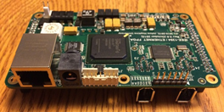
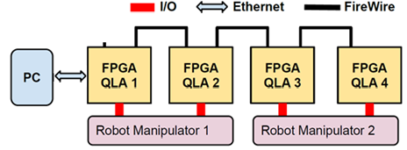
Ethernet Support (UDP)
Ethernet is supported everywhere, including Windows, RTOS, Simulink Real-Time
Real-time drivers for Ethernet readily available
Supported by Firmware Rev 7 and dVRK 2.0

Slide 17
Other firmware updates
Dallas Chip interface for PSM instruments
Even better velocity estimation
More efficient power on/off commands
More efficient broadcast protocol
Implement Configuration ROM to provide FPGA type, board ID and firmware version for PC (dmesg –w), helps with troubleshooting
Software command to reboot FPGA (e.g., after reprogramming)
Waveform table to enable precisely timed digital outputs via QLA (e.g., for testing)

Slide 18
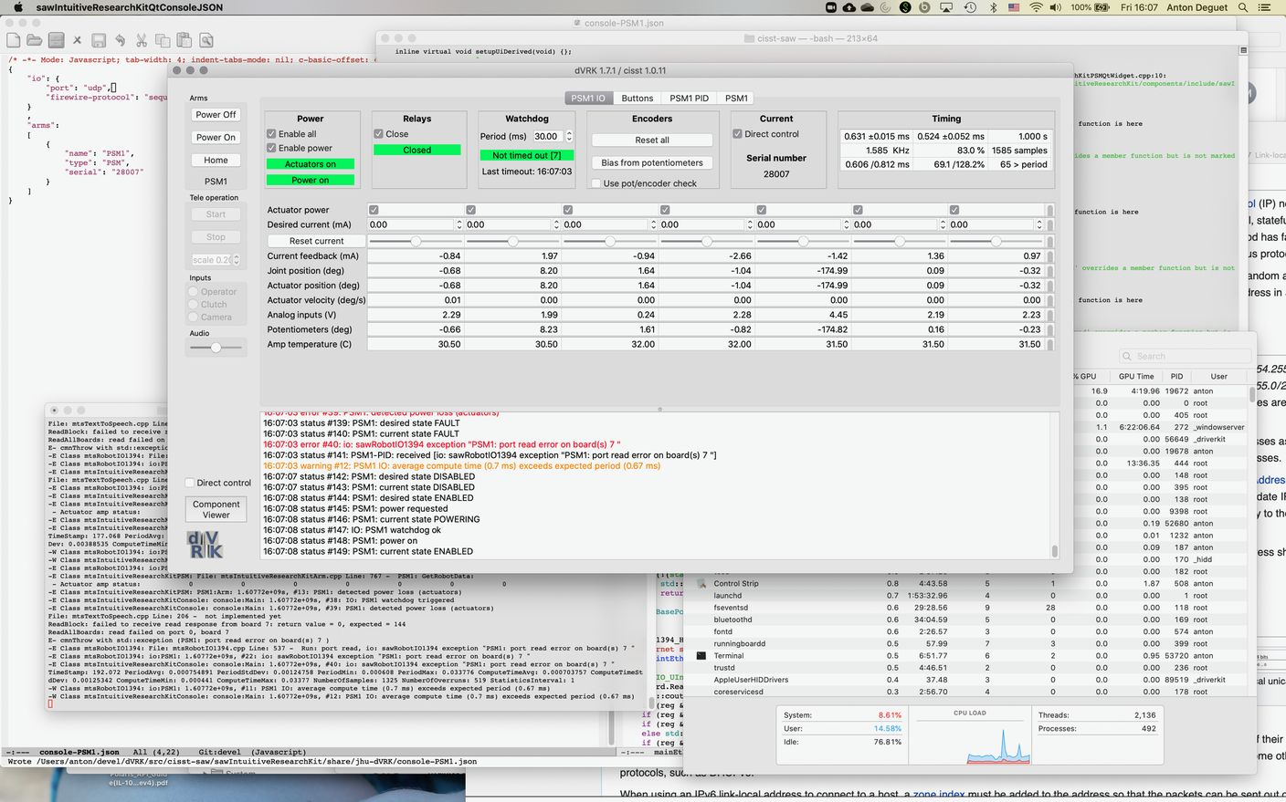
dVRK on other platforms (MacOS and Windows)

Slide 19
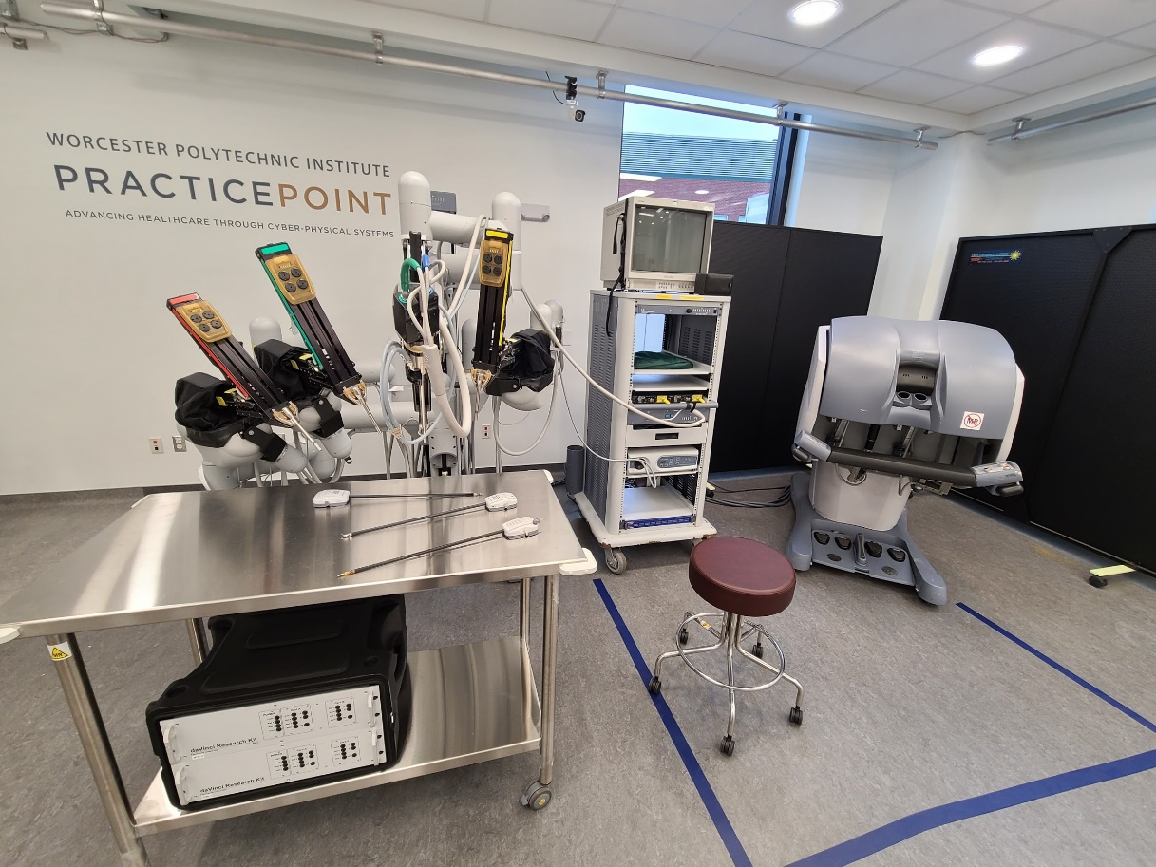
Controller Update: Some Stats
We are in Production Run #8
12 Sites ordering new control systems!
41 new dVRK Controllers (MTM, PSM, ECM) in production
13 new SUJ Controllers in production
107 Control Boards going out in this run

Slide 20
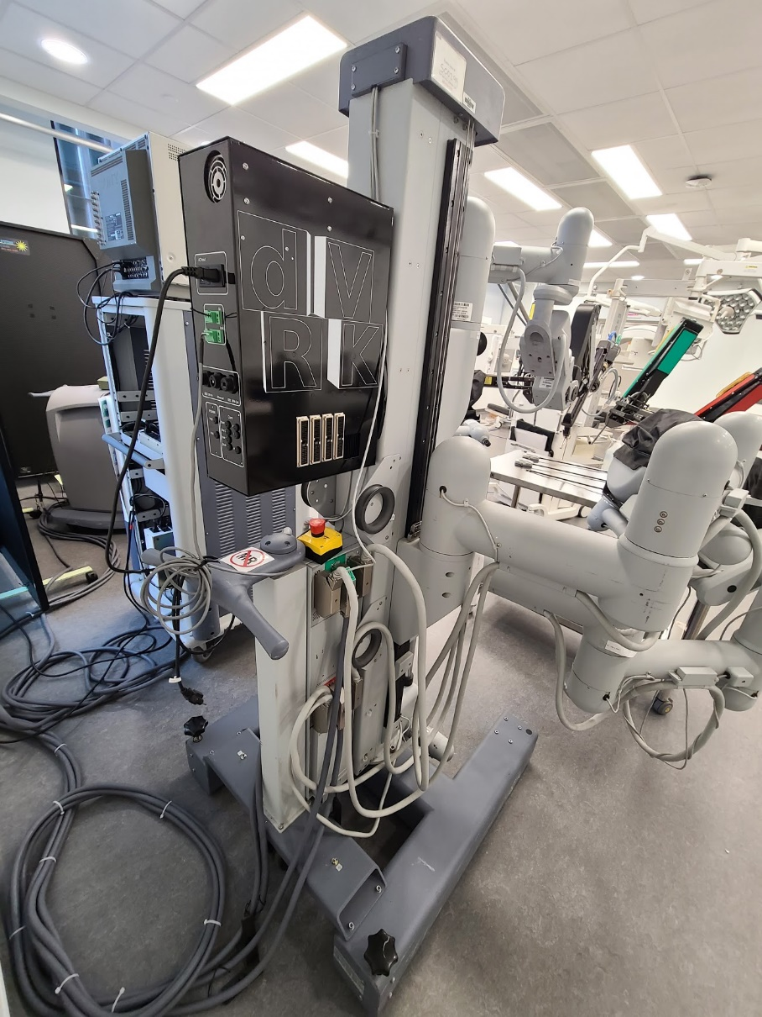
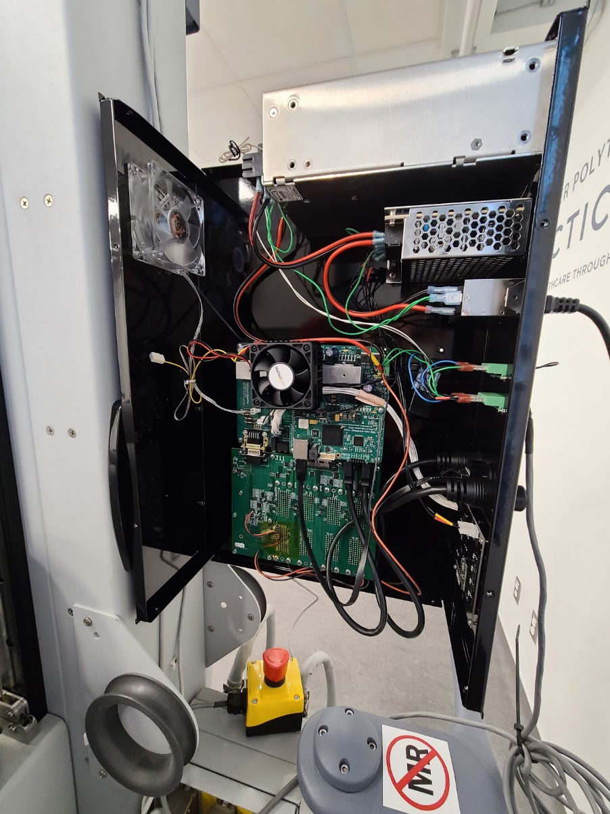
Controller Update: SUJ

Slide 21
Controller Update Timing
The dVRK & SUJ controllers are being fabricated as we speak by our contract manufacturer.
Some minor delays due to COVID, but progressing well. We are awaiting the custom indicator boards (should be ~ 2 weeks)
We anticipate having the controllers built in February.
The system will then be tested, packed, and shipped.
We will keep the sites posted on progress and estimated ship dates, and we will likely also reach out to confirm shipping address soon.
Email Greg Fischer @ WPI with questions (or interest in future production runs): gfischer@medmotion.co

Slide 22
Documentation
Dependencies
cisst-ros: https://github.com/jhu-cisst/cisst-ros/tree/devel
CRTK API:
Operating state: https://github.com/collaborative-robotics/documentation/wiki/Robot-API-status
Motion commands: https://github.com/collaborative-robotics/documentation/wiki/Robot-API-motion
CRTK clients:
Matlab: https://github.com/collaborative-robotics/crtk_matlab_client
Python: https://github.com/collaborative-robotics/crtk_python_client
sawOpenIGTLink: https://github.com/jhu-saw/sawOpenIGTLink/tree/devel (e.g. Slicer)
sawSocketStreamer: https://github.com/jhu-saw/sawSocketStreamer/tree/devel (e.g. Unity)
dVRK wiki:
Controller versions: https://github.com/jhu-dvrk/sawIntuitiveResearchKit/wiki/Board-Versions
Hardware modifications for Dallas Chip on PSM controllers: https://github.com/jhu-dvrk/sawIntuitiveResearchKit/wiki/Tool-Detection
Heat sink for QLAs: https://github.com/jhu-dvrk/sawIntuitiveResearchKit/wiki/QLA-Heat-Sink
Compilation with wstool: https://github.com/jhu-dvrk/sawIntuitiveResearchKit/wiki/CatkinBuild
Compilation on MacOS: https://github.com/jhu-dvrk/sawIntuitiveResearchKit/wiki/MacBuild

Slide 23
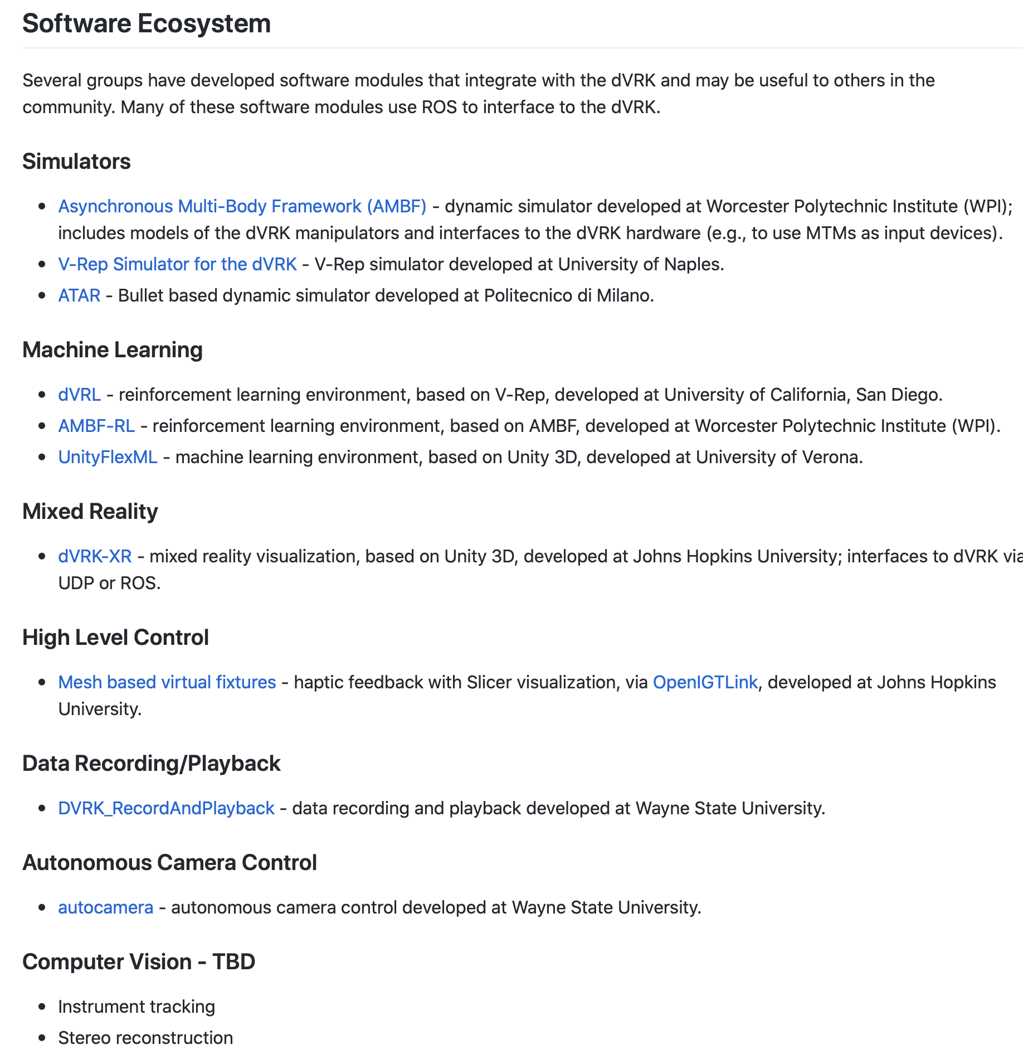
Community: Wiki and Slack

Slide 24
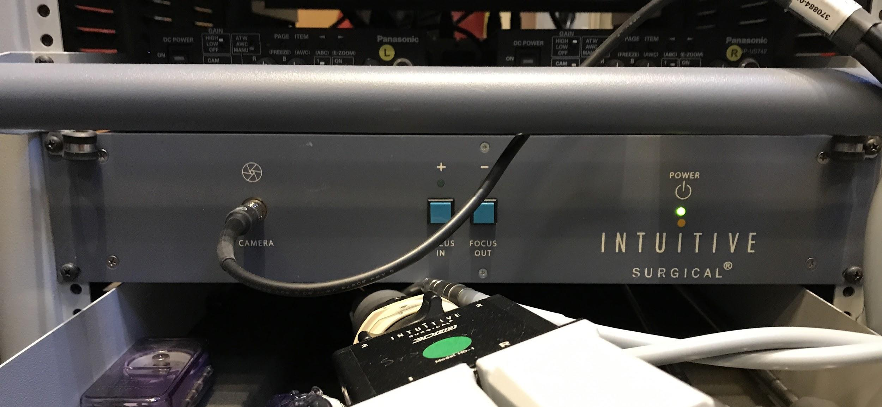
Endoscope focus: current setup
No access to encoder position, limits use of camera calibration
dVRK computer
Endoscope
Encoder position
Limit switches
Motor power
Digital IO (+/-)
FireWire
Foot pedals
dVRK controller
Focus controller
Digital IO (+/-)
Custom cable
Digital IO (+/-)
Custom cable

Slide 25
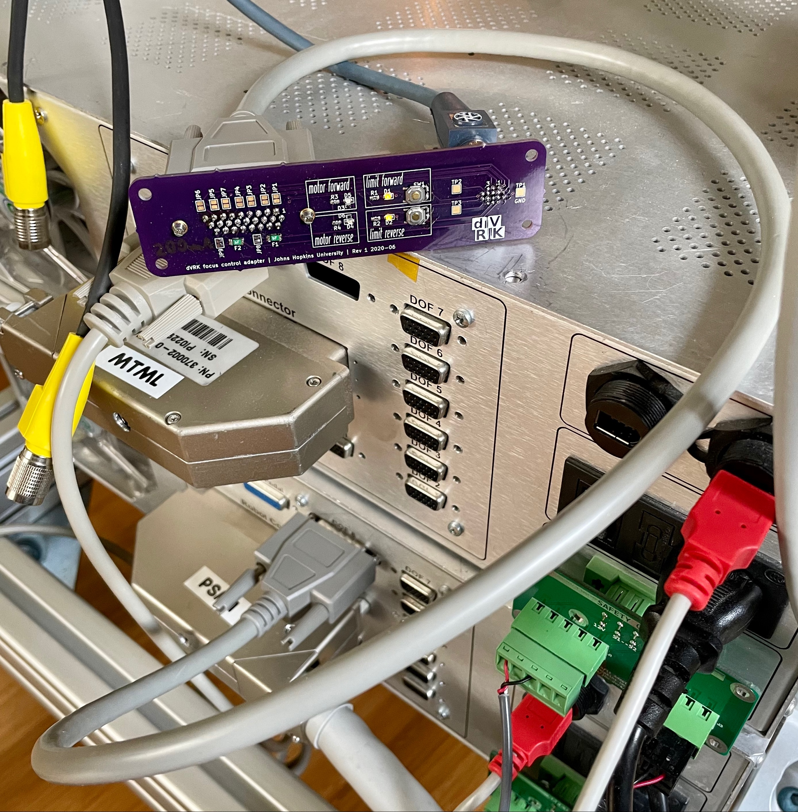
Endoscope focus: proposed setup
Focus motor control (PID)
dVRK computer
Endoscope
Encoder position
Limit switch
Motor power
Digital IO (+/-)
FireWire
Encoder position
Limit switches
Motor power
Foot pedals
dVRK controller
Digital IO (+/-)
Custom cable
Cable adapter (single PCB)
ISI endoscope cable to dVRK controller

Slide 26
Prioritization
Simulink Real-Time (requires Ethernet UDP)
Some work already completed
Video pipeline (at least with endoscope)
3D user interface
Integration of electrocautery unit
Connect to footpedals
Feedback when unit on/off
Other items?
ROS 2.0
Better trajectory support (non-zero final velocities) -- e.g., MoveIt!

