Slide 1
dVRK PI / User Group Meeting
September 26, 2023
(online)

Slide 2
Agenda
Introduction
Announcements
Community Presentation: Allison Okamura (Stanford Univ.)
dVRK/dVRK-Si Hardware/Software Updates
Controllers (dVRK and dVRK-Si)
FPGA V3
Firmware updates
Embedded software
PC software
Open discussion

Slide 3
Announcements
Augmented Dexterity: Ken Goldberg (UC Berkeley)
2023-2024 AccelNet Surgical Robotics Challenge

Slide 4
AccelNet Surgical Robotics Challenge
https://surgical-robotics-ai.github.io/surgical-robotics-challenge-2023/challenge-2023.html
Relaunch of 2021-2022 challenge
Online phase
AMBF Simulator
In-person phase (JHU)
Summer 2024?
Focus on surgical autonomy:
Needle detection
Needle driving
Suturing
This video created via teleoperation
Challenge: Can you do it autonomously?
OISE-1927354 (JHU)
OISE-1927275 (WPI)

Slide 5
Community Presentation
Allison Okamura, Stanford University

Slide 6
Agenda
Introduction
Announcements
Community Presentation: Allison Okamura (Stanford Univ.)
dVRK/dVRK-Si Hardware/Software Updates
Controllers (dVRK and dVRK-Si)
FPGA V3
Firmware updates
Embedded software
PC software
Open discussion

Slide 7
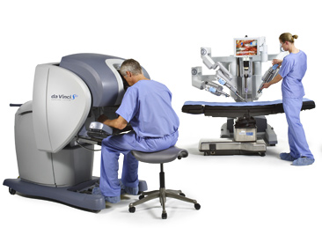
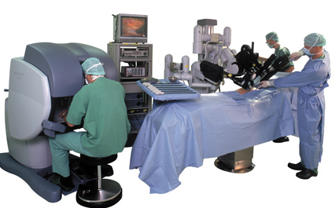
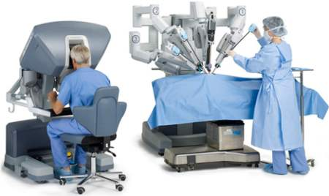
dVRK and dVRK-Si Controllers
dVRK
(V1-V3)
dVRK-Si
(some)
da Vinci “Classic”
da Vinci S
da Vinci Si

Slide 8
dVRK Controller (V1 & V2)
E-Stop
FireWire
Ethernet
Arm
V1: FireWire only
V2: FireWire + Ethernet
(could also use FPGA V3)
dMIB
dVRK Controller
Legend
Ethernet pass-through
Ethernet cable
FireWire pass-through
FireWire cable
E-Stop connector
E-Stop wiring
Data cable (SCSI 68)
Power cable (DB 9)
QLA
FPGA
QLA
FPGA
Logic Power Supply
Motor Power Supplies
MTM (12V + 24V) PSM(24V) ECM (36V)
Front LEDs

Slide 9
dVRK Controller (V3)
FireWire
Ethernet
E-Stop
Arm
FPGA V3
dMIB
Legend
Flat flex cable
Data cable (SCSI 68)
Power cable (DB 9)
Notes
Ethernet and FireWire external connections use PCB-mounted connectors on FPGA
E-Stop external connections use PCB-mounted connector on DQLA-F
DQLA-F
dVRK Controller
QLA
QLA
DQLA-Q
Logic Power Supply
Motor Power Supplies
MTM (12V + 24V) PSM(24V) ECM (36V)
Front LEDs

Slide 10
dVRK-Si Controller
Arm
E-Stop
dRAC
Si Controller
Notes
Ethernet and FireWire external connections use PCB-mounted connectors on FPGA
Cannot use FPGA V1 or V2 (not enough I/O)
E-Stop external connections use PCB-mounted connectors on dRAC
Power and serial communication (LVDS) to the arm use PCB-mounted connectors on dRAC
Logic Power Supply
Motor Power
Supply
(48V)
FPGA
Front LEDs
Ethernet
FireWire

Slide 11
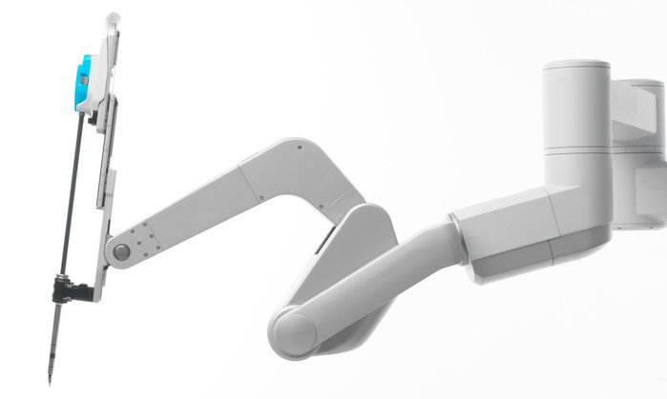
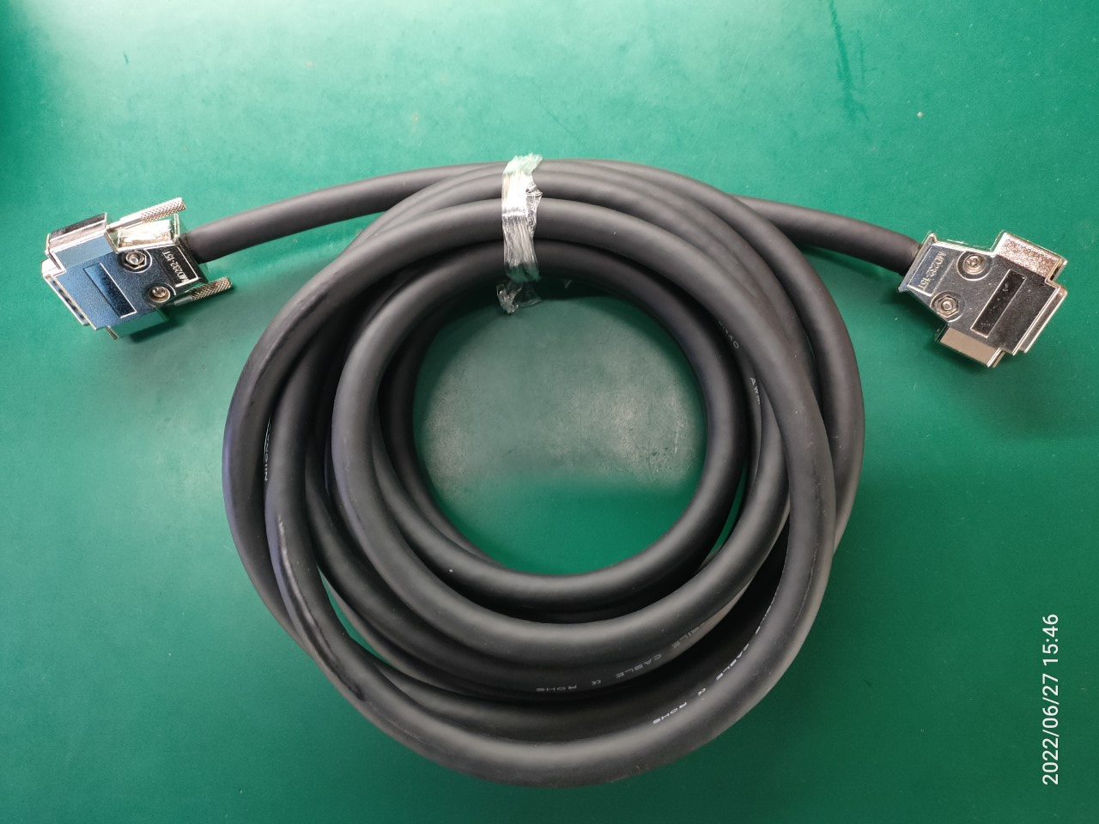
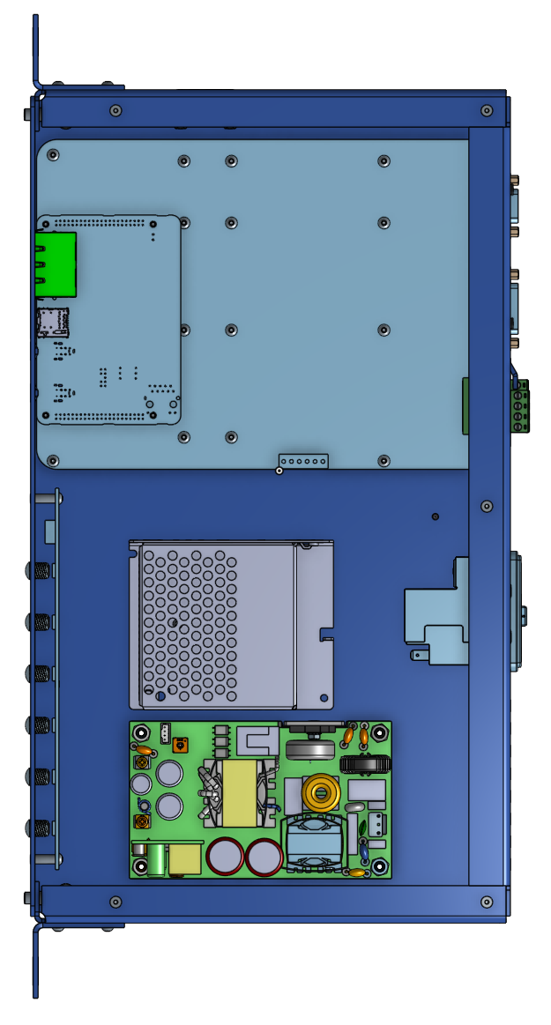
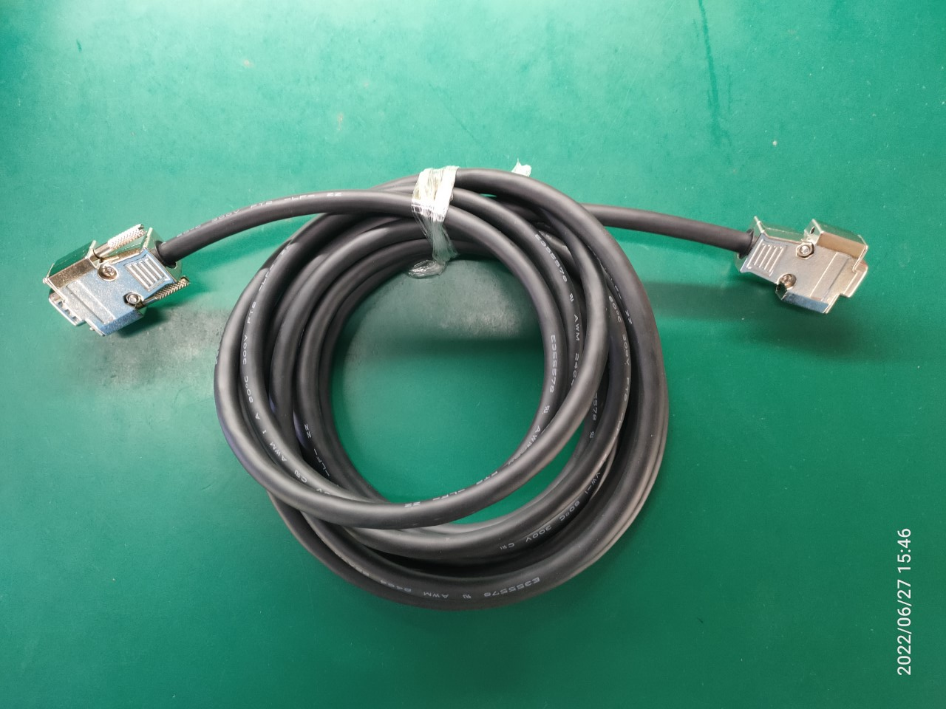
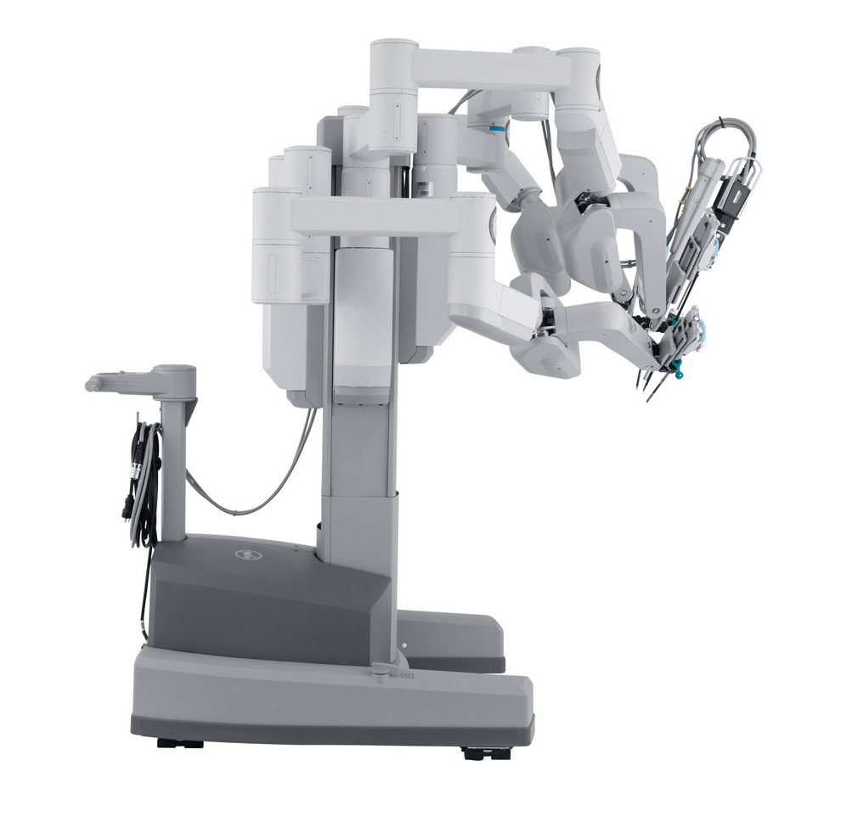
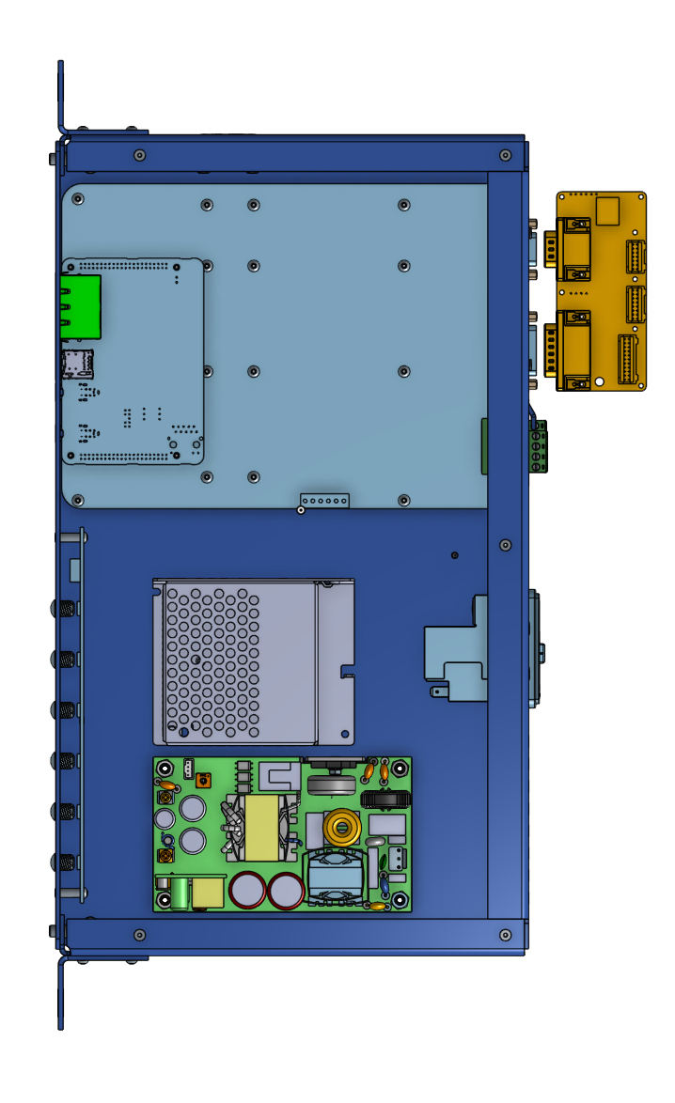
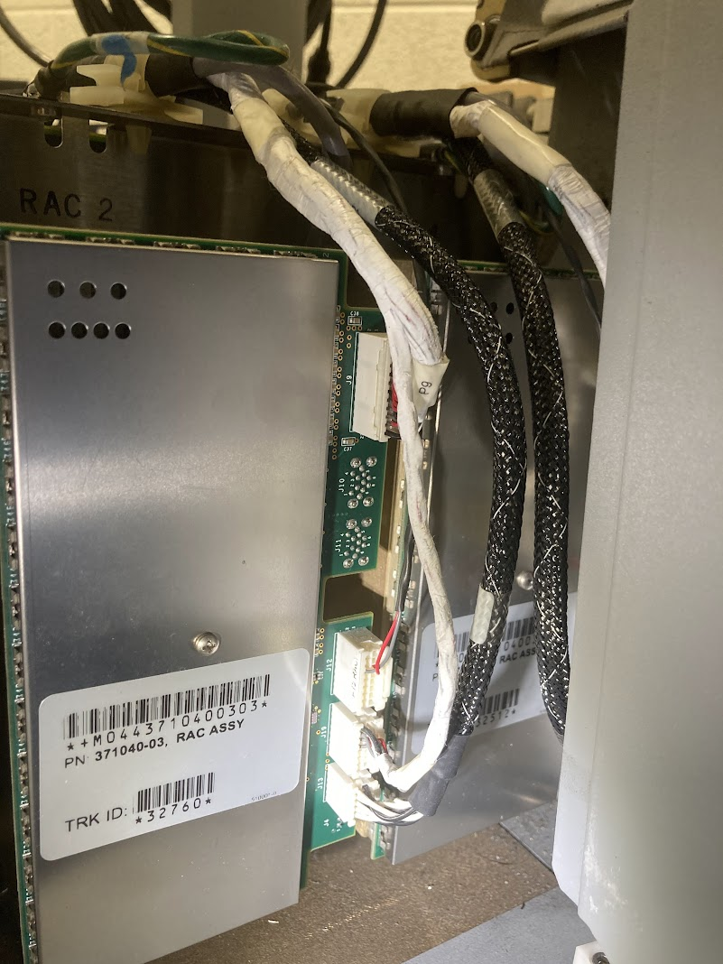
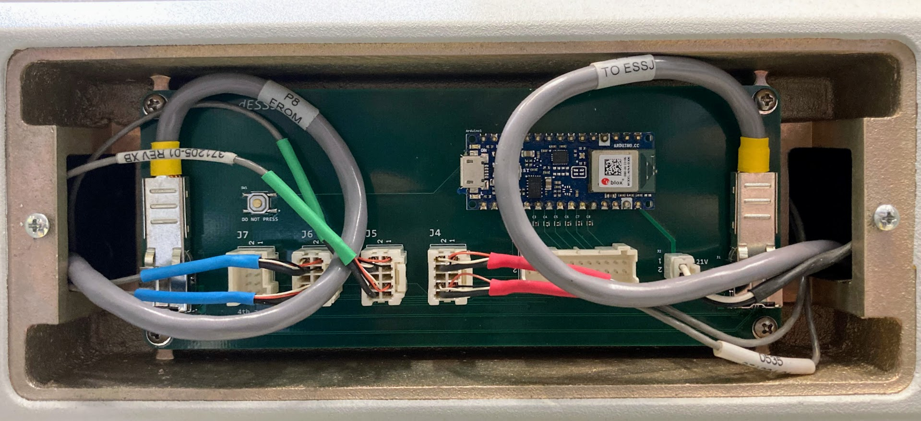
dVRK-Si Controllers
Standalone arms: Controller + Cables + Arm + ESPM Programmer
Full system with SUJ: Controller + dSIB-Si + dESSJ + Patient Cart + ESPM Programmer

Slide 12
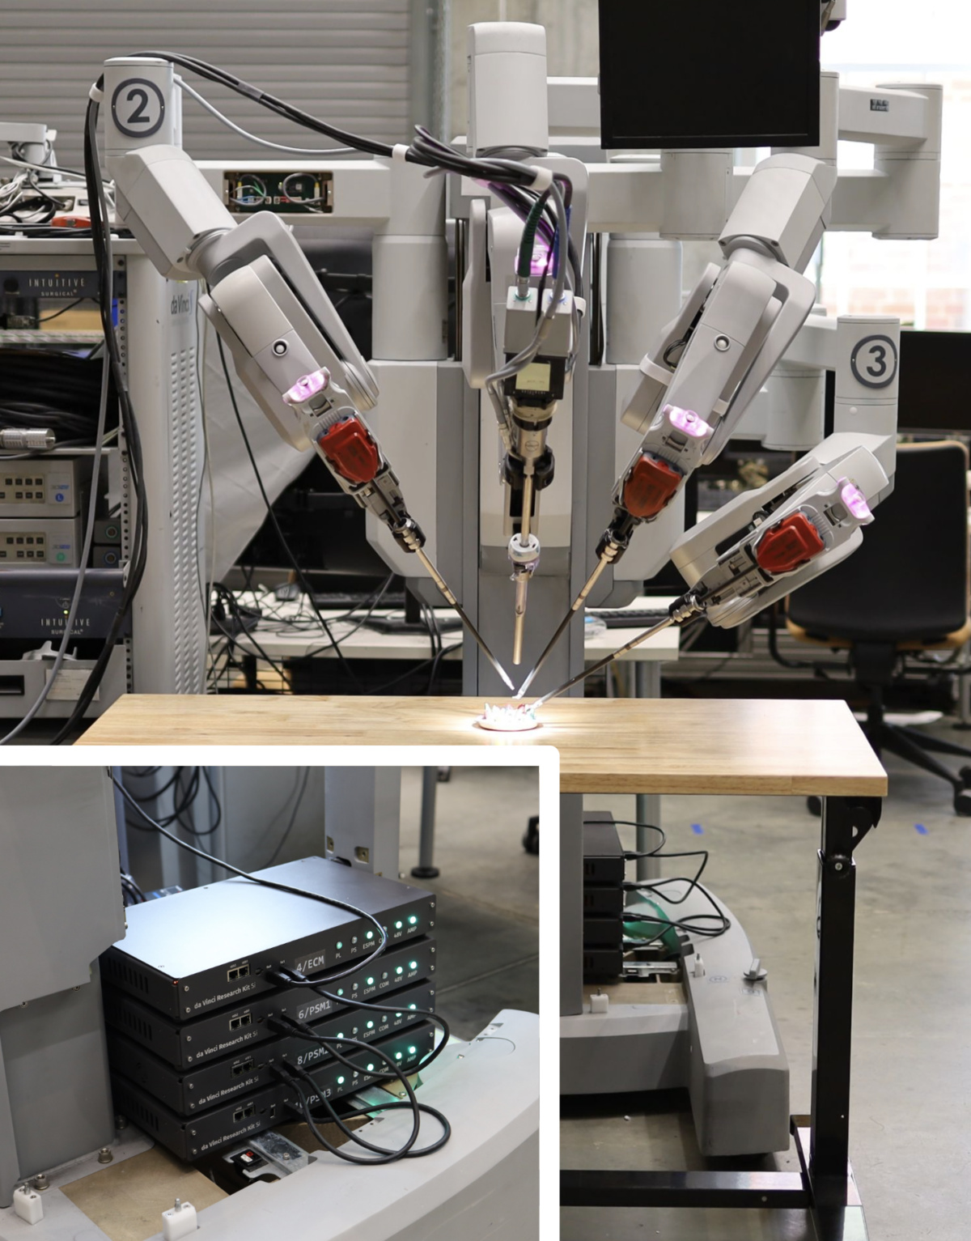
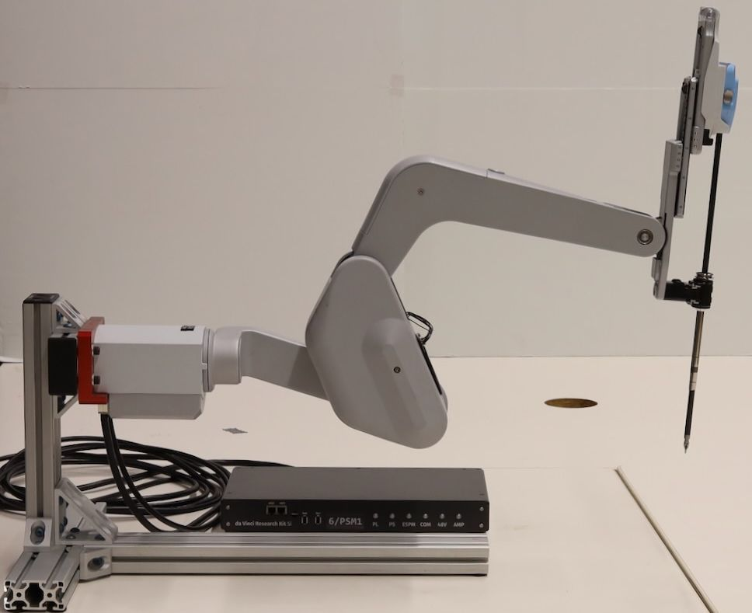
dVRK-Si Setups

Slide 13
ESPM Programmer
Reprograms the ESPM (Altera FPGA).
Sticks to the arm. Connects to the JTAG port of ESPM.
Replays an XSVF file stored in the SD card when the arm powers up.
Firmware update by replacing the file in the SD card.
Reprogramming is not persistent. Unplugging or toggling switch, and then power cycling, restores original firmware.

Slide 14
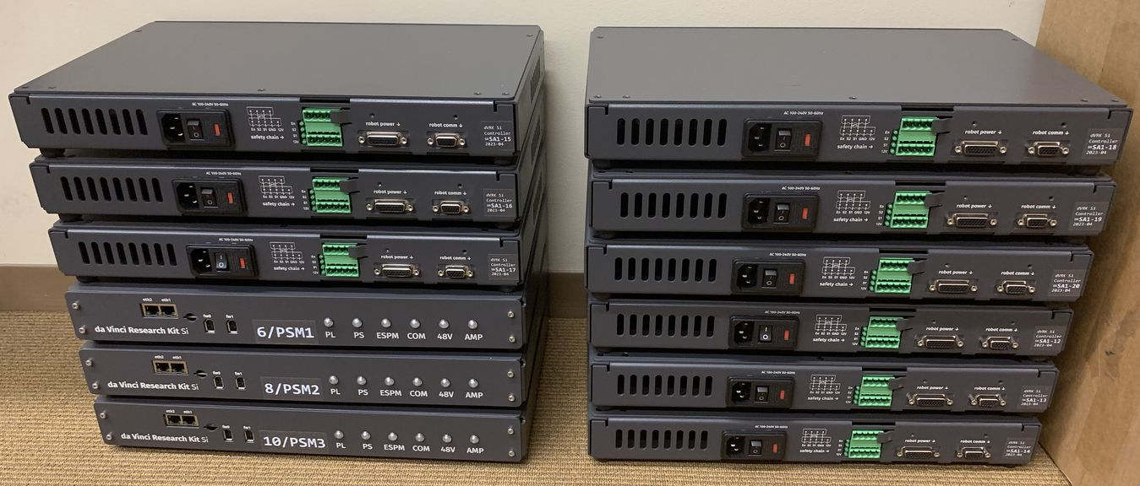
Controller Build Status
dVRK Controllers: Update from Greg Fischer
dVRK-Si Controllers: 12 controllers available

Slide 15
Agenda
Introduction
Announcements
Community Presentation: Allison Okamura (Stanford Univ.)
dVRK/dVRK-Si Hardware/Software Updates
Controllers (dVRK and dVRK-Si)
FPGA V3
Firmware updates
Embedded software
PC software
Open discussion

Slide 16
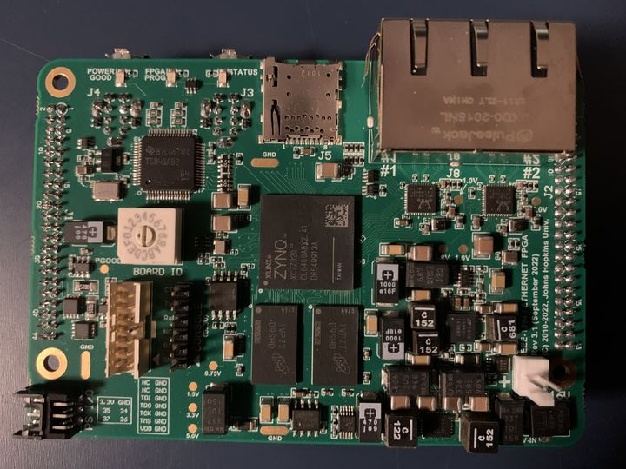
FPGA V3.1
Upgrade from Spartan 6 to Zynq (Spartan 7)
Bigger FPGA + dual-core ARM processor
Firewire x 2
Micro-SD
Key features:
Backward compatible with prior FPGA versions
Additional Ethernet port (2 total, 1GB each)
Linux on ARM processor (1 GB DDR3 RAM)
Micro-SD for firmware upgrades
4 additional I/O (V3.1)
Status:
Built 108 boards
10 failed permanently (9% failure rate)
13 with minor issues
Ethernet x 2
FPGA
FPGA
DRAM

Slide 17
Network Connections
FPGA
real-time connection
(Firewire or Ethernet/Firewire)
FPGA
PC
Firewire
Ethernet
FPGA
non-real-time connection
(Ethernet)
Note: Ethernet daisy-chain not yet supported by firmware
FPGA
EtherCAT could be an option (would need to license IP core)

Slide 18
Agenda
Introduction
Announcements
Community Presentation: Allison Okamura (Stanford Univ.)
dVRK/dVRK-Si Hardware/Software Updates
Controllers (dVRK and dVRK-Si)
FPGA V3
Firmware updates
Embedded software
PC software
Open discussion

Slide 19
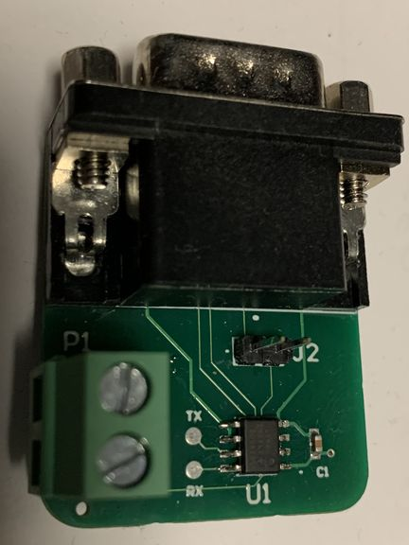
Firmware Rev 8
Released August 10, 2023
Required for FPGA V3
For FPGA V1 and V2:
Required to co-exist with FPGA V3, including dVRK-Si
Required to use QLA V1.6
Supports “dongle” for reading instrument id
Required for controller builds 1-4 (2012-2015)
Distributed at ICRA and Hamlyn 2022
https://github.com/jhu-dvrk/sawIntuitiveResearchKit/wiki/Tool-Detection

Slide 20
Firmware V8 Configurations
 | QLA (dVRK, V1/V2) | DQLA (dVRK, V3) | dRAC (dVRK-Si)
FPGA V1 | FPGA1394V1-QLA | Not feasible | Not supported
FPGA V2 | FPGA1394V2-QLA | Not feasible | Not supported
FPGA V3 | FPGA1394V3-QLA | FPGA1394V3-DQLA | FPGA1394V3-DRAC
Notes:
FPGA1394V1 previously called FPGA1394 (Rev 1-7)
FPGA1394V2 previously called FPGA1394Eth (Rev 1-7)
DQLA not feasible with V1/V2 due to lack of 4 extra I/O introduced with V3
dRAC not officially supported with V1/V2, but is expected to work for arm only (SUJ requires 4 extra I/O introduced with V3)

Slide 21
Firmware Update
For FPGA V1 and V2, continue to flash EPROM via FireWire (or Ethernet) using pgm1394
https://github.com/jhu-cisst/mechatronics-firmware/wiki/FPGA-Program
For FPGA V3, copy release to MicroSD card
https://github.com/jhu-cisst/mechatronics-embedded/releases
Utility: dvrk-sd-card-updater.py
Documentation forthcoming

Slide 22
Firmware V9 Goals
Fix Ethernet support for FPGA V3
Migrate from Xilinx ISE to Vivado for FPGA V3
FPGA V1 and V2 only supported by ISE
Support digital current control for QLA V1.5+
Add digital (FIR) filters on analog feedback

Slide 23
Agenda
Introduction
Announcements
Community Presentation: Allison Okamura (Stanford Univ.)
dVRK/dVRK-Si Hardware/Software Updates
Controllers (dVRK and dVRK-Si)
FPGA V3
Firmware updates
Embedded software
PC software
Open discussion

Slide 24
Embedded Software
FPGA V3 has Xilinx Zynq System on Chip (SoC), which has FPGA (PL) and dual-core ARM processor (PS)
Firmware
PS
PL
2 x eth
Embedded software
2 x fw
Zynq
Companion Board
(QLA, DQLA, dRAC)

Slide 25
Embedded Software
GitHub: https://github.com/jhu-cisst/mechatronics-embedded
Dual-core ARM processor, running embedded Linux (6.1.5 kernel)
Built using Xilinx Petalinux tool (V2023.1)
Custom library (libfpgav3) and applications (fpgav3init, fpgav3sn)
Initialization process (fpgav3init)
Detect companion board type, then load correct firmware
Read FPGA serial number
Program flash (if needed)
Other initialization

Slide 26
Embedded Software – Initialization
 | QLA | DQLA | dRAC
FPGA V3 | FPGA1394V3-QLA | FPGA1394V3-DQLA | FPGA1394V3-DRAC
Also: FPGA1394V3-BCFG (boot configuration firmware to determine board type)
Allows the same MicroSD card to be used everywhere!
Load QLA
Power Up
Load
BCFG
Boot Linux
Determine board type
Load DQLA
Will keep BCFG firmware if QLA, DQLA or DRAC not detected
- Most likely cause: MicroSD card not inserted
Can still talk to board via FireWire or Ethernet, but will not drive outputs
Load DRAC

Slide 27
Embedded Software – Utilization
Can cross-compile applications to run on embedded Linux
Advantage: high-speed interface to FPGA logic
Disadvantage: lower performance and less memory than PC
Current limitation: FPGA processor not easily accessed
Ethernet connection to processor not yet supported
6-pin serial console connector not exposed (inside controller box)

Slide 28
Embedded Software – Cross-Compiling
Option 1: Use toolchain_vitis_fpgav3.cmake, created in mechatronics-embedded build directory
Option 2: Use Vitis IDE
When configuring mechatronics-embedded (option 1) or Vitis IDE (option 2), choose sysroot as:
Released sysroot (on GitHub)
Locally built sysroot (using Petalinux)
Documentation forthcoming
For an example of option 1, see mechatronics-software repository (low-level PC software)

Slide 29
Agenda
Introduction
Announcements
Community Presentation: Allison Okamura (Stanford Univ.)
dVRK/dVRK-Si Hardware/Software Updates
Controllers (dVRK and dVRK-Si)
FPGA V3
Firmware updates
Embedded software
PC software
Open discussion

Slide 30
dVRK Software Updates
Improvements
New hardware (dVRK-Si + DQLA)
ROS
Release

Slide 31
Software: better control
PID
IO and PID components now use actuator space
Added desired velocity, better trajectory following
Added disturbance observer, better positioning
Fixed deadband implementation
Teleoperation
Updated to use the MTM cartesian position and velocity to send a position and velocity goal to the PSM
Promising results: “latency” between MTM and PSM down from
~100ms to ~60ms with better PID gains
~60ms to ~10ms with Cartesian velocity

Slide 32
Software: miscellaneous
Rewrote configuration generator
Support new hardware (dRAC, DQLA)
Python based, no need to install Matlab
Generates IO, arm and console configuration files
SUJs
Cleaned up code for Classic SUJ
Added support for Si SUJ
Added “fixed” SUJ class to support groups with PSMs and ECM on custom frames, related poses can come from hand-eye calibration
More Python examples

Slide 33
Software: support for new hardware
Si arms (PSM and ECM)
Brakes on PSM Si
Different code to get instrument model
New potentiometer calibration procedure
Different configuration files for IO, PID and kinematics
New configuration file generator, Python based
Modified console class to accommodate generations, Classic vs. Si
Si SUJ
Bluetooth used to get all SUJ joint values
SUJ brakes are working
Forward kinematics implemented
No good method for potentiometer calibration

Slide 34
Software: ROS 1 and ROS 2
Past years updates
dVRK software built and tested on Ubuntu 20.04 with ROS 2 Galactic and 22.04 with ROS 2 Humble
Missing launch files, calibration scripts, CRTK Matlab client… so ROS 1 was needed to get started
ROS 2 without ROS 1
Ubuntu 20.04 is the last version with ROS 1 support and is getting a bit old (though EOL is still 04/25)
Upcoming dVRK release to support ROS 2 without any need for ROS 1 so one can use Ubuntu 22.04 with ROS 2 Humble or later
But we still need to maintain ROS 1 so lots of code duplication…

Slide 35
Software: ROS 1 and ROS 2
Server side:
cisst to ROS 1 bridge ported to ROS 2
Code can’t be easily shared but we can manually maintain both code bases in synch using diff tools
Client side using CRTK clients
Extended CRTK Python and Matlab client libraries to introduce a ROS Abstraction Layer (RAL) so scripts can be ROS version agnostic
Updated all existing scripts (calibration, utilities and examples) to use crtk.ral
Status
Python client library updated and fairly well tested
Matlab client library updated but need further testing
CRTK documentation partially ported to readthedocs: https://crtk-robotics.readthedocs.io/en/latest/

Slide 36
Software: release
Aiming for November!
To do:
Finish porting a few Python scripts
Test Matlab CRTK for MTM gravity compensation
SUJ Si calibration method
Create new ROS packages for video pipeline
Documentation! None of the new features for the Si are documented ☹ Likely to use readthedocs
For groups receiving hardware before upcoming release:
Development branches are fairly stable
Anton will help over Zoom

Slide 37
Open Discussion

