Slide 1

dVRK PI / User Group Meeting
October 8, 2025
(online)

Slide 2
Agenda
Introduction
Intuitive Research Presentation
  Mallory Shields, ISI Digital
Announcements / Discussion
Community Presentation:
  Axel Krieger, JHU
dVRK/dVRK-Si Hardware/Software Updates

Slide 3
Intuitive Research Presentation
Mallory Shields, ISI Digital

Slide 4
Announcements / Discussion
Open-H Embodiment
dVRK User Group Meeting
dVRK Competition at ICRA
Proposal for Non-Profit

Slide 5
dVRK User Group Meeting
Detailed hardware/software updates, best practices, etc.
  Perhaps a tutorial format?
Primary audience: students, postdocs, research scientists
In person, preferably with access to dVRK hardware
Have not held one since pandemic – is there interest?
If so, when/where?
  Before/after a conference, especially if near dVRK site
  Standalone event (e.g., at JHU)

Slide 6
dVRK Competition at ICRA
Proposing ICRA 2026 competition (Vienna), due Oct 10
  dVRK PSMs from Obuda University
ICRA 2025 competition proposal was rejected
  One critique was “limited public interest”
  Any suggestions to address this?
Could dVRK competition be an annual event?
  ICRA 2027 is in Seoul

Slide 7
Proposal for Non-Profit
Medical Robotics Research Foundation
  medical-robotics-research.org (available)
Mission Statement
  Our mission is to advance medical robotics research and education by supporting the creation and maintenance of shared platforms and facilitating interaction and sharing of ideas between researchers.

Slide 8
Proposal for Non-Profit
Director Roles:
  Community Engagement (meetings, events)
  Technical Support (user support, troubleshooting)
  System Enhancements (develop/curate GitHub)
  Controller Production and Distribution
  Fundraising (donations, grants)
Followup:
  Please email me if you are interested in a followup meeting, pkaz@jhu.edu

Slide 9
Community Presentation
Axel Krieger, Johns Hopkins University

Slide 10
dVRK Hardware

Slide 11
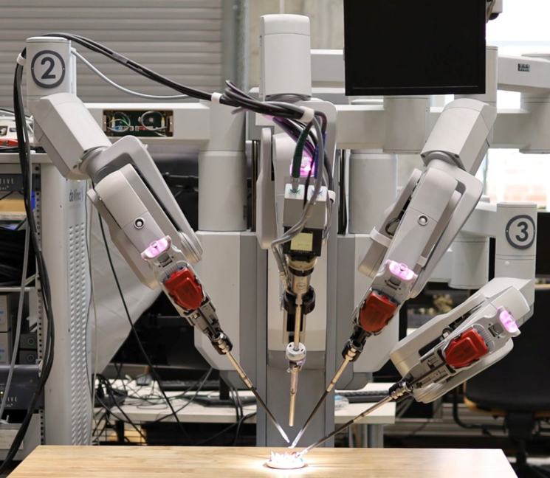
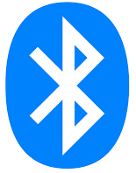
dVRK-Si Setup Joints: New Design
Reuse ESSJ (reprogram with new firmware)
  Simpler to set up (do not need to replace boards)
  SUJ pots will be added to LVDS data stream (no Bluetooth)
  Higher-resolution ADC for pots
Current Design
ESPM
pgm
New Design
ESPM
pgm
LVDS
LVDS
dESSJ
SUJ Z-axis pots
ESSJ
pgm
SUJ Z-axis pots
SUJ rotary pots
SUJ rotary pots
LVDS
LVDS
Serial
dSIB-Si
dESSJ
dSIB-Si
dSIB-Z-Si
dVRK-Si Controller
dVRK-Si Controller
1 per arm (PSMs, ECM)
1 per system
1 per arm (PSMs, ECM)
1 per system

Slide 12
dVRK Software
Reminders
Dissemination
dVRK usage and leveraging cisst/SAW

Slide 13
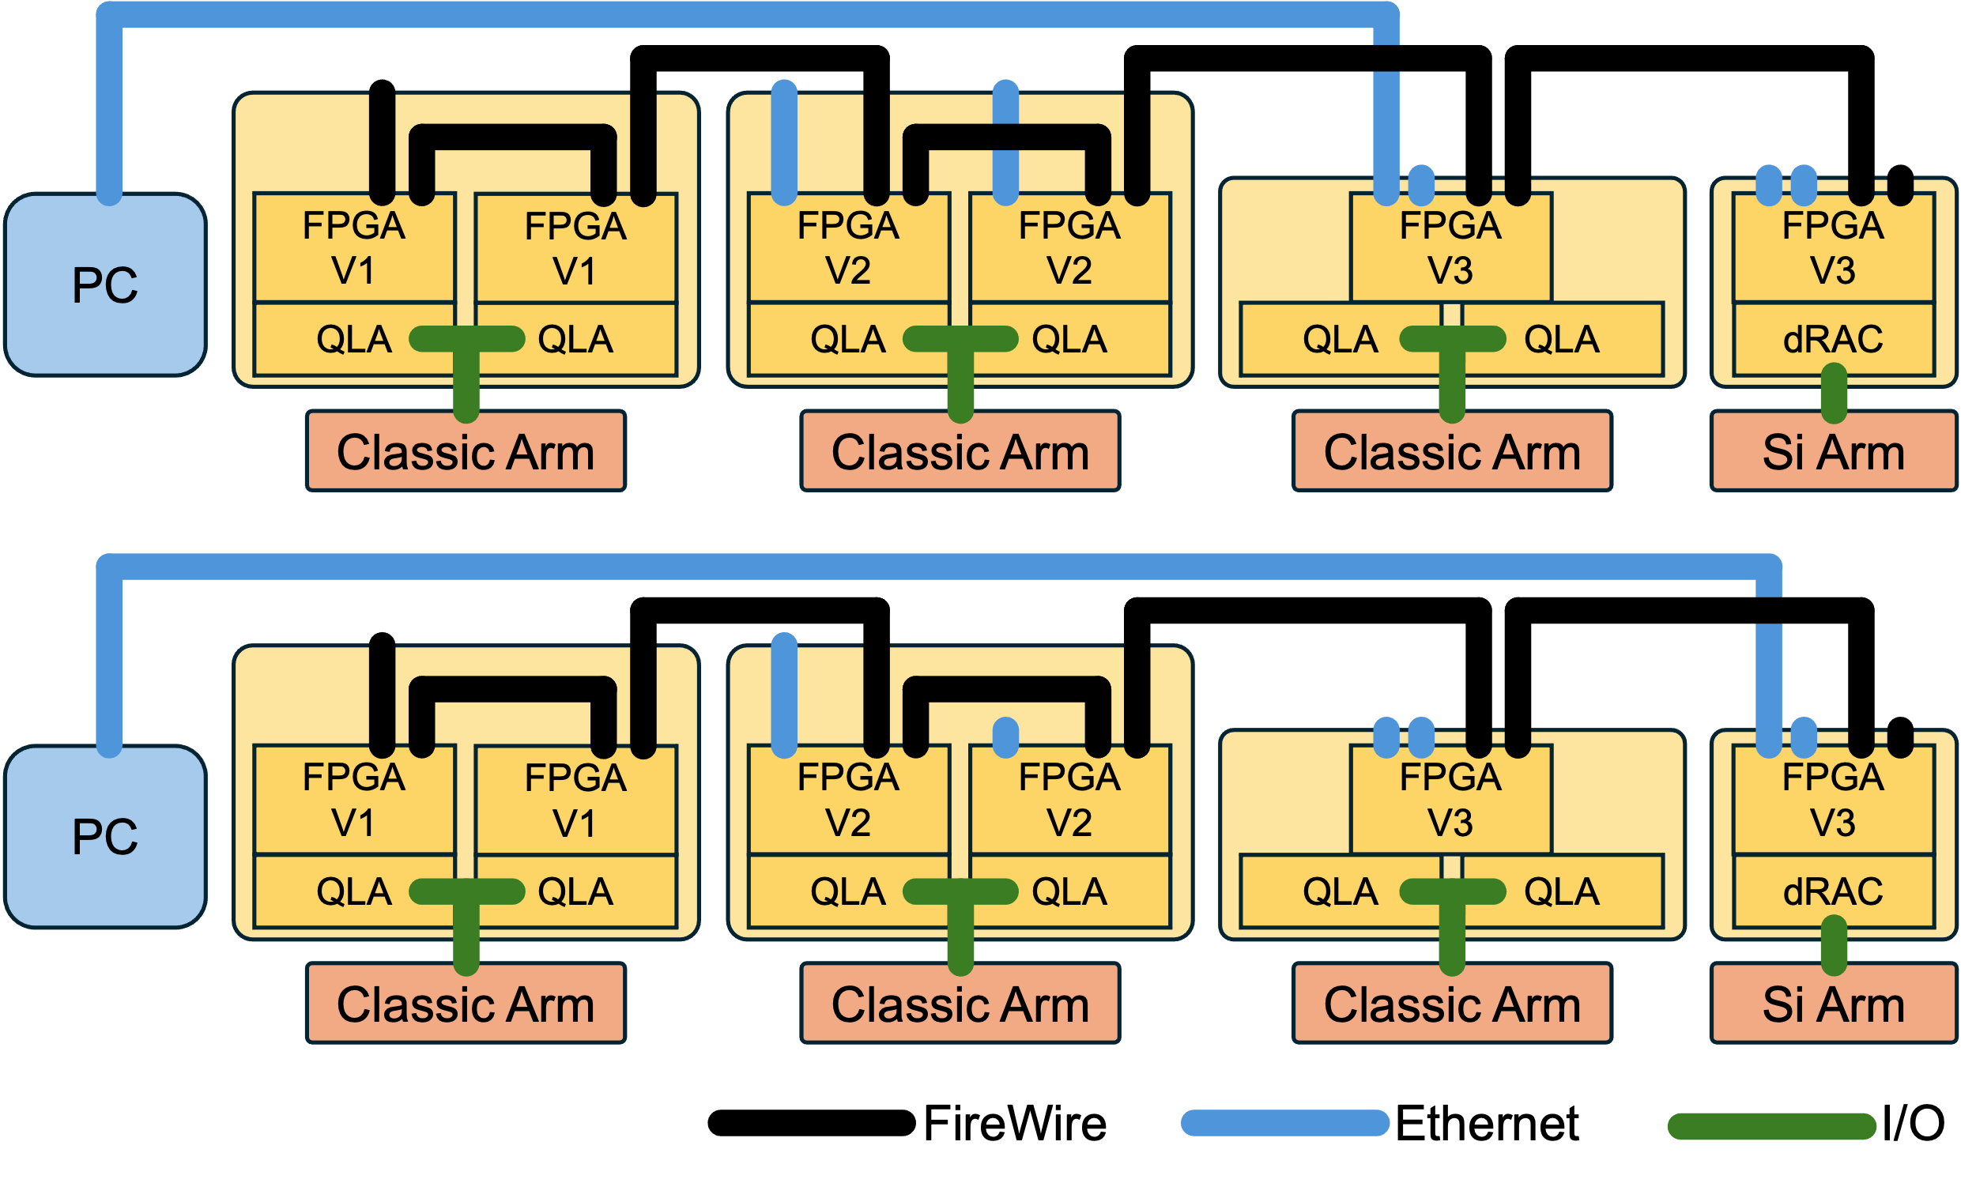
Reminders 1/2
Issue: FireWire connectors are not reversible! If you force a connector in, you will likely damage your controller
Fix: If you have a least one controller with Ethernet, we recommend to use UDP/FW: https://dvrk.readthedocs.io/main/pages/connectivity/introduction.html
You can even use a laptop!

Slide 14
Reminders 2/2
Save your configuration files on https://github.com/dvrk-config: anton.deguet@jhu.edu
Documentation is continuously evolving : https://dvrk.readthedocs.io
If you have collaborators with anything Classic, S or Si related, try to scavenge what they have
Make sure you use the dVRK correctly!
  https://dvrk.readthedocs.io
  https://www.youtube.com/@dvrk-robot
  da Vinci manuals: https://dvrk.readthedocs.io/en/latest/pages/references/links.html#documents

Slide 15
dVRK dissemination
dVRK branches and tags (releases)
  Plenty of good features in devel, but not very stable
  Too much time between releases
  main branch was last release…
  … now using main to stage stable features before release
  For any new installation, new user, OS upgrade… I recommend main branches!
Currently in main (soonish to be tagged as release 2.4):
  More ROS topics
  Gravity compensation for Si arms
  Example of bilateral teleoperation
  Support for multiple surgeon consoles
  System configuration generator with GUI
  Much better ROS2 support …

Slide 16


Ubuntu 24.04
ROS 2 Jazzy

Slide 17
How do you use the dVRK?
Without any programming, as a poor man’s da Vinci
Most likely some programming. Which API, where to start?
Everything is open source, figure it out, fix it and submit a PR
Not my circus, not my monkeys
That sounds like a “you” problem
  😈 🤗

Slide 18
How do you use the dVRK?
Without any programming: dVRK as an application
Most likely some programming: dVRK as a part of a system
  Most common approach: ROS
    API documented
    Pick your language on the client side, optional dVRK Python client library
    Tools for visualization, introspection, data collection, etc.
  Also possible: cisst/SAW components
    Better performance (lower latency)
    Not too hard: using existing components can be done with JSON configuration files
    Harder: writing your own components needs some C++ and cisstMultiTask knowledge. But examples are provided to show how to derive existing dVRK components
    Teaser: you can even use Python. How? It’s magical!

Slide 19
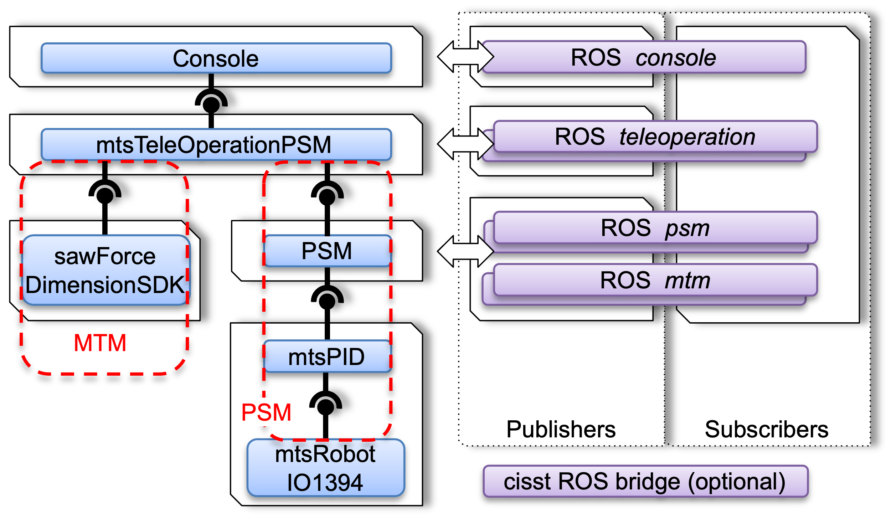
Leveraging existing cisst/SAW components
Alternate devices:
ForceDimension and NovintFalcon: https://github.com/jhu-saw/sawForceDimensionSDK
3D Touch aka Sensable Omni: https://github.com/jhu-saw/sawSensablePhantom
PlayStation Move controllers (WIP): https://github.com/jhu-saw/sawPSMove
Haply, maybe
USB foot pedals, HID inputs (WIP)
Alternate patient side:
Simulators like AMBF, IsaacSim (WIP) through ROS
Custom robots…
Utilities:
Middleware bridges: OpenIGTLink, UDP socket with JSON
Data collection: https://dvrk.readthedocs.io/main/pages/development/components/collectors.html

Slide 20
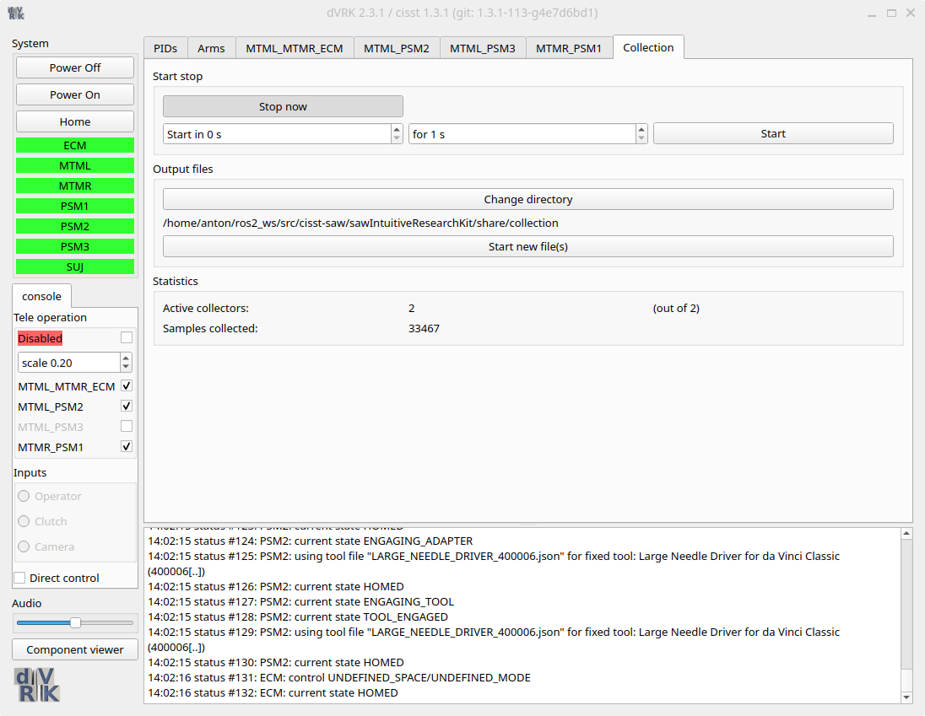
State table collector
Components store states in state tables at each time increment
Collect every sample (not missed data) or fixed sub-sampling
Collect from any component (Arm, IO, PID, etc.)
Dumping to files performed in dedicated thread to minimize impact on other components
JSON Configuration files and Qt widget
{
"state-collectors":
[
{
"component": "PSM1",
"tables":
[
{
"sampling": 1,
"table": "StateTable",
"signals": ["measured_cp", "jaw/measured_js"]
}
]
}
]
}

Slide 21
Python embedded interpreter
Interactive Research Environment (IRE)
Developed in early days of cisst libraries, circa 2005
  cisstMultiTask self describing components and interfaces
  cisstMultiTask thread-safety
  SWIG for payload conversions
Concept
  Python interpreter runs in same process
  Python interpreter automatically generates cisstMultiTask thread-safe interfaces to exchange SWIG generated payloads with other components
  IRE is just another component

Slide 22
Python embedded interpreter
Interactive Research Environment (IRE)
Developed in early days of cisst libraries, circa 2005
  cisstMultiTask self describing components and interfaces
  cisstMultiTask thread-safety
  SWIG for payload conversions
Concept
  Python interpreter runs in same process
  Python interpreter automatically generates cisstMultiTask thread-safe interfaces to exchange SWIG generated payloads with other components
  IRE is just another component

Slide 23
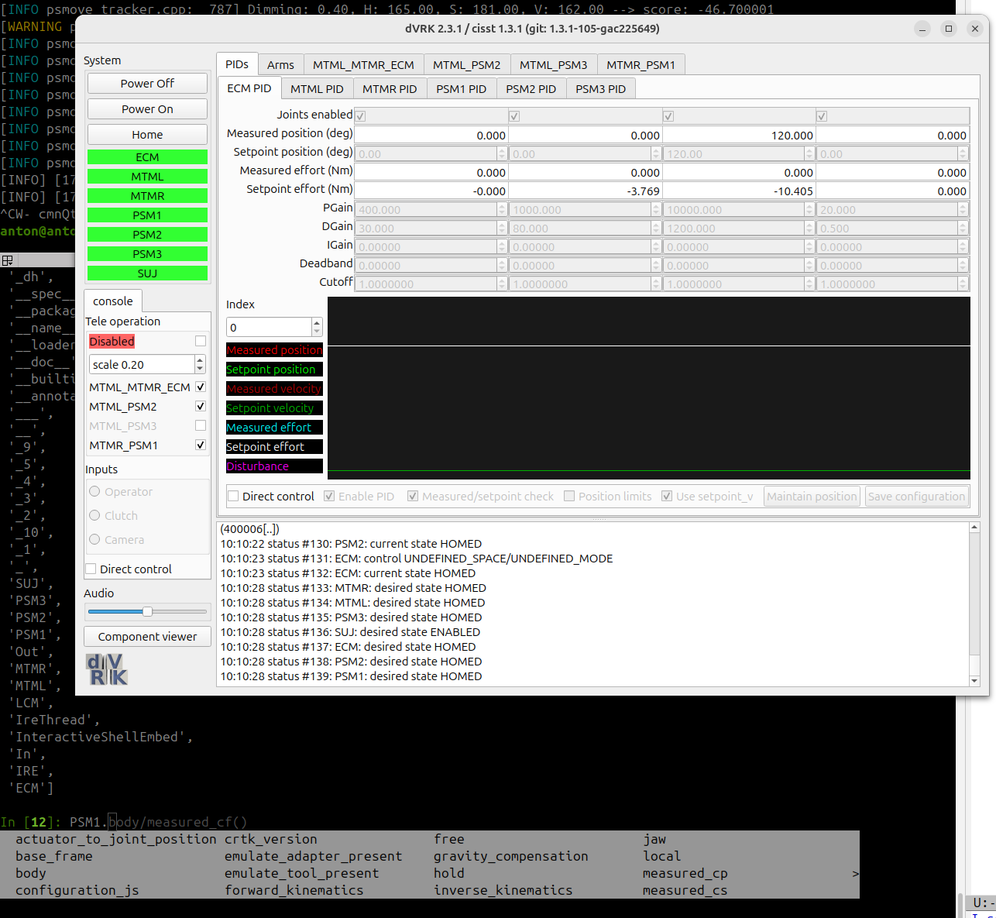
IRE in practice
system.home()
console.teleop_enable(True)
console_MTMR_PSM1.set_scale(0.5)
ECM.measured_cp().Position().GetTranslation()
PSM2_PID = cisstMultiTask.mtsCreateClientInterface('system_Python', 'PSM2_PID', 'Controller')

