Slide 1
dVRK PI / User Group Meeting
March 20, 2024
(online)

Slide 2
Agenda
Introduction
Announcements / Events
dVRK Consortium and Community
dVRK/dVRK-Si Hardware/Software Updates
Controllers, firmware / embedded, software
Models and simulation
Community Presentations:
Ken Goldberg (UC Berkeley)
Dominic Jones (Univ. of Leeds)

Slide 3
Announcements / Events
ISMR Workshop: “Machine Learning with the da Vinci Research Kit”, June 3, 2024 (half day)
https://surgical-robotics-ai.github.io/ismr-2024-workshop.html
dVRK Summer School (Verona), July 2024
2023-2024 AccelNet Surgical Robotics Challenge

Slide 4
AccelNet Surgical Robotics Challenge
https://surgical-robotics-ai.github.io/surgical-robotics-challenge-2023/challenge-2023.html
Relaunch of 2021-2022 challenge
Autonomous suturing
Sim-to-real
Online phase
AMBF Simulator
Azure server
In-person phase (JHU)
TBD
This video created via teleoperation
Challenge: Can you do it autonomously?
OISE-1927354 (JHU)
OISE-1927275 (WPI)

Slide 5
dVRK Consortium
Formed as a result of dVRK PI Meeting discussion
Institution and JHU sign a Consortium Agreement
Voluntary membership, with $5,000 initiation fee
Consortium has option to decide on any future fees
Benefits of membership:
Free replacement boards (e.g., FPGA, QLA)
Free accessories (e.g., Dallas chip interface dongle)
Free technical support (with a smile)
Good karma

Slide 6
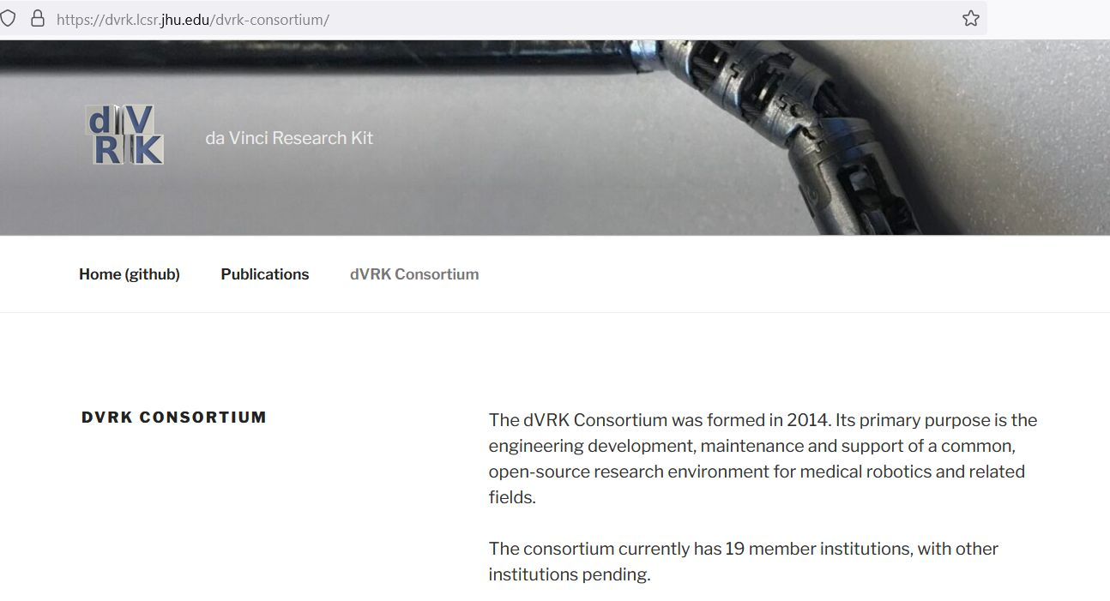
dVRK Consortium
Finally, a (placeholder) website: https://dvrk.lcsr.jhu.edu/dvrk-consortium/
Any concerns about listing member institutions?

Slide 7
dVRK Community
Upgrades to dVRK-Si may free up dVRK systems/controllers
dVRK systems could be “traded in” and provided to other sites
dVRK controllers could be repurposed for MTMs (still needed)
PSM / ECM controllers would need a power supply change
SUJ Controllers (for dVRK)
There is interest from at least one site. Any others?

Slide 8
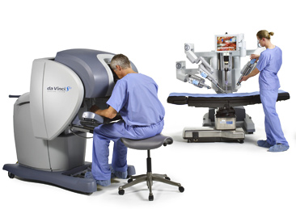
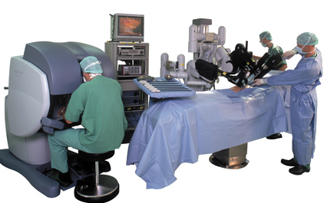
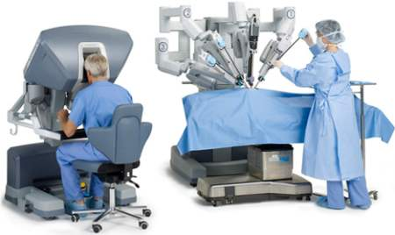
dVRK and dVRK-Si Controllers
dVRK
(V1-V3)
dVRK-Si
(some)
da Vinci “Classic”
da Vinci S
da Vinci Si

Slide 9
Controller Build Status
Some dVRK controllers still available
Primarily required for MTM
Second build of dVRK-Si controllers in process
Components procured
Ready to start final assembly

Slide 10
Embedded Software / Firmware
FPGA V3 has Xilinx Zynq System on Chip (SoC), which has FPGA (PL) and dual-core ARM processor (PS)
Firmware
PS
PL
2 x eth
Embedded software
(Linux)
2 x fw
Zynq
Companion Board
(QLA, DQLA, dRAC)

Slide 11
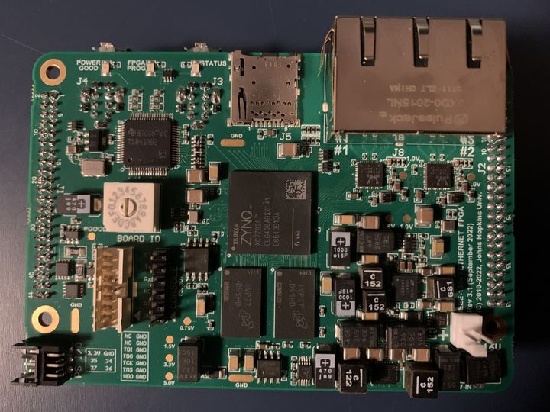
FPGA V3
Firewire x 2
Micro-SD
Key features:
Backward compatible with prior FPGA versions
Additional Ethernet port (2 total, 1GB each)
Linux on ARM processor (1 GB DDR3 RAM)
Micro-SD for firmware upgrades
4 additional I/O (V3.1)
Ethernet x 2
FPGA
FPGA
DRAM
Used for all dVRK-Si controllers and for recent dVRK controllers (since 2023)

Slide 12
Network Connections
FPGA
FPGA
PC
Firewire
Ethernet
FPGA
Note: Ethernet daisy-chain not yet supported by firmware
FPGA
Firmware Rev 9

Slide 13
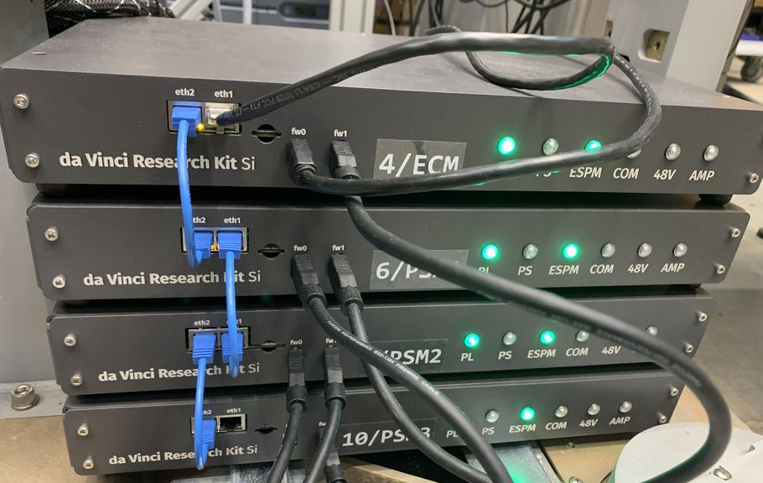
Network Connections

Slide 14
1) Firewire only
FPGA
FPGA
PC
Firewire
FPGA
Original configuration: supported by all FPGA version (V1, V2, V3)
FPGA

Slide 15
2) Ethernet/Firewire bridge
FPGA
FPGA
PC
Firewire
Ethernet
FPGA
FPGA
First FPGA board in chain must be V2 or V3 (Firmware Rev 7+)

Slide 16
3) Ethernet only
FPGA
FPGA
PC
Firewire
Ethernet
FPGA
FPGA
All FPGA boards must be V3 (Firmware Rev 9+)

Slide 17
Firmware Rev 9 Goals (in Sept 2023)
Fix Ethernet support for FPGA V3
Migrate from Xilinx ISE to Vivado for FPGA V3
FPGA V1 and V2 only supported by ISE
Support digital current control for QLA V1.5+
Add digital (FIR) filters on analog feedback

Slide 18
Firmware Rev 9 (expected April 2024)
FPGA V3 Ethernet support:
4-port switch
Implementation of “broadcast” protocols initially developed for Firewire
Minor updates:
Fixed ECM-Si encoder preload
Improved internal interface (EMIO bus) to PS (processor)
Internal:
Significant refactoring of internal busses (all FPGA versions)
Cleaned up unused files (only support CMake build)

Slide 19
Ethernet Design
eth
Eth1
Eth2
Eth1
Eth2
Eth1
Eth2
PC
Switch
Switch
Switch
RT I/O
RT I/O
RT I/O
PL (FPGA)
PL (FPGA)
PL (FPGA)
PS (Linux)
PS (Linux)
PS (Linux)
FPGA V3 (ID 0)
FPGA V3 (ID 1)
FPGA V3 (ID 2)
Different MAC addresses for FPGA and PS

Slide 20
Broadcast Write
PC combines data for all boards into a single packet, which is sent by Firewire broadcast or Ethernet multicast (UDP)
Each 32-bit header specifies board number and block size
HDR
DATA
HDR
DATA
HDR
DATA
Firewire broadcast
or
Ethernet multicast
Board 0
Board 1
Board 2

Slide 21
Broadcast Read
PC sends “query” command (incl. sequence number) via Firewire broadcast or Ethernet multicast
Each board sends its data to all other boards (Firewire broadcast or raw Ethernet multicast)
PC can read all data from any one board (for Ethernet, reads from closest board)
Header (HDR) includes block size and sequence number
HDR
DATA
HDR
DATA
HDR
DATA
Firewire or
Ethernet read
Board 0
Board 1
Board 2

Slide 22
Embedded Software
GitHub: https://github.com/jhu-cisst/mechatronics-embedded
Released as ZIP file: fpgav3-micro-sd.zip
Contains Linux image and all FPGA V3 firmware
Linux app (fpgav3init) detects board type and loads correct firmware
Power Up
Load
BCFG firmware
Boot Linux
Determine board type
Load
board firmware

Slide 23
Embedded Software Releases
1.0.0 (Aug 2023) – Initial release
1.0.1 (Nov 2023) – Minor updates
1.1.0 (April 2024)
Firmware Rev 9
Functional Ethernet interface on Linux
Faster interface to FPGA registers
Added fpgav3block / fpgav3quad utilities
Support for cross-compiling with gcc or clang
Can copy files to MicroSD or send via Ethernet (e.g., scp)
Automount MicroSD to /media

Slide 24
dVRK Software Updates
Release(s)
ROS1 and ROS2 support
Upcoming features

Slide 25
Software: releases
2.2.0, November 2023
OS: dropping support for Ubuntu 16.04, added 22.04
ROS: better ROS2 support
Hardware: DQLA and Si support
Features:
Better control (updated PID and teleoperation)
More ROS topics to access internal information
New configuration generator, generates IO, arm and console files
Some bug fixes and some new bugs…
2.2.1, December 2023
Bug fixes
Minor updates

Slide 26
Software: ROS1/2
In 2.2.x
Client side
Added python crtk.ral to hide rospy (ROS1) and rclpy (ROS2)
Leads to portable Python scripts to ease migration for users
But separate repositories because catkin (ROS1) and colcon (ROS2) require different files for the build
Server side
cisst_ros_bridge and cisst_ros2_bridge are similar but there are some differences so they are synchronized by hand
Same applies to cisst_msgs, crtk_msgs…
Also separate repositories for build files
Need shared build description and shared code…

Slide 27
Software: ROS1/2 – shared build
Build process compatible with catkin and colcon
Files used: CMakeLists.txt, package.xml, colcon.pkg (ROS2 only)
File organization: ROS2 will find top CMakeLists.txt and assumes it’s a package. ROS1 relies on package.xml.
Solution
File re-organization to isolate code without ROS dependencies (CMakeLists.txt only for ROS2)
Use conditions in package.xml and CMakeLists.txt

Slide 28
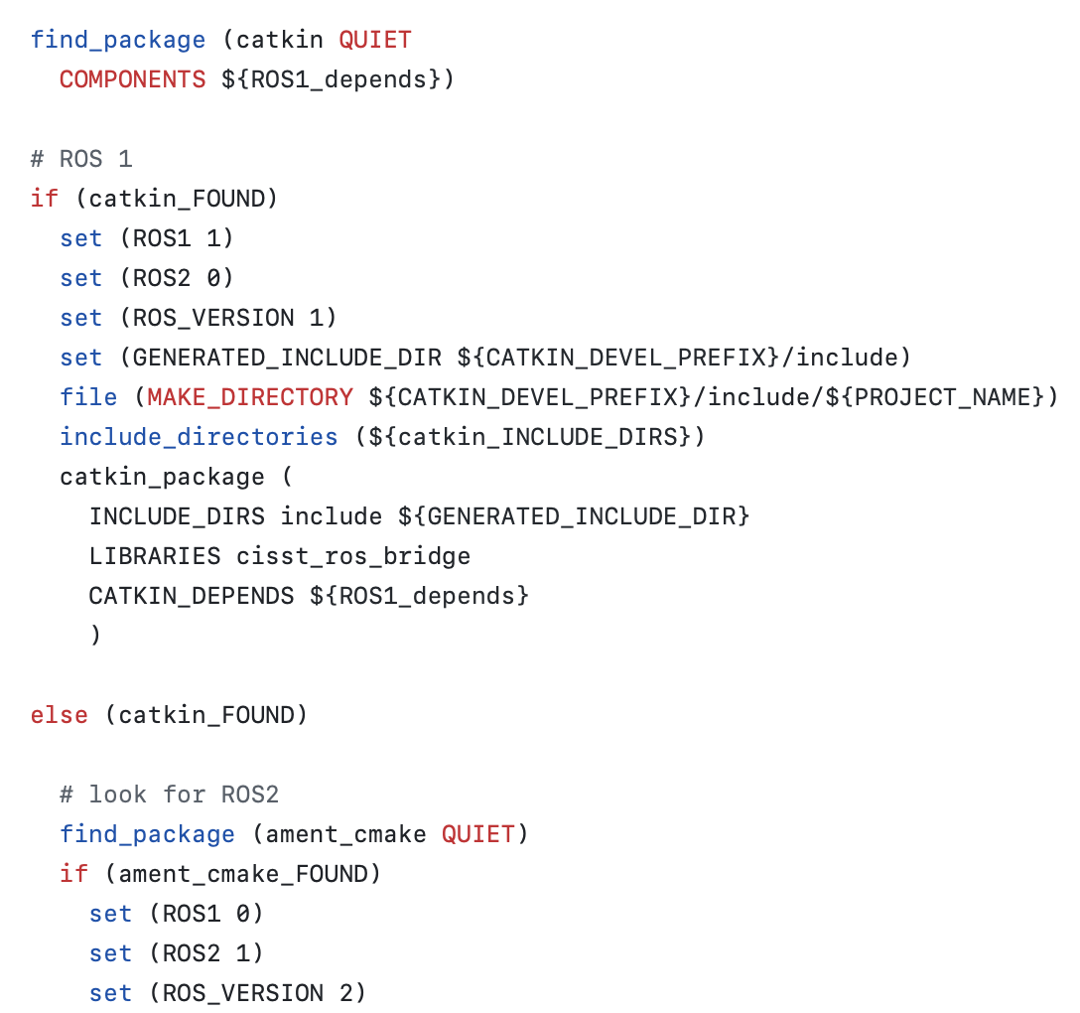
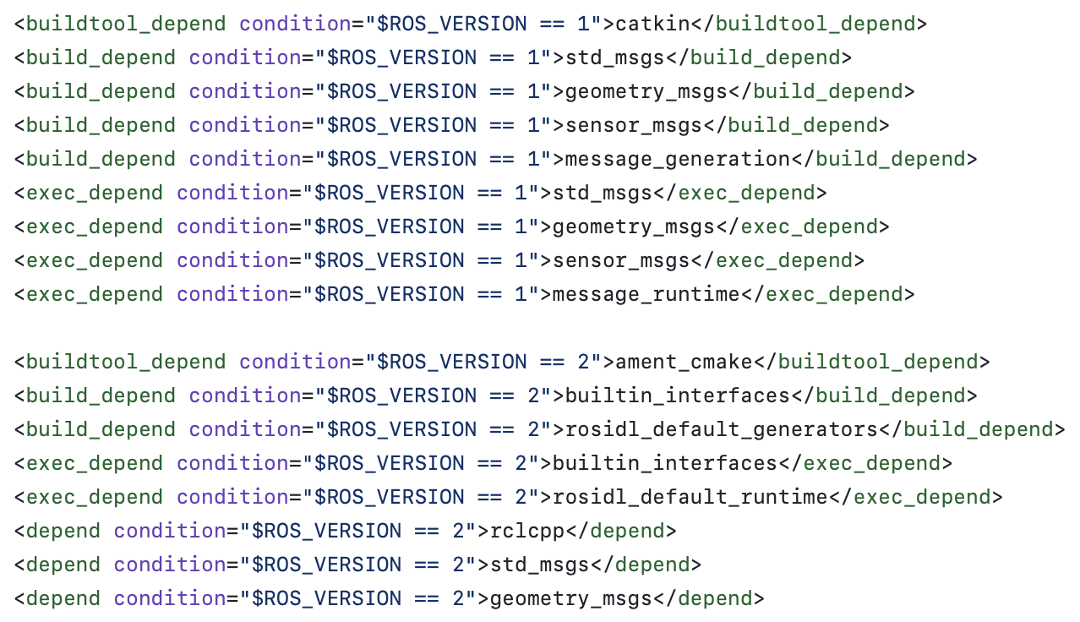
Software: ROS1/ROS2 – shared build
package.xml CMakeLists.txt

Slide 29
Software: ROS1/2 – shared code
Introduced C++ RAL, similar to Python RAL (ROS Abstraction Layer)
Implemented in cisst_ros_bridge
#if ... #else
Macros for messages and services types
Macros over ROS log macros
Methods and classes to abstract:
Node creation, argc/argv parsing, shutdown
Publisher and subscriber creation
Time computations
…

Slide 30
Software: ROS1/2 – last issues
ROS repositories also contain:
Models, mostly URDF and CAD files
These seem to be shared between ROS1 and ROS2 so we should be able to merge repositories using CMakeLists.txt and package.xml with conditions
Launch files
ROS2 introduced Python and YAML based launch files, not supported in ROS1
ROS2 XML launch files use different tags from ROS1 launch files
No easy solution

Slide 31
Software: ROS1/2
End result:
For us
Major merge, files and repositories re-organization
Fixed some discrepancies between ROS1 and ROS2 dVRK features
Less code and documentation to maintain, repositories to tag, etc.
For you
Nothing different , except some files have moved
… but ROS1 and ROS2 features available until ROS1 disappears

Slide 32
Software: next release
Aiming for June/July, 2.3.0 with:
New firmware support
New repositories (following ROS1/2 merge)
New features:
Hand-eye calibration
Stereo camera calibration
Code for hand-eye calibration
Fixed SUJ class
Si SUJ calibration
Simple gravity compensation for ECM on Si
More ROS topics

Slide 33
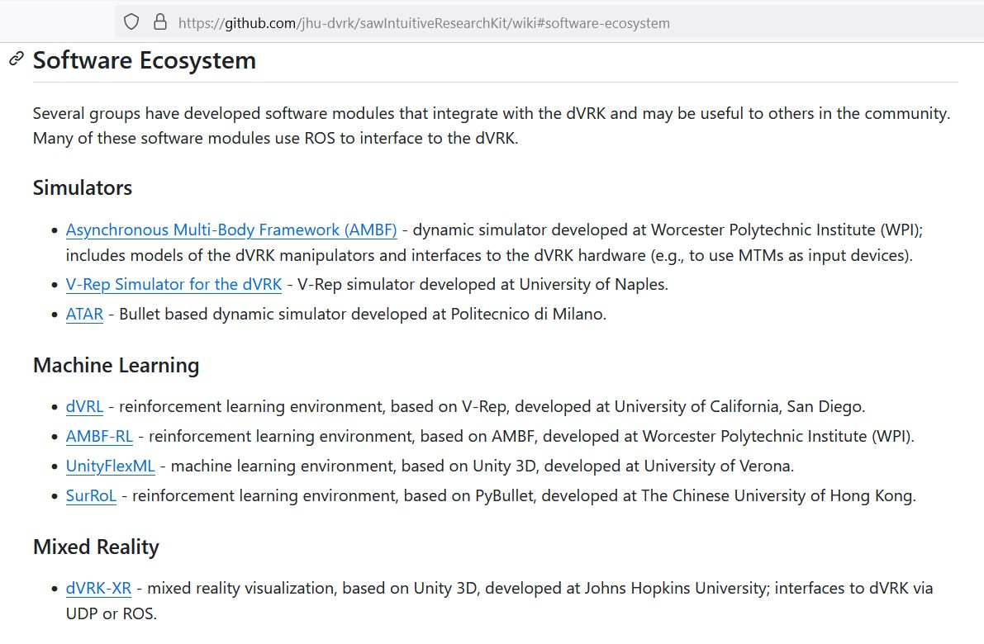
Models and Simulation

Slide 34
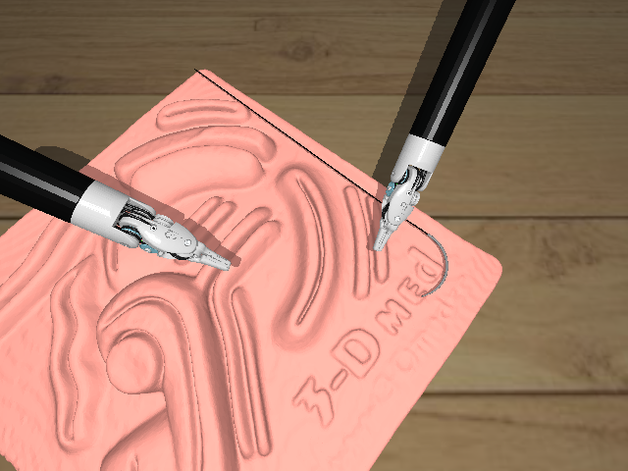
Instrument Models
https://github.com/jhu-dvrk/instrument-cad
Created from ISI CAD files by removing internal details
Currently, just large needle driver (420006)
Credit: Irene Kim, Haoying (Jack) Zhou, Juan Barragan, Adnan Munawar

Slide 35
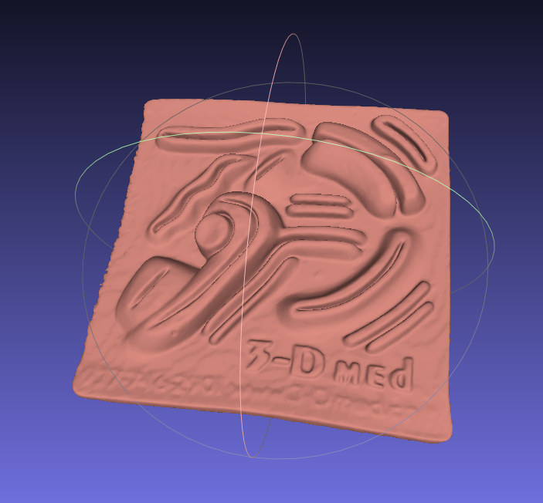
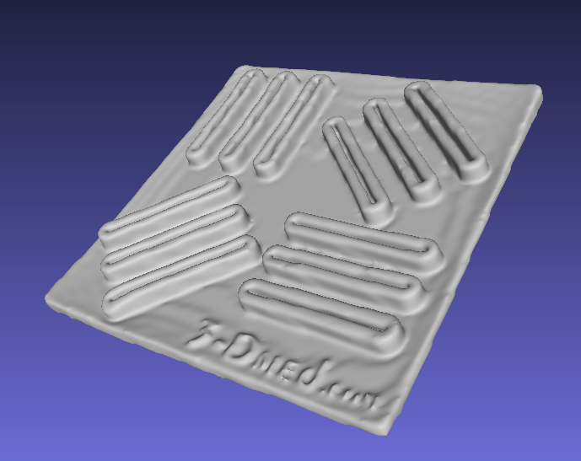
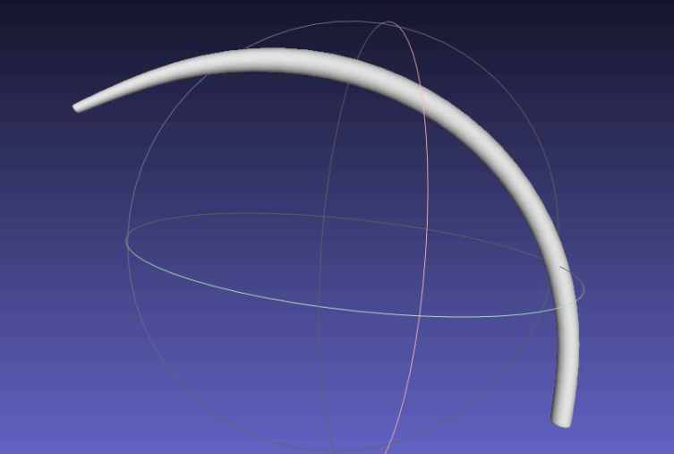
Other Models
Surgical Robotics Challenge Assets
Suture needle
3D-Med phantoms
Coming soon…

Slide 36
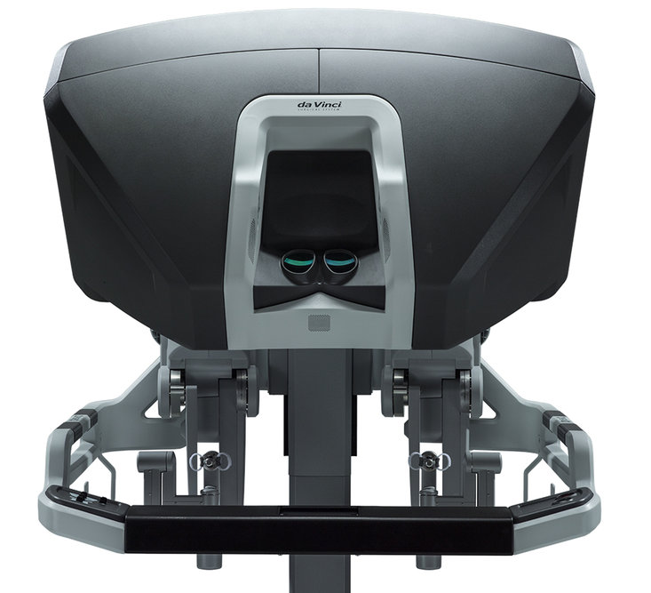
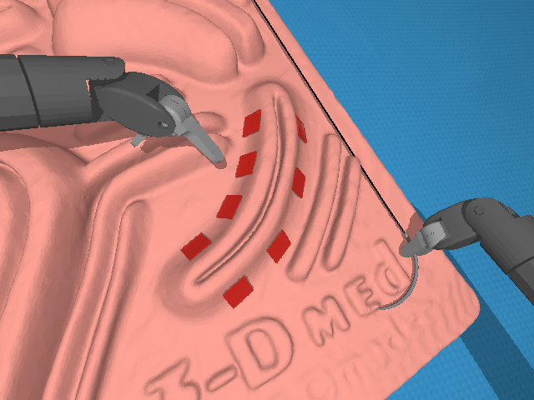
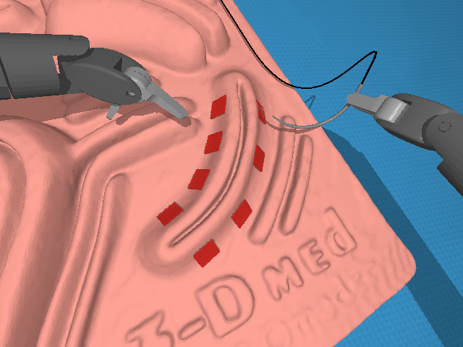
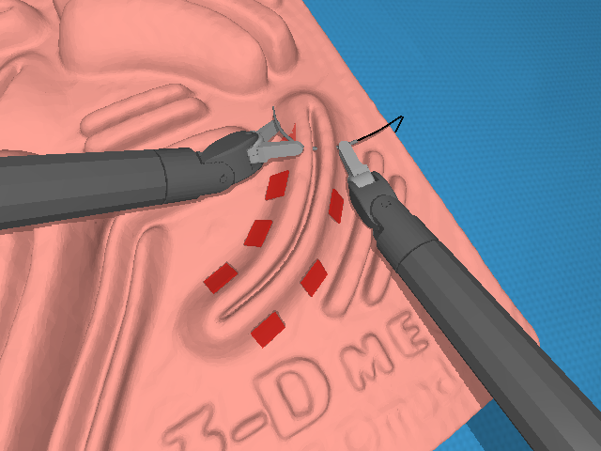
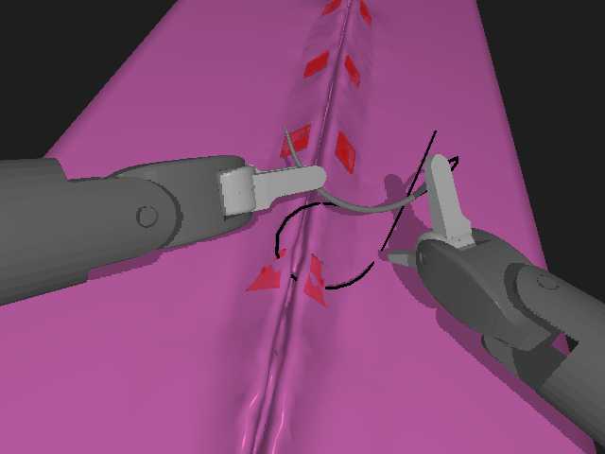
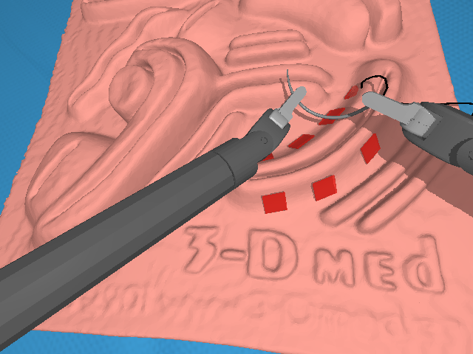
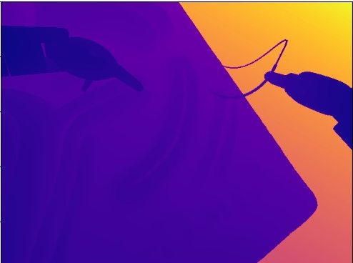
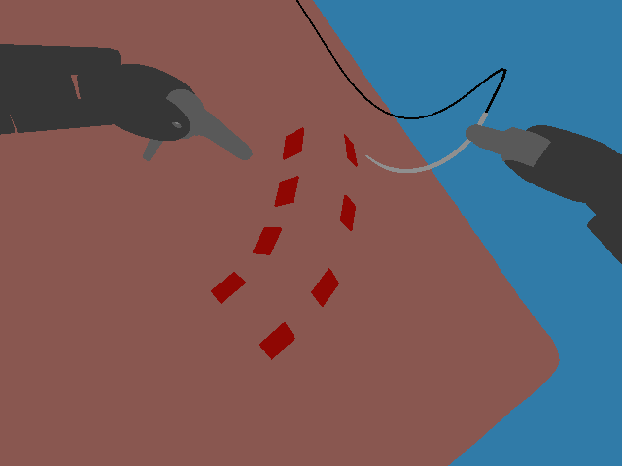
Data Generation Pipeline
Processing and generation step
Recording step
Teleoperation device
Recorded trajectories
Replay trajectories
AMBF
Simulator
rosbag
Annotated dataset
Scene 1
Scene 2
Depth map
Segmented image
Instrument model
Instrument pose
Camera parameters

Slide 37
Rationale for Trajectory Replay
Collect human demonstration with lower fidelity visualization
Generate higher quality (photorealistic) images for training
AMBF Visualization
(data collection)
Blender Visualization (eevee rendering)
(replay)
Blender Visualization (cycles rendering)
(replay)

Slide 38
Community Presentations
Ken Goldberg, UC Berkeley
Dominic Jones, Univ. of Leeds

