Slide 1
dVRK Update
PI Meeting
March 22, 2022

Slide 2
Agenda
Controller build update
Technical Updates
New FPGA and QLA designs
dVRK Next Generation
da Vinci instrument identification
ROS 2
Software release
Announcements
AccelNet Surgical Robotics Challenge
Raven/dVRK Research Symposium, Session 3
Community Announcements
Community Presentations
PI Session (Breakout)

Slide 3
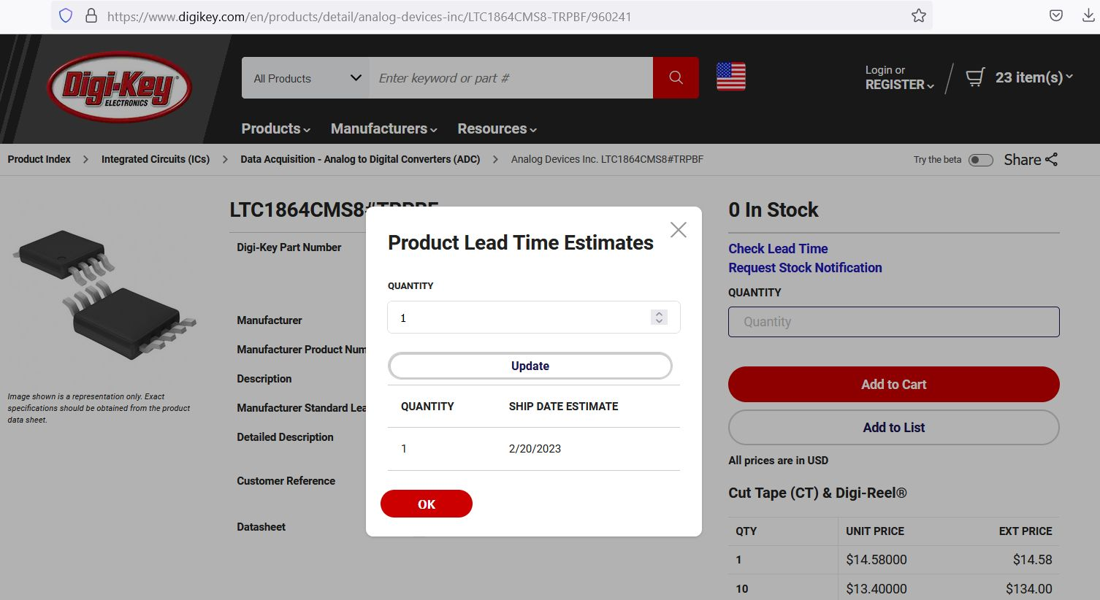
Controller Build Update
Major impact due to global chip shortage
FPGA
QLA
Other parts
Spartan 6 FPGA Quotes
9/20/21 | $29.25
11/22/21 | $512.00
Today | > $1,000.00
At present, only availability is from questionable distributors (scalpers)

Slide 4
Original Controller Build Process
Determine how many to build
Get quotes from vendors
Provide quotes for dVRK
Collect upfront payments
Cash
Pay vendor deposits
Procure parts, assemble, test
Inventory
Ship
Collect remaining balance and pay vendors
This process took about a year! Needed to wait for sufficient volume, then was difficult to get upfront payments/deposits from universities. Cash and Inventory start at 0, end at 0.

Slide 5
Improved Controller Build Process
Intuitive Foundation
Decide how many to build
Get quotes from vendors
Provide quotes for dVRK
Collect upfront payments
Cash
Pay vendors
Procure parts, assemble, test
Inventory
Ship
Collect payment
Intuitive Foundation provides initial Cash, which is then translated to Inventory/Cash.

Slide 6
Overcoming the Global Chip Shortage
Only possible due to Intuitive Foundation!
Intuitive Foundation contribution used to build inventory of chips, which are then provided to vendors for assembly
FPGA and QLA had to be redesigned (next slides)
Build has been slow due to:
Time to figure out the process (stocking chips)
Time to redesign the boards

Slide 7
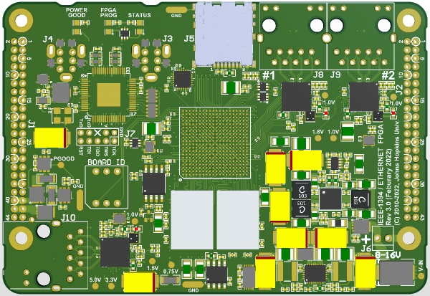
FPGA V3.0
Upgrade from Spartan 6 to Zynq (Spartan 7)
Bigger FPGA + dual-core ARM processor
Firewire x 2
Micro-SD
Ethernet x 2
Key features:
Backward compatible with prior FPGA versions
Additional Ethernet port (2 total, 1GB each)
Linux on ARM processor (1 GB DDR3 RAM)
Micro-SD for firmware upgrades
Status:
Prototype build in process
First boards by mid-April
FPGA
DRAM
Contributions from Hao (Simon) Yang, Keshuai Xu

Slide 8
Network Connections
FPGA/QLA
FPGA/QLA
real-time connection
(Firewire or Ethernet/Firewire)
FPGA/QLA
FPGA/QLA
PC
FPGA/QLA
FPGA/QLA
non-real-time connection
(Ethernet)
Firewire
FPGA/QLA
FPGA/QLA
Ethernet

Slide 9
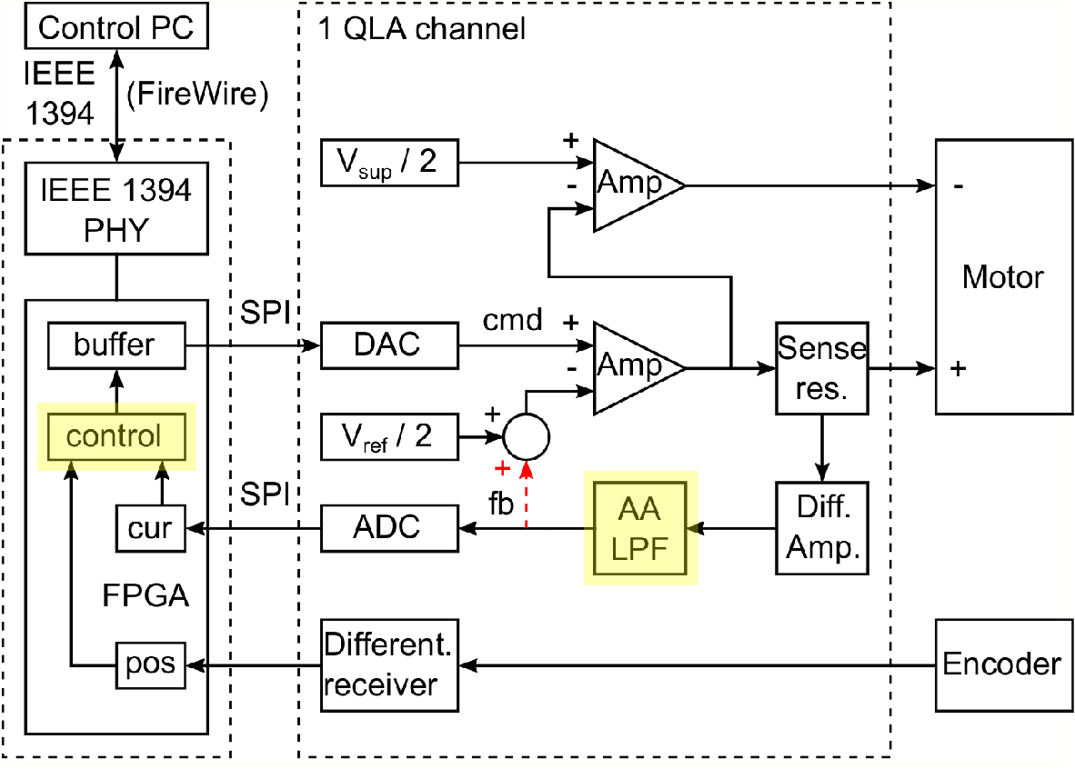
QLA V1.5
Design changes due to parts availability
Different ADC and DAC (handled in firmware)
Other minor changes
Software selectable control:
Analog current control: existing design
Digital current control (on FPGA)
Prototype by Stefan Kohlgrueber (MCI)
Other minor updates
Feedback of safety chain status
Measure motor supply voltage
Status
Nearly all parts procured (one left)
Build to start soon
S. Kohlgrueber, Y. Kim, P. Kazanzides, “Model-based design and digital implementation to improve control of the da Vinci Research Kit telerobotic surgical system," ICRA 2021

Slide 10
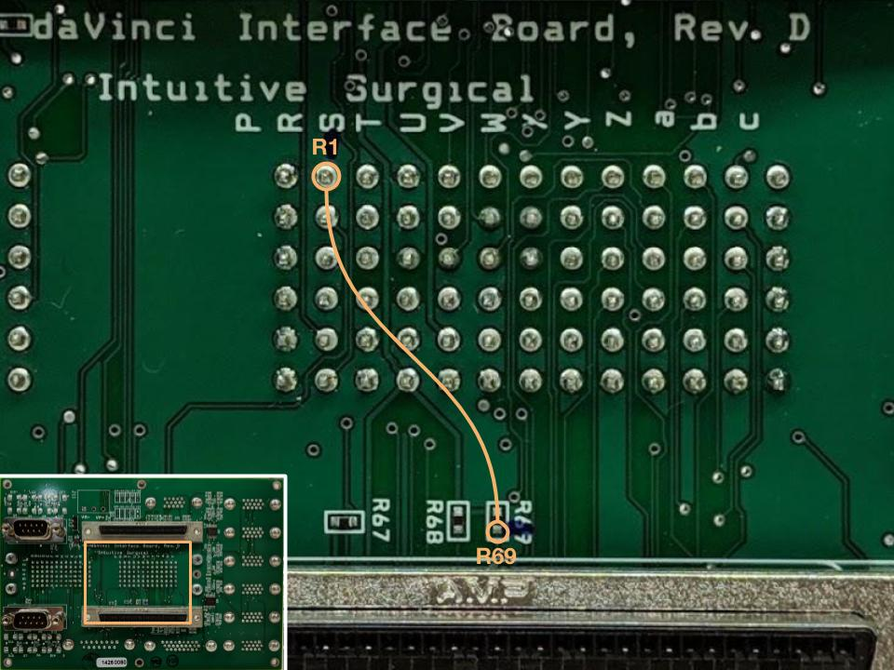
da Vinci Instrument Identification
Already available for systems with dMIB Rev F and QLA V1.4+
Build #8 (2020)
Hardware modification (jumper wire) for older dMIBs with QLA V1.4+
Build #5, #6, #7 (2016-2019)
Developed dongle to support older controller versions
Build #1, #2, #3, #4 (2012-2015)
Hardware modification (jumper wire) still necessary
New firmware version required
Plan to distribute at Intuitive booth at ICRA 2022 and at Hamlyn Symposium
Contributions from Hao (Simon) Yang

Slide 11
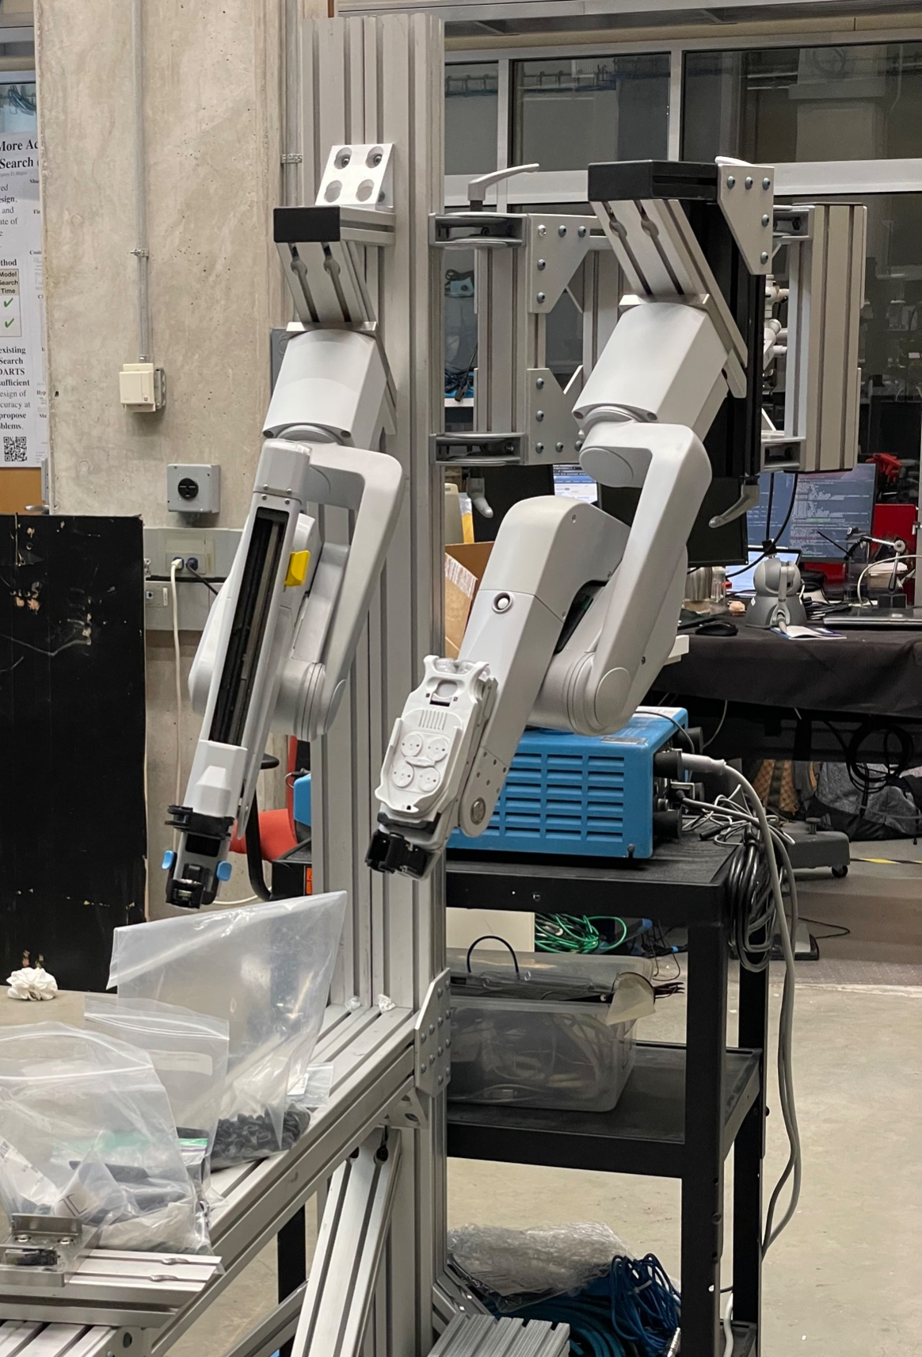
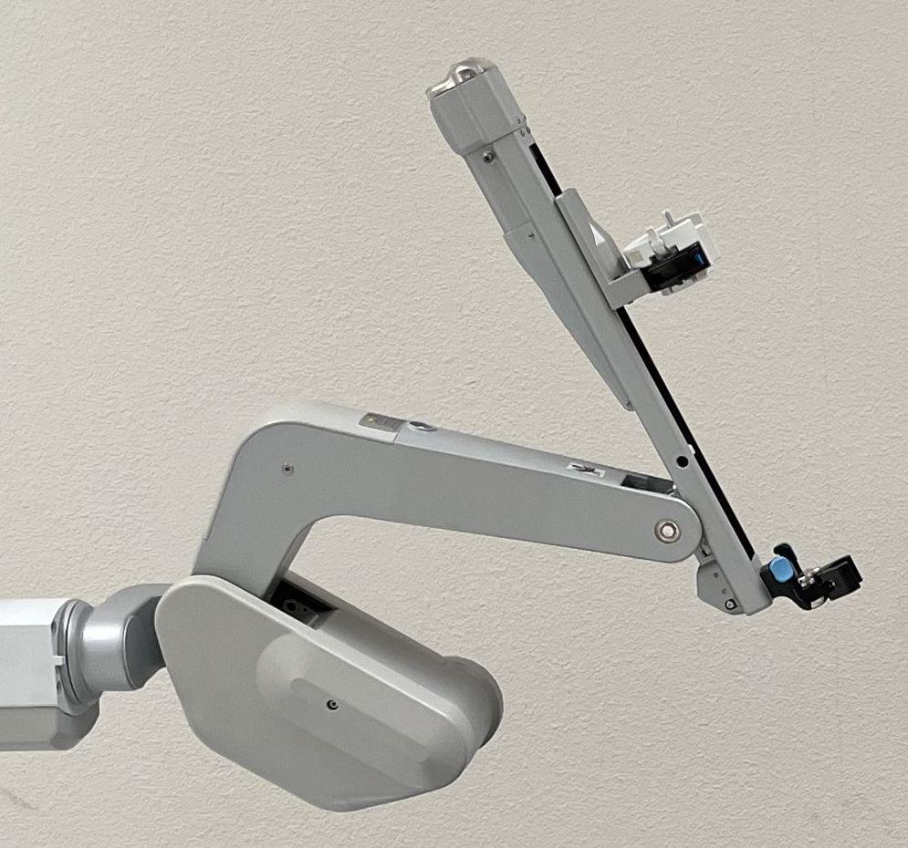
dVRK: beyond Classic
ISI models: Classic (aka Standard), S, Si, X, Xi
da Vinci S (retired)
MTM: same as Classic
PSM and ECM: new design vs Classic *some with analog potentiometers, some with digital potentiometers
SUJ: new design vs Classic, still used for X
da Vinci Si (eol announced for 2024)
MTM: new design, still used for X/Xi
PSM and ECM: same as S but all digital potentiometers
SUJ: same as S
dVRK-S
MTMs from Classic and S: supported
PSM from S/Si with digital pots: working prototype
ECM from S/Si: investigating
SUJ from S/Si: investigating but BYSUJ, alternatively 80/20

Slide 12
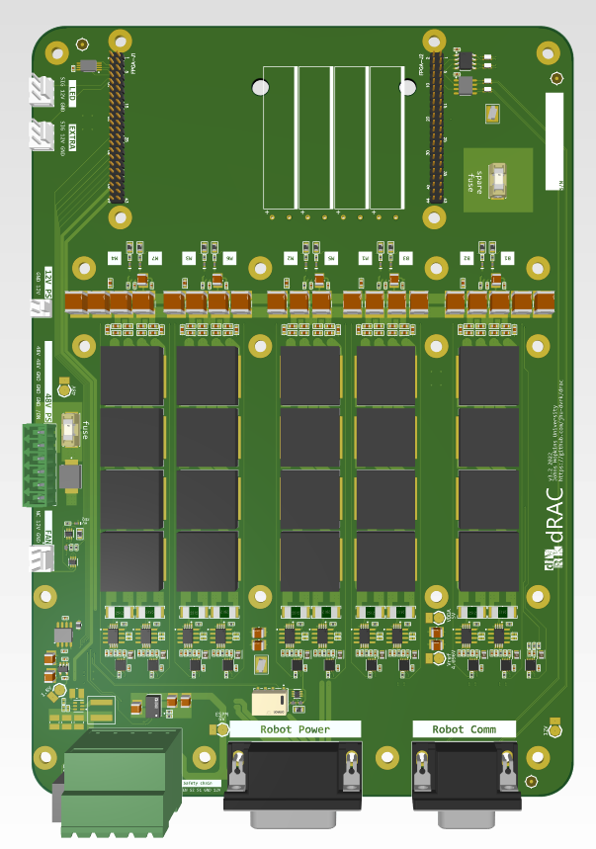
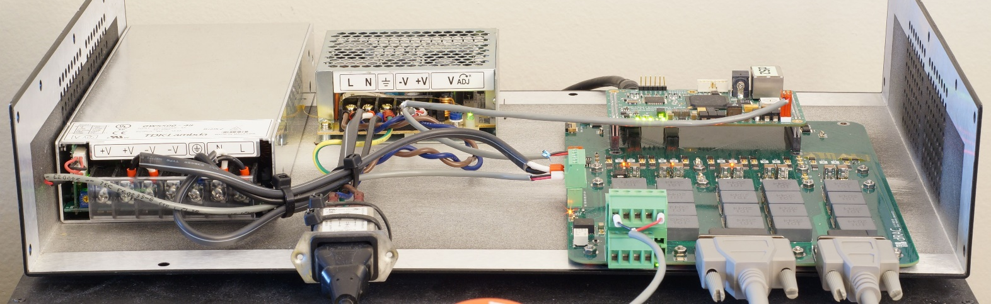
dVRK-S Design
Existing embedded ESPM for low voltage IOs
Custom firmware
JTAG programming device attached to arm
dRAC for motor power (1 vs 2 QLAs, PWM vs linear amps)
Same FPGA for logic (1 vs 2)
V2 works
V3 better
More compact, lower cost
Same FPGA so compatible with older generation systems (FireWire bus, e-stop)
Status:
Parts procured
Blank PCBs being fabricated
Requested quote for assembly
Contributions from Jie Ying Wu, Keshuai Xu

Slide 13
dVRK-S Software
Unified code base
Compiled once for Classic or S arms
Similar configuration files, same GUI
Same API/ROS topics: Code that works on dVRK Classic should work on dVRK-S
Can mix generations of PSMs and ECMs on single testbed
Video using prototype controller and development branch
https://youtu.be/7DxG2f0MlxQ
Demo at Intuitive Surgical booth ICRA 2022, Philadelphia

Slide 14
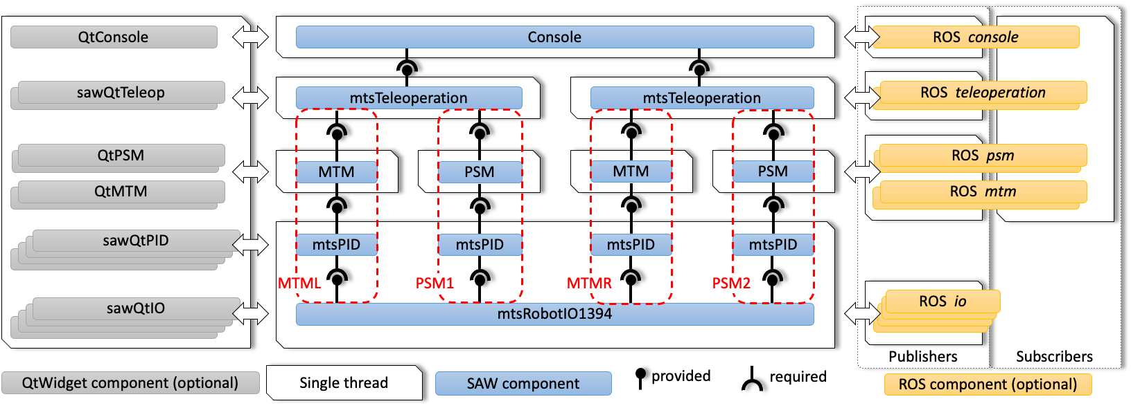
ROS 2 (beta)
dVRK core software is independent of ROS
Integration for ROS encapsulated in cisst-CRTK-ROS bridge
Developed cisst-CRTK-ROS2 bridge

Slide 15
ROS 2 (beta)
Beta
dVRK ROS 2 node
Colcon build configuration and instructions
Python client API (using CRTK ROS Python client)
Missing
Calibration scripts
Launch files, URDF and anything RViz2
Matlab client API (required for MTM gravity compensation calibration)
Primary platform will still be ROS 1 for foreseeable future but we want to make sure we are ready for ROS 2
OSRF has been “forced” to add ROS 1 Noetic for Ubuntu 20.04, not sure this will happen for Ubuntu 22.04

Slide 16
Releases
dVRK 2.1.0 released August 2021:
Support for more instruments, Classic and S/Si
Better support for custom instruments
https://github.com/jhu-dvrk/sawIntuitiveResearchKit/releases/tag/2.1.0
dVRK 2.2.0 targeting May/June 2022:
Bug fixes, minor API changes: Easier upgrade
Future proofing:
New configuration file generator (python based)
ROS 2 preliminary support (including colcon build)
Support for dVRK-S

Slide 17
Releases
Firmware 8 targeting May/June 2022
At minima: Dallas dongle, dRAC
Maybe for rev 9: QLA 1.5, FPGA 3
Hardware
All dates are tentative, many dependencies not under our control
Components stockpiled, initial designs completed
Test run for new designs
dRAC with FPGA 2: within weeks
QLA 1.5 and FPGA 3: within months
Production
20 dVRK-S controllers: Summer 2022
40 dVRK Classic controllers: Summer/Fall 2022

Slide 18
AccelNet Surgical Robotics Challenge
https://collaborative-robotics.github.io/surgical-robotics-challenge/challenge-2021.html
Entries due May 1, 2022
Simulation-based, using AMBF
Focus on surgical autonomy:
Needle detection
Needle driving
Suturing
Cash prizes and travel grants for future in-person challenges
This video created via teleoperation
Challenge: Can you do it autonomously?
OISE-1927354 (JHU)
OISE-1927275 (WPI)

Slide 19
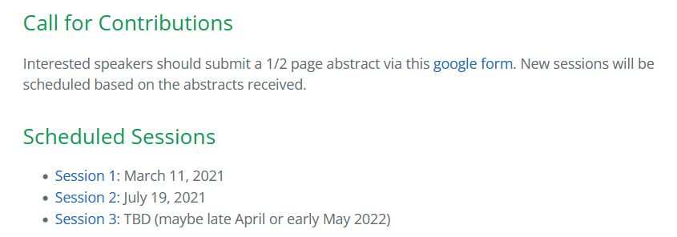
Raven/dVRK Research Symposium
Is there interest in continuing this online event?
Have not yet advertised for Session 3
https://collaborative-robotics.github.io/crtk-2021-research-symposium.html

