Slide 1

dVRK PI Meeting
January 25, 2023
(online)

Slide 2
Agenda
Introduction
Announcements
Community Presentation: Pietro Valdastri (Univ. of Leeds)
dVRK/dVRK-Si Controller Hardware
  Overview
  Technical details
  Controller build
dVRK Software Update
Open discussion

Slide 3
Announcements
2023 AccelNet Surgical Robotics Challenge
ICRA Workshop
Proposed ISMR Workshop
Raven/dVRK Research Symposium

Slide 4
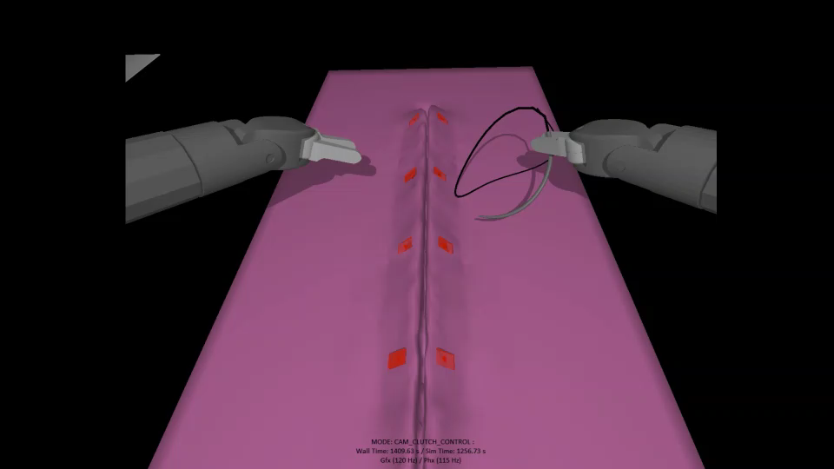



AccelNet Surgical Robotics Challenge
Coming Soon!
https://collaborative-robotics.github.io/surgical-robotics-challenge-2023/challenge-2023.html
Relaunch of 2021-2022 challenge
Online phase
  AMBF Simulator
In-person phase (JHU or WPI)
  dVRK, Raven
Focus on surgical autonomy:
  Needle detection
  Needle driving
  Suturing
This video created via teleoperation
Challenge: Can you do it autonomously?
OISE-1927354 (JHU)
OISE-1927275 (WPI)

Slide 5

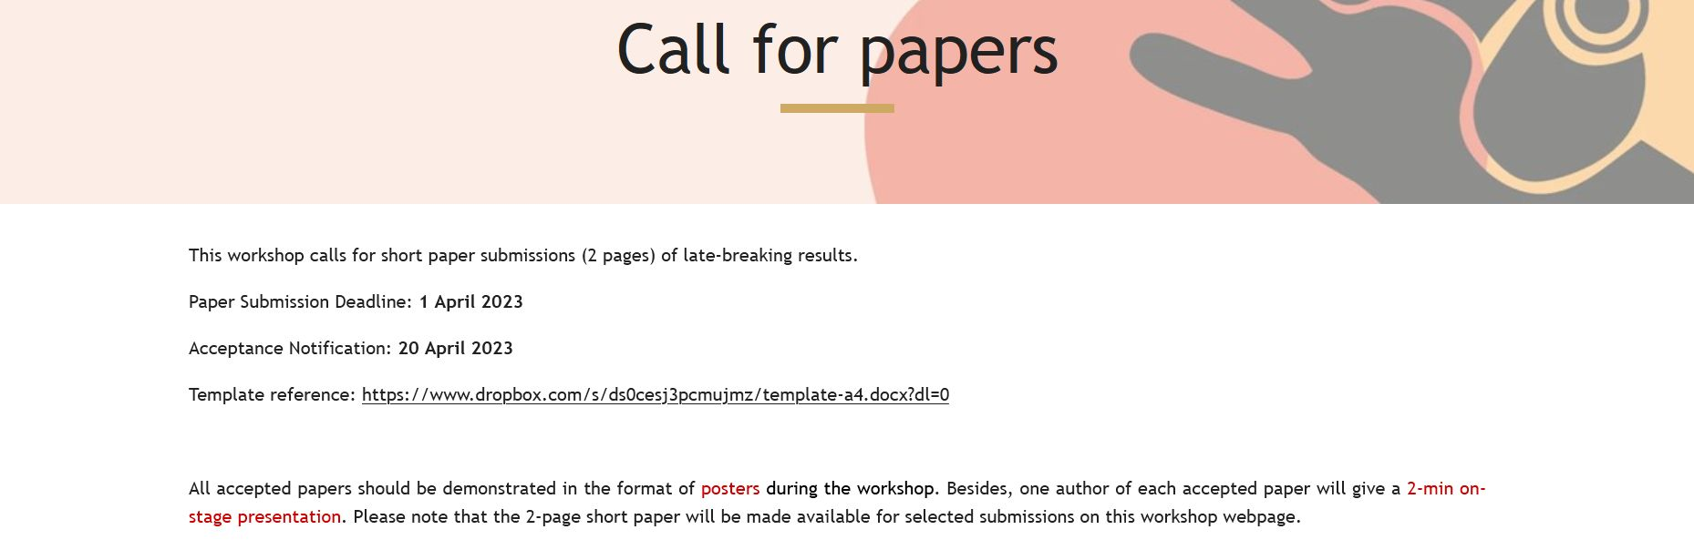
Organizing Committee:
Xiaomei Wang, UHK
Ka-Wai Kwok, UHK
Qi Dou, CUHK
Iulian Iordachita, JHU
Peter Kazanzides, JHU

Slide 6
ISMR 2023 Workshop Proposal
Hands-On Machine Learning in Simulation and Reality with the da Vinci Research Kit
  Half-day workshop, April 19, 2023 (if accepted)
  Planning to bring dVRK PSM(s) to workshop
  Will solicit abstracts for poster presentation
  Organizers: Peter Kazanzides, Adnan Munawar, Greg Fischer, Jie Ying Wu

Slide 7

Raven/dVRK Research Symposium
Nothing scheduled since 2021
Does anyone want to continue this format?
https://collaborative-robotics.github.io/crtk-2021-research-symposium.html

Slide 8
Community Presentation
Pietro Valdastri, Univ. of Leeds

Slide 9
dVRK / dVRK-Si Hardware Overview
da Vinci Systems and dVRK Controllers
Anatomy of da Vinci S / Si
dVRK-Si requirements and approach
Controller evolution (i.e., “how the dVRK-Si controller and the global chip shortage led to an improved dVRK controller”)
dVRK / dVRK-Si controller layout
  Introducing the new dVRK controller design (DQLA)

Slide 10
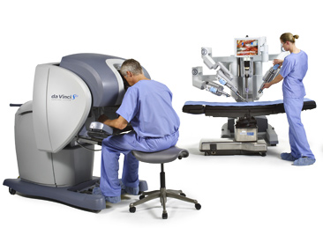
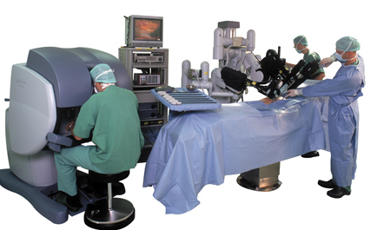
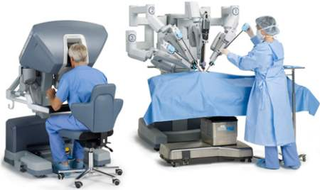
da Vinci Systems and dVRK Controllers
dVRK
dVRK-Si
(some)
da Vinci “Classic”
da Vinci S
da Vinci Si

Slide 11
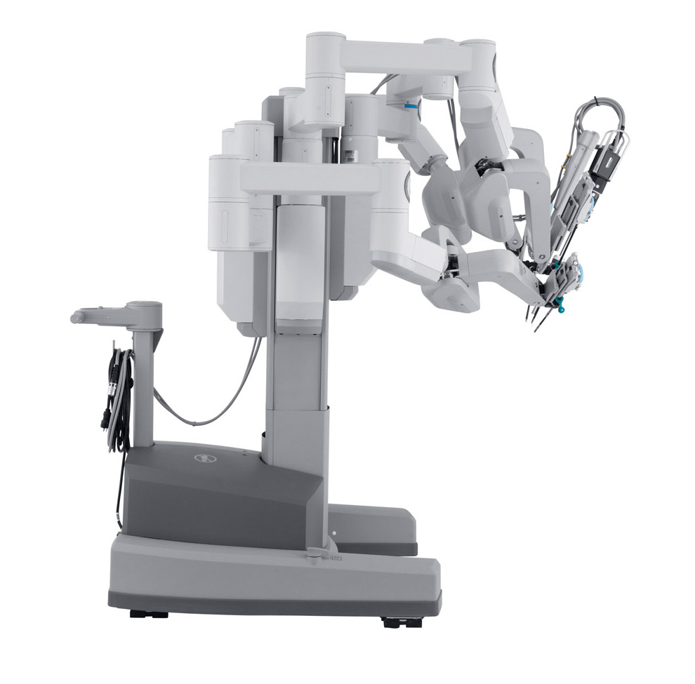
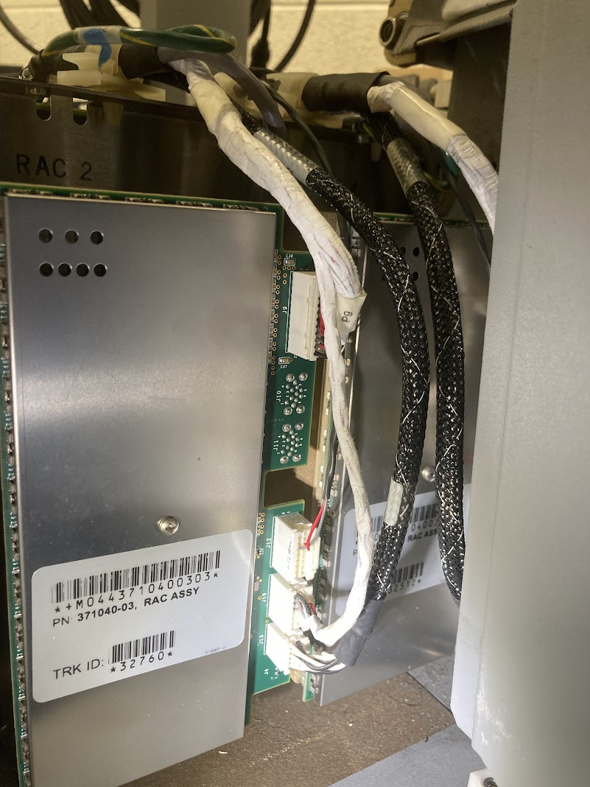
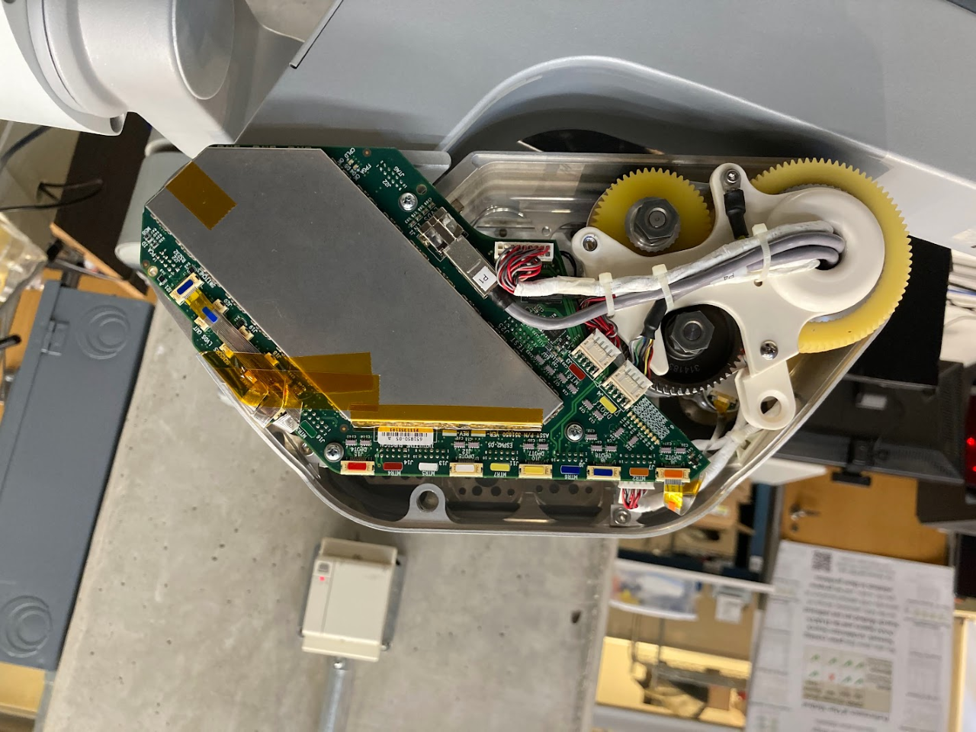
Anatomy of da Vinci S/Si
Problem: Proprietary embedded devices everywhere!
ESSJ
Solution: replace with dVRK-Si controller
(credit: Keshuai Xu)
ESII
ESPM
Solution: create alternative firmware with open interface
(credit: Jie Ying Wu)
RAC
Sensor feedback via LVDS

Slide 12
dVRK-Si Controller Requirements
Control up to 7 motors
Control up to 3 brakes
Reuse embedded electronics in ESPM
  Receive sensor feedback via LVDS
Leverage, and interoperate with, existing dVRK infrastructure
Custom electronics necessary due to non-standard acquisition of sensor feedback

Slide 13
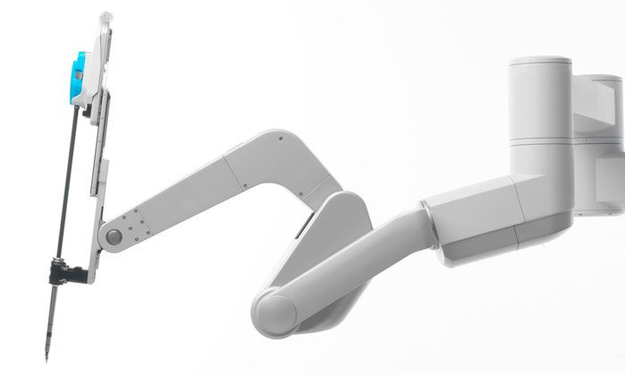
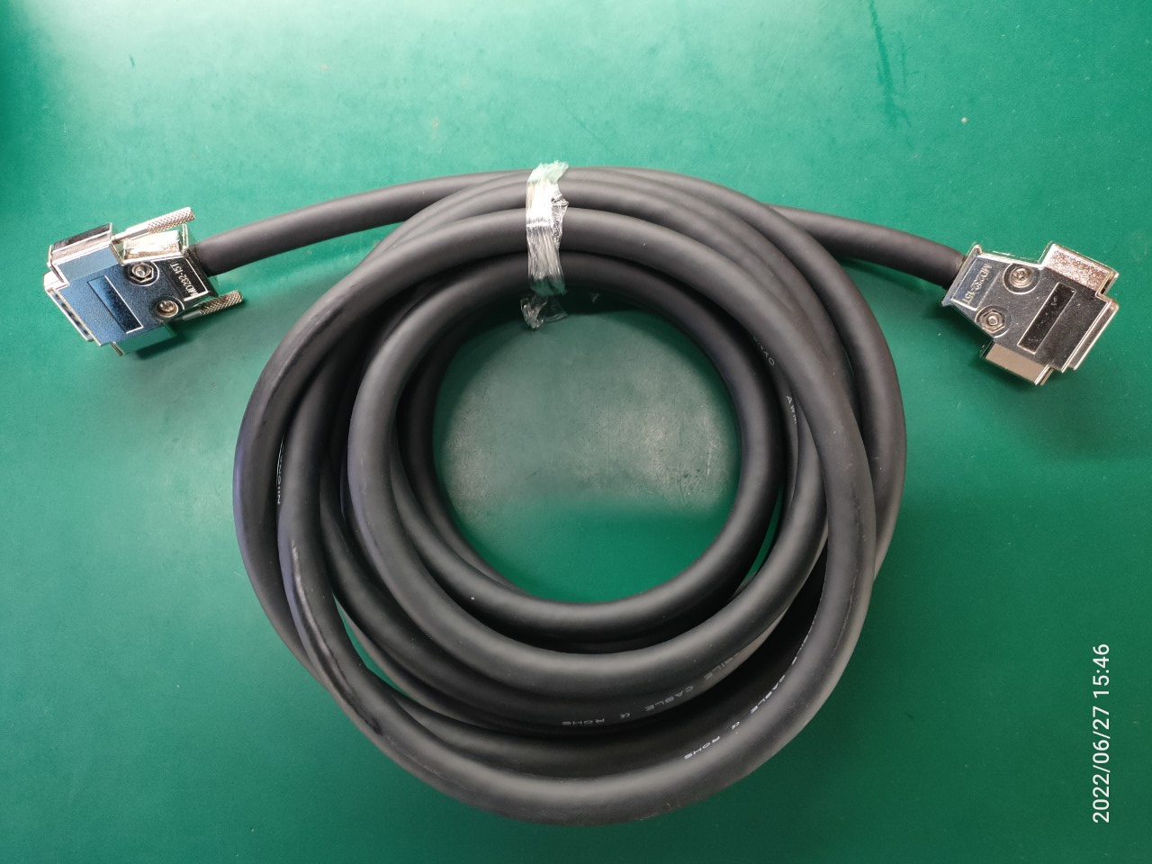
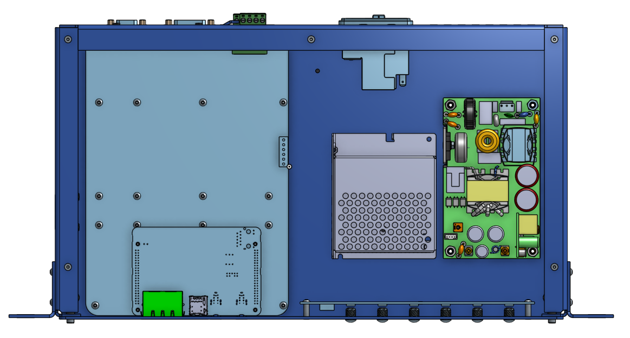
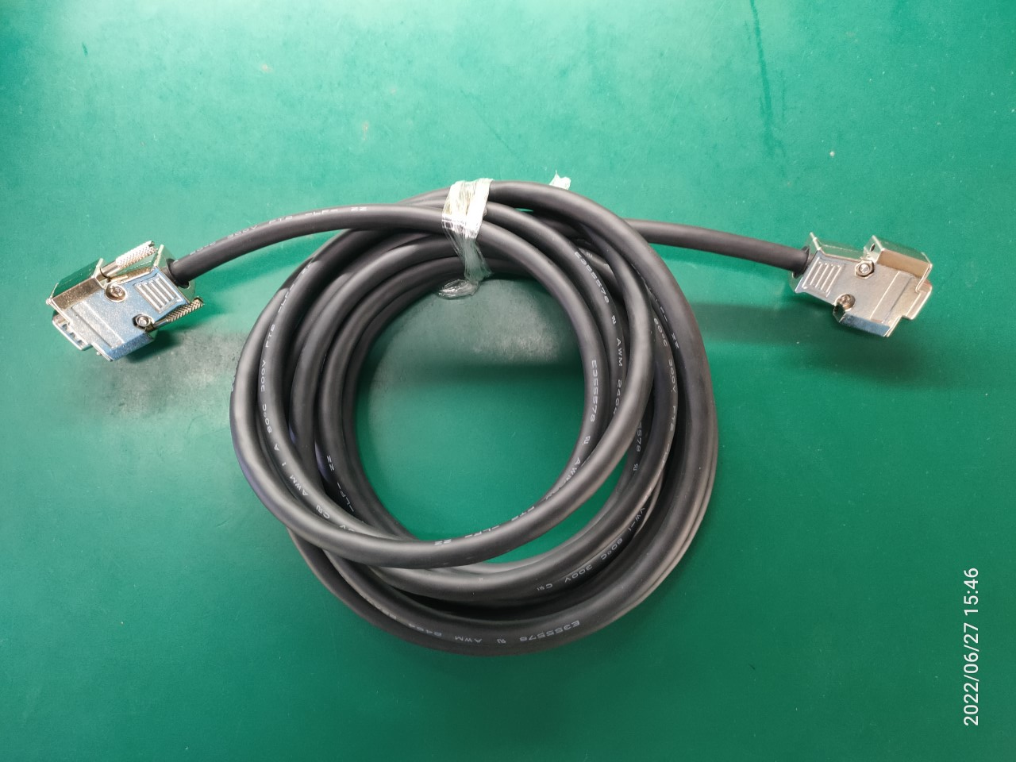
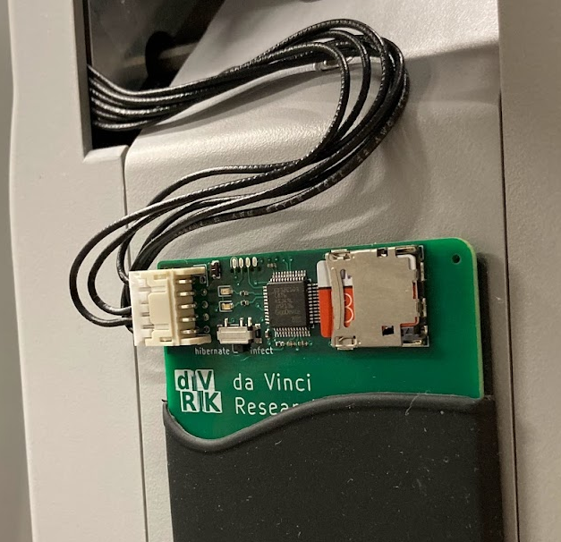
dVRK-Si Approach
ESII
ESPM
Reprogram custom firmware with ESPM Programmer
dVRK-Si controller
dVRK-Si cables

Slide 14
Controller Evolution
“How the dVRK-Si controller and the global chip shortage led to an improved dVRK controller”
dMIB
DQLA
Custom electronics available
2012
Adapt design for dVRK
2021
Update design
2022
Optimize for dVRK
dVRK
FPGA, QLA
FPGA V3, QLA
FPGA
Global chip shortage (2021)
FPGA V3
Custom electronics required
Optimize design for dVRK-Si
Add SUJ-Si
2019
dVRK-Si
dRAC
dRAC
dSIB-Si

Slide 15
dVRK-Si Controller
Arm
E-Stop
dRAC
Si Controller
Notes
Ethernet and FireWire external connections use PCB-mounted connectors on FPGA
E-Stop external connections use PCB-mounted connectors on dRAC
Power and serial communication (LVDS) to the arm use PCB-mounted connectors on dRAC
Logic Power Supply
Motor Power
Supply
(48V)
FPGA
Front LEDs
Ethernet
FireWire
Minimal internal wiring!

Slide 16
dVRK Controller (current design)
E-Stop
FireWire
Ethernet
Arm
dMIB
dVRK Classic Controller
Legend
Ethernet pass-through
Ethernet cable
FireWire pass-through
FireWire cable
E-Stop connector
E-Stop wiring
Data cable (SCSI 68)
Power cable (DB 9)
QLA
FPGA
QLA
FPGA
Logic Power Supply
Motor Power Supplies
MTM (12V + 24V) PSM(24V) ECM (36V)
Front LEDs

Slide 17
dVRK Controller (new DQLA design)
FireWire
Ethernet
E-Stop
Arm
FPGA V3
dMIB
Legend
Flat flex cable
Data cable (SCSI 68)
Power cable (DB 9)
Notes
Ethernet and FireWire external connections use PCB-mounted connectors on FPGA
E-Stop external connections use PCB-mounted connector on DQLA-F
DQLA-F
dVRK Classic DQLA Controller
QLA
QLA
DQLA-Q
Logic Power Supply
Motor Power Supplies
MTM (12V + 24V) PSM(24V) ECM (36V)
Reduced internal wiring!
Enabled by FPGA V3
Front LEDs

Slide 18
dVRK Controller: Original vs DQLA
Components | Original | DQLA | Notes
FPGA | 2 | 1 | Cost savings; all joints handled together
Firewire cables | 3 | 0 | Fewer “hops”, reduce daisy chaining issues
FireWire pass-through | 2 | 0 | Getting hard to find, fewer “hops”
Ethernet cables | 2 | 0
Ethernet pass-through | 2 | 0
E-Stop wires | 3 | 0
E-Stop connectors | 2 | 2 | Now mounted on FPGA Interface Board (DQLA-F)
Interface boards | 0 | 2 | Inexpensive to manufacture
Other benefits
Fewer cables will simplify manufacturing and help troubleshoot hardware issues
Fewer FPGAs means:
  Fewer FireWire I/O issues
  Fewer firmware updates
  All axes controlled by same CPU with FPGA v3: better for synchronization, coupling… (future use)
  Fewer ethernet messages to FPGA v3 ARM cores (future use)

Slide 19
dVRK / dVRK-Si Hardware Details
FPGA V3.1
QLA V1.6
  Possible QLA problem (prior to V1.6)
DQLA design
dVRK-Si
Firmware design

Slide 20
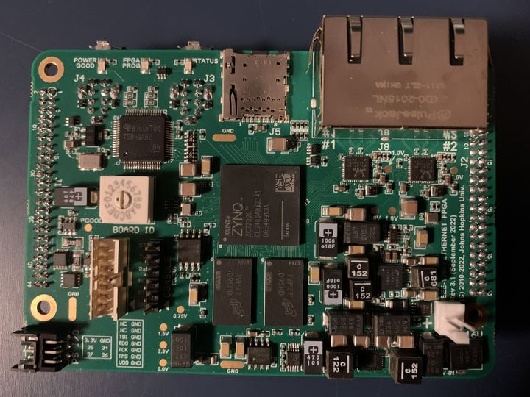
FPGA V3.1
Upgrade from Spartan 6 to Zynq (Spartan 7)
Bigger FPGA + dual-core ARM processor
Firewire x 2
Micro-SD
Key features:
Backward compatible with prior FPGA versions
Additional Ethernet port (2 total, 1GB each)
Linux on ARM processor (1 GB DDR3 RAM)
Micro-SD for firmware upgrades
4 additional I/O (V3.1)
Status:
Two prototype builds (V3.0 and V3.1)
Full build of V3.1 in process (expected Feb 10)
Ethernet x 2
FPGA
FPGA
DRAM

Slide 21
Network Connections
FPGA
real-time connection
(Firewire or Ethernet/Firewire)
FPGA
PC
Firewire
Ethernet
FPGA
non-real-time connection
(Ethernet)
Note: Ethernet daisy-chain not yet supported by firmware
FPGA
EtherCAT could be an option (would need to license IP core)

Slide 22
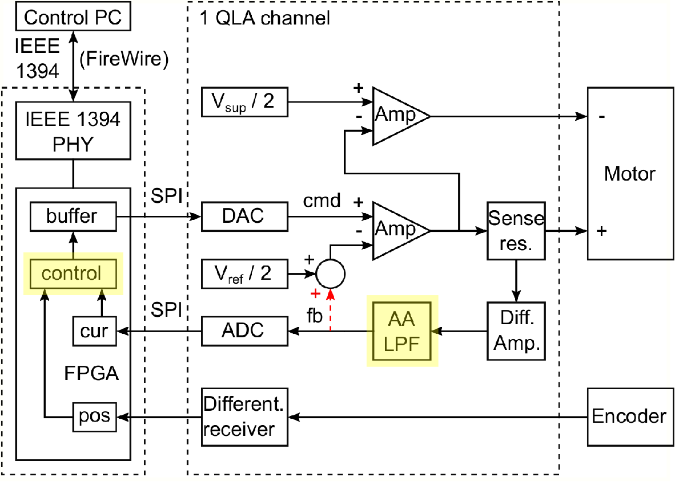
QLA V1.6
Design changes due to parts availability
  Different ADC and DAC (handled in firmware)
  Other minor changes
Software selectable control:
  Analog current control: existing design
  Digital current control (on FPGA)
    Prototype by Stefan Kohlgrueber (MCI)
Status
  One prototype build (V1.5)
  Full build of V1.6 to start soon (first, need blank PCBs)
S. Kohlgrueber, Y. Kim, P. Kazanzides, “Model-based design and digital implementation to improve control of the da Vinci Research Kit telerobotic surgical system," ICRA 2021

Slide 23
Possible QLA problem (prior to Rev 1.6)
C74 is rated for 16V for all versions of QLA prior to Rev 1.6, but op amp output can be larger than that, especially for ECM (36V supply) and SUJ (48V supply)
Symptom of missing (or damaged) C74 is that op amp output may oscillate, which would cause excessive heating
This does not seem to have happened, but one easy solution is to solder a higher-rated cap on back on PCB

Slide 24
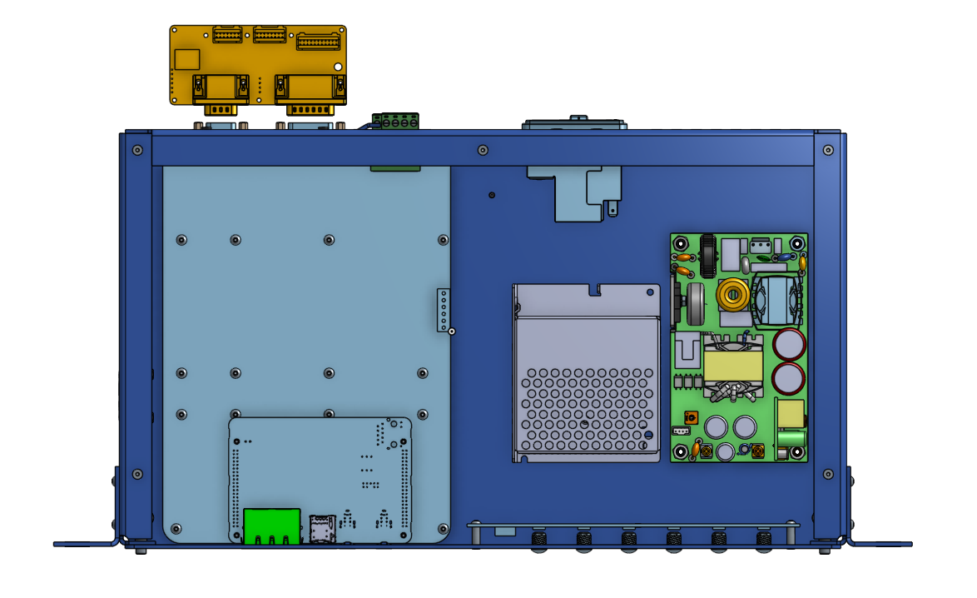
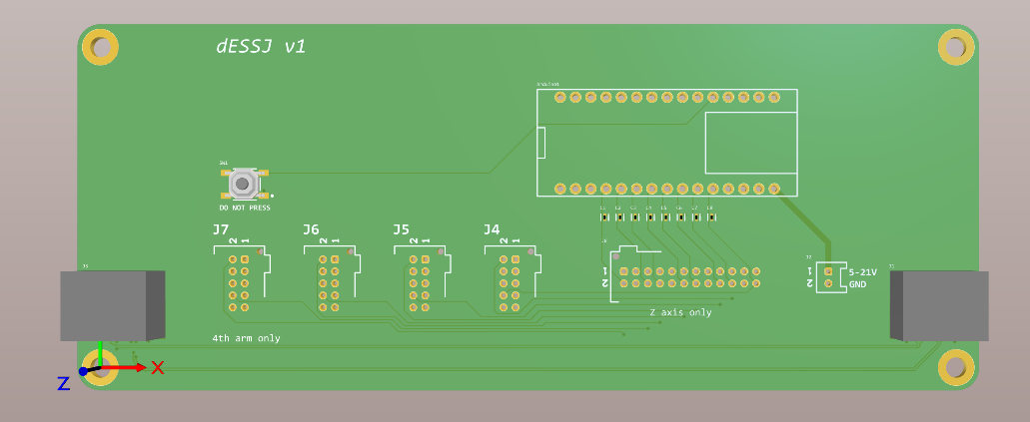
dVRK-Si electronics
If you get arms from Intuitive: Controller + Cables + ESPM Programmer + Arm
If you have an SUJ: Controller + dSIB-Si + dESSJ + ESPM Programmer + Patient Cart

Slide 25
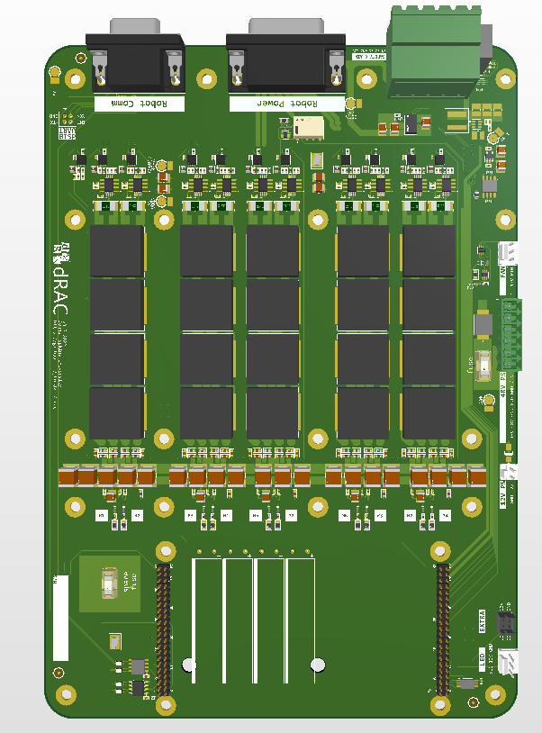
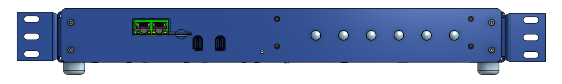
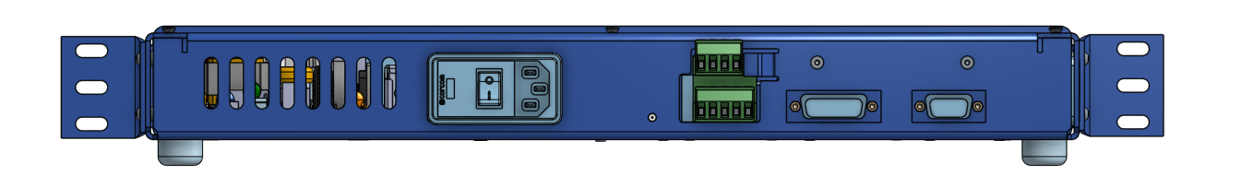
dVRK-Si Controller
No SUJ configuration: Controller + Cables + ESPM Programmer + Arm
Internals:
dRAC + FPGA + 48V + 12V + LED
10 channel motor driver
LVDS transceivers
Power supply for the arm
Current loop implemented in FPGA
2 high current channels: 48V 6A
8 low current channels: 48V 2A
Controller
1.5U height, rack mount optional
Bottom panel is heatsink. Must leave gap.
Front: firewire/ethernet ports, firmware SD
Back: power, safety, robot connectors

Slide 26
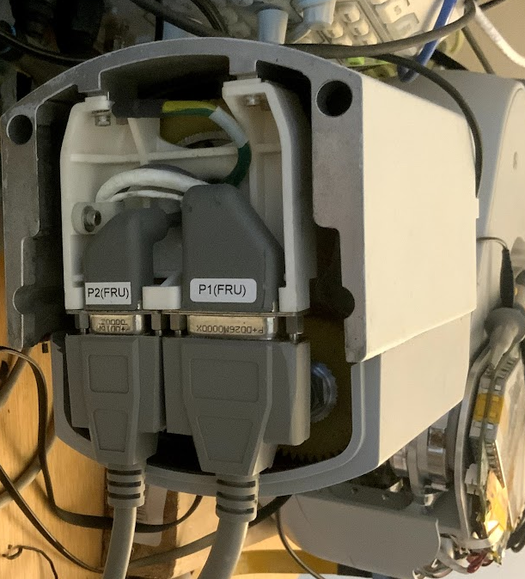
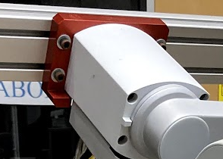
dVRK-Si cables
No SUJ configuration: Controller + Cables + ESPM Programmer + Arm
Custom cables
Cables with D-sub connectors.
4.2m (14ft)
Robot power cable:
10 motors/brakes, 6V power
Robot comm cable:
Cat 6
Back of the arm
Mounting plate

Slide 27
ESPM
No SUJ configuration: Controller + Cables + ESPM Programmer + Arm
ESPM
The big circuit board in the arm.
Has an FPGA that talks to encoders, pots, instrument, LED etc.
We will release a closed-source alternative firmware that speaks an open protocol. (Credit: Jie Ying Wu)
Inside the arm

Slide 28
ESPM Programmer
No SUJ configuration: Controller + Cables + ESPM Programmer + Arm
ESPM programmer
Reprograms the ESPM.
Sticks to the arm. Connects to the JTAG port of ESPM.
Replays an XSVF file stored in the SD card when the arm powers up.
Firmware update by replacing the file in the SD card.
Reprogramming is not persistent. If you unplug it and power cycle the arm, the firmware goes back to stock. Un-dVRKing is possible but physical rewiring is tedious.

Slide 29
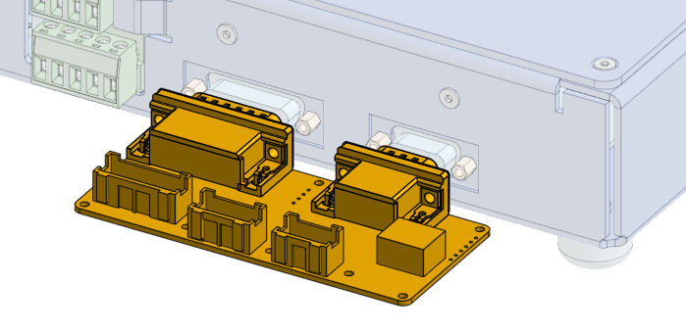
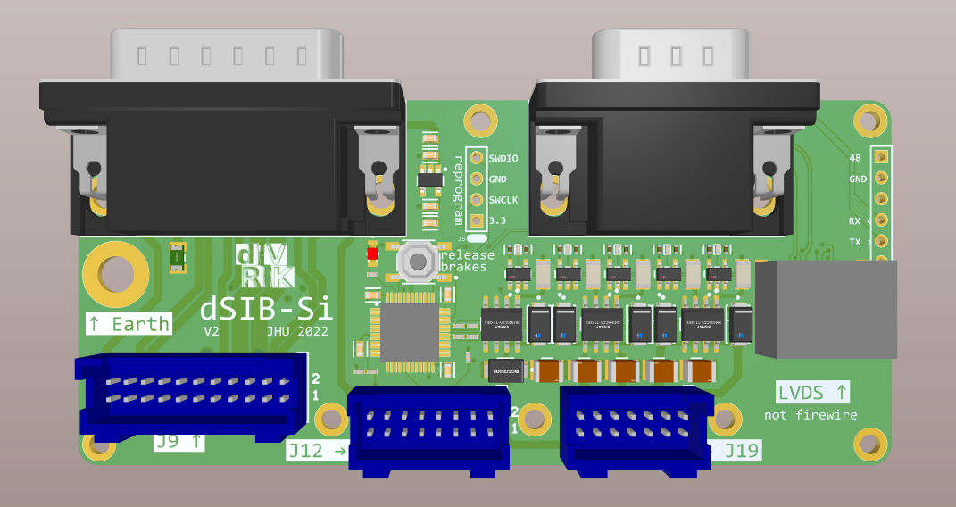
Si SUJ
With SUJ configuration: Controller + dSIB-Si + dESSJ + ESPM Programmer + Patient Cart
dSIB-Si
Allows you to connect the internal wiring to the controller.
Additional 5 brake drivers to release SUJ brakes.
The internal cables are short. We stack the controller boxes on the base of the Patient Cart
Base of the patient cart Unplug cables from the stock controller and plug into dSIB-Si

Slide 30
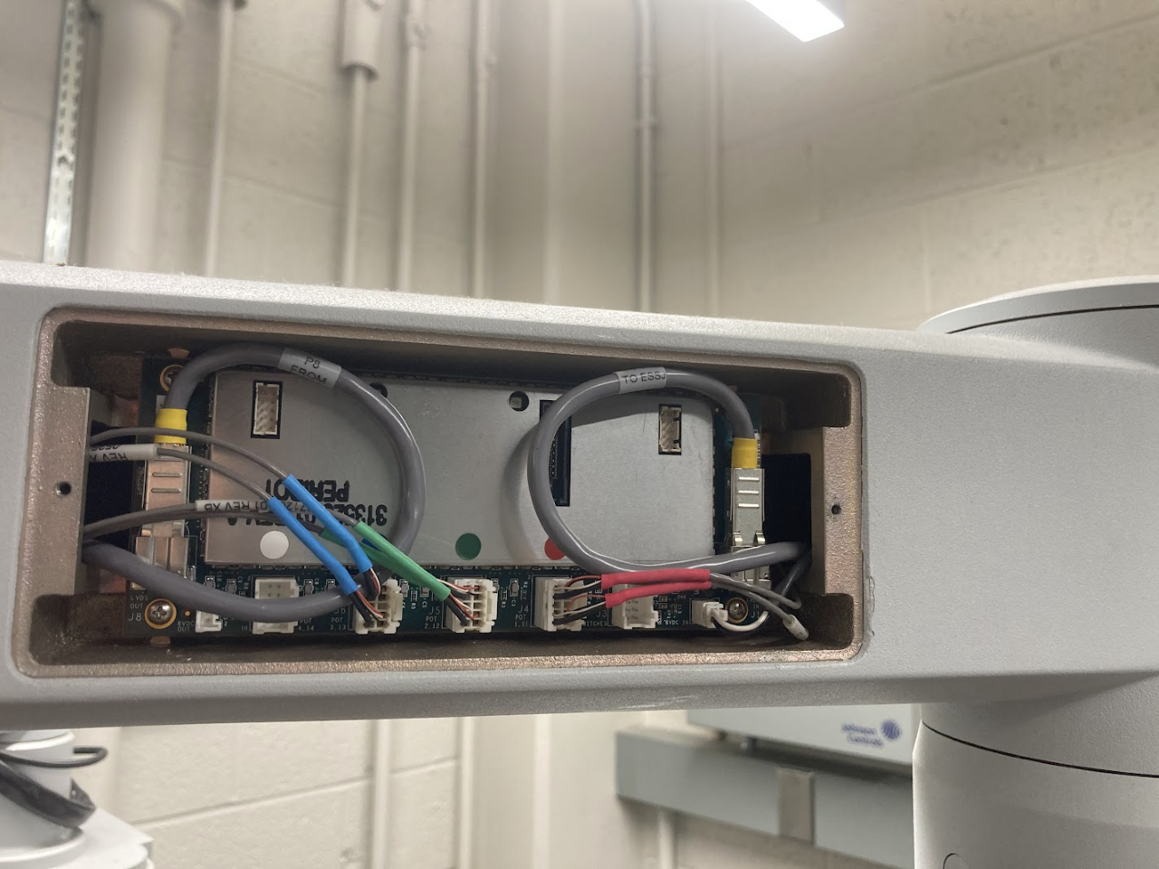
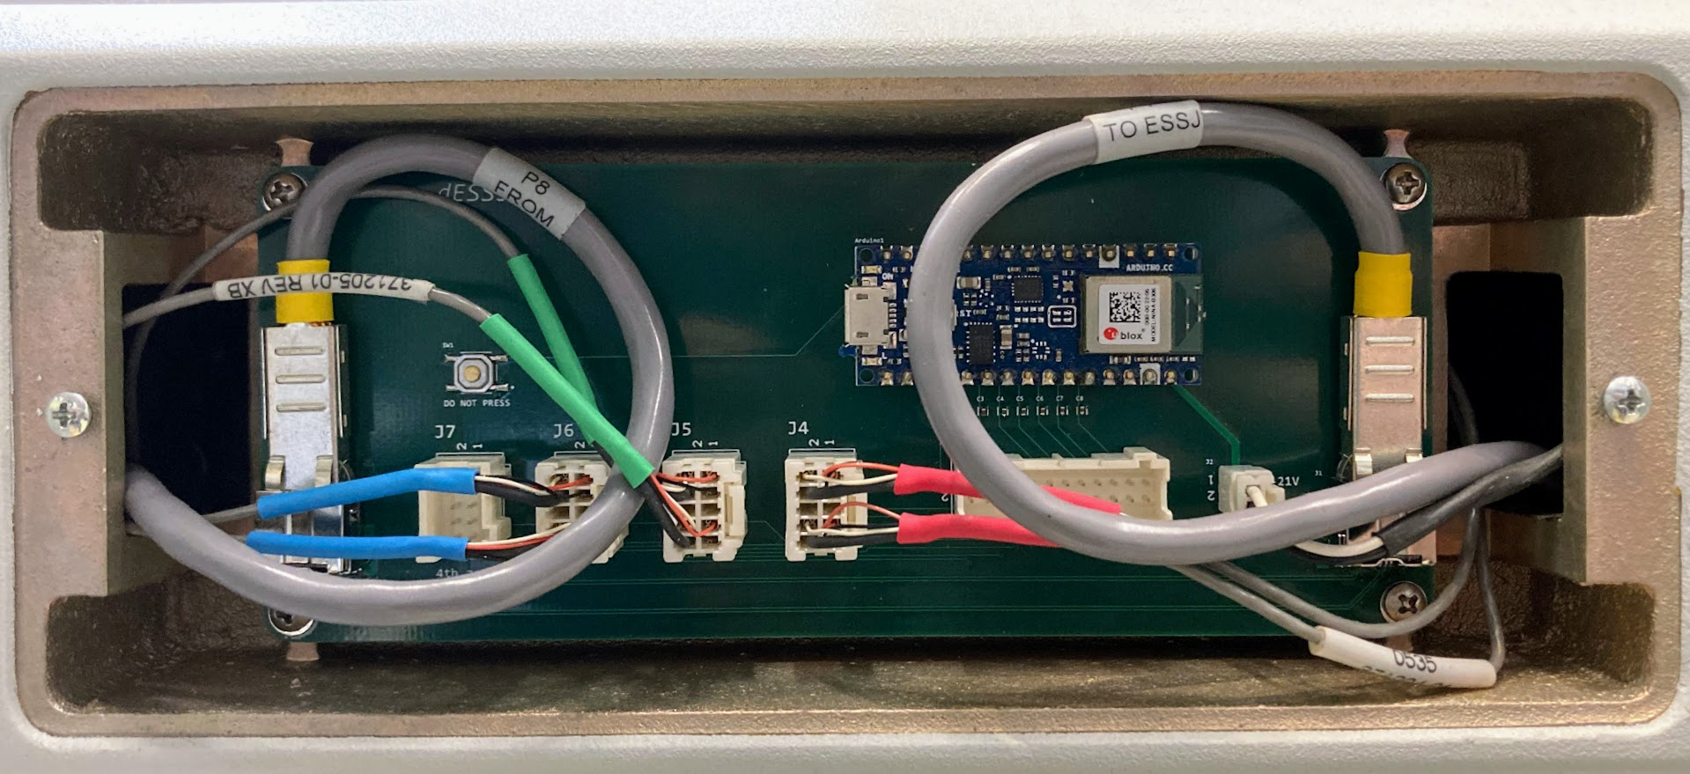
Si SUJ
With SUJ configuration: Controller + dSIB-Si + dESSJ + ESPM Programmer + Patient Cart
dESSJ
Arduino reads the pots in the SUJ. Talks to PC with Bluetooth BLE.
LVDS passthrough.
Qty 5 needed: One for each arm and one for the translational joints.
Inside SUJ arm
Replace ESSJ and swap cables

Slide 31
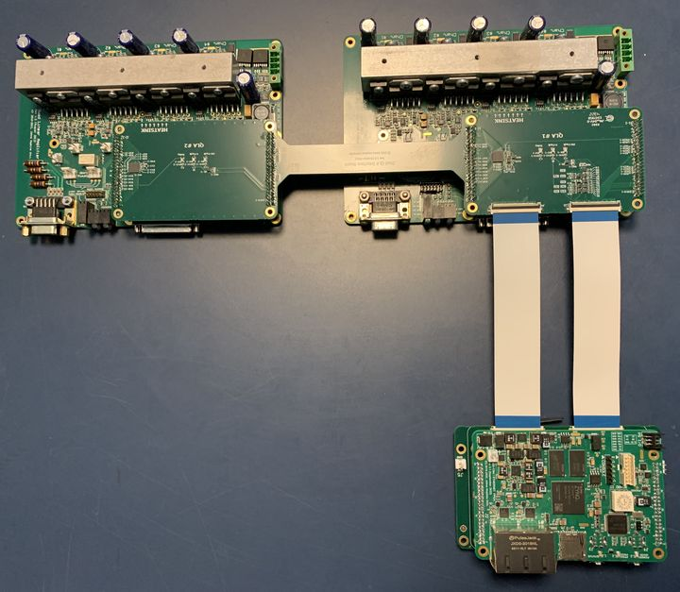
Dual QLA (DQLA) Design
FPGA V3.1
2 x 44
74 I/O, 3.3V, 5V
DQLA-F
2 x 50
74 I/O, 3.3V, 5V
DQLA-Q
EXP
EXP
2 x 44
(each)
70 I/O, 3.3V, 5V
QLA
QLA
Possible to upgrade existing controllers to DQLA design

Slide 32
Dual QLA (DQLA) Design
FPGA V3.1
Basic approach:
Share signals between QLAs when possible (e.g., SPI clocks)
Add I/O expander (with SPI interface)
Replaced 3 non-critical QLA feedback signals with LEDs
2 x 44
74 I/O, 3.3V, 5V
DQLA-F
2 x 50
74 I/O, 3.3V, 5V
Max7301 I/O Expander
SPI interface (4 signals from FPGA)
Provides 28 I/O to QLA
Used for “slow” signals: (most) digital inputs, LED outputs, power control outputs
DQLA-Q
EXP
EXP
2 x 44
(each)
70 I/O, 3.3V, 5V
QLA
QLA
https://github.com/jhu-dvrk/dvrk-DQLA

Slide 33
Firmware Configurations
 | QLA | DQLA | dRAC
FPGA V1 | FPGA1394V1-QLA | Not feasible | Not supported
FPGA V2 | FPGA1394V2-QLA | Not feasible | Not supported
FPGA V3 | FPGA1394V3-QLA | FPGA1394V3-DQLA | FPGA1394V3-DRAC
Notes:
FPGA1394V1 previously called FPGA1394
FPGA1394V2 previously called FPGA1394Eth
DQLA not feasible with V1/V2 due to lack of 4 extra I/O introduced with V3
dRAC not officially supported with V1/V2, but is expected to work for arm only (SUJ requires 4 extra I/O introduced with V3)

Slide 34
Controller Build #9 Status
dVRK-Si: Qty 20
  FPGA V3.1, Qty 20, expected Feb 10, 2023
  dRAC V3.3, Qty 20, expected this week
  JHU to assemble enclosure by end of Feb 2023
dVRK: Qty 50
  FPGA V3.1, Qty 50 (DQLA design), expected Feb 10, 2023
  QLA V1.6, Qty 100, expected March 2023
  DQLA-F V1.1, Qty 50, expected Feb/March 2023
  DQLA-Q V1.1, Qty 50, expected Feb/March 2023
  Contract manufacturer to assemble enclosure (April 2023)

Slide 35
dVRK Software Updates
New hardware (dVRK-Si)
New OS/ROS
Improved control
Improved teleoperation

Slide 36
New software for new hardware
Si arms (PSM and ECM)
  Brakes on PSM Si
  Different code to get instrument model
  New potentiometer calibration procedure
  Different configuration files for IO, PID and kinematics
  New configuration file generator, Python based
  Modified console class to accommodate generations, Classic vs. Si
Si SUJ
  dESSJ
    Bluetooth reading is working, getting all SUJ joint values
    Missing forward kinematics
  dSIB-Si
    SUJ brakes are working!

Slide 37
New software for new OS/ROS
Last year updates
  dVRK software built and tested on Ubuntu 20.04 with ROS 2 Galactic
  Main ROS 2 node and CRTK Python client working
  Missing launch files, calibration scripts, CRTK Matlab client…
Updates
  ROS 2 code updated periodically to match ROS 1 developments
  Builds on Ubuntu 22.04 with ROS 2 Humble
How much should we be doing?
  ROS 1 will very likely not be supported by OSRF past Ubuntu 20.04
  AFAIK, not a single dVRK ROS 2 user so far
Likely a very short overlap when both dVRK ROS 1 and ROS 2 will be used and maintained
Are you using ROS 2 or do you plan to? When? RSVP in Zoom chat

Slide 38
New software to fix the existing one
dVRK software was written over the past 10 years, so, inevitably:
  some shortcuts
  solutions based on older requirements
  decisions with unintended consequences
  … and plain old bugs
How and when do we find these? Mostly users and applications
  For example, Nural Yilmaz and Ugur Tumerden (visiting JHU from Marmara University, Istanbul) are working on bidirectional tele-operation and helped us identify some control issues

Slide 39
New software: better control
Control in actuator vs. joint space?
Original approach
  Convert from actuator to joint space (coupling) at the IO level, PID and arm classes only work on joint space
  Simpler code overall but makes PID tuning much harder
Updates
  IO and PID components now use actuator space
  Arm class handles coupling for position, velocities, efforts as well as all limits
  Lots of updated configuration files
  Better PID for all joints, some much better
IO
pa₀, va₀
pj₀, vj₀
PID
p...: position
v…: velocity
e…: effort
…a: actuator
…j: joint
Good signal
Real noise
Pollution
pa₁, va₁
pj₁, vj₁
Coupling
ea₀
ej₀
ea₁
ej₁

Slide 40
New software: improved PID
Removed non-linear gains and fixed deadband bug
  Originally implemented to remediate issues due to poor velocity estimation
  Deadband fixed so it can be used instead of non-linear gains for low res encoders
Added support for goal velocity
  Old stack only sent goal position to PID, so goal velocity wasn’t needed
  dVRK now supports joint and cartesian PID goals with position and velocity
  It turns out move commands were based on Reflexxes which provides both position and velocity so already a significant improvement
Deadband position
Old
Deadband position
New

Slide 41
New software: improved teleoperation
Simple unidirectional, position-based teleoperation without haptic feedback
Updated to use the MTM cartesian position and velocity to send a position and velocity goal to the PSM
Promising results: “latency” between MTM and PSM down from
  ~100ms to ~60ms with better PID gains
  ~60ms to ~10ms with cartesian velocity
IO: MTM ap + av
Arm: MTM cp + cv
Teleop: Scale to PSM cp + cv
Arm: PSM ap + av
PID: PSM ae

Slide 42
Open Discussion

