Slide 1
dVRK PI / User Group Meeting
February 13, 2025
(online)

Slide 2
Agenda
Introduction
Announcements / Events
Community Presentation:
Elena De Momi (Politecnico di Milano)
dVRK/dVRK-Si Hardware/Software Updates
dVRK Consortium and Community
Discussion

Slide 3
Announcements / Events
Does anyone have an announcement?

Slide 4
Announcements / Events
ICRA 2025 Workshop not accepted
ICRA 2025 Challenge not accepted
Proposed workshop for ISMR 2025

Slide 5
Community Presentation
Elena De Momi, Politecnico di Milano

Slide 6
dVRK Hardware

Slide 7
dVRK/dVRK-Si Controllers
Have inventory of dVRK-Si controllers
Building dVRK controllers (mostly for MTMs)
FPGA V3.2 assembled
QLA V1.6 in process
DQLA-F/DQLA-Q assembled
dMIB assembled
Next step will be enclosure assembly

Slide 8
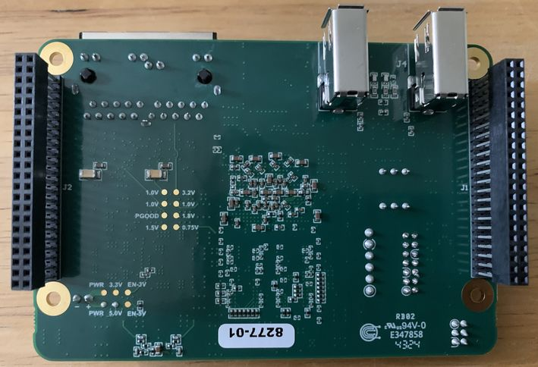
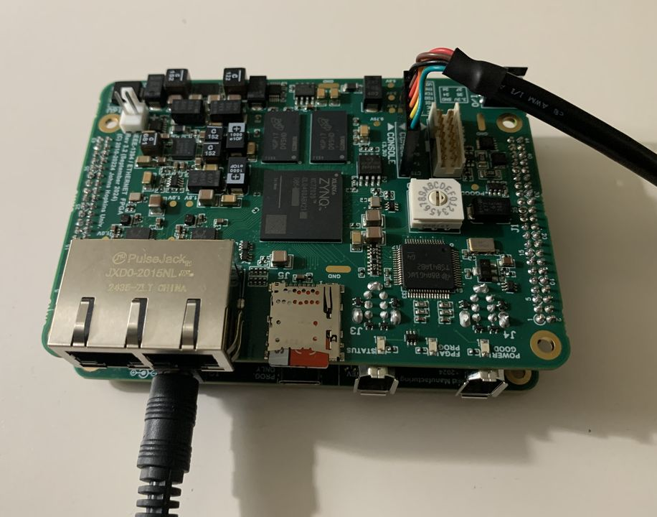
FPGA V3.2
No functional changes compared to FPGA V3.1
Added test pads to facilitate manufacturing tests
Previous build (FPGA V3.1) had ~10% failure rate
Current build (FPGA V3.2) had 0% failure rate

Slide 9
dVRK-Si Setup Joints: Key Points
Discontinuing the current approach using Bluetooth
Existing sites with Si SUJ:
Please look for the ESSJ boards you removed from your system – you will need them!
We will provide updated custom boards (at no cost):
dSIB-SI
dESSJ-Z

Slide 10
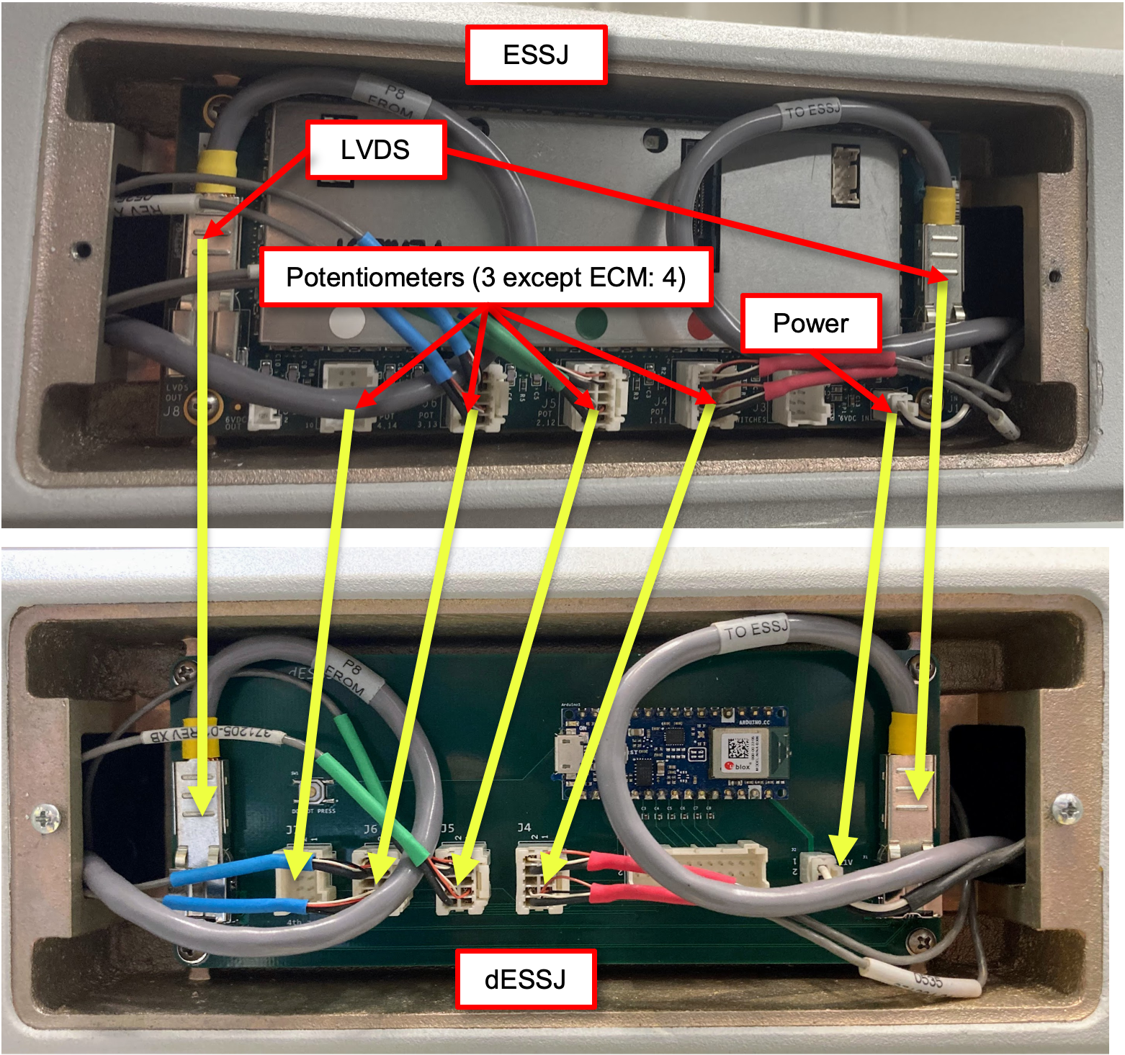
dVRK-Si Setup Joints: Current Design
Current design uses custom dESSJ in place of ISI ESSJ
Pass-through for LVDS data to/from ESPM
Arduino acquires SUJ pots and sends to PC via Bluetooth
Encountering issues with Bluetooth connectivity

Slide 11
dVRK-Si Setup Joints: New Design
Reuse ESSJ (reprogram with new firmware)
Simpler to set up (do not need to replace boards)
SUJ pots will be added to LVDS data stream (no Bluetooth)
Higher-resolution ADC for pots
Current Design
ESPM
pgm
New Design
ESPM
pgm
LVDS
LVDS
dESSJ
SUJ Z-axis pots
ESSJ
pgm
SUJ Z-axis pots
SUJ rotary pots
SUJ rotary pots
LVDS
LVDS
Serial
dSIB-Si
dESSJ
dSIB-Si
dESSJ-Z
dVRK-Si Controller
dVRK-Si Controller
1 per arm (PSMs, ECM)
1 per system
1 per arm (PSMs, ECM)
1 per system
Credit: Keshuai Xu

Slide 12
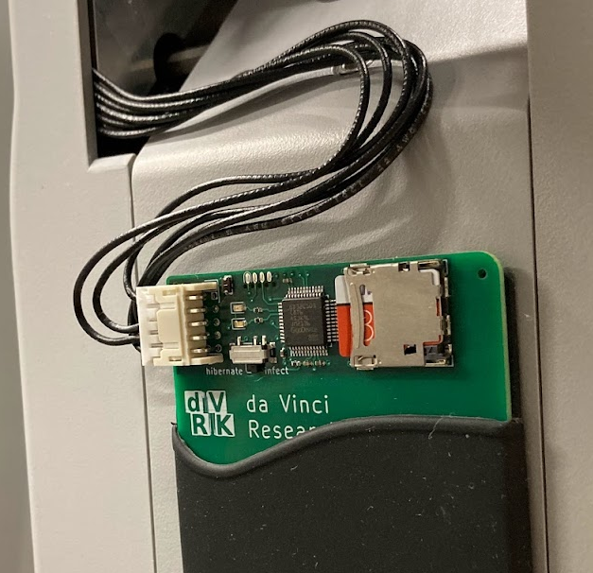
Reprogramming Embedded Boards
Current Approach
ESPM programmer reprogram board at each power-up
Firmware updates via Micro SD
Future Plan
ESPM programmer attached once to reprogram board
Firmware updates from PC via LVDS
Advantages:
Do not have to leave ESPM programmer attached
Only need 1 ESPM programmer, rather than 4 (3 PSM, 1 ECM), plus another 4 for SUJ ESSJ
Credit: Keshuai Xu

Slide 13
dVRK Embedded Software/Firmware

Slide 14
Embedded Software / Firmware
FPGA V3 has Xilinx Zynq System on Chip (SoC), which has FPGA (PL) and dual-core ARM processor (PS)
Firmware
PS
PL
2 x eth
Embedded software
(Linux)
2 x fw
Zynq
Companion Board
(QLA, DQLA, dRAC)

Slide 15
Embedded Software / Firmware
FPGA V1 and V2 have Xilinx Spartan 6 FPGA
Firmware
PL
1 x eth
2 x fw
Spartan 6
Companion Board
(QLA, DQLA, dRAC)

Slide 16
Firmware Update
Rev 9, released May 2024
Recent changes in devel (for Rev 10)
Build FPGA V3 firmware with Vivado instead of ISE
Must continue to use ISE for FPGA V1 and V2
Improved robustness of PS/PL interface
Other minor updates

Slide 17
Embedded Software (FPGA V3)
GitHub: https://github.com/jhu-cisst/mechatronics-embedded
Firmware
PS
PL
2 x eth
Embedded software
(Linux)
2 x fw
Zynq
Companion Board
(QLA, DQLA, dRAC)

Slide 18
Embedded Software Update
Version 1.1.0 released May 2024 (with Firmware Rev 9)
Recent changes in devel (for Version 1.2.0)
Support Xilinx 2023.2, 2024.1, 2024.2 toolset
Simplified setup for cross-compiling
https://github.com/jhu-cisst/mechatronics-embedded/blob/devel/cross_compile/ReadMe.md
Added NTP to synchronize embedded clock (on PS)
Added zeroconf to simplify board access (mtml.local, psm1.local, etc.)
Other planned changes:
More dVRK software on Zynq ARM processor (starting with Amp1394 library)

Slide 19
High-bandwidth data collection (FPGA V3)
Leverage PS/PL connection to acquire robot data at ~25 kHz
Stream to host PC via Ethernet
https://github.com/jhu-dvrk/fpgav3-data-collection
Zynq
Host PC
Ethernet
PS
PL
(FPGA)
dvrk-data-collection-host
dvrk-data-collection-zynq
Credit: Noah Drakes
Simon Yang

Slide 20
dVRK Software

Slide 21
Reminders
FireWire connectors are not reversible! If you force a connector in, you will likely damage your controller
Save your configuration files on https://github.com/dvrk-config
If you have collaborators with anything Classic, S or Si related, try to scavenge what they have
Make sure you have all the small parts you need! E.g. missing ECM cannula holder. For reference:
https://www.youtube.com/@dvrk-robot
da Vinci manuals: https://dvrk.readthedocs.io/en/latest/pages/references/links.html#documents

Slide 22
dVRK Software Updates
Documentation
Release for 2.3.1 for Ubuntu 24.04
Upcoming features
ROS changes
Gravity compensation
Bilateral teleoperation

Slide 23
Documentation: refactoring in progress
GitHub wiki -> restructured text on readthedocs.io: https://dvrk.readthedocs.io
Adds search function
Indexed by search engines
Easier to create cross references
Status
A lot more documentation is already available on readthedocs.io
A few pages left on the GitHub WiKi

Slide 24
Release 2.3.1 (minor release)
Support for compilation on Ubuntu 24.04 with ROS Jazzy
A bit more user friendly:
dVRK console application now closes safety relays by default
No need to use qla-command -c close-relays
Arms are re-homed every time the console is restarted
Revert change introduced in 2.0
Reading encoder preload from controllers led to many potentiometer to encoder discrepancy errors

Slide 25
Next release: CRTK ROS change
In current implementation, dVRK node doesn’t publish if data is not valid because there is no field in ROS message to store a “valid” flag
Robot not homed
PSM doesn’t have an instrument so it doesn’t have a Cartesian state
…
On client side, we used timeout to detect invalid data
Ideally, timeout should be as small as possible to detect data becoming invalid asap
But very sensitive to network delays as discovered with ROS 2 Humble and Jazzy
Throws exception way too often and users don’t add try/except

Slide 26
Next release: CRTK ROS change
Now use the ROS message timestamp = 0 to invalidate a message
Client side needs to be updated to always get timestamp
Old code: cp = arm.measured_cp()
New code: cp, ts = arm.measured_cp() Then check if data is valid using: if ts != 0:
We also added support for actual network timeout (exception)
Status
C++ code and all Python scripts updated in devel branches
Need to update Matlab CRTK client
ROS2 users might want to use devel branches before next release

Slide 27
Next release: More ROS topics
Added read-write vs read-only ROS bridges to safely publish data without granting control
Bridges added for IO and PID components

Slide 28
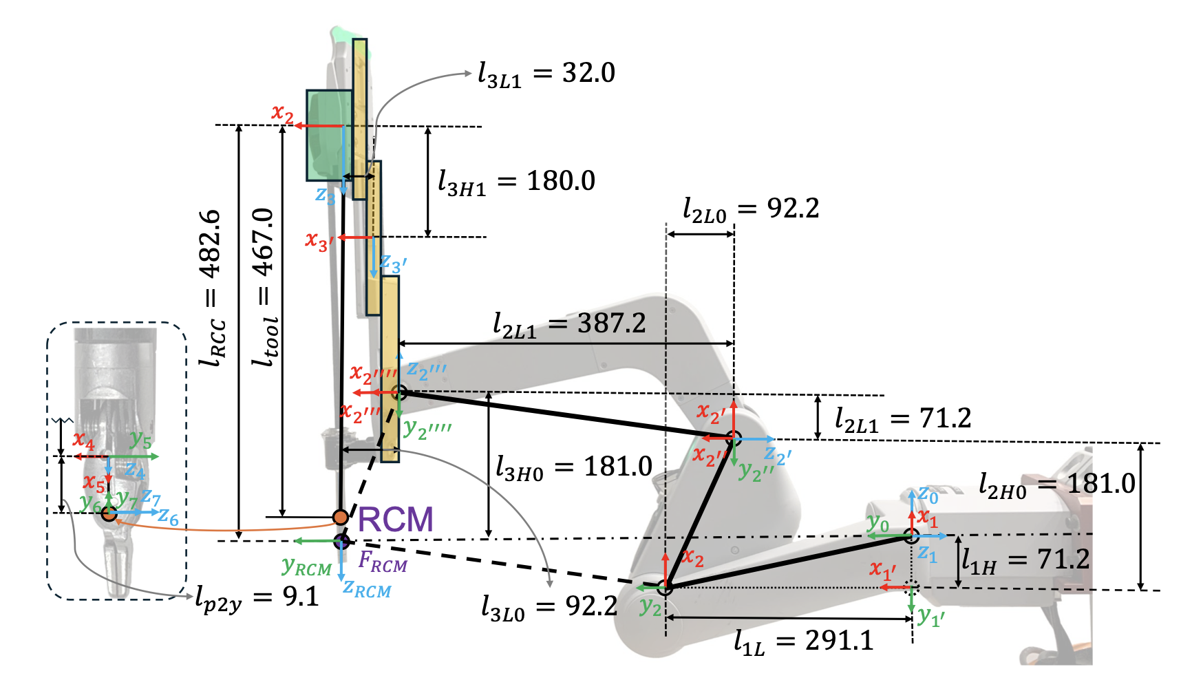
Next release: Si Gravity Compensation
Si PSM and ECM are heavy
Current implementation has no gravity compensation nor PID feed forward, leading to stiff and a bit jittery control, arms heavy in manual mode
Two working groups
Full dynamic parameter identification: Haoying (Jack) Zhou (JHU/WPI) and Hao Yang (VU)
https://github.com/jackzhy96/dVRK_Si_PSM_gravity_compensation
https://arxiv.org/abs/2501.19058
Static forces only: Brendan Burkhart (JHU)
Sufficient for manual mode and better PID control
No added code to the dVRK stack (included in cisstRobot)
Soon in devel branch

Slide 29
Next release: Bilateral Teleoperation
Position/velocity
MTM
Force
PSM
Position/velocity
All the same features as existing unilateral teleop (clutch, head sensor/operator pedal, etc.)
Loaded as plugin via config, so can be used out of the box simply by modifying console configuration
Default force estimation based on actuator efforts, but can be configured to use custom source, e.g., a force sensor
Based on previous implementation from:
Yilmaz et al, "Sensorless Transparency Optimized Haptic Teleoperation on the da Vinci Research Kit", IEEE RAL, 2024.
Force

Slide 30
Next release: Bilateral Teleoperation
Position/velocity
MTM
Force
PSM
Position/velocity
Force
Provides ROS topics to switch between unilateral and bilateral modes on the fly
C++ code is self-contained and can be easily extended/customized if desired
Documentation and example/template configs can be found in https://github.com/brendanburkhart/sawIntuitiveResearchKit/tree/feature-bilateral-teleop/ros/examples/bilateralTeleop - should be in sawIntuitiveResearchKit devel soon!

Slide 31
dVRK Consortium and Community

Slide 32
Potential dVRK Events
Conference workshops/tutorials
dVRK PI Meeting
Currently every ~6 months
dVRK User Group Meeting
Detailed hardware/software updates, best practices, etc.
In person, often opportunistic when conference at dVRK site (e.g., Hamlyn at Imperial College, IROS in Vancouver/UBC)
Have not held one since pandemic
Other
School, challenge, …

Slide 33
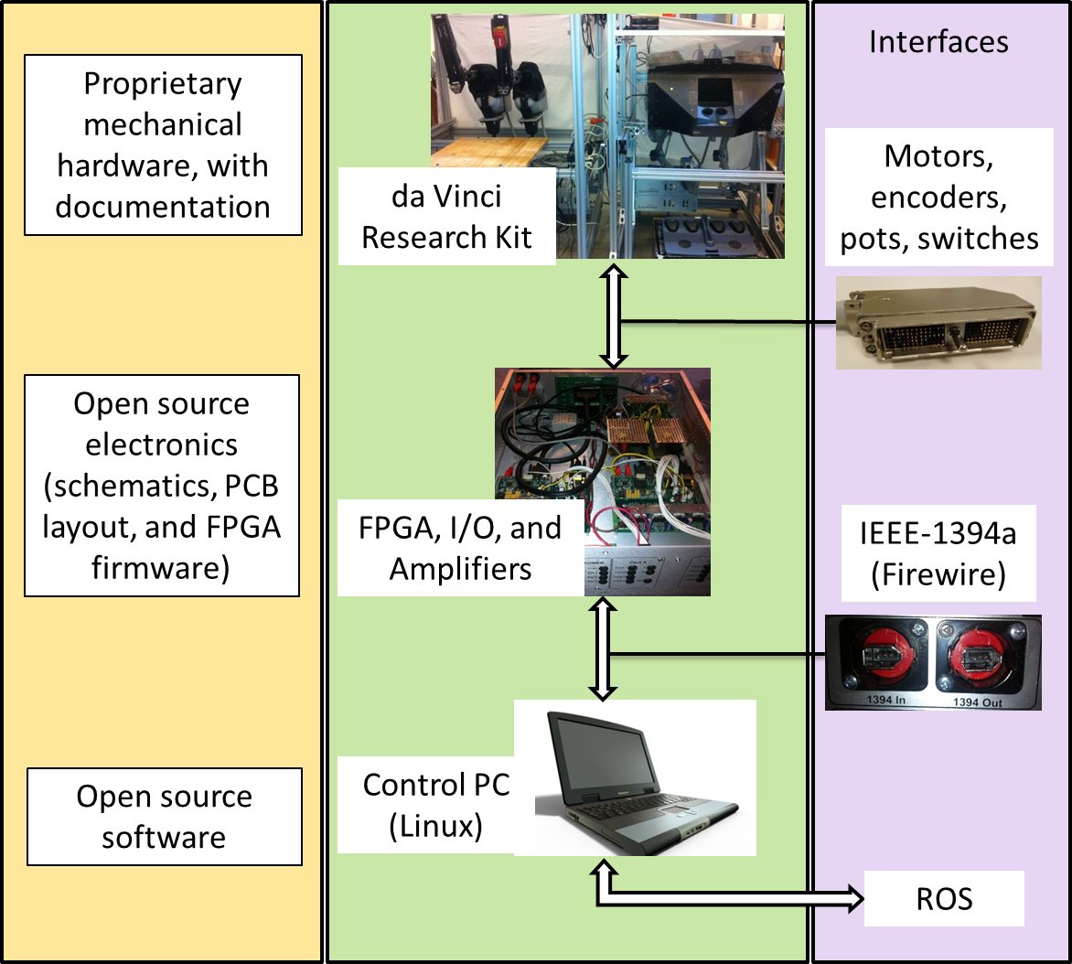
dVRK Background and Support
Routine Electronics Tasks:
Generate quotes [Greg, MMC]
Manufacturing support [Peter/Greg, JHU/MMC]
Vendor payments [Greg, MMC]
Shipping [Greg, MMC]
User support [Peter/Anton, JHU]
Routine Software Tasks:
System enhancements [Anton, JHU]
Extensive user support [Anton, JHU]

Slide 34
dVRK Consortium
Members sign a Consortium Agreement (with JHU) and pay a $5,000 initiation fee

Slide 35
Motivation for Non-Profit
Lifespan of dVRK is increased due to dVRK-Si (and potential future systems)
dVRK technical support is currently provided by JHU faculty/staff, but likely to become more distributed during the dVRK lifespan
Less dependent on policies of a large institution (e.g., to join dVRK Consortium)
Consolidate all activities, including production of controllers

Slide 36
Proposal
Set up non-profit, 501(c)(3), in state of Delaware
Name of non-profit must include:
association, foundation, society, union
company, corporation, club, fund, incorporated, institute, syndicate, limited
Naming considerations:
Should be clear that we are supporting research systems, and not providing medical devices (i.e., for clinical use)
Avoid being too similar to Open Source Robotics Foundation (OSRF)
Would need ISI input for use of “da Vinci” (or “dVRK”)
Future could include a broader mission (not just dVRK)

Slide 37
Some Possible Names
Medical Robotics Research Foundation
Association for Medical Robotics Research
Association for Research in Medical Robotics

Slide 38
Mission Statement
Our mission is to advance medical robotics research and education by supporting the creation and maintenance of shared platforms, including hardware and software, and by facilitating interaction and sharing of ideas between researchers.

Slide 39
Mission Statement (shorter)
Our mission is to advance medical robotics research and education by supporting the creation and maintenance of shared platforms and facilitating interaction and sharing of ideas between researchers.

Slide 40
Next Steps
Decide on non-profit name
Finalize mission statement
Create bylaws
Select board of directors
Incorporate as a nonprofit

