Slide 1



Software Infrastructure Review
Peter Kazanzides, Anton Deguet, Russell Taylor
Sept. 20, 2021

Slide 2
Where to find it?
GitHub, of course
GitHub organizations:
  jhu-cisst: cisst software, open source electronics, FPGA firmware
  jhu-saw: SAW components
  jhu-dvrk: dVRK software
  jhu-lcsr: Other LCSR software (machine learning, ROS)
Also, git.lcsr.jhu.edu

Slide 3
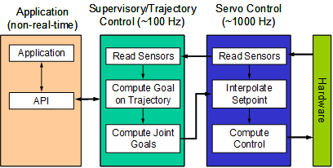
cisst/SAW Requirements
Real-time performance
  hierarchical multi-rate control
  multi-threaded (single process) or multi-process
Portable (Linux, Windows, …)
Reusable components
Plug & play of devices

Slide 4
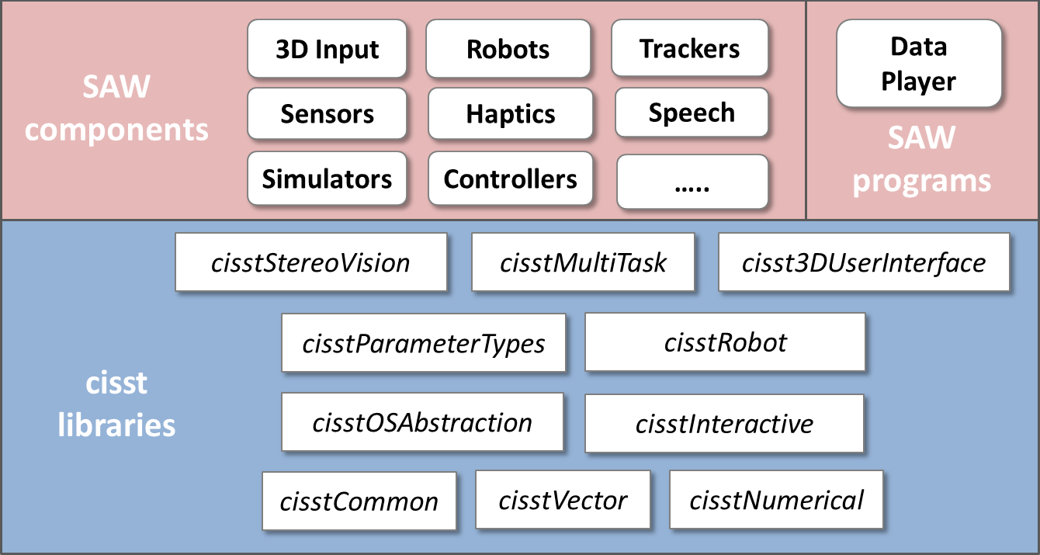
cisst/SAW Overview

Slide 5
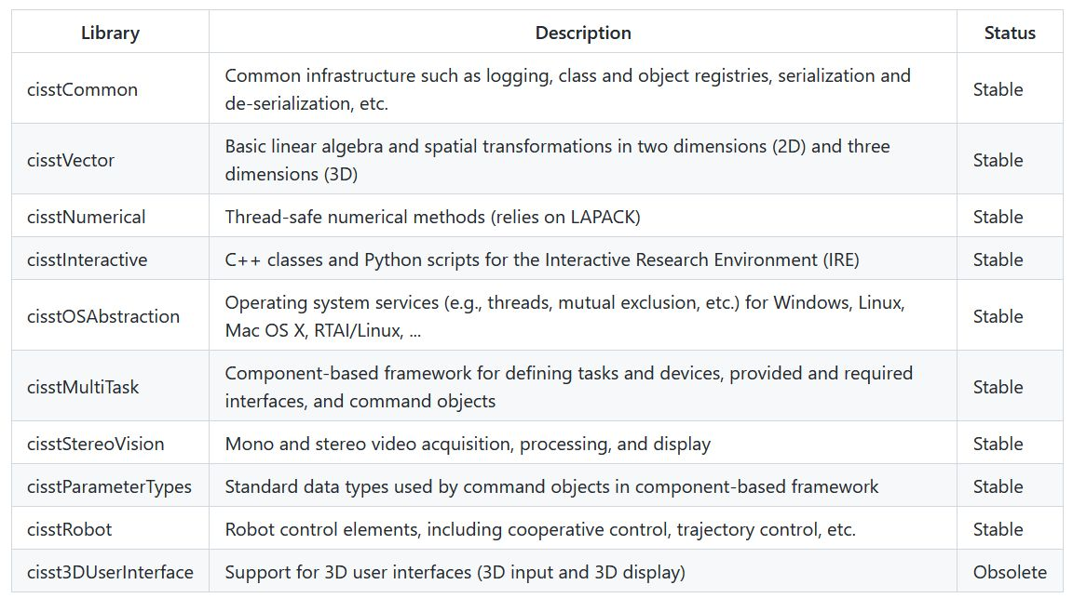
cisst libraries
Alternatives today
Eigen
C++ 14/17/20?
Boost?
Orocos RTT
Orocos KDL

Slide 6
Component-based software
Software component: “an independently deployable executable unit of composition” (Szyperski, 1998)
C1
Required Interface
Provided Interface
C4
Required Interface
C2
Required Interface
Provided Interface
Required Interface
C3
Required Interface
Analogous to electronic circuit design
Robot Operating System (ROS) also uses a component-based software architecture

Slide 7
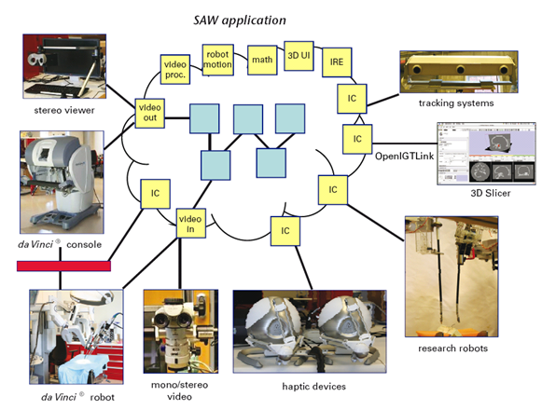
Surgical Assistant Workstation (SAW)

Slide 8
Components: dVRK on Linux with ROS
Publishers
Subscribers
QtConsole
Console
ROS console
sawQtTeleop
mtsTeleoperation
mtsTeleoperation
ROS teleoperation
QtPSM
ROS psm
MTM
PSM
MTM
PSM
QtMTM
ROS mtm
sawQtPID
mtsPID
mtsPID
mtsPID
mtsPID
MTML
PSM1
MTMR
PSM2
sawQtIO
mtsRobotIO1394
ROS io
QtWidget component (optional)
Single thread
SAW component
provided
required
ROS component (optional)

Slide 9
Components: dVRK on Linux with ForceDimension haptic devices (VU)
Publishers
Subscribers
QtConsole
Console
ROS console
sawQtTeleop
mtsTeleoperation
mtsTeleoperation
ROS teleoperation
QtPSM
ROS psm
Sigma L
PSM
Sigma R
PSM
QtMTM
ROS mtm
sawQtPID
mtsPID
mtsPID
PSM1
PSM2
sawQtIO
mtsRobotIO1394
ROS io
QtWidget component (optional)
Single thread
SAW component
provided
required
ROS component (optional)

Slide 10
Components: dVRK on Mac OS with IGTL
IGTL Server
QtConsole
Console
sawQtTeleop
mtsTeleoperation
mtsTeleoperation
QtPSM
IGTL psm
MTM
PSM
MTM
PSM
QtMTM
IGTL mtm
sawQtPID
mtsPID
mtsPID
mtsPID
mtsPID
MTML
PSM1
MTMR
PSM2
sawQtIO
mtsRobotIO1394
QtWidget component (optional)
Single thread
SAW component
provided
required
IGTL component (optional)

Slide 11
Components: dVRK with ROS 2 (beta)
Publishers
Subscribers
QtConsole
Console
ROS2 console
sawQtTeleop
mtsTeleoperation
mtsTeleoperation
ROS 2 teleoperation
QtPSM
ROS2 psm
MTM
PSM
MTM
PSM
QtMTM
ROS2 mtm
sawQtPID
mtsPID
mtsPID
mtsPID
mtsPID
MTML
PSM1
MTMR
PSM2
sawQtIO
mtsRobotIO1394
ROS2 io
QtWidget component (optional)
Single thread
SAW component
provided
required
ROS2 component

Slide 12
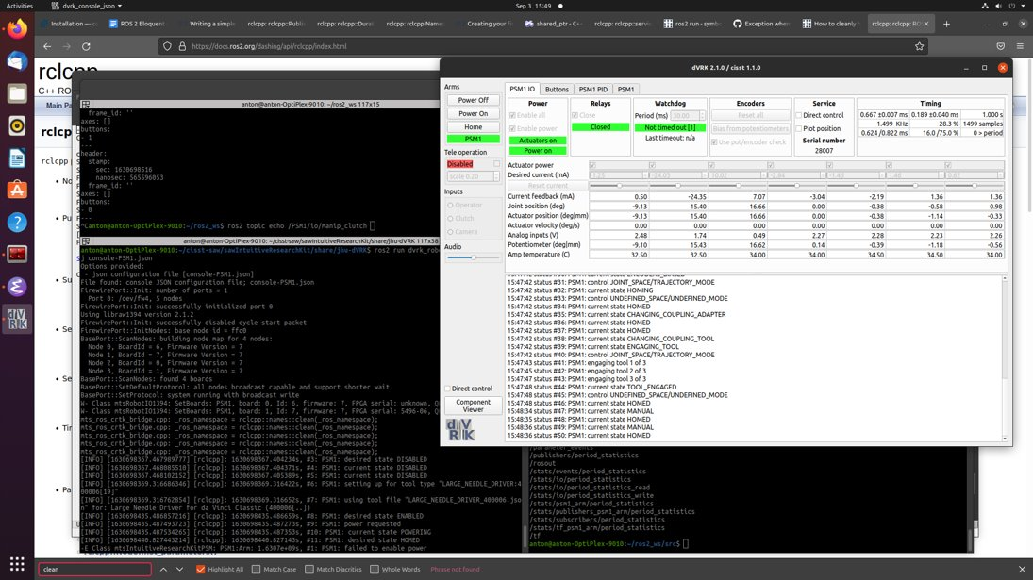
Components: ROS 2 (beta)

Slide 13
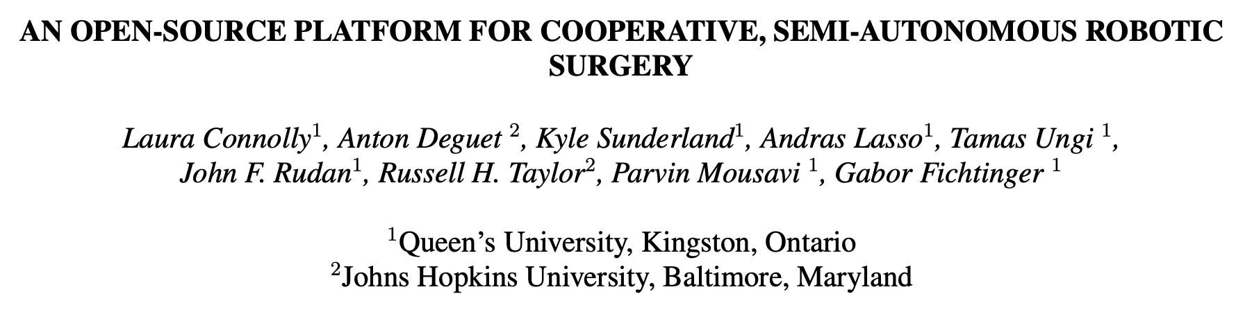
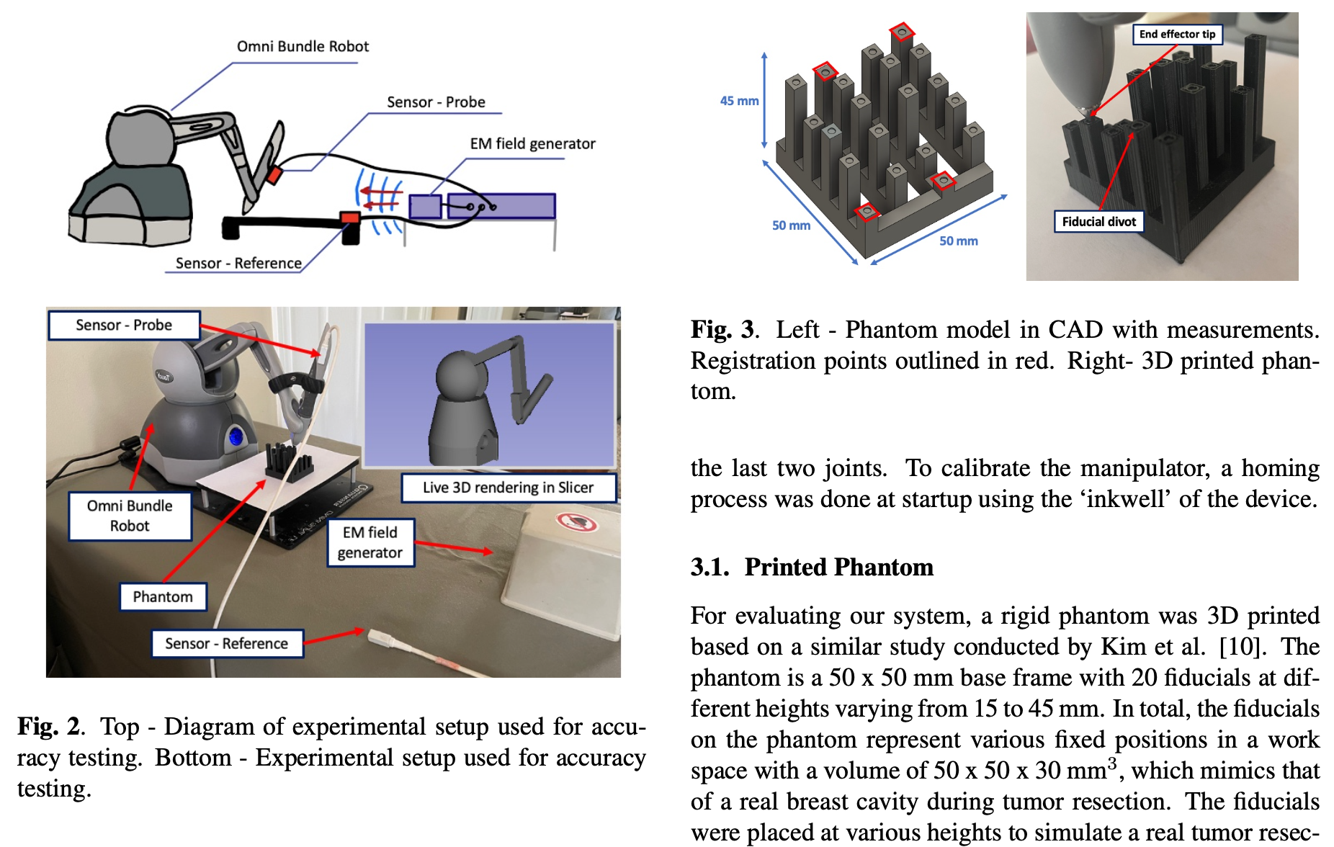
Components: sawSensablePhantom on Windows with IGTL and dynamic loading (Queens)
IGTL
Slicer
sawSensablePhantom
cisst IGTL

Slide 14
Technical Details
Safe, efficient and flexible multi-threading
cisst/SAW component model and types
Command pattern
Standardized interfaces (CRTK)

Slide 15
Multi-processing vs. multi-threading
Some consider that a software component must be a separate executable program (multi-processing)
  Example: ROS node
  (ROS added nodelets to provide multi-threading)
In cisst, software components are separate threads (multi-threading)
  Better real-time performance
  Must be careful about shared memory access (next slides)
  Requires middleware to use separate executables (more later)

Slide 16
Multi-threaded programming
A process may contain multiple threads that share the same memory
  Must be careful when accessing memory!
Simple example
Thread 1
Thread 2
Write
Robot position
Read
What happens if Thread2 attempts to read while Thread1 is writing?

Slide 17
Typical Solutions
Use a mutex to restrict access:
Thread 1
Lock mutex
Write
Unlock mutex
Lock mutex
Read
Unlock mutex
Thread 2
Robot position
Send a message (mailbox/FIFO/queue)
  Might use mutex for access to mailbox
Thread 1
Thread 2
Read
Robot position
Write
Robot position

Slide 18
Thread-safe interfaces
Task 1
Task 3
cmd
queue
queue
State Table
queue
state
New mailbox (queue) created for each connected interface
State Table
thread
event
queue
thread
Each State Table has a single writer and possibly multiple readers
Task 2
queue
queue
cmd
Usage | Command Types
cmd | void, write
state | read, qualified read
event | void, write
State Table
state
thread
queue
event
Events can also be immediate

Slide 19
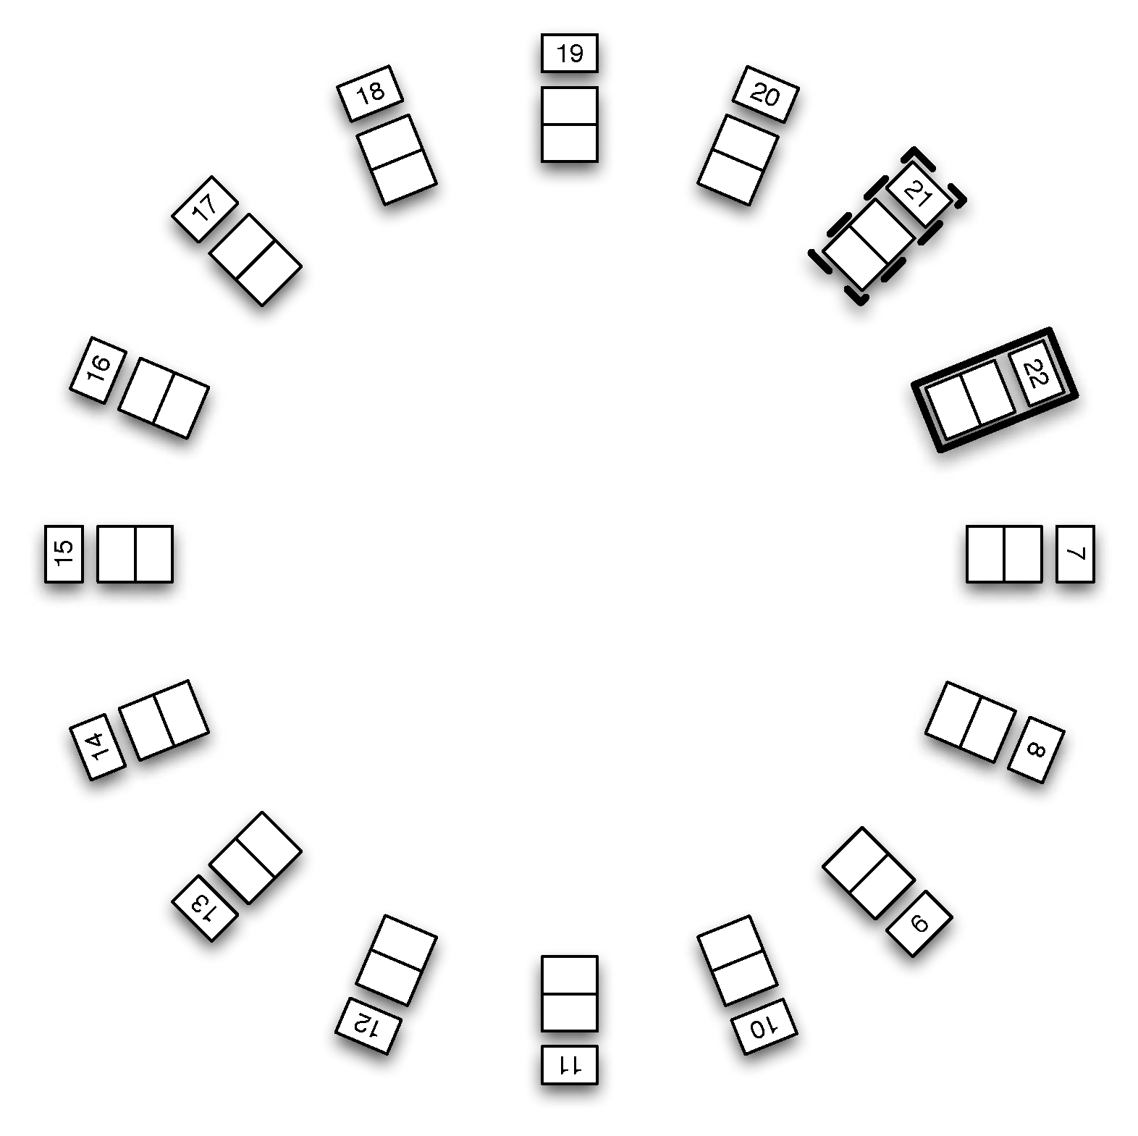
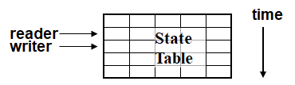
State Table views
Use circular (ring) buffers for data exchange
Buffers have single writer, so mutex not needed
Command pattern encapsulates details
read
write

Slide 20

cisst/SAW component model
<<component>>
mtsComponent
Provided
Interfaces
Required Interfaces
State tables
cisstMultiTask
Commands
Functions
<1…*>
Event
Generators
Event
Handlers
<0…*>
Component state
Input Interfaces
Output Interfaces
Buffer
cisstStereoVision
<0…*>
<0…*>
mtsTask derives from mtsComponent and adds a Run method, which is invoked by a thread
Most components derive from mtsTask (continuous, periodic, etc.)

Slide 21
cisst Component Types
mtsComponent: base class (no thread)
mtsTaskContinuous: continuously running task, using internal or external thread
mtsTaskPeriodic: periodic task, can be hard-real-time
mtsTaskFromSignal: executes when command or event received
mtsTaskFromCallback: gets thread from external callback
svlFilterBase: primarily uses input/output, relies on stream manager for thread(s)

Slide 22
Command Objects
mtsFunctionRead measured_js; // measured joint state
mtsFunctionVoid enable_motor_power;
mtsInterfaceRequired *required = AddInterfaceRequired(“robot”);
required->AddFunction(“measured_js”, measured_js);
required->AddFunction(“enable_motor_power”, enable_motor_power);
User
Task
Command 1
Resource
Task
Command A
Provided Interface
Required Interface
Command B
Command 2
Command 3
Command C
Command 4
Command D
(optional)
StateTable.AddData(m_measured_js, "measured_js");
mtsInterfaceProvided *provided = AddInterfaceProvided("control");
provided->AddCommandReadState(StateTable, m_measured_js, "measured_js");
provided->AddCommandVoid(&ServerTask::enable_motor_power, this, "enable_motor_power");

Slide 23
Command Pattern Implementation
Command objects are strongly typed:
  Void, Read, Write, QualifiedRead (Conversion)
Command names and actual parameter types should be standardized for dynamic reconfiguration (plug and play)
  Collaborative Robotics ToolKit (CRTK) – more soon

Slide 24
Events
User
Task
Provided Interface
Resource
Task
Event handler A
(command)
Required Interface
Event name 1
Trigger command
Event handler B
(command)
Event name 2
Trigger command
Event name 3
Trigger command

Slide 25
Standardization for plug & play
Standardized names and payloads (I.e. command signature)
In practice, APIs tend to grow organically
dVRK example:
C++ | ROS topic | Python Client | Matlab Client
GetPositionCartesian | position_cartesian_current | get_current_position | position_current
GetPositionCartesianDesired | position_cartesian_desired | get_desired_position | position_desired
SetPositionCartesian | set_position_cartesian | move (interpolate = False) | move (interpolate = False)
SetPositionGoalCartesian | set_position_goal_cartesian | move | move

Slide 26
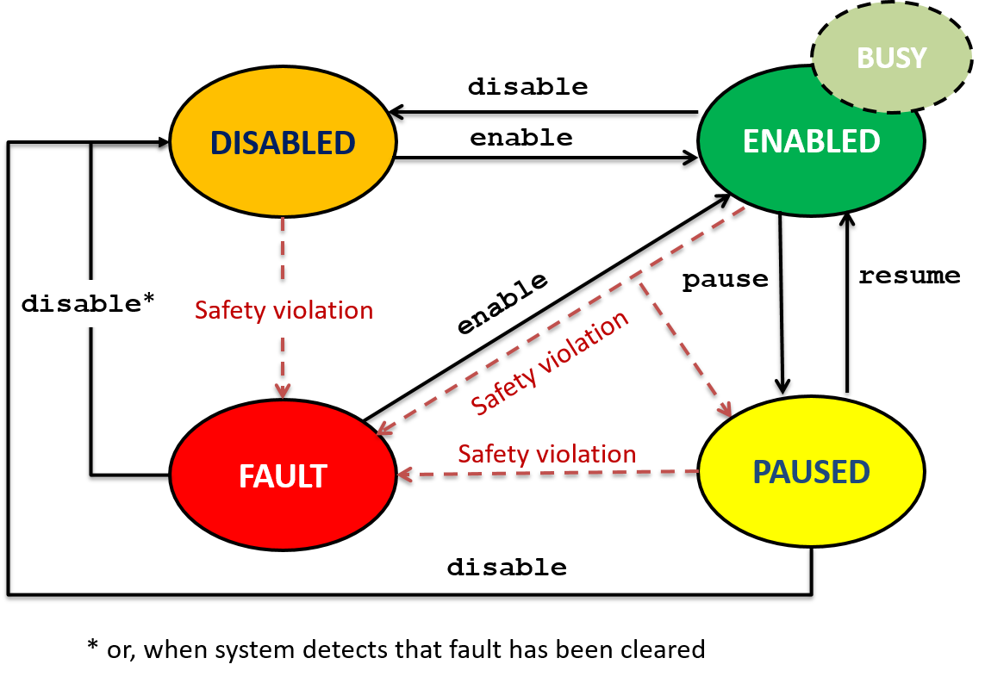
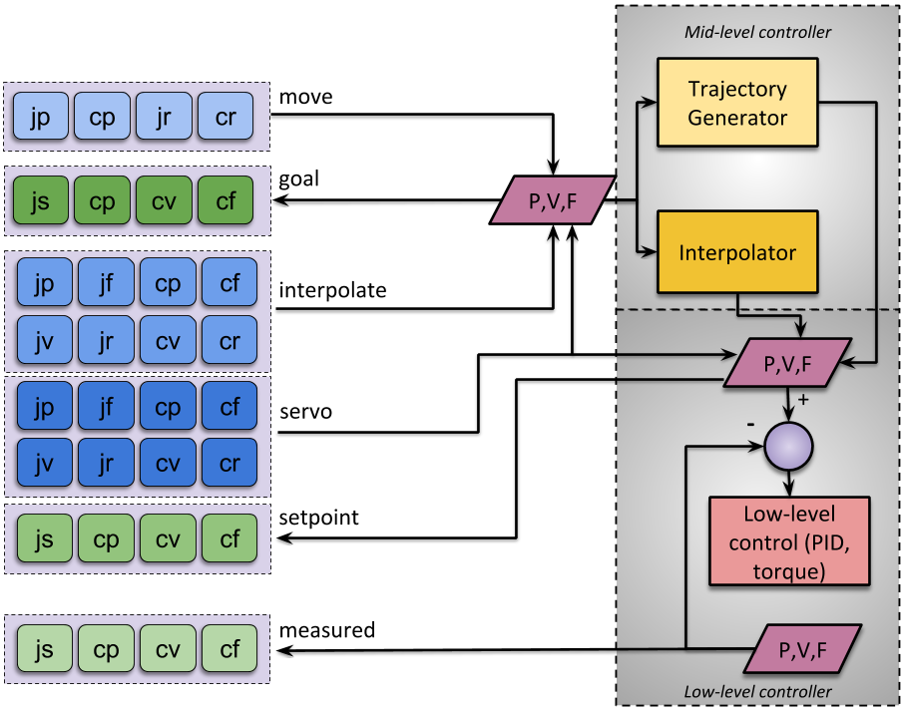
Collaborative Robotics Toolkit (CRTK) https://collaborative-robotics.github.io - JHU, UW and WPI
Operating State Commands
Motion Commands

Slide 27
Documentation for cisstMultiTask
GitHub:
https://github.com/jhu-cisst/cisst/wiki
Concepts:
https://github.com/jhu-cisst/cisst/wiki/cisstMultiTask-concepts
Tutorial:
https://github.com/jhu-cisst/cisst/wiki/cisstMultiTask-tutorial
Doxygen:
http://jhu-cisst.github.io/cisst-saw-doxygen/html

Slide 28
Software Infrastructure Review (Continued)
Anton Deguet, Peter Kazanzides, Russell Taylor
Sept. 27, 2021

Slide 29
Previously on… cisstMultiTask components
<<component>>
mtsComponent
Provided
Interfaces
Required Interfaces
State tables
Commands
Functions
<1…*>
Event
Generators
Event
Handlers
<0…*>
Component state
mtsTask derives from mtsComponent and adds a Run method, which is invoked by a thread
Most components derive from mtsTask (continuous, periodic, etc.)

Slide 30
Previously on .. Collaborative Robotics Toolkit (CRTK) https://collaborative-robotics.github.io - JHU, UW and WPI
Operating State Commands
Motion Commands

Slide 31
Previously on… CRTK feedback and control
Control level | servo: direct real-time stream (pre-emptive) interpolate: interpolated stream (pre-emptive) move: plan trajectory to goal (not pre-emptive)
Feedback | setpoint: current setpoint to low-level control goal: most recent interpolate or move goal measured: sensor feedback measuredN: redundant sensor feedback (N=2, 3, …)
Space | _j: joint _c: cartesian
Type | p: position r: relative (incremental) position v: velocity; (t: twist) f: generalized force (e: effort, w: wrench) s: state (position, velocity, effort) feedback
Examples: servo_jf, setpoint_cp, measured2_js, etc.
See https://github.com/collaborative-robotics/documentation/wiki/Robot-API-motion

Slide 32
Inter-Component Communication
Within process, cisst uses internal mechanisms (state table and queues)
Between processes, require proxy or bridge objects
Client
Server
Client
Client
Bridge
Server
Bridge
Server
Middleware

Slide 33
Bridge Component Options
Internet Communication Engine (ICE)
  original implementation, now obsolete
Raw Sockets (UDP)
Robot Operating System (ROS)
OpenIGTLink
Others…
Client
Client
Bridge
Server
Bridge
Server
Middleware
Possible data conversions (cisst-to-middleware and middleware-to-cisst)

Slide 34
Robot Operating System (ROS) as middleware
Pros: widely used in robotics, can interface to many other packages
Cons: Ubuntu Linux only (ROS 1), migration to ROS 2 has been very slow but will add Windows and MacOS
Other ROS nodes
Create ROS bridges and then make connections
Client
Client
Bridge
(cisst /ROS conv.)
Server
Bridge
(cisst/ROS conv)
Server
ROS

Slide 35
cisst vs ROS: Data Types
All middleware packages require methods to serialize/deserialize data
  ROS: msg files
  cisst: cdg files (cisstDataGenerator)
These files describe the data types, and are parsed to create support code, such as serialization/deserialization
cisst:
  cisstDataGenerator is a newer feature, so some older cisst data types have manually created support code (https://github.com/jhu-cisst/cisst/wiki/cisstCommon-Data-Generator)
  cisst standardized payloads are defined in the library cisstParameterTypes and names use the prefix prm

Slide 36
cisst vs ROS: Execution Model
cisst | Trigger | ROS (Topics) | Trigger
Read Command | Consumer | Publisher | Producer
Void Command | Consumer | Subscriber with empty message | Consumer
Write Command | Consumer | Subscriber | Consumer
Void Event | Producer | Publisher with empty message | Producer
Write Event | Producer | Publisher | Producer
Design decision for cisst read commands:
cisst Read commands are usually associated to data in state tables refreshed periodically
Continuously publish the data using the read command

Slide 37
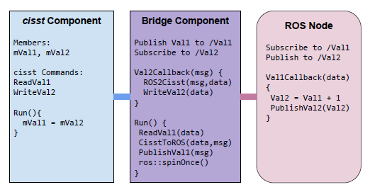
System Integration via ROS: overview
cisst-ROS Bridge component basic feature

Slide 38
cisst components and ROS
Server bridge connects to a provided interface and subscribes/publishes to ROS topics and services
  ROS bridge creates a required interface
  cisst commands to read from server and publish to ROS (producer trigger)
  cisst events to publish to ROS
  cisst commands to receive ROS topics and write to server
Client bridge can also connect to a required interface
  ROS bridge creates a provided interface
  cisst read functions access a state table populated by a ROS subscriber (consumer trigger)
  cisst events triggered by ROS subscribers
  cisst write functions to publish to ROS
Server
Bridge
cisst-ROS
Server
Client
Client
Bridge
cisst-ROS

Slide 39
cisst components and ROS
Proxy needs to be handwritten for a given set of commands
Use or derive class mtsROSBridge
Add publishers and subscriber using base class methods to bridge a provided interface:
  AddPublisherFromCommandRead
  AddPublisherFromEventWrite
  AddSubscriberToCommandWrite
To bridge a required interface:
  AddSubscriberToCommandRead
  AddSubscriberToEventWrite
  AddPublisherFromCommandWrite

Slide 40
cisst components and ROS
Conversion methods
  Use provided ones for cisst standard types
  Add your own for custom types and ROS messages by overloading mtsCISSTToROS or mtsROSToCISST
Timestamps
  Most cisst data types have a timestamp
  When ready to publish, use the cisst age and subtract for ros::now() to update ROS timestamp
Valid flag
  Most cisst data types have a valid flag
  No equivalent in ROS, bridge skips publishing if the data is not valid
  ROS user must check age of data when receiving

Slide 41
cisst components and ROS
Services
  Support for triggers
  Example to query forward kinematics:
  bridge->AddServiceFromCommandQualifiedRead
  <vctDoubleVec, vctFrm4x4, cisst_msgs::QueryForwardKinematics>
  (interface_name, command_name, topic_name);
Tf2
  cisst data type prmPositionCartesianGet has two strings for reference and moving frames
  Can broadcast to tf2
  No support to subscribe to tf2 yet
Param
  No support yet
  No equivalent in cisst but could be added if needed

Slide 42
cisst-ROS: base bridge component examples
Add a publisher from a read command:
AddPublisherFromCommandRead
<prmPositionJointGet, sensor_msgs::JointState>
(interface_name, "measured_js" "my_robot/measured_js");
Add a subscriber to a write command:
AddSubscriberToCommandWrite
<prmPositionJointSet, sensor_msgs::JointState>
(interface_name, "move_jp", "my_robot/move_jp");
Add a publisher from an event:
AddPublisherFromEventWrite
<prmOperatingState, crtk_msgs::operating_state
(interface_name, "operating_state", "my_robot/operating_state");

Slide 43
Really?
No, I don't expect all users (nor myself) to…
  Remember all the methods available in mtsROSBridge
  Have fun with C++ templates
  Populate a ROS bridge for each and every component’s provided interface
But…
  It's important to understand what the ROS bridge can and can't do
  Some of you might be interested in the details of implementation
So, what now?
Forget cisst-ROS bridge, time to introduce the cisst-ROS-CRTK bridge!

Slide 44
cisst-ROS-CRTK bridge
Automating the whole ROS bridge creation:
A component with a proper CRTK interface will only use CRTK command names and corresponding payloads
cisstMultiTask components are self-describing, meaning that we can enumerate the interfaces and commands/events at runtime
So, cisst-ROS-CRTK bridge can automatically figure out which commands to bridge and how…
… if and only if the component is CRTK compliant!

Slide 45
cisst-ROS-CRTK bridge
Code is now:
crtk_bridge->bridge_interface_provided
(component, interface,
rosPeriod, tfPeriod);
CRTK ROS bridge class can be derived to add non-CRTK commands
cisst/SAW process
“CRTK” provided interface
“CRTK” required interface
cisst/SAW
device
cisst to ROS
bridge
ROS
CRTK

Slide 46
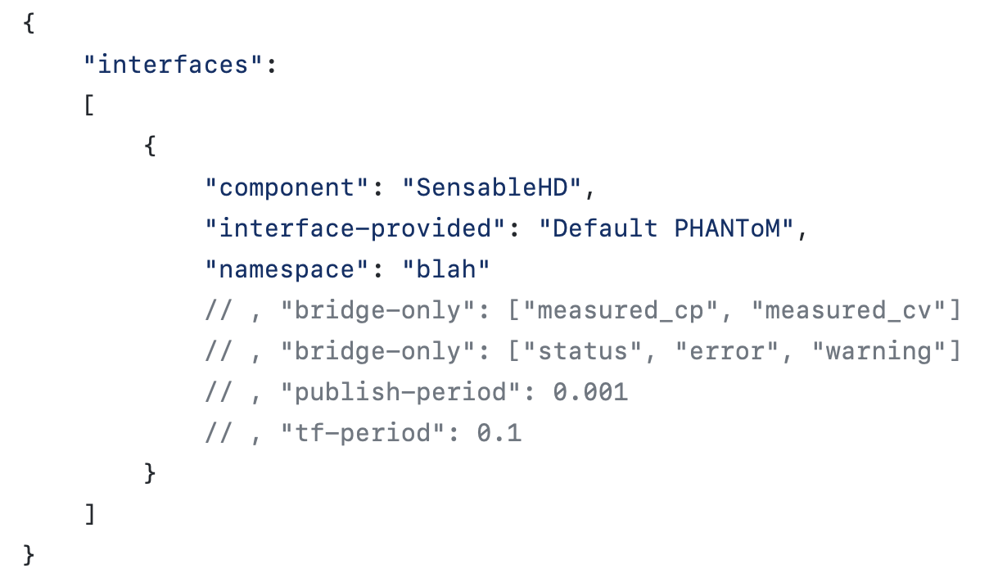
cisst-ROS-CRTK bridge
This can also be instantiated using JSON configuration files thanks to dynamic loading!

Slide 47
cisst-ROS-CRTK: threading
Multiple threads/mtsROSBridge:
  One for all events published to ROS, de-queuing as fast as possible
  One for all commands subscribed from ROS, de-queuing as fast as possible
  One for all tf2 broadcasts from cisst to ROS
  Multiple threads to publish from read commands (at least one per rate of publishing)
Performance:
  CRTK bridge also publishes internal interval statistics

Slide 48
cisst-ROS-CRTK: links
README:
  https://github.com/jhu-cisst/cisst-ros#readme
Links:
  Components (same repository):
    cisst-ROS: https://github.com/jhu-cisst/cisst-ros/tree/master/cisst_ros_bridge
    cisst-ROS-CRTK: https://github.com/jhu-cisst/cisst-ros/tree/master/cisst_ros_crtk
  Examples:
    https://github.com/jhu-saw/sawSensablePhantom/blob/master/ros/src/sensable_phantom.cpp (simple)
    https://github.com/jhu-dvrk/dvrk-ros/blob/master/dvrk_robot/src/dvrk_console.cpp (advanced)

Slide 49
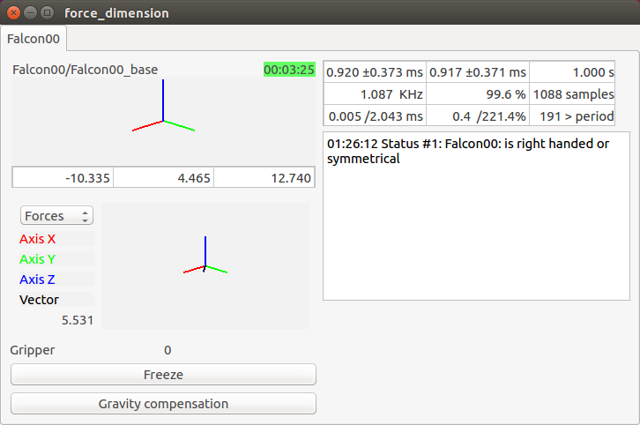
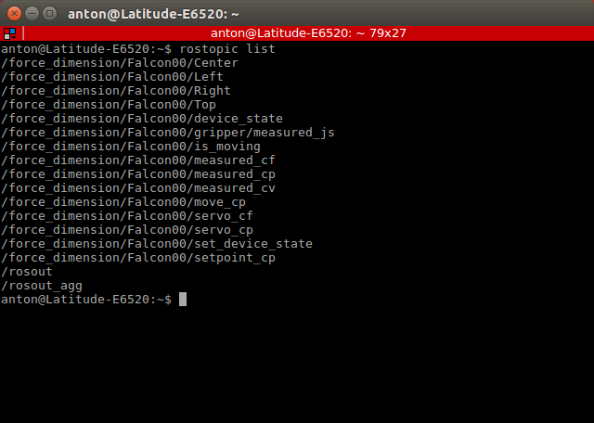
CRTK: What a device looks like?

Slide 50
CRTK ROS: Devices
Devices used to prototype the CRTK API:
  Sensable Omni, Novint Falcon and Force Dimension, dVRK, Raven2
Devices/platforms we plan to support:
  Devices: NDI trackers, Atracsys, ATINetFT, OptoForce
  Python and Matlab client APIs
  AMBF
  OpenIGTLink
Others:
  Micron Tracker, Universal Robot, Galil based JHU Robots

Slide 51
CRTK: ROS Client APIs
Motivation:
Simplify application development!
  Hide most of the ROS communication layer (callbacks, topic settings such as queue size and latching)
  Provide conversion methods from ROS messages to data types with proper algebra, e.g., apply a rotation to a vector
Add “high level” features
  Wait on events
  Operating state logic
  …

Slide 52
CRTK: ROS Python Client API
Design decisions (1/2)
Hide all rospy.Publisher, rospy.Subscribers…
Use convenient data types instead of ROS messages
  PyKDL for Cartesian position:
  f = PyKDL.Frame()
  f.p = 0.5 * measured_cp().p
  Numpy arrays for joints, twist, jacobian…
Use Python threads to provide blocking waits on events:
  Device state management: enable(timeout), disable(timeout)…
  Motion status: home(timeout), wait until robot is done moving…

Slide 53
CRTK: ROS Python Client API
Design decisions (2/2)
Populate the Python Client dynamically
  Add only the publishers and subscribers one needs
  Motivation:
    The CRTK device might not support all the features
    (This could be solved using ROS parameters)
    Subscribing to all features, including unused ones will likely degrade performances
    This is based on our previous experience on the dVRK
  Features can be added and removed anytime
Client APIs can be time consuming to implement but are now shared across all CRTK compatible devices!

Slide 54
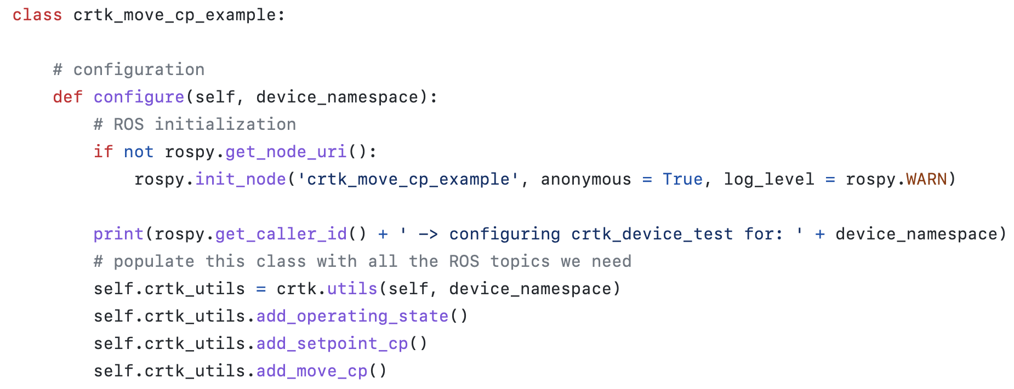
CRTK ROS: Python Client Example Configure

Slide 55
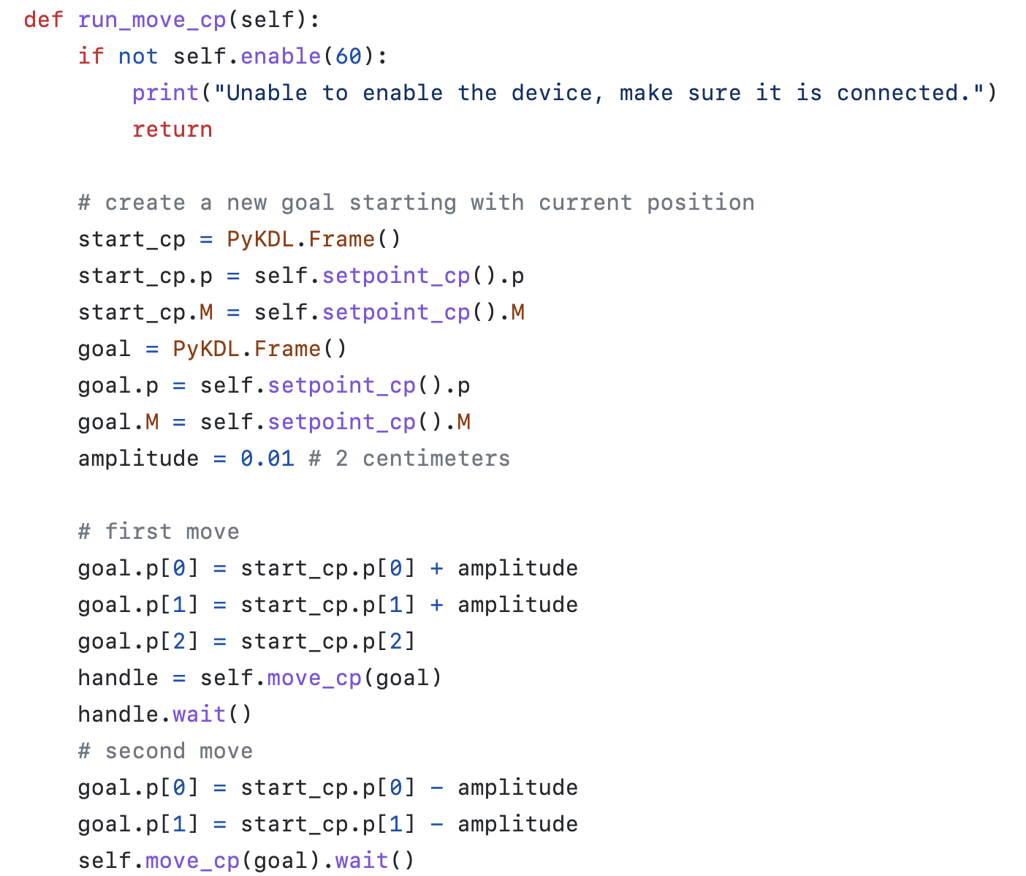
CRTK ROS: Python Client Example Move

Slide 56
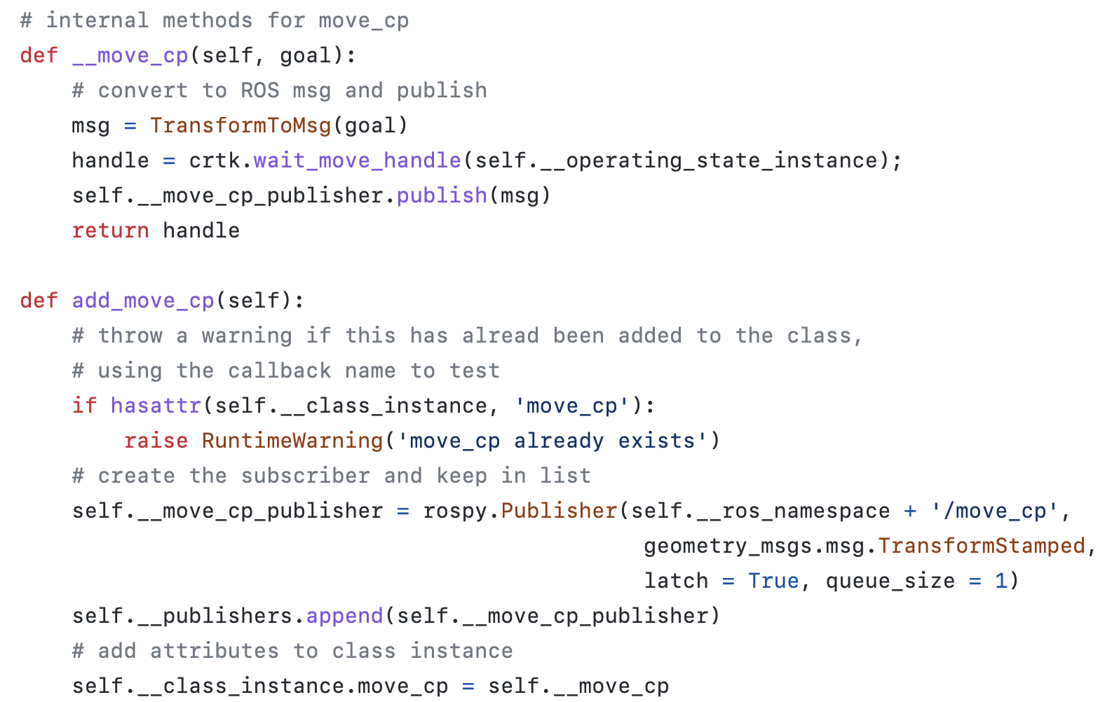
CRTK ROS: Python Client behind the scene
Actual method
Create publisher
Create “alias”

Slide 57
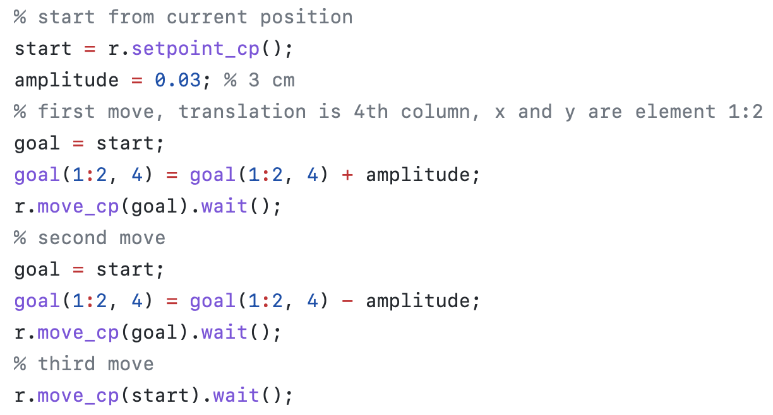
CRTK ROS: Matlab Client

Slide 58
CRTK Python and Matlab clients
Links to code repositories with READMEs
Libraries
  Python: https://github.com/collaborative-robotics/crtk_python_client
  Matlab: https://github.com/collaborative-robotics/crtk_matlab_client
Examples:
  dVRK Python: https://github.com/jhu-dvrk/dvrk-ros/tree/master/dvrk_python
  dVRK Matlab: https://github.com/jhu-dvrk/dvrk-ros/tree/master/dvrk_matlab
  Sensable: https://github.com/jhu-saw/sawSensablePhantom/tree/master/ros/python/sensable

Slide 59
cisst-ROS2-CRTK?
What needs to be updated?
Application code is the same for all devices and component logic!
cisst-ROS2 bridge mostly (and main.cpp)
Publishers
Subscribers
QtConsole
Console
ROS2 console
sawQtTeleop
mtsTeleoperation
mtsTeleoperation
ROS 2 teleoperation
QtPSM
ROS2 psm
MTM
PSM
MTM
PSM
QtMTM
ROS2 mtm
sawQtPID
mtsPID
mtsPID
mtsPID
mtsPID
MTML
PSM1
MTMR
PSM2
sawQtIO
mtsRobotIO1394
ROS2 io
QtWidget component (optional)
Single thread
SAW component
provided
required
ROS2 component

Slide 60
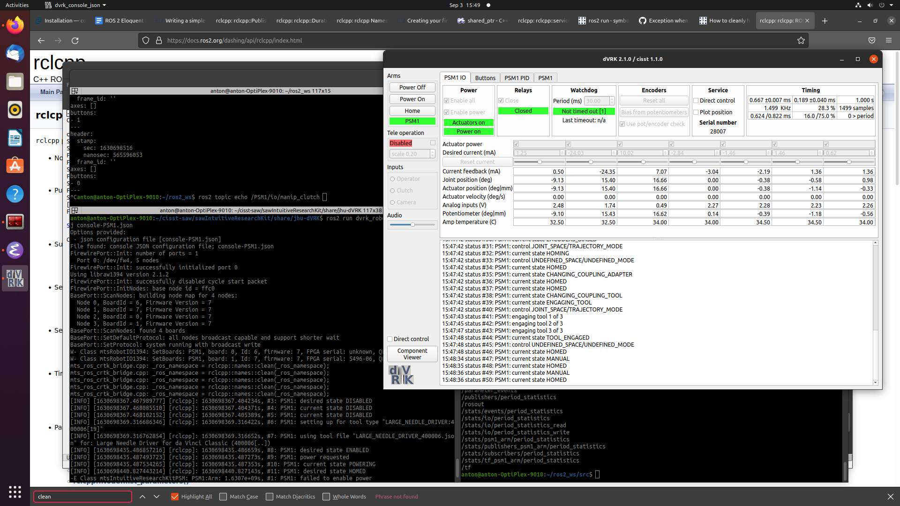
cisst-ROS2-CRTK!

Slide 61
cisst-ROS2-CRTK to do
Port CRTK Python and Matlab clients
  For users
  For systematic testing using the dVRK code base (latched messages issues?)
Document build process
  catkin is dead, long live ament colcon or whatever OSRF will come up with next month
  vcstool configuration files
  For non-ROS2 packages (cisstNetlib, cisst…), Debian packages or make; make install
Other ROS files
  dVRK URDF
  Launch files
Move repositories to GitHub organizations
  https://github.com/adeguet1/ros2_cisst_msgs to jhu-cisst
  https://github.com/adeguet1/ros2_crtk_msgs to collaborative-robotics
  https://github.com/adeguet1/cisst_ros2_bridge to jhu-cisst
  https://github.com/adeguet1/cisst_ros2_crtk to jhu-cisst
  https://github.com/adeguet1/dvrk_robot to jhu-dvrk

Slide 62
OpenIGTLink Middleware
Extensible, cross-platform, open-source research protocol for Image Guided Therapy
Often used to transfer medical images, endoscope video, and tool transforms
Supported by 3D Slicer
Bridge component in cisst/SAW for Windows, Linux and MacOS
Links (with README.md)
  Component: https://github.com/jhu-saw/sawOpenIGTLink
  Example: https://github.com/jhu-saw/sawSensablePhantom/tree/master/igtl
www.openigtlink.org
J. Tokuda, G. S. Fischer, X. Papademetris, Z. Yaniv, L. Ibanez, P. Cheng, H. Liu, J. Blevins, J. Arata, A. J. Golby, T. Kapur, S. Pieper, E. C. Burdette, G. Fichtinger, C. M. Tempany, and N. Hata, “OpenIGTLink: an open network protocol for image-guided therapy environment,” Intl. J. of Medical Robotics and Computer Assisted Surgery, vol. 5, no. 4, pp. 423–434, 2009.

Slide 63
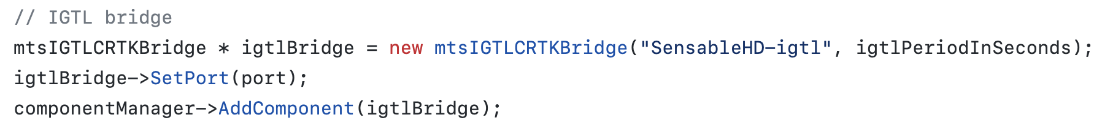
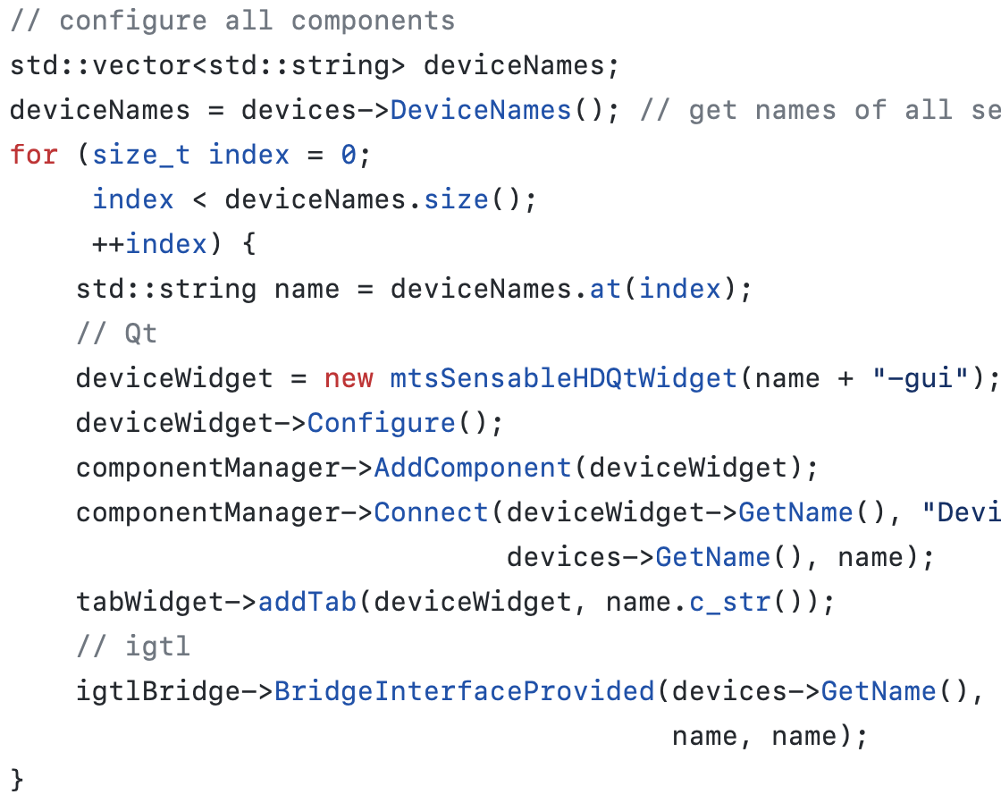
OpenIGTLink Middleware

Slide 64
CRTK: One Last Thing
Using existing controllers from ROS-control, work in progress!
  Why? Any CRTK device could have a MoveIt! Interface for “free”
  How? Implement at ROS control hardware_interface::RobotHW with:
    Read joint state: measured_js
    Control joints in:
      Position: servo_jp
      Velocity: servo_jv
  API level?
    ROS middleware:
    cisst/SAW:
ROS-CRTK
device
ROS control
ROS-CRTK RobotHW
MoveIt!
cisst/SAW process
Provided interface
Required interface
MoveIt!
cisst/SAW
device
ROS control
cisstCRTK RobotHW

Slide 65
CRTK: One Last Thing
Using ROS control future controllers
  JointCartesianTrajectory is clearly designed for MoveIt! joint trajectories, MoveIt! community might be interested in cartesian trajectories
Using ROS control for new CRTK controllers
  Take advantage of existing code base
  Increase potential user base (anyone who has a RobotHW implemented)
  Prime candidate would be interpolate_jp
  interpolate_cp might be harder to implement until ROS control supports cartesian space

Slide 66
Infrastructure Value Today
Good package for portable, multi-threaded, real-time systems (as real-time as feasible with the OS)
Middleware-agnostic component-based interfaces that are self-describing
Standardized interface conventions (CRTK)
The above two features enable (semi) automatic generation of middleware bridges (ROS 1, ROS 2, OpenIGTLink) and other interfaces (Python, Matlab)

