Slide 1




The da Vinci Research Kit (dVRK):
Research Highlights
Peter Kazanzides
Research Professor
July 15, 2024

Slide 2
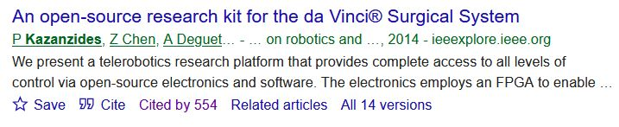
dVRK Research Review
C. D’Ettorre et al., “Accelerating Surgical Robotics Research: A Review of 10 Years With the da Vinci Research Kit,” IEEE Robotics & Automation Magazine, Dec. 2021.
+14 review papers
253 total publications
Google scholar,
July 14, 2024

Slide 3
Outline
Augmented reality for First Assistant (or laparoscopy)
Force estimation for bilateral teleoperation
Autonomous camera motion
AccelNet surgical robotics challenge

Slide 4
ARssist: Augmented Reality Assistance for Robotic Surgery

Slide 5
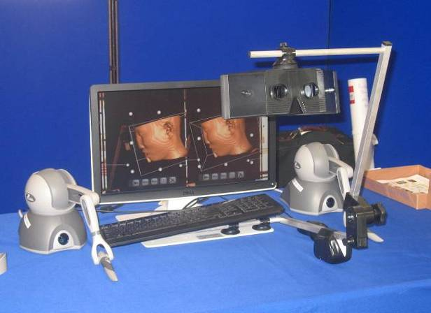
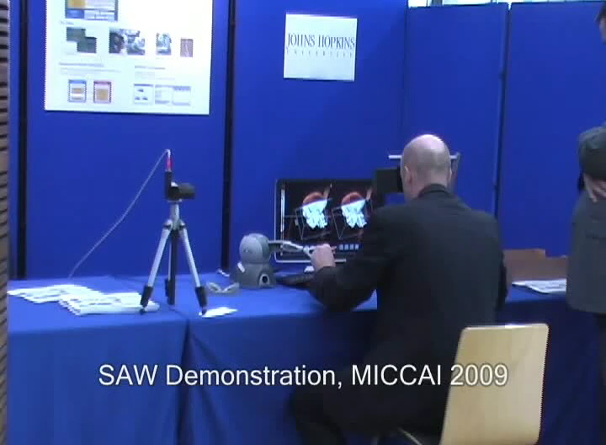
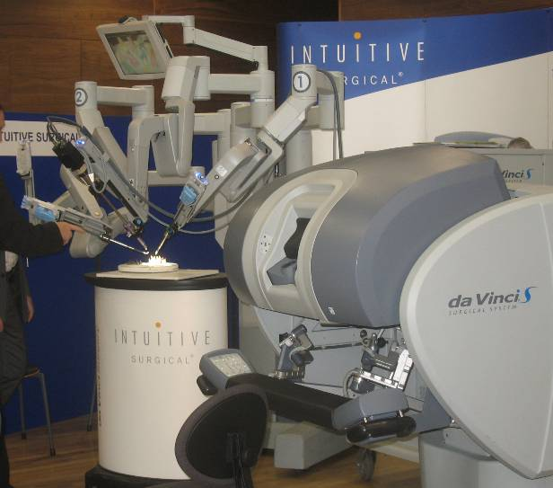
Augmented Reality on da Vinci Console

Slide 6
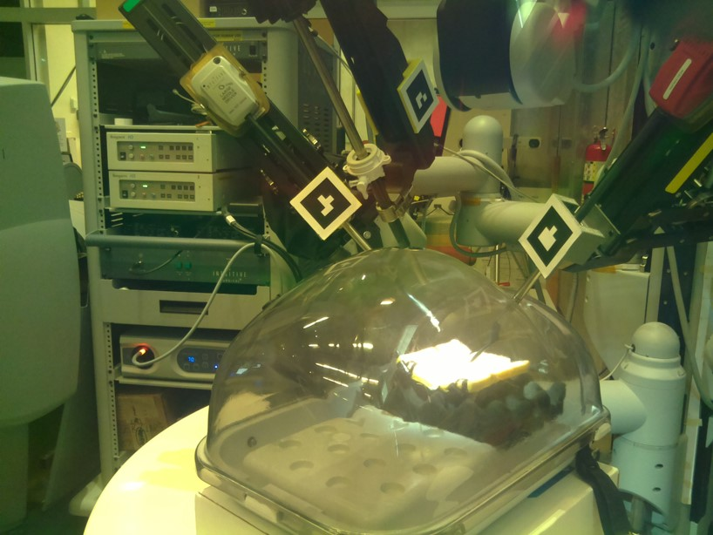
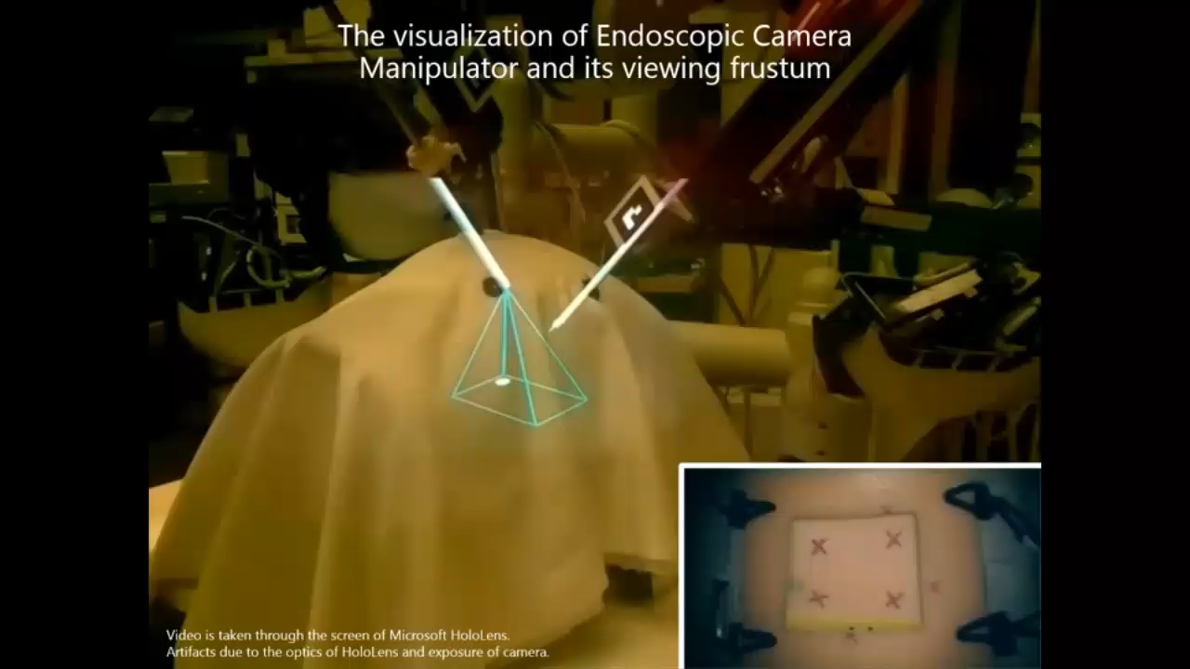
Augmented Reality for da Vinci Assistant
Setup with transparent abdominal phantom
View through HMD (HoloLens)
L. Qian, A. Deguet, P. Kazanzides, “ARssist: Augmented Reality on a Head-Mounted Display for the First Assistant in Robotic Surgery”, IET Healthcare Technology Letters, Oct. 2018
L. Qian, A. Deguet, Z. Wang, Y. Liu, P. Kazanzides, “Augmented Reality Assisted Instrument Insertion and Tool Manipulation for the First Assistant in Robotic Surgery”, IEEE ICRA, May 2019.
Supported by Intuitive Surgical Technology Research Grant, 2018

Slide 7
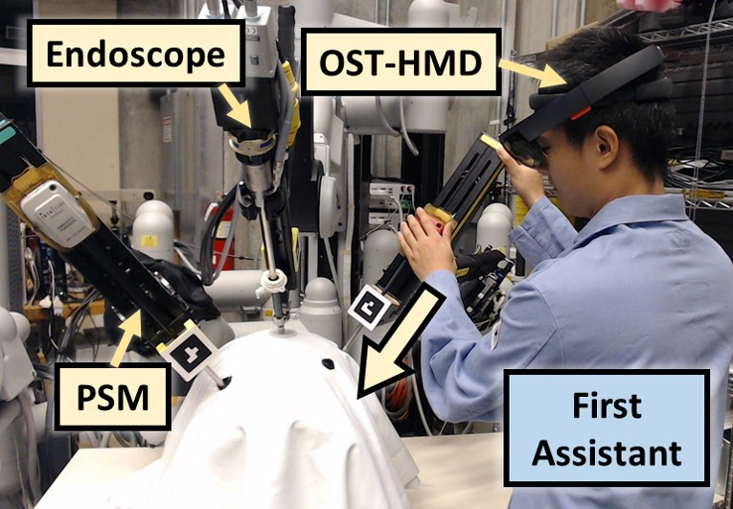
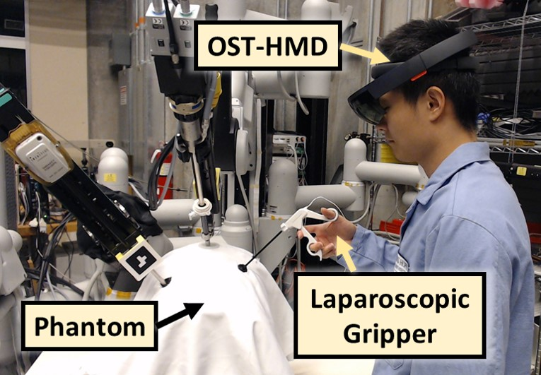
ARssist Evaluation
Instrument Insertion
3 Endoscope Positions: EP1, EP2, EP3 (easy to hard)
Experts (N=10)
Tool Manipulation
Novices (N=20)

Slide 8
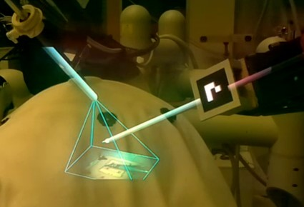
ARssist Limitations
Requires markers to be attached to da Vinci
  progress toward markerless tracking (ISMR 2023)
3D visualization of overlays (instrument models, endoscope frustum), but 2D visualization of anatomy
ARAMIS
(3D visualization of anatomy)

Slide 9
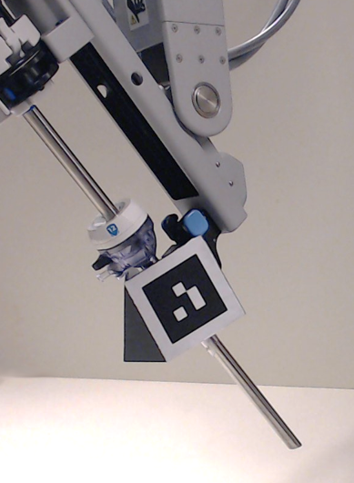
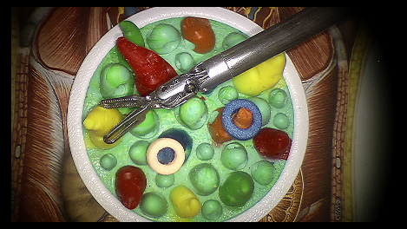
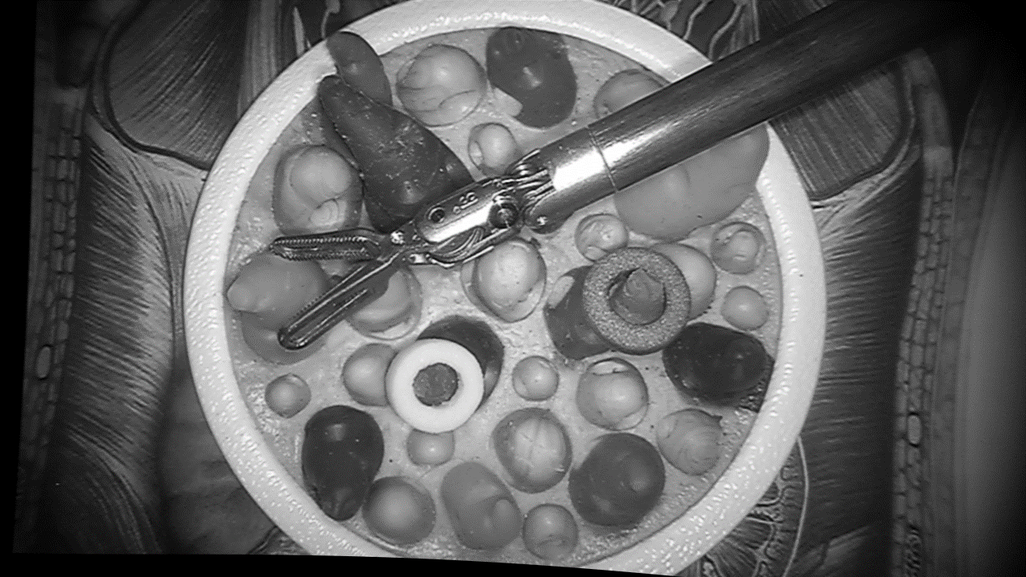
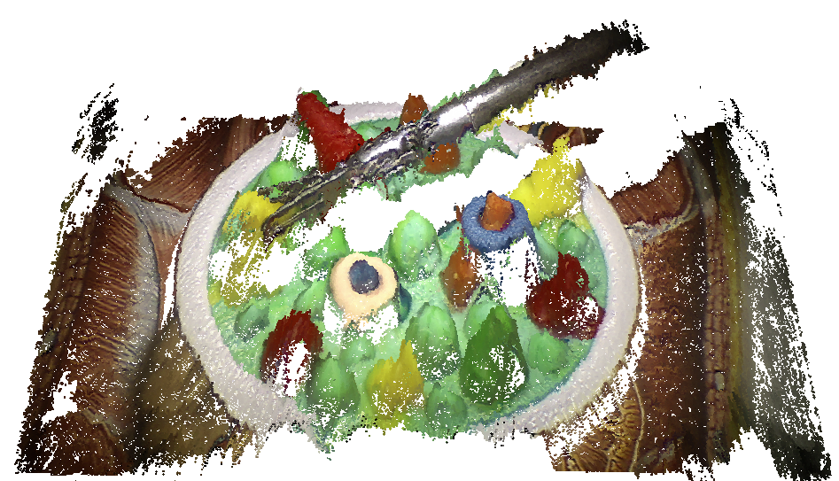
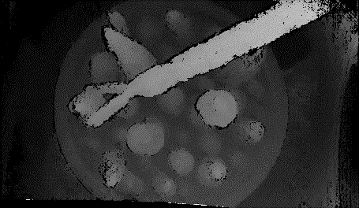
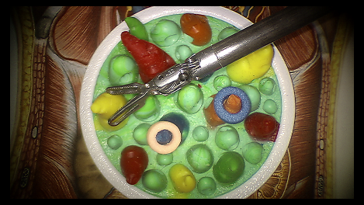
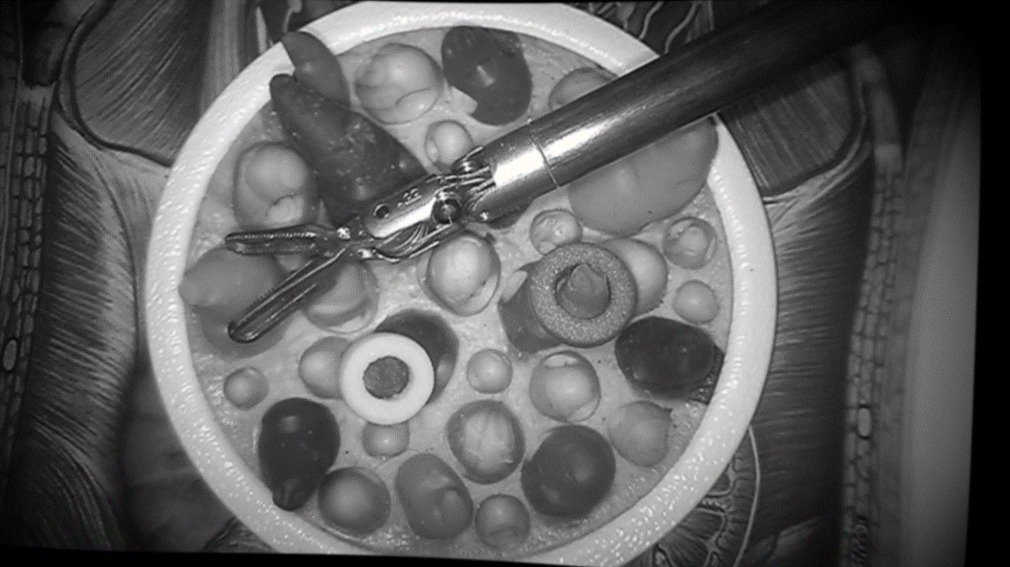
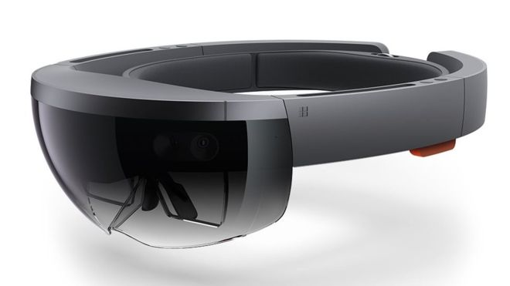

ARAMIS: System Pipeline
Semi-Global Matching
Scaling
Copy Raw Image to GPU
Rectification
Cropping
Frame Grabber
Subpixel Refinement
Grayscaling
Point Cloud Generation
Smoothing
Smoothing
Endoscope Tracking
Point Cloud Rendering
Point Cloud Streaming

Slide 10
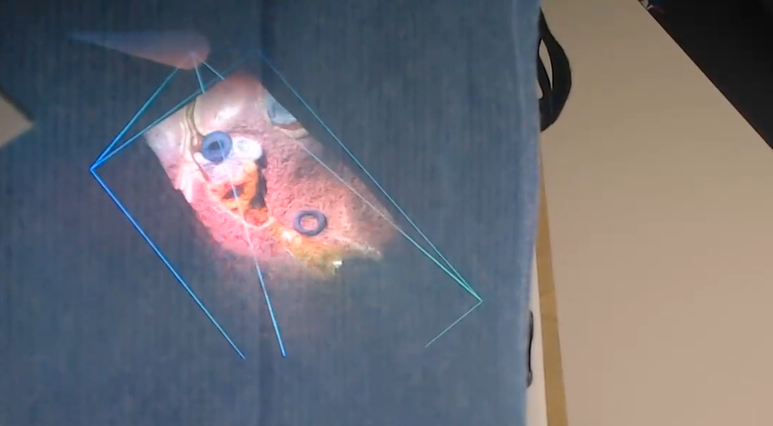
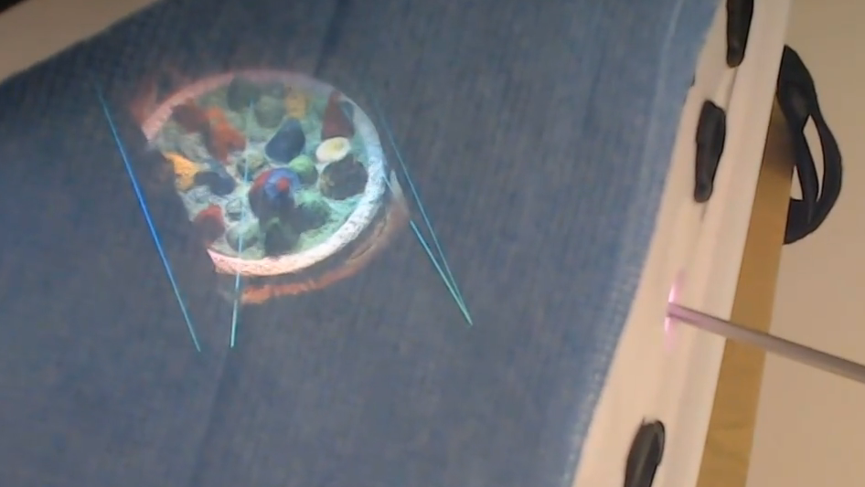
ARAMIS: Augmented Reality Assistance for MIS
2x
2x
L. Qian, X. Zhang, A. Deguet, P. Kazanzides. "ARAMIS: Augmented Reality Assistance for Minimally Invasive Surgery Using a Head-Mounted Display." MICCAI 2019.

Slide 11
ARAMIS Limitations
Does not work as well when human observation angle (virtual camera) is significantly different from real camera view
  Missing information
  Unrealistic reflections
FlexiVision
L. Qian, C. Song, Y. Jiang, Q. Luo, P.W. Chiu, Z. Li, P. Kazanzides, "FlexiVision: Teleporting the Surgeon’s Eyes via Robotic Flexible Endoscope and Head-Mounted Display." IROS 2020

Slide 12
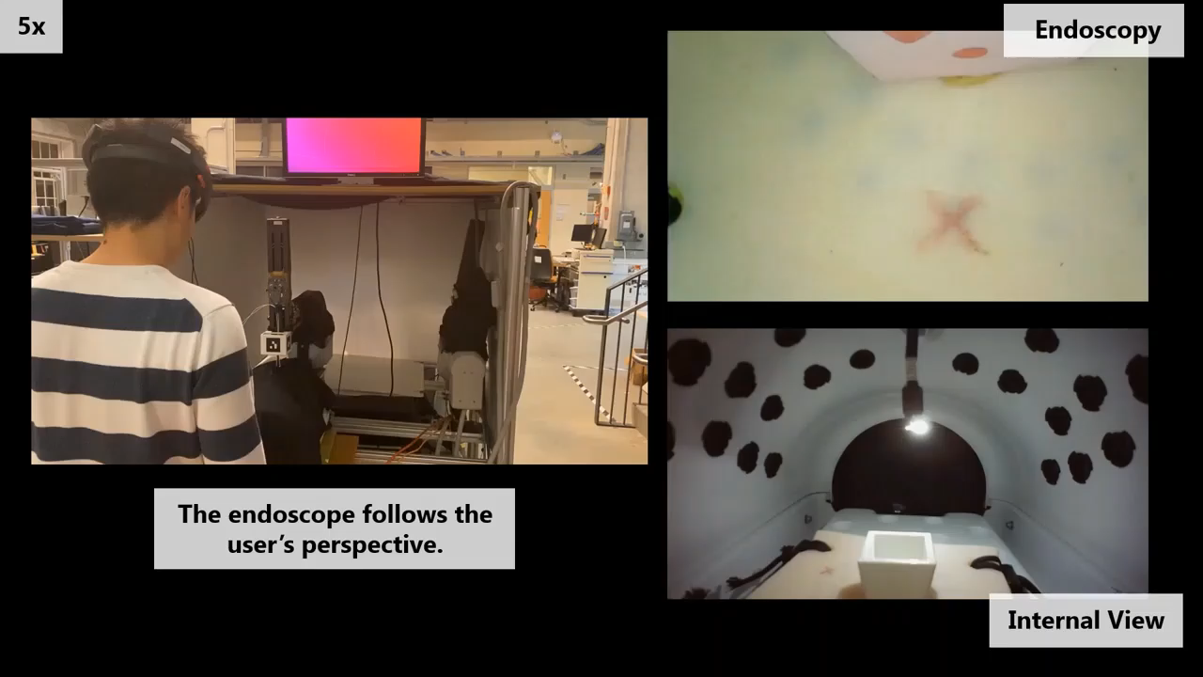
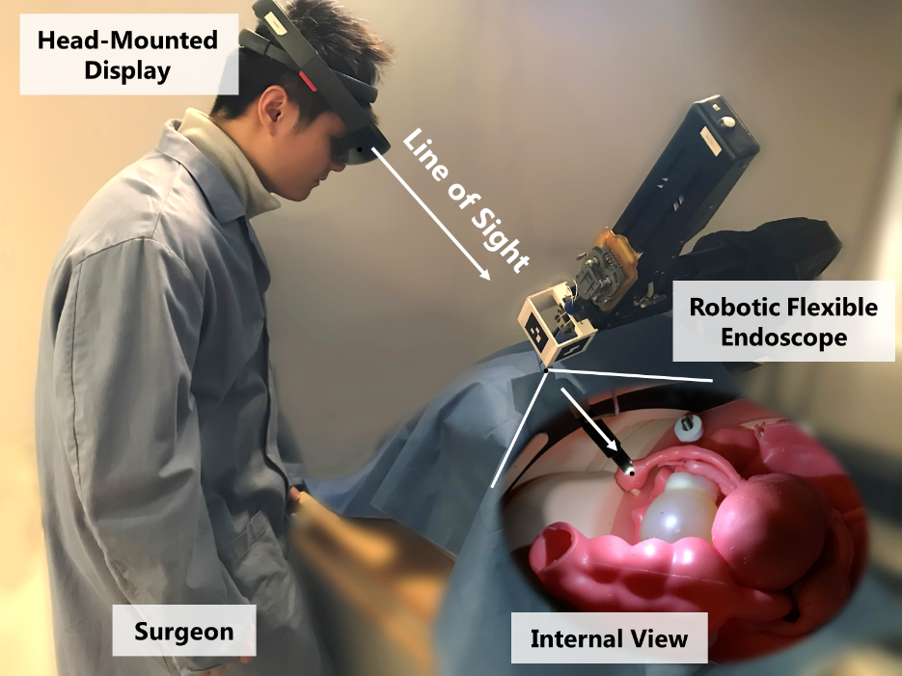
AR Control of a Flexible Endoscope
Control the perspective of a flexible endoscope
  Align with observer’s line of sight
AR visualization
L. Qian, C. Song, Y. Jiang, Q. Luo, P.W. Chiu, Z. Li, P. Kazanzides, "FlexiVision: Teleporting the Surgeon’s Eyes via Robotic Flexible Endoscope and Head-Mounted Display." IROS 2020

Slide 13
Outline
Augmented reality for First Assistant (or laparoscopy)
Force estimation and bilateral teleoperation
Autonomous camera motion
AccelNet surgical robotics challenge

Slide 14
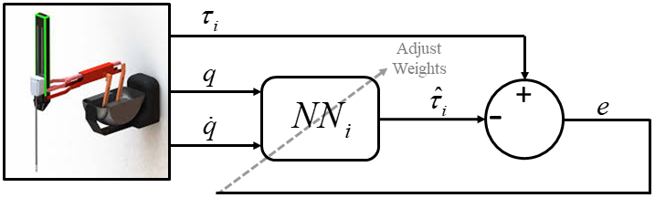
Force Estimation for dVRK
One frequently cited limitation of robotic surgery is the lack of high quality haptic/tactile/force feedback to the surgeon
  da Vinci 5 introduced force feedback for some instruments
One solution: add a force sensor
Another solution: estimate force from existing data (e.g., measured motor currents)
Robot dynamics:
Cartesian force/torque:

Slide 15
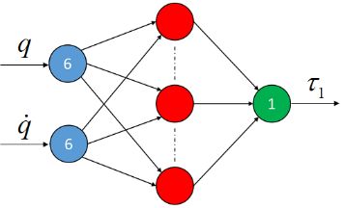





Neural Network for Dynamics Identification
1 NN for each joint
N. Yilmaz, J.Y. Wu, P. Kazanzides, U. Tumerdem “Neural network based inverse dynamics identification and external force estimation on the da Vinci Research Kit”, ICRA 2020.

Slide 16
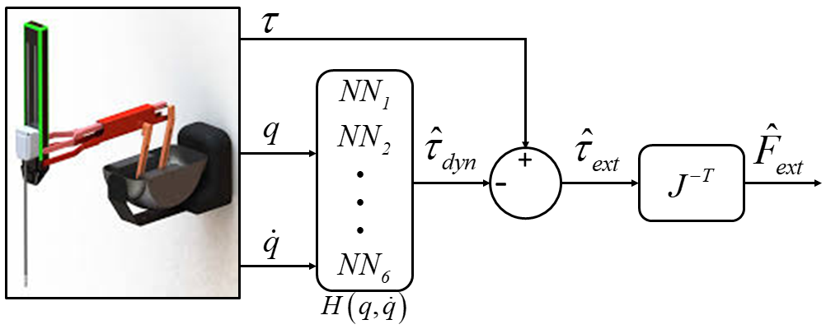
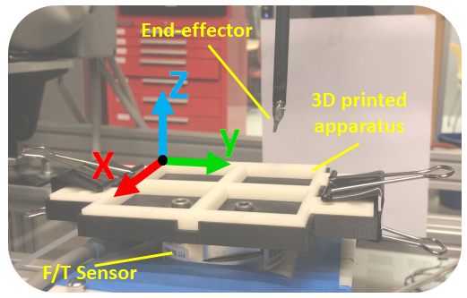
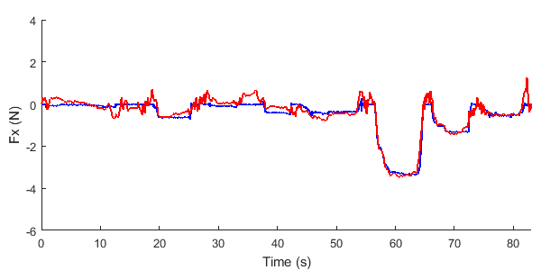
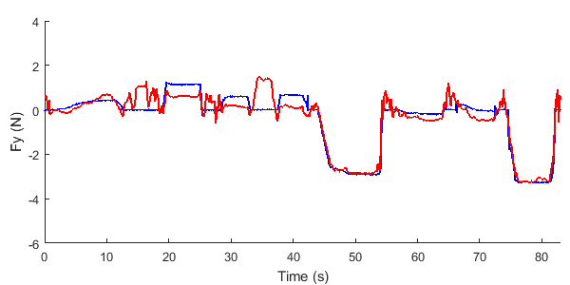
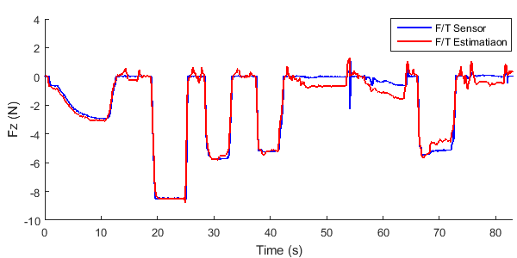
Force Estimation for dVRK

Slide 17
Bilateral Teleoperation
Improved low-level control (e.g., added disturbance observer)
Implemented 4-channel architecture for bilateral teleoperation
Four channel architecture
Low-level control improvements
N. Yilmaz, B. Burkhart, A. Deguet, P. Kazanzides, U. Tumerdem, “Sensorless Transparency Optimized Haptic Teleoperation on the da Vinci Research Kit”, IEEE RA-L 2023

Slide 18
Experimental Evaluation
Percentage of correct results when palpating phantom to identify stiffest one (12 subjects)
Hand | Direct palpation with human hand
Inst | Palpating with hand-held instrument
FS | Bilateral teleoperation with force sensor feedback
Dyn | Bilateral teleoperation with estimated force, with dynamic compensation (NN)
nDyn | Bilateral teleoperation with estimated force, without dynamic compensation
Uni | Unilateral teleoperation (no force feedback)
N. Yilmaz, B. Burkhart, A. Deguet, P. Kazanzides, U. Tumerdem, “Enhancing Robotic Telesurgery with Sensorless Haptic Feedback”, IJCARS (IPCAI) 2024

Slide 19
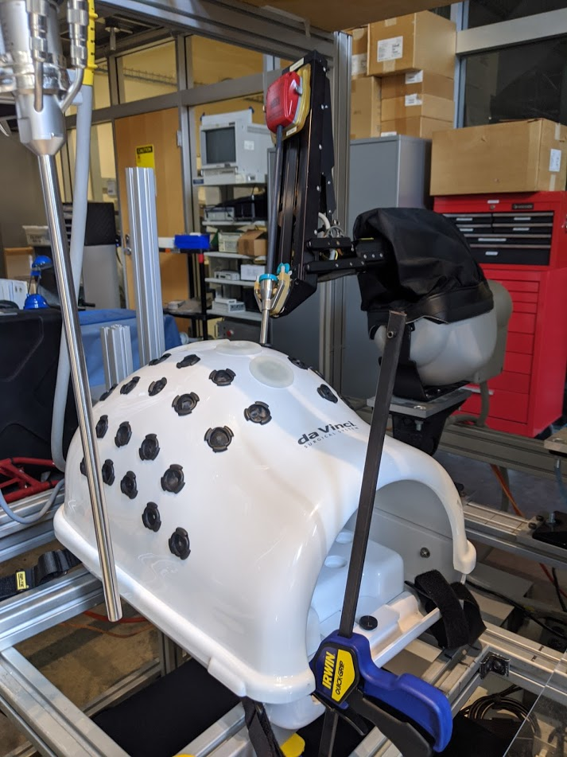
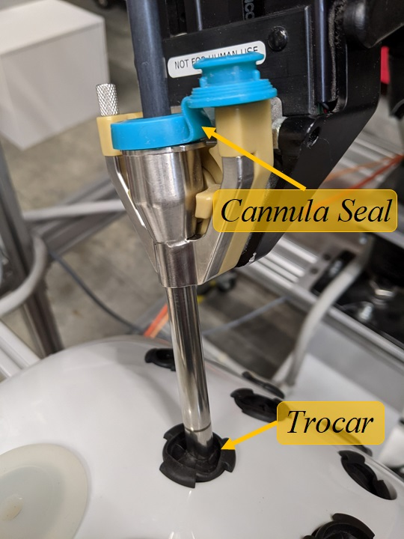
Force Estimation: Practical Considerations
Dynamics identification network was trained in free space
Patient-specific points of contact include trocar and cannula seal
Not feasible to collect a large amount of intraoperative training data
Possible solutions:
  Two-stage network
  Transfer learning

Slide 20
Two-Stage Force Estimation
Robot Measurements
Step 1: Train with free space data
(no time limit)
Step 2: Train trocar correction
(< 5 minutes to collect and train)
Joint position
Torque Estimation Network
Trocar Correction Network
Joint
velocity
L2
Loss
L2
Loss
Joint
torque
-
J.Y. Wu, N. Yilmaz, U. Tumerdem, P. Kazanzides “Robot Force Estimation with Learned Intraoperative Correction”, ISMR 2021.

Slide 21
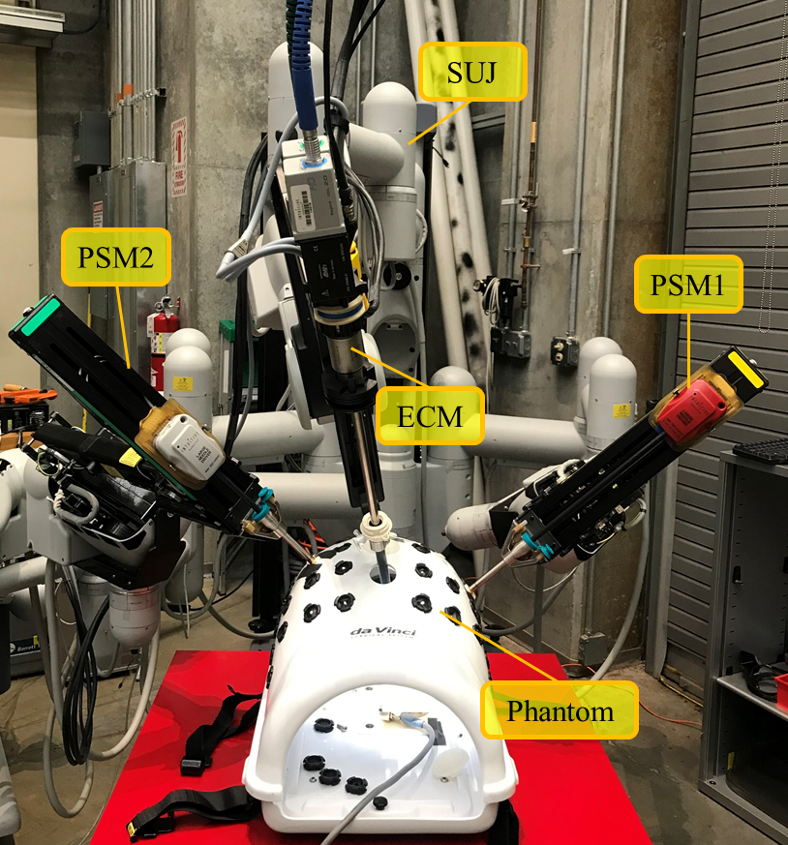
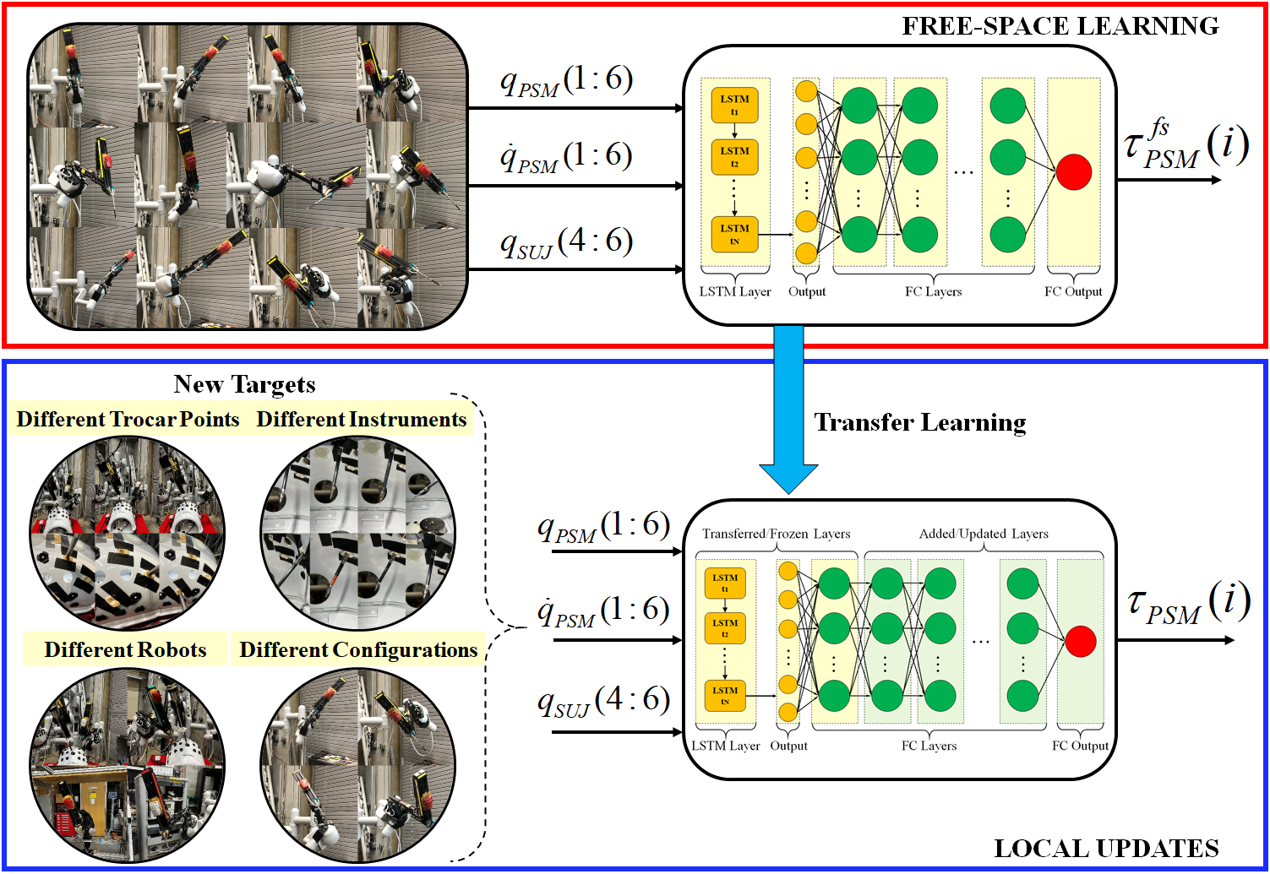
Transfer Learning at Scale
Q: How well does this approach scale to different robots, different instruments, different clinical setups (PSM orientation and trocar)?
N. Yilmaz, J. Zhang, P. Kazanzides, and U. Tumerdem,”Transfer of learned dynamics between different surgical robots and operative configurations," Intl. Journal of Computer Assisted Radiology and Surgery (IJCARS), 2022.

Slide 22
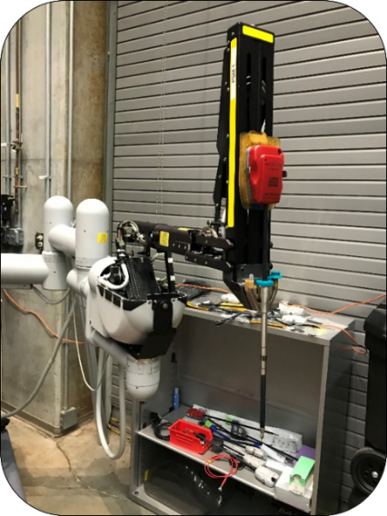
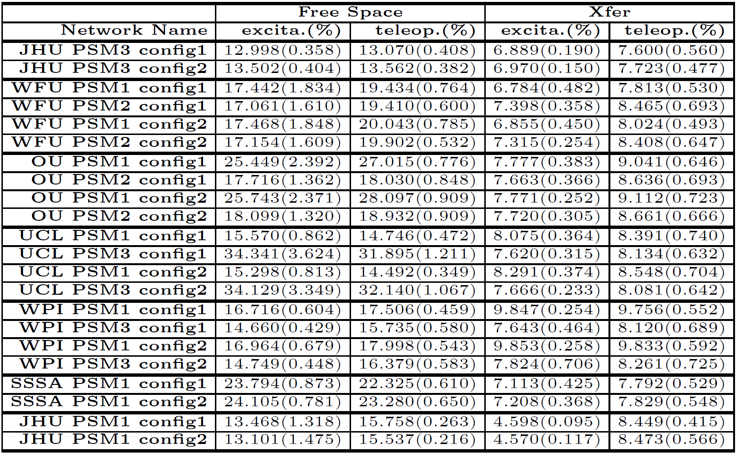
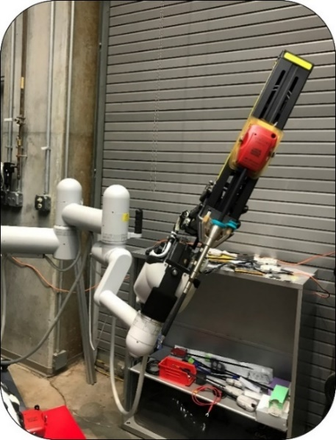
Results: Different Robots and Configurations
config1
config2
Train (config1)
Test (JHU)

Slide 23
Outline
Augmented reality for First Assistant (or laparoscopy)
Force estimation for bilateral teleoperation
Autonomous camera motion
AccelNet surgical robotics challenge

Slide 24
SCAN: System for Camera Autonomous Navigation
Autonomous endoscope navigation based on instruments kinematic tracking for the dVRK surgical robot
  Center on left, right or midpoint between instruments
Comparison study between the classic endoscope teleoperation approach and the autonomous system
Better objective performances and higher user confidence using the autonomous camera
One of the SCAN modalities: field of view centered on the tools midpoint
T. Da Col, A. Mariani, A. Deguet, A. Menciassi, P. Kazanzides, E. De Momi, “SCAN: System for Camera Autonomous Navigation in Robotic-Assisted Surgery,” IROS 2020.

Slide 25
GRACE: Gesture Recognition for Autonomous Camera-motion Enhancement
Camera control modality based on gesture:
  Reaching for needle: camera holds steady position
  Needle positioning: camera tracks scene center, weighted toward PSM1
  Tissue bite: camera holds a steady zoomed-in position
  Suture throw: camera tracks weighted scene center, weighted toward PSM2
N. Pasini, A. Mariani, A. Munawar, E. De Momi, P. Kazanzides, “A virtual suturing task: proof of concept for awareness in autonomous camera motion”, IEEE Robotic Computing, 2022.

Slide 26
GRACE: Implementation on dVRK
LSTM to recognize gestures (within task)
N. Pasini, A. Mariani, A. Deguet, P. Kazanzides, E. De Momi, “GRACE: online Gesture Recognition for Autonomous Camera-motion Enhancement in robot-assisted surgery”, IEEE RA-L, 2023.

Slide 27
GRACE User Study
Compared conventional footpedal control (P), SCAN autonomous camera motion (S), and GRACE (A)
10 subjects (non-medical)
  P trial performed first, with data used to train LSTM
  S and A trials performed two weeks later

Slide 28
GRACE User Study Results
P: conventional footpedal control
S: SCAN (autonomous camera motion)
A: GRACE (autonomous camera motion with situation awareness)

Slide 29
Outline
Augmented reality for First Assistant (or laparoscopy)
Force estimation and bilateral teleoperation
Autonomous camera motion
AccelNet surgical robotics challenge

Slide 30

AccelNet
NSF AccelNet Program: “Aimed at fostering connections among research networks to address pressing scientific challenges, rather than supporting primarily research or research infrastructure.”
International Collaboration to Accelerate Research in Robotic Surgery
Sept. 1, 2019 – Aug. 31, 2025
AccelNet: International Collaboration to Accelerate Research in Robotic Surgery
OISE-1927354 (JHU, PI: Kazanzides), OISE-1927275 (WPI, PI: Fischer)

Slide 31
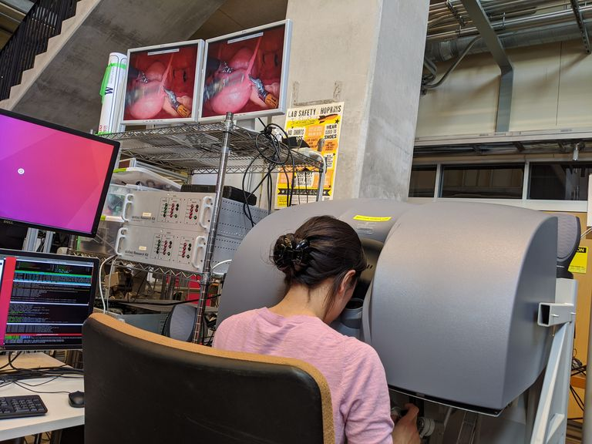
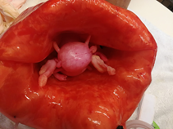
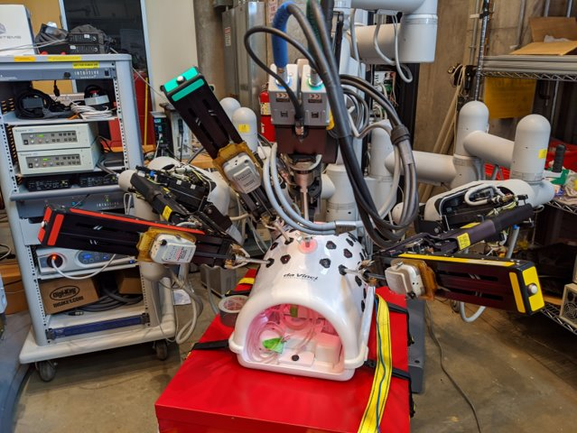
AccelNet: Original (Optimistic) Plan
Engage community to obtain clinically-realistic data
Surgical robotics challenge
Shared repository of data
Early challenges:
Surgeons use electro-cautery; most dVRK systems do not have that
Surgical fellow had never used first-generation da Vinci (only Si and Xi)
dVRK was not robust enough (frequent loss of motor power)
Hydrogel phantom, Dr. Ahmed Ghazi
JHU
Feb 2020

Slide 32
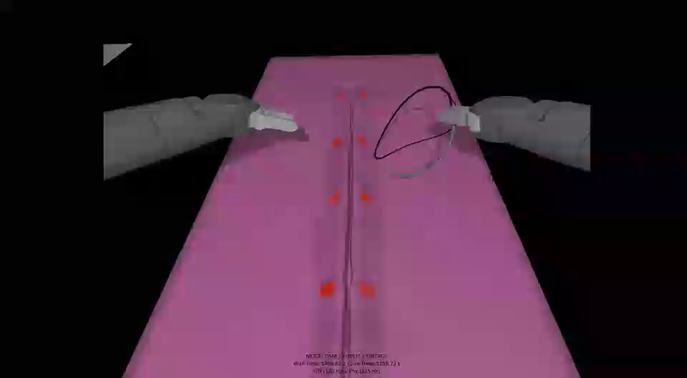
AccelNet: Revised Plan
Pandemic forced shift to online challenge in simulation (2021-2022)
  Asynchronous Multi-Body Framework (AMBF)
  Did not attempt to model soft-tissue deformation
  Simulated suture using small rigid links
  Challenges: (1) detect needle, (2) suturing
Did not focus on shared data because simulation data is cheap and easy
Autonomy is difficult, even in simulation!

Slide 33
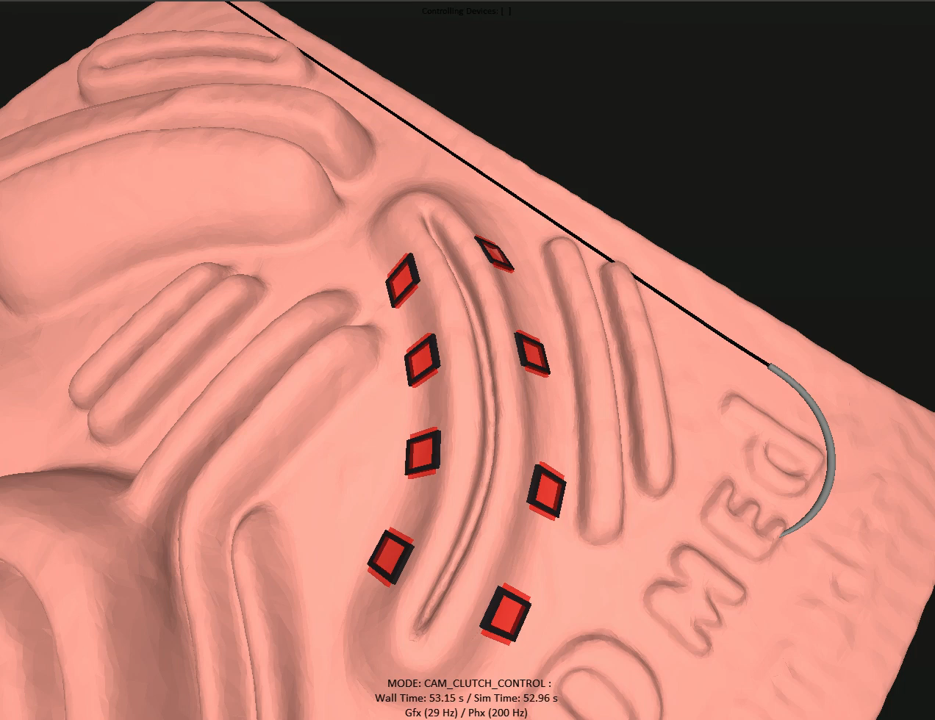
AccelNet: Current Plan
Continue with (online) simulation-based challenge
Culminate with an (in-person) physical challenge
Focus on reducing sim-to-real gap
  More realistic models
  Similar robot behavior (including position error)
  Similar video quality
Improve simulator deployment
  Cloud-based solution
https://surgical-robotics-ai.github.io/surgical-robotics-challenge-2023/challenge-2023.html

Slide 34
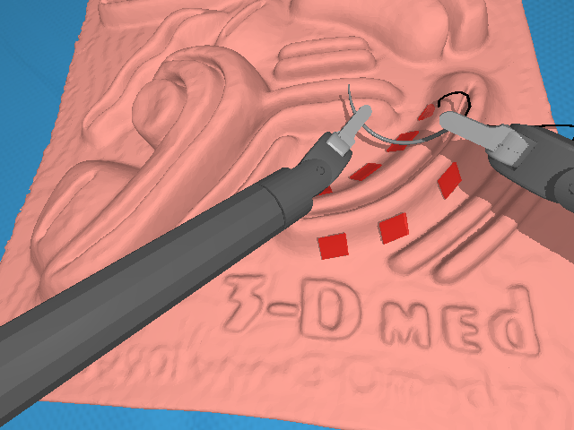
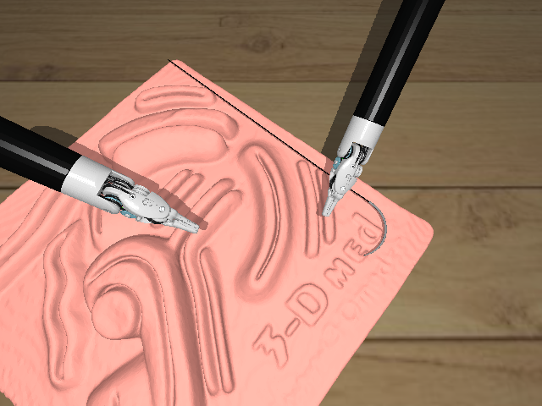
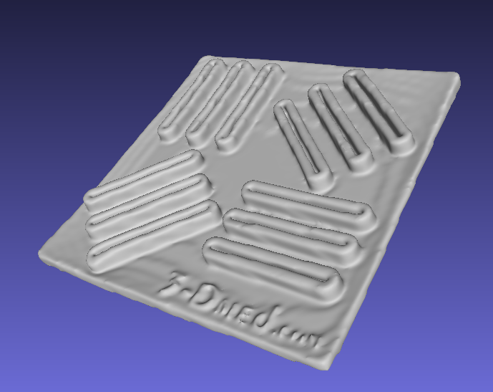
Realistic Models
MRI of physical phantoms (3-Dmed)
Suture needle
More realistic model of surgical instrument
  Obtained CAD models from Intuitive Surgical, and authorization for public release after removing internal details
  https://github.com/jhu-dvrk/instrument-cad

Slide 35
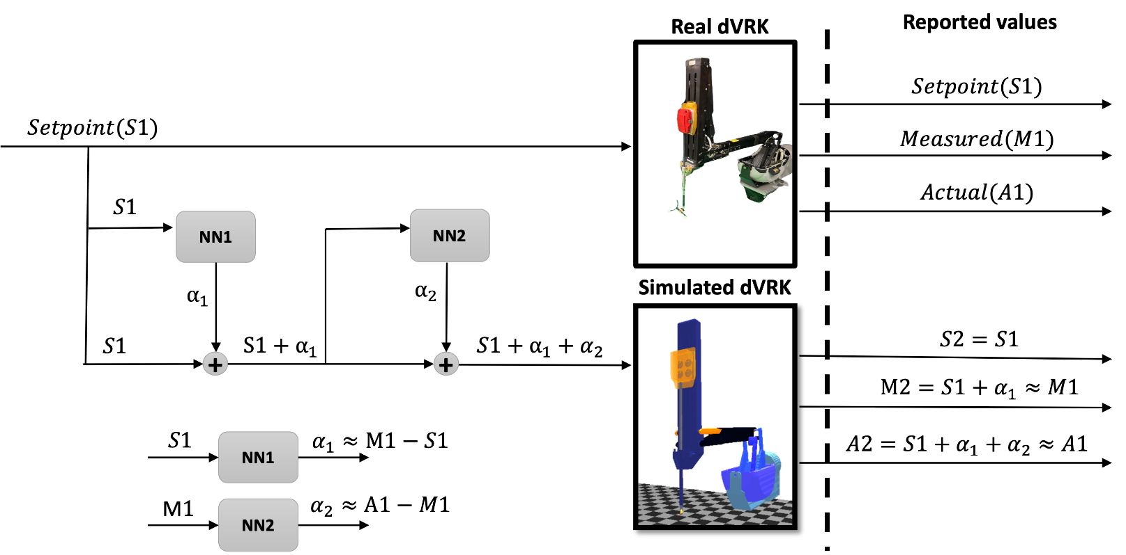
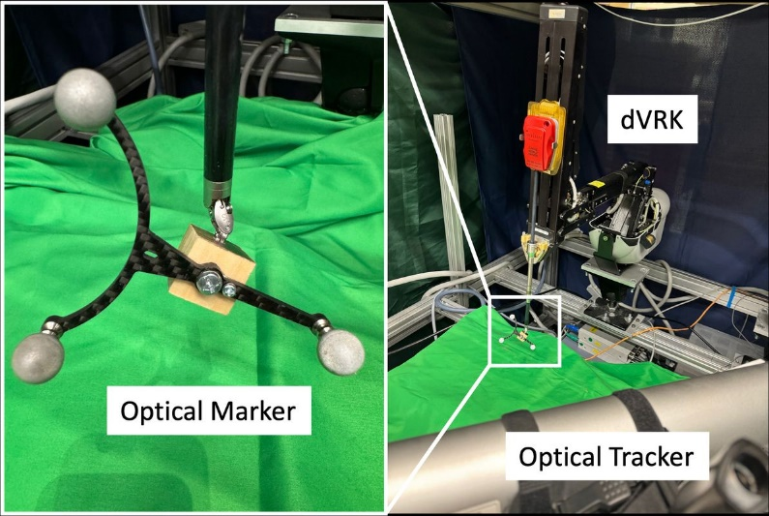
Robot Accuracy
da Vinci (and dVRK) is not accurate
  Surgeons compensate by closing loop based on visual feedback
Simulated robot has high accuracy
  One solution: Train neural networks to add realistic error
  J. Barragan et al., “Improving the Realism of Robotic Surgery Simulation through Injection of Learning-Based Estimated Errors”, ISMR 2024

Slide 36
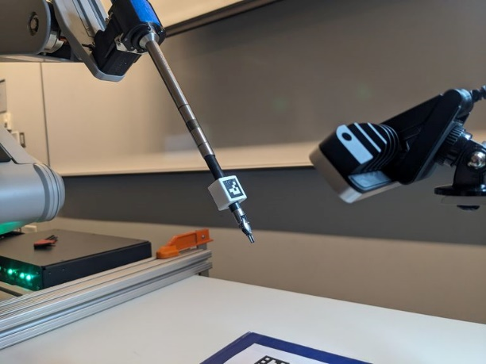
Endoscope Video: Challenges
Simulation:
  High image quality, but usually not photo-realistic
  One solution: Collect interactive data with low-fidelity rendering, and replay with high-fidelity rendering (and different viewpoints, lighting conditions, etc.)
Research platforms (dVRK):
  Low (dVRK) or medium (dVRK-Si) image quality
  No single widely-adopted solution; many use standard cameras
Standard hand-eye calibration (instrument to camera)
https://github.com/jhu-dvrk/dvrk_camera_registration

Slide 37
Summary
da Vinci Research Kit
  Community infrastructure to enable medical robotics research
  Current available at about 40 institutions worldwide
Some research examples:
  Mixed reality visualization for the assistant surgeon
  Force estimation and bilateral teleoperation
  Autonomous camera motion
  Surgical robotics challenge (autonomous suturing)

Slide 38
Acknowledgments
JHU Contributors Russell Taylor Anton Deguet Adnan Munawar Jie Ying Wu Keshuai Xu Zihan Chen Jintan Zhang Brendan Burkhart Juan Barragan Hisashi Ishida Irene Kim Nick Greene Long Qian Ehsan Azimi Paul Thienphrapa Xiran Zhang | Visitors & Collaborators Greg Fischer Simon DiMaio Ugur Tumerdem Nural Yilmaz Elena De Momi Zerui Wang Yunhui Liu Philip W. Chiu Zheng Li Xin Ma Qi Luo Arianna Menciassi Loris Fichera Haoying (Jack) Zhou Yiwei Jiang | Nicolo Pasini Chengzhi Song Tommaso Da Col Andrea Mariani Support NSF Intuitive Foundation dVRK Consortium

