Slide 1
dVRK Software Overview
Anton Deguet
July 15, 2024

Slide 2
Content
Introduction
Core components
APIs
User applications
Tools

Slide 3
dVRKs are all different
The dVRK is a Kit.
Hardware from Intuitive Surgical, eBay or other sources:
PSM: Patient Side Manipulator, Standard or Si
ECM: Endoscopic Camera Manipulator, Standard or Si
MTM: Master Tele Manipulator
SUJ: Set Up Joints, Standard or Si
Full surgeon console or just stereo display
Endoscope, SD, HD or Si
dVRK controllers:
Designed at JHU, shipped from WPI, multiple generations
Or custom-built using PCB designs on GitHub (much harder path)
BYOPC: Bring Your Own Personal Computer
Software:
Mostly from JHU
Supports all dVRK configurations

Slide 4
Technical skills required
Depending on setup:
Build 80/20 frame for the surgeon or patient side
Short pins on sterile adapters (Standard)
Build custom cables for the head sensor or camera focus controller
Build motor drive for console lift (Standard)
Get a PC with a FireWire adapter
Install Linux Ubuntu (20.04, 22.04) with ROS (1, 2)
Connect everything
Compile some code, create some configuration files
Some calibration required!
Documentation: https://github.com/jhu-dvrk/sawIntuitiveResearchKit/wiki

Slide 5
Software distribution
Source based
All repositories can be retrieved using vcs on Linux
Easy to build using catkin (ROS1) or colcon (ROS2)
Instructions:
ROS1: https://github.com/jhu-dvrk/sawIntuitiveResearchKit/wiki/CatkinBuild
ROS2: https://github.com/jhu-dvrk/sawIntuitiveResearchKit/wiki/BuildROS2
Can be built using CMake directly (e.g. Windows, MacOS)

Slide 6
Software features
Written in C++, component based and multithreaded (cisst libraries)
IO, powering, safety checks, homing, position and effort control, trajectory generation using Reflexxes, actuator vs joint vs cartesian conversions, tele-operation, head sensors, focus controller…
Configuration files for calibration and user settings
Qt Graphical Interface (mostly visualization and debug in “direct mode”)
ROS interfaces (1 and 2), OpenIGTLink, JSON over UDP
Python (and Matlab) clients over ROS
Calibration tools
All available on GitHub
NOT FDA APPROVED, NOT FOR ACTUAL SURGERIES!

Slide 7
Content
Introduction
Core components
APIs
User applications
Tools

Slide 8
Software architecture
Publishers
Subscribers
QtConsole
Console
sawROS console
sawQtTeleop
mtsTeleoperation
mtsTeleoperation
sawROS teleoperation
QtPSM
sawROS psm
MTM
PSM
MTM
PSM
QtMTM
sawROS mtm
sawQtPID
mtsPID
mtsPID
mtsPID
mtsPID
MTML
PSM1
MTMR
PSM2
sawQtIO
mtsRobotIO1394
sawROS io
QtWidget component (optional)
Single thread
SAW component
provided
required
ROS component (optional)
For components, see https://github.com/jhu-cisst/cisst/wiki/cisstMultiTask-concepts

Slide 9
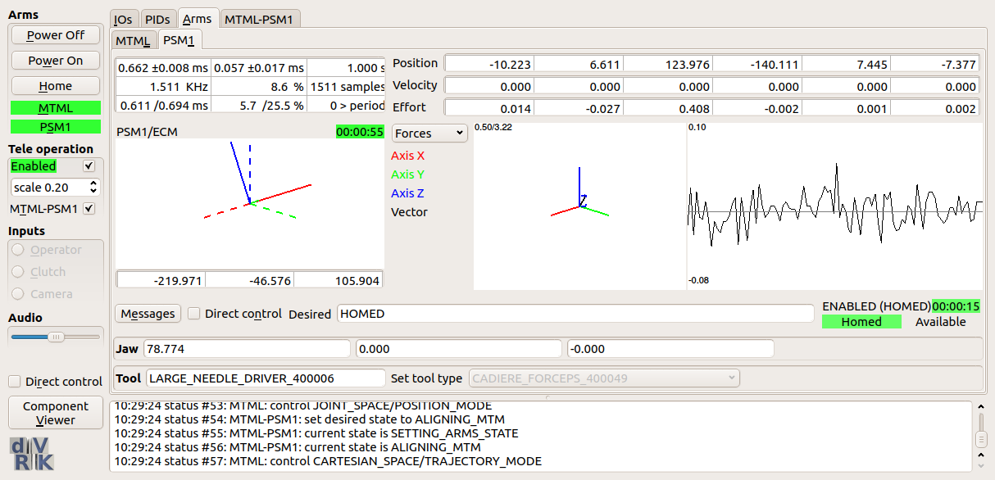
Software: Console
State
Component’s widgets
Features
Create components based on console configuration file (IO, PID, Arm, GUI, ROS)
Manages state of arms and teleoperation components
Configuration files
JSON
Messages

Slide 10
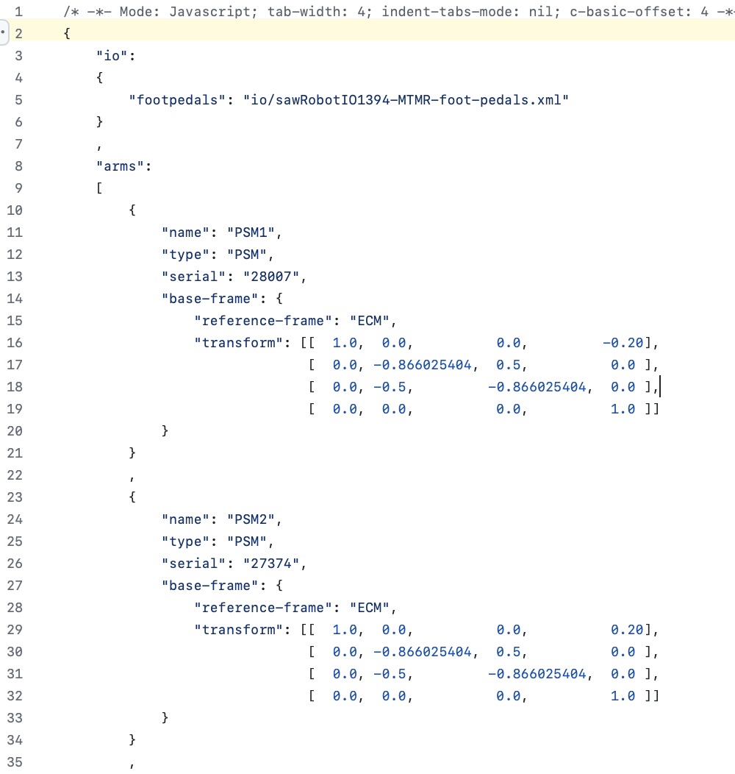
Software: Console

Slide 11
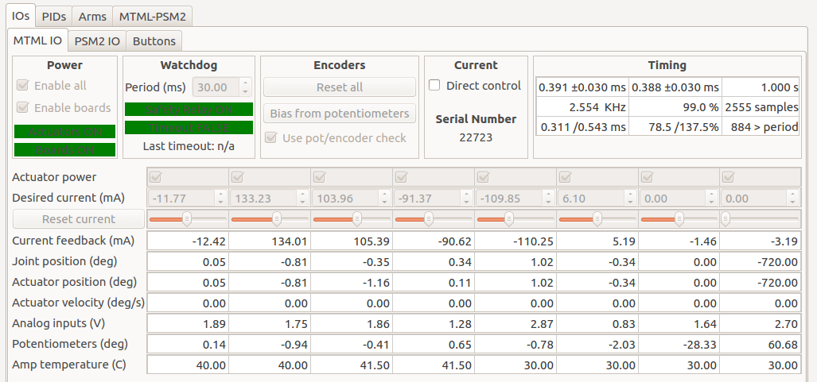
Software: IO
Features
Convert to/from SI units
Safety checks
Configuration files
XML
config-generator.py provides a template
Stores results of calibration per arm

Slide 12
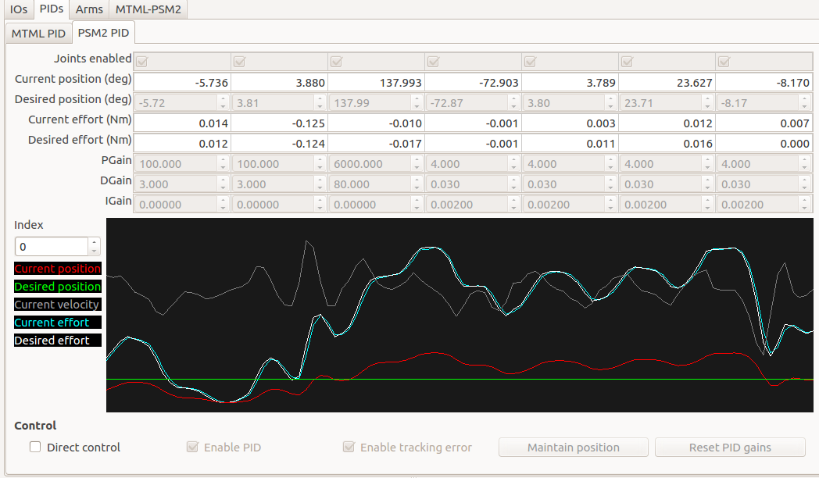
Software: PID
Features
PID
Disturbance observer
Safety checks
Position/Effort per actuator
Configuration files
JSON
Default files provided

Slide 13
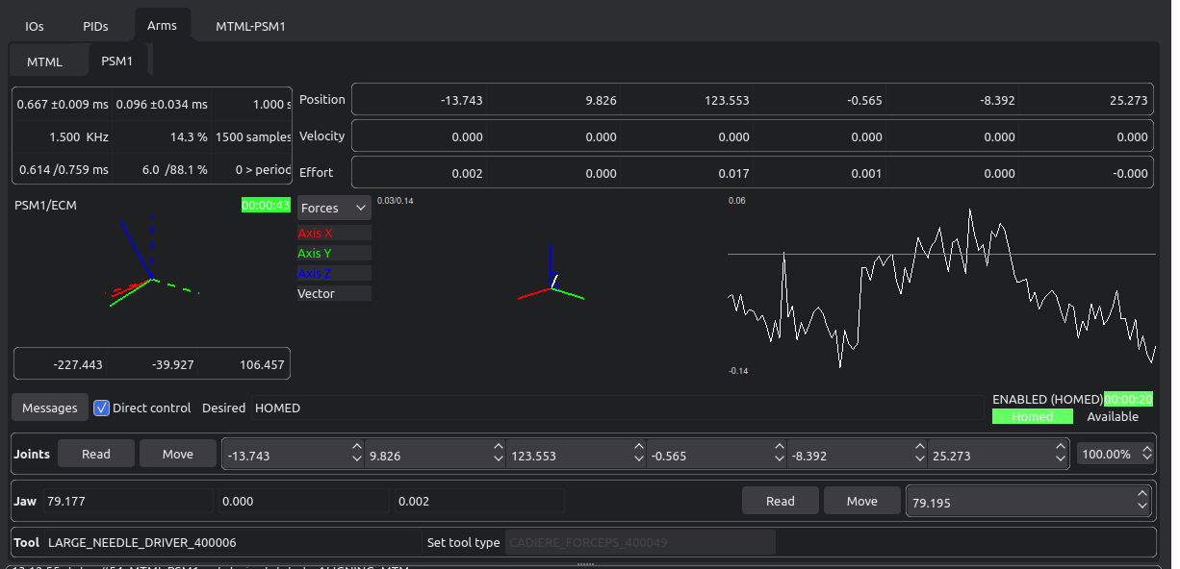
Software: Arm
Features
Homing
Actuator to/from joints
Joints to/from cartesian
Provides position, velocity and effort (joint and cartesian)
Position and effort controller (joint and cartesian)
Instrument detection
Configuration files
JSON
Default files generated

Slide 14
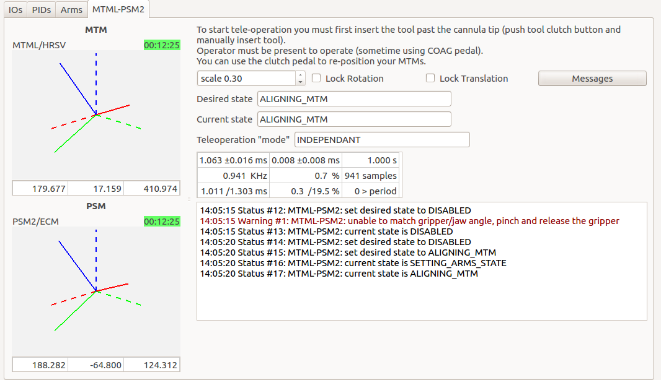
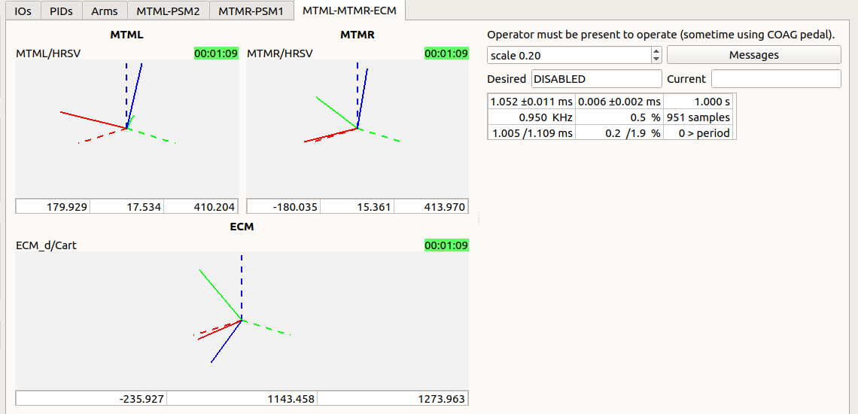
Software: Teleoperation
Features
Emulate da Vinci behavior
Nowhere as smooth but usable
Configuration files
JSON

Slide 15
Content
Introduction
Core components
APIs
User applications
Tools

Slide 16
API?
dVRK API grew “organically” since 2012…
API not easy to understand for new users, hard to write your own application
Inconsistent API across devices, hard to integrate/swap devices and develop shared tools
Inconsistent API within the dVRK code base, hard to maintain for us
C++ | ROS topic | Python Client | Matlab Client
GetPositionCartesian | position_cartesian_current | get_current_position | position_current
GetPositionCartesianDesired | position_cartesian_desired | get_desired_position | position_desired
SetPositionCartesian | set_position_cartesian | move (interpolate = False) | move (interpolate = False)
SetPositionGoalCartesian | set_position_goal_cartesian | move | move

Slide 17
API: CRTK (JHU, WPI, UW)
Standardized and documented API for robot state, move commands and operating state: https://crtk-robotics.readthedocs.io
More options to swap arms (PSM vs. JHU Eye Robot, MTM vs Omni or ForceDimension)
General purpose clients (not dVRK specific):
ROS Python: https://github.com/collaborative-robotics/crtk-python-client
ROS Matlab: https://github.com/collaborative-robotics/crtk-matlab-client
For cisst/SAW “devices” (dVRK, Omni, Falcon, NDi, Atracsys…): ROS bridge, OpenIGTLink bridge, Qt Widgets..

Slide 18
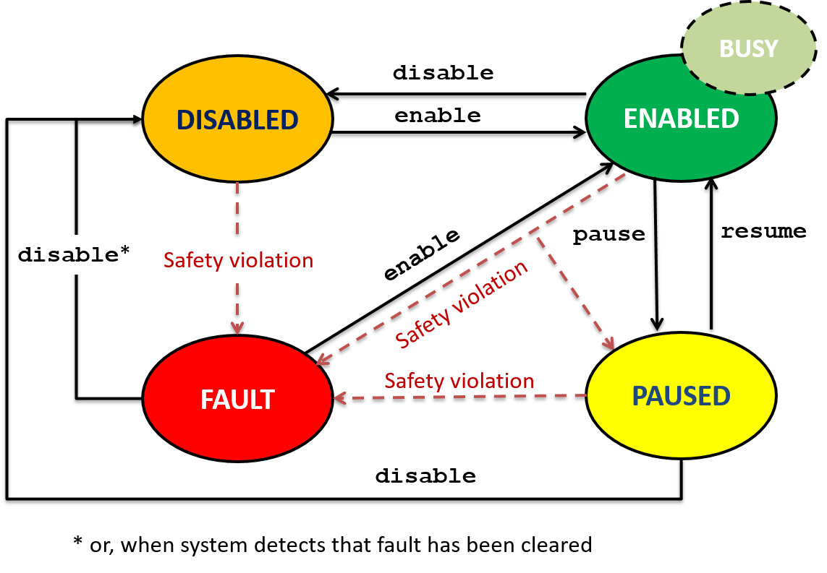
API: Operating State

Slide 19
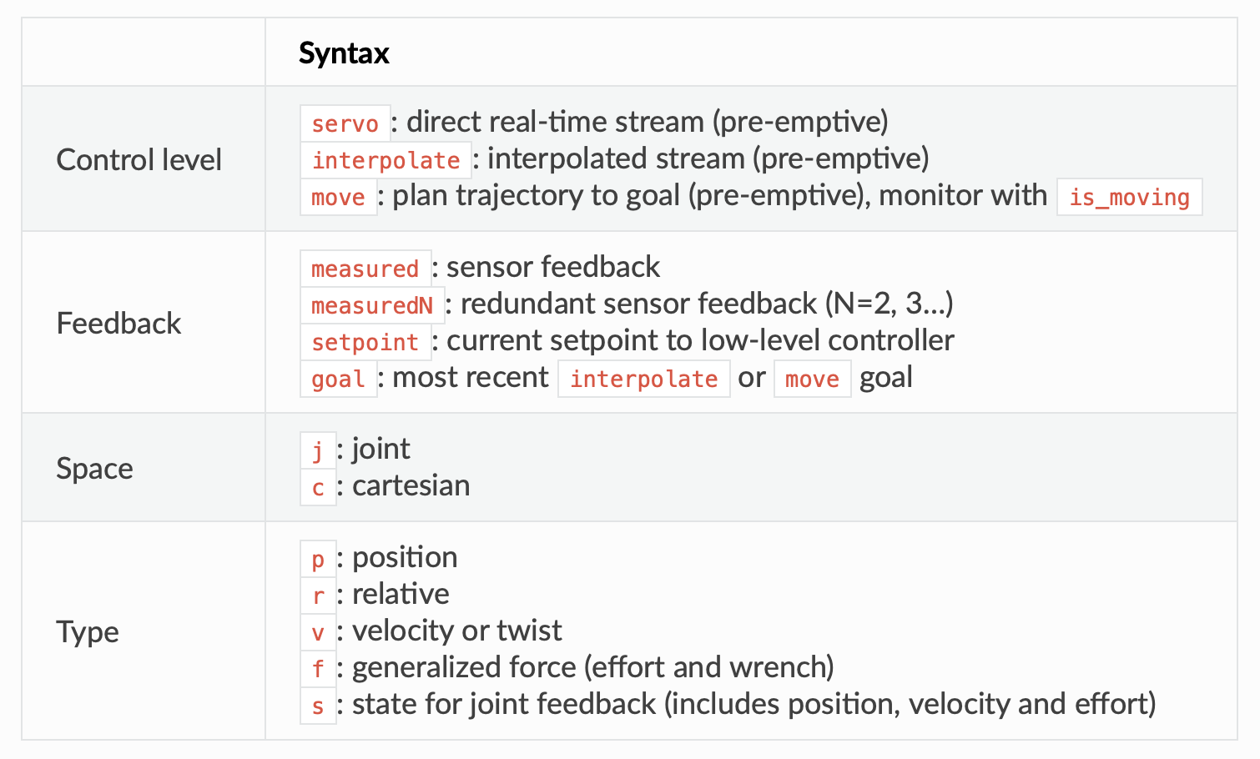
API: Robot Commands

Slide 20
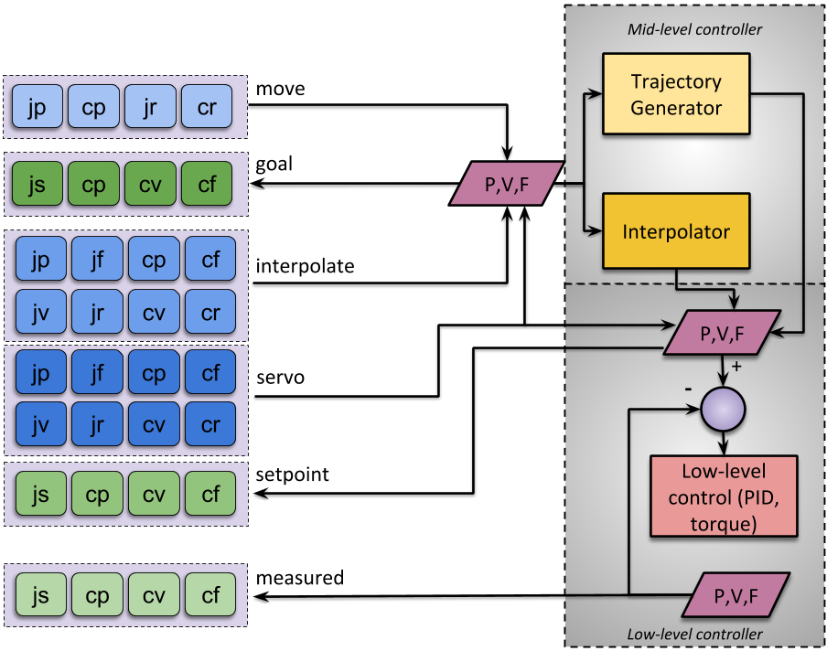
API: Robot Commands

Slide 21
Content
Introduction
Core components
APIs
User applications
Tools

Slide 22
User applications: ROS
See https://github.com/jhu-dvrk/sawIntuitiveResearchKit/wiki/Application-Development
Easiest approach
Choose your language with ROS bindings on the client side (C++, Python, Matlab)
Some latency but can still close the loop at high rate (~1KHz)
dVRK Process
Publishers
Subscribers
Console
ROS console
User Application
(teleoperation)
ROS psm
ROS
MTM
PSM
ROS mtm
mtsPID
mtsPID
MTM
PSM
mtsRobotIO1394
cisst ROS bridge (optional)

Slide 23
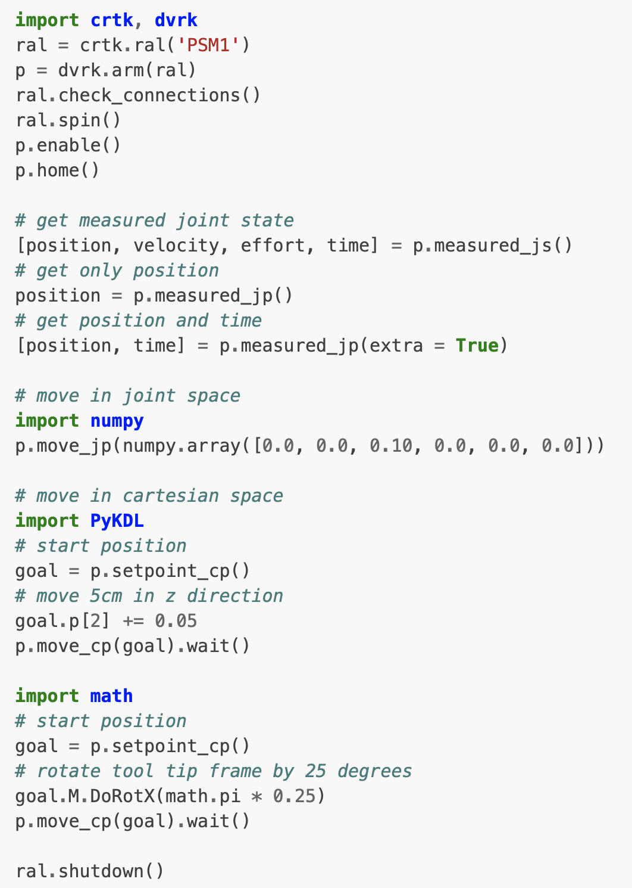
User applications: ROS + CRTK Python Client
dVRK Process
Publishers
Subscribers
Console
ROS console
User Application
(teleoperation)
ROS psm
ROS
MTM
PSM
ROS mtm
mtsPID
mtsPID
MTM
PSM
mtsRobotIO1394
cisst ROS bridge (optional)

Slide 24
User applications: C++
See https://github.com/jhu-dvrk/sawIntuitiveResearchKit/wiki/Application-Development
Requires some knowledge of C++ as well as cisst libraries
Can replace or add components, either new or derived from existing ones
Payoff is very low latency, single executable
For example, replacing MTM with ForceDimension:
Publishers
Subscribers
Publishers
Subscribers
Console
ROS console
Console
ROS console
mtsTeleOperationPSM
ROS teleoperation
mtsTeleOperationPSM
ROS teleoperation
MTM
PSM
ROS psm
sawForce
DimensionSDK
PSM
ROS psm
ROS mtm
ROS mtm
mtsPID
mtsPID
MTM
mtsPID
MTM
PSM
PSM
mtsRobotIO1394
mtsRobot
IO1394
cisst ROS bridge (optional)
cisst ROS bridge (optional)

Slide 25
User applications: managing CPU and IO loads
Soft vs hard real-time
dVRK software currently uses soft real-time (FireWire driver is not real-time compatible)
With UDP, we could migrate to hard real-time. With PID on Zynq, we could also stick to soft real-time on the PC side
In practice
If the PC is overloaded, either CPU or IOs, the dVRK software will raise errors. Unfortunately, video acquisition, disk writes are IO intensive
Split the load on 2 PCs, use ROS between processes. One PC for ROS core, video and data collection, one PC just for the dVRK

Slide 26
Content
Introduction
Core components
APIs
User applications
Tools

Slide 27
Tools: Python scripts
Most tests and calibrations scripts are written using CRTK Python: https://github.com/jhu-dvrk/dvrk-ros/tree/main/dvrk_python/scripts
Examples:
servo and move commands in dvrk_arm_test.py
Record and replay a trajectory using ROS bag in dvrk_bag_replay.py
Collect data over the joint space in dvrk_ecm_psm_gc_collect.py
Hand-eye calibration: https://github.com/jhu-dvrk/dvrk_camera_registration

Slide 28
Tools: simulation (kinematic only)
Run and visualize the dVRK in Rviz
Single arm
Both MTMs (surgeon’s console)
Patient side with SUJ, ECM and PSMs for Standard or Si
See https://github.com/jhu-dvrk/dvrk_model

