Slide 1
The da Vinci Research Kit (dVRK): System Description: Mechatronics
Peter Kazanzides
Research Professor
July 15, 2024

Slide 2
Outline
da Vinci Research Kit (dVRK)
Next generation dVRK-Si and controller

Slide 3
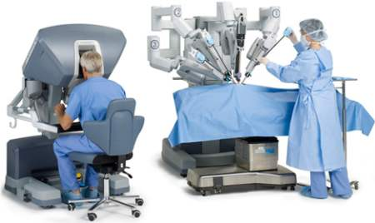
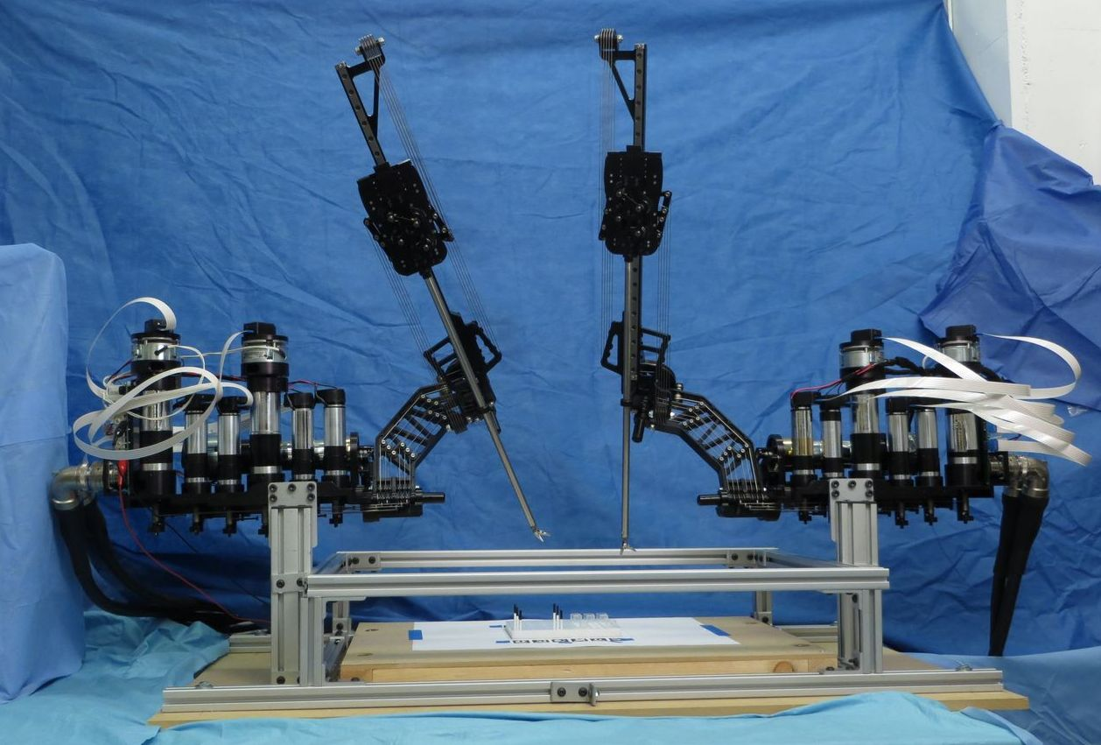
Medical Robotics Research
The da Vinci Surgical System is available to surgeons, but what is available to researchers?
da Vinci Surgical System, © 2022 Intuitive Surgical, Inc.
da Vinci “Read only” Research API
Raven II robot (Applied Dexterity)

Slide 4
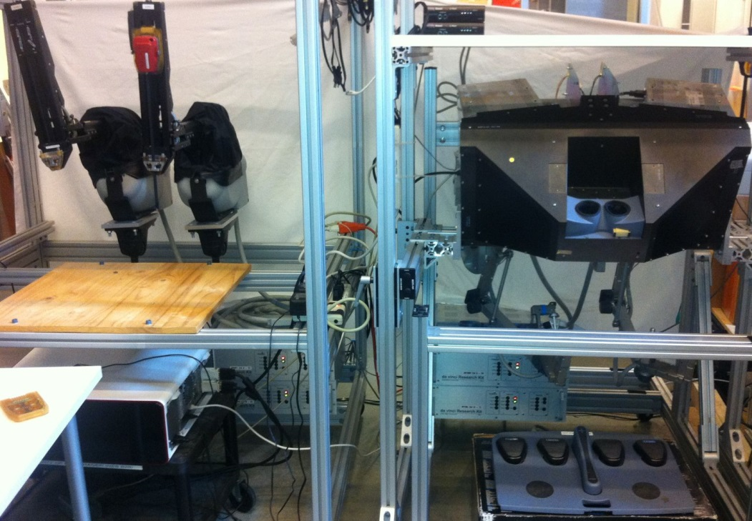
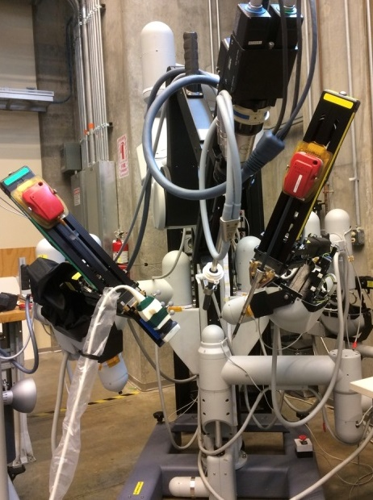
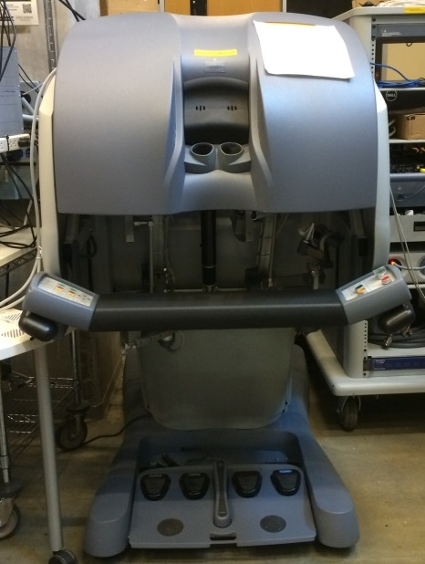
da Vinci Research Kit
Mechanical components from decommissioned da Vinci surgical robots
Consortium for “open source” controllers
JHU: software, controller electronics
WPI: controller power, packaging, assembly
ISI: Interface electronics
P. Kazanzides, Z. Chen, A. Deguet, G. Fischer, R. Taylor, S. DiMaio, “An open-source research kit for the da Vinci® surgical system”, ICRA 2014.

Slide 5
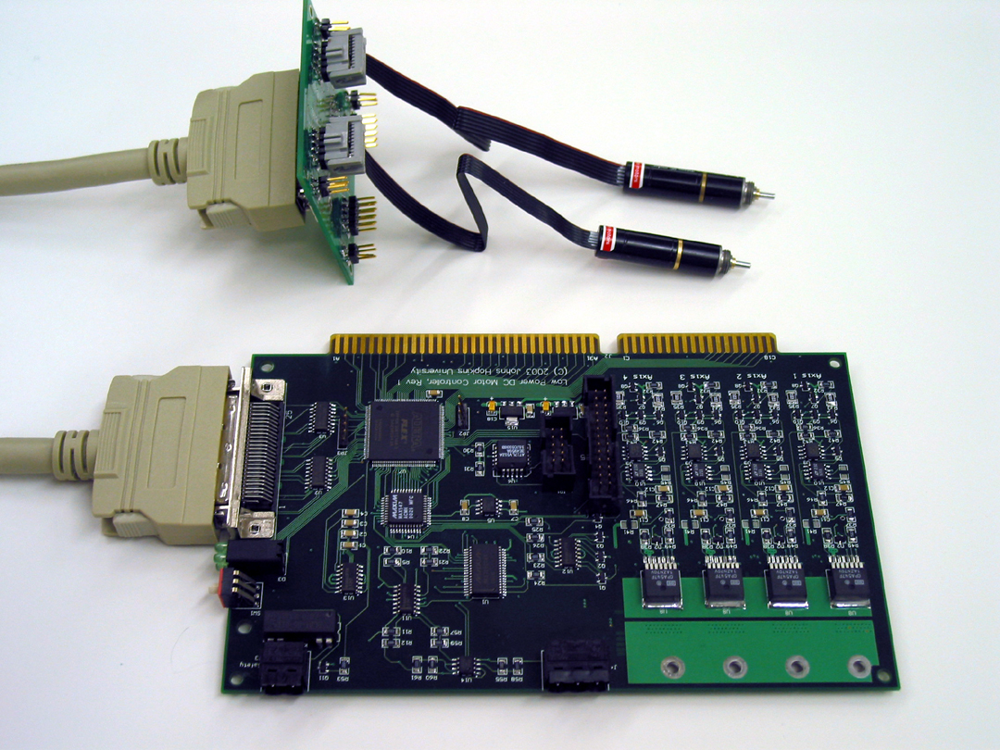
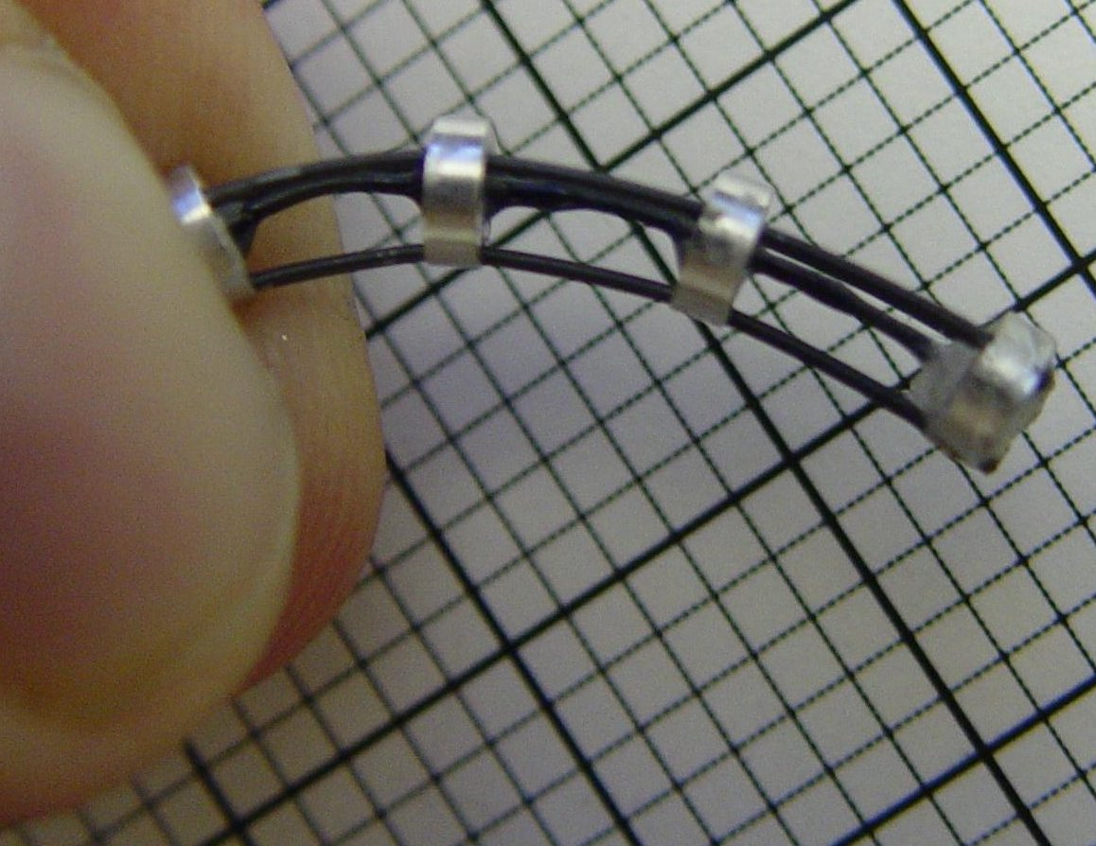
Historical Origin, 2003-2004
Snake Robot, Nabil Simaan (JHU)
Low Power Motor Controller (LoPoMoCo)
Kapoor, Simaan, Kazanzides, “A system for speed and torque control of DC motors with application to small snake robots”, IEEE/APS Intl. Conf. on Mechatronics and Robotics, 2004.

Slide 6
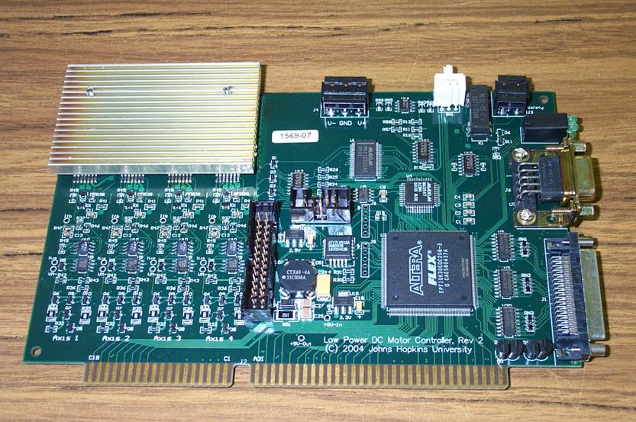
Original dVRK at JHU (2004)
Low Power Motor Controller (LoPoMoCo), V2
da Vinci MTMs and PSMs

Slide 7
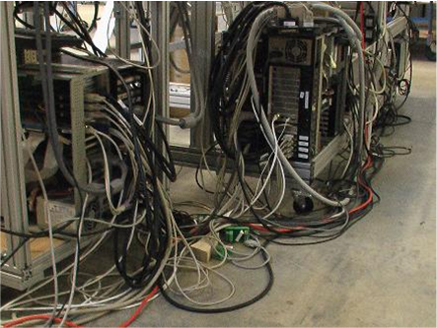
Limitations of LoPoMoCo Architecture
Centralized processing and I/O
Cabling nightmare!
Required Industrial PCs with ISA bus

Slide 8
Centralized Processing and Distributed I/O
App
Traj
Servo
Computer
(multicore)
IO
IO
IO
Amp
Amp
Amp
Power and high-speed serial network (e.g., Firewire)
Robot
Possible with high-performance networks/computers
All the benefits of distributed I/O (reduced cabling)
Computation on familiar development platform (flexibility)

Slide 9
Fieldbus Requirements
Speed of at least 100 Mbits/sec
Low latency (tens of µsec)
Ability to daisy-chain
Readily available
Simple FPGA implementation
Option for high-flex cabling
?
IEEE-1394a (FireWire)
EtherCAT
In 2006, FireWire appeared to be best choice
Since then, other good options, such as EtherCAT

Slide 10
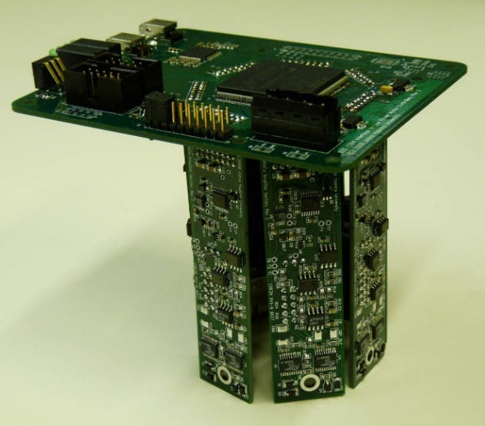
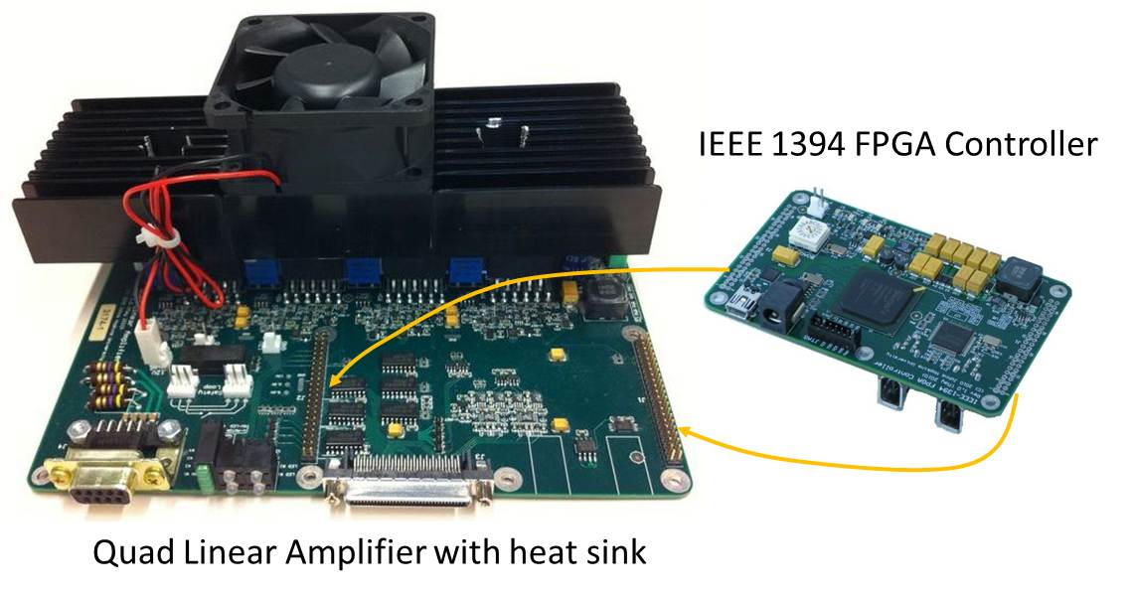
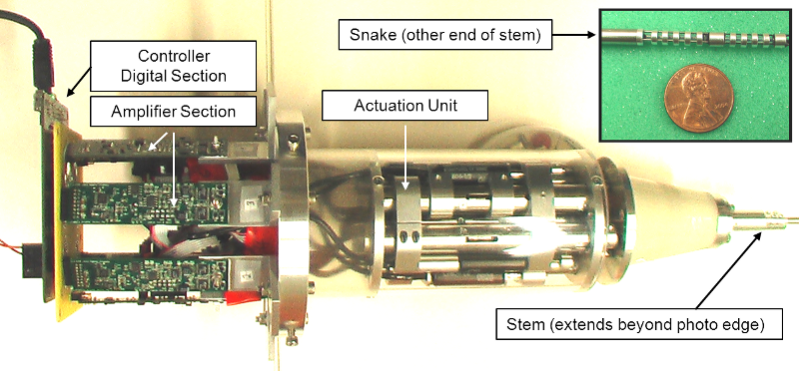
Next Generation: Distributed I/O
IEEE1394 Snake Controller, 2008
IEEE1394 general-purpose controller, 2010
FPGA/QLA (V1)
P. Thienphrapa, P. Kazanzides, “A Scalable System for Real-Time Control of Dexterous Surgical Robots”, TePRA 2009
NSF MRI 0722943 (2007)
PI: Allison Okamura
Initial dVRK firmware comes from here

Slide 11
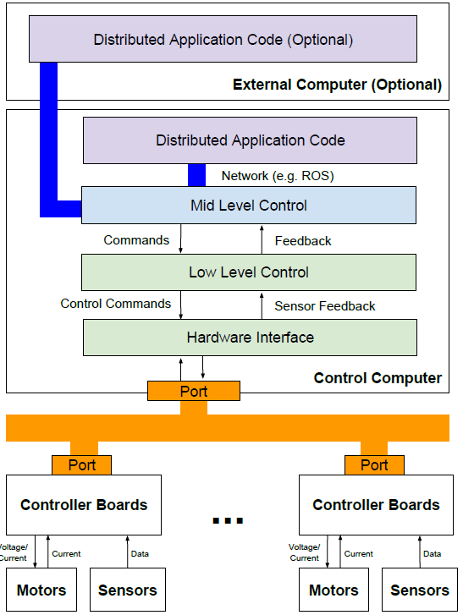
System Architecture
Layer
Key Concerns
Interoperability (ROS)
Application
Performance, ease of programming
Real-time Control
Fieldbus
Scalability, performance
Hardware/Firmware
Low latency
Z. Chen, A. Deguet, R Taylor, P. Kazanzides, “Software architecture of the da Vinci Research Kit," IEEE Robotic Computing, 2017

Slide 12
Hardware Block Diagram
IEEE 1394
PHY
Cmd current
+
DAC
Power Op Amp
write
SPI
Motor
-
read
Meas current
Filter
Power Op Amp
Sense Resistor
-
SPI
buffers
ADC
Pot
Amplifier
Diff. Amplifier
quad.
Pot
Filter
FPGA
Differential Receiver
Enc

Slide 13
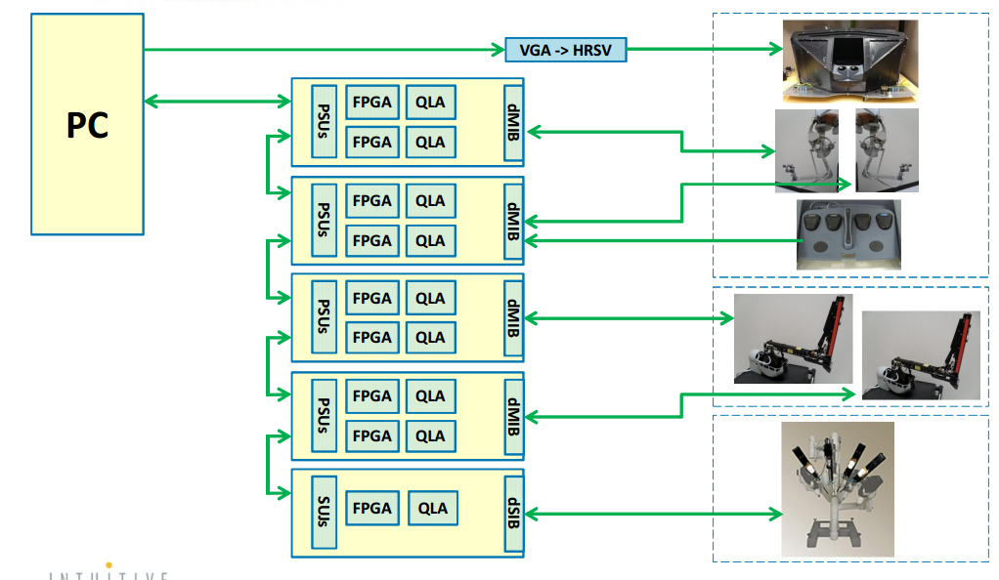
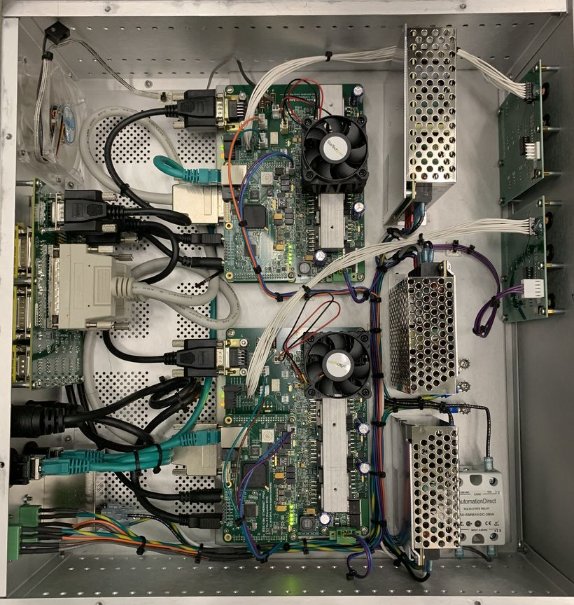
da Vinci Research Kit

Slide 14
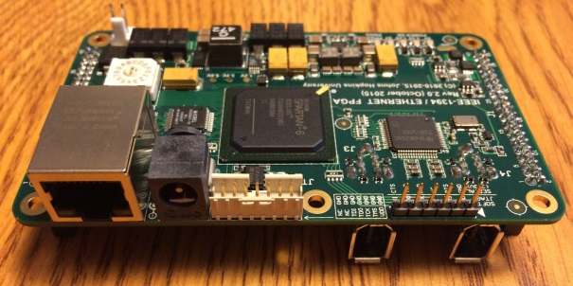
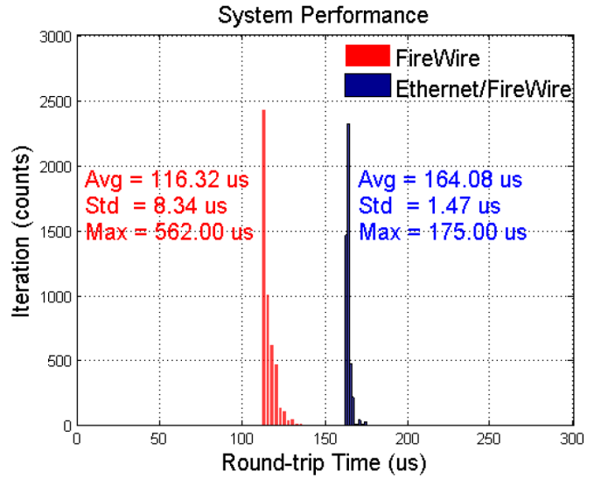
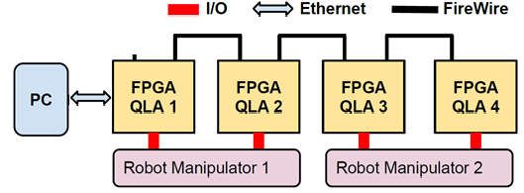
Ethernet Interface (V2)
Ethernet is supported everywhere, including RTOS, Simulink Real-Time (Matlab xPC)
Real-time drivers for Ethernet readily available
Linux
+ libraw1394
Xenomai
+ Rtnet
FPGA V2.1
L. Qian, Z. Chen, P. Kazanzides, “An Ethernet to FireWire bridge for real-time control of the da Vinci Research Kit (dVRK)”, IEEE Conf. on Emerging Technologies and Factory Automation (ETFA), 2015.

Slide 15
Outline
da Vinci Research Kit (dVRK)
Next generation dVRK-Si and controller

Slide 16
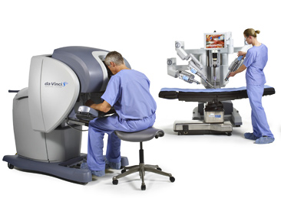
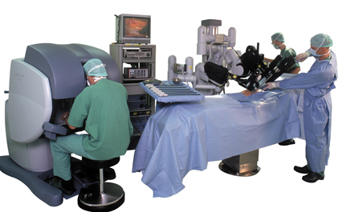
da Vinci Systems and dVRK Controllers
(V1, V2, V3)
(V3)
dVRK
dVRK-Si
(some)
da Vinci “Classic”
da Vinci S
da Vinci Si

Slide 17
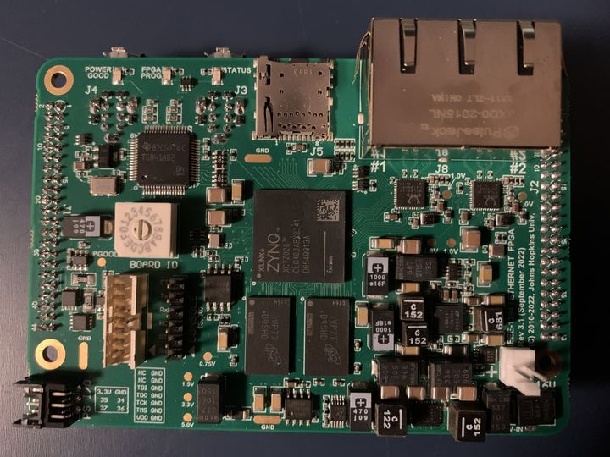
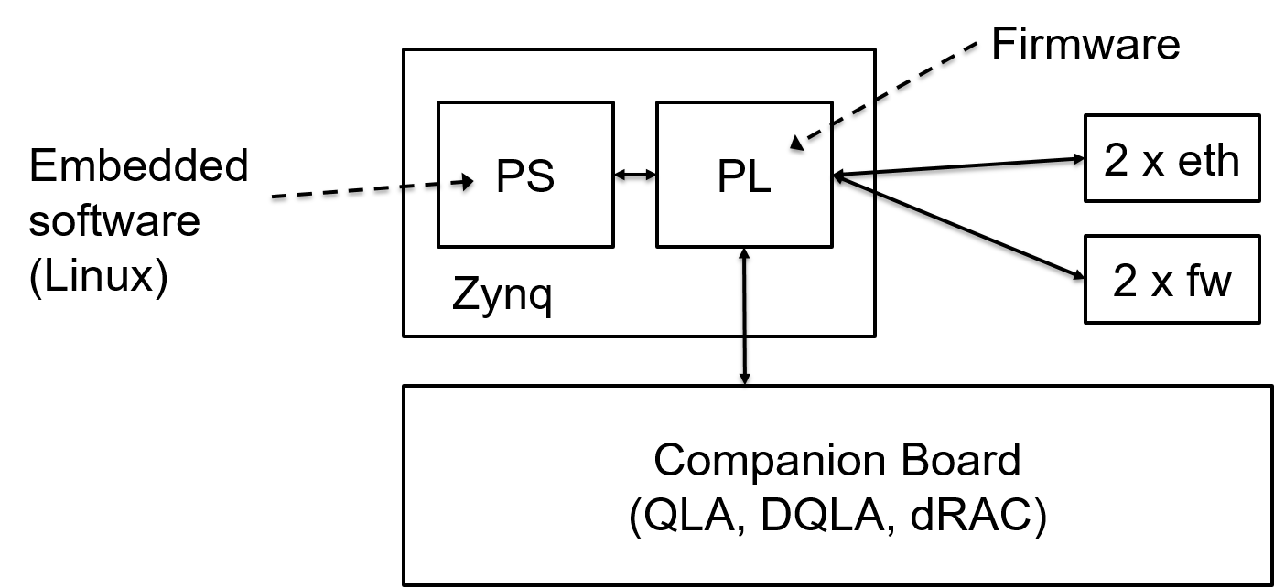
Current dVRK (V3)
Upgrade from Xilinx Spartan 6 FPGA to Xilinx Zynq 7000 SoC (FPGA + ARM processor)
One FPGA can drive a full robot arm (up to 8 axes)
Higher bandwidth access to low-level signals
Could improve force estimation (and other) research
https://github.com/jhu-cisst/mechatronics-firmware
https://github.com/jhu-cisst/mechatronics-embedded

Slide 18
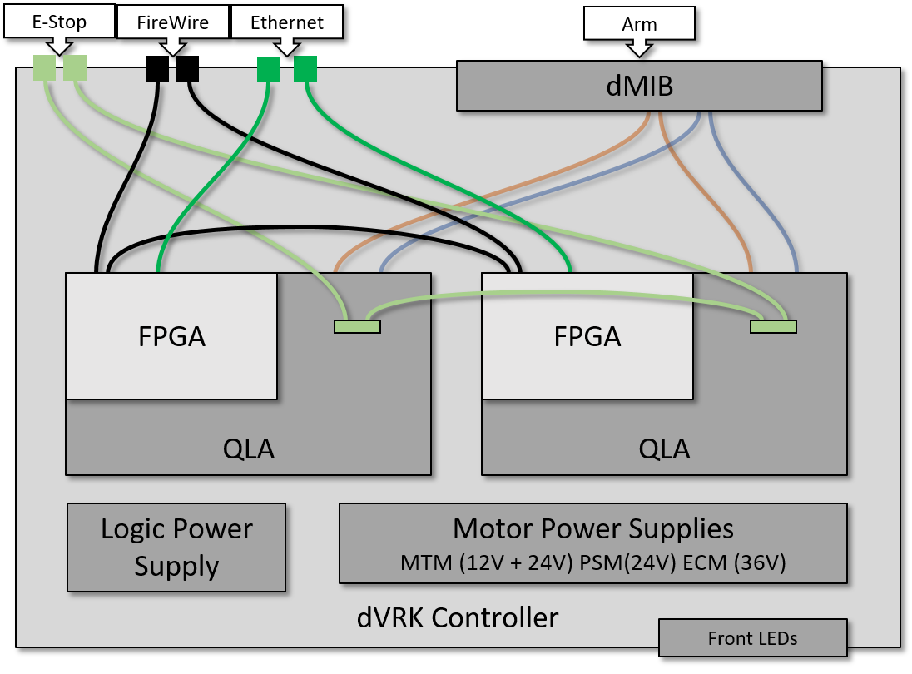
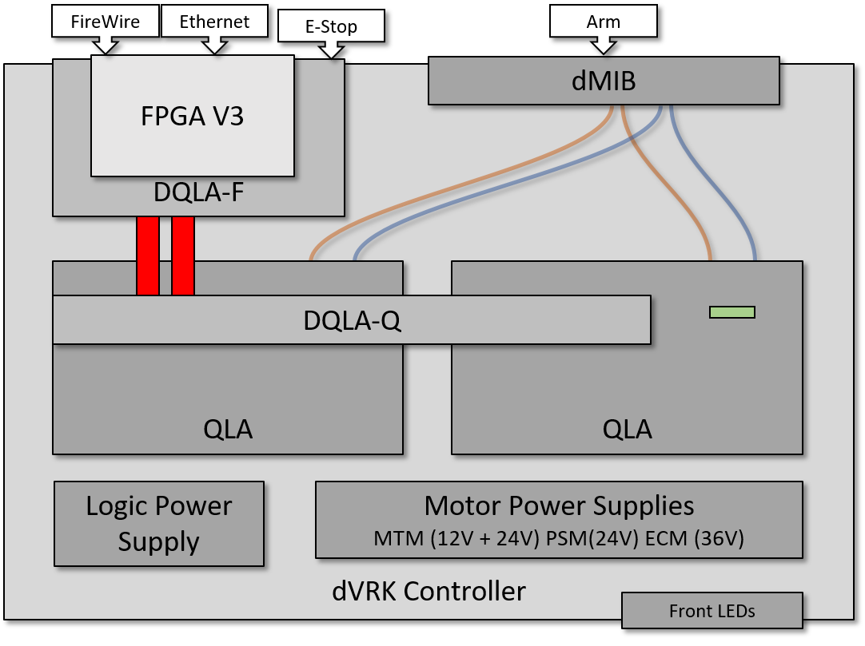
dVRK Controllers
V1, V2
V3
2 FPGA/QLA board sets
(could use FPGA V3, but a waste of resources)
1 FPGA, 2 QLAs (DQLA)

Slide 19
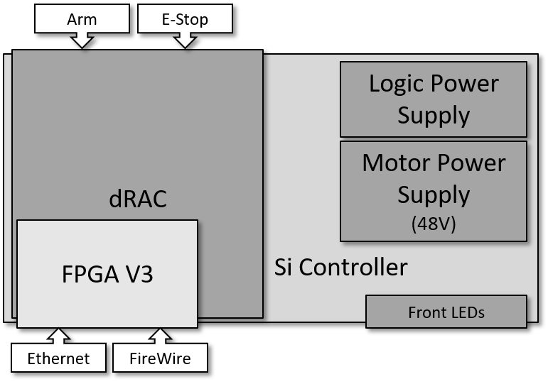
dVRK-Si Controller

Slide 20
Revisiting the Controller Architecture
Current dVRK
Future dVRK

Slide 21
dVRK Controller Electronics (dVRK-Si uses H bridge PWM)
High-Level control
Low-Level control
Control PC
commanded voltage
+
Power Op Amp
Firewire or Ethernet
Motor
cmd torque
Power Op Amp
Sense Resistor
Low-Level
Control
control
DAC
-
meas. torque
measured current
Diff. Amplifier
ADC
position
quadrature
Differential Receiver
Enc
velocity
ARM
FPGA
Zynq SoC (FPGA V3+)
One channel of Quad Linear Amplifier (QLA), V1.5+

Slide 22
Potential Uses for Embedded Processor
Low-level control (instead of PC)
High-bandwidth data collection (~30 kHz)
“Small” neural networks (e.g., for force estimation)
Currently runs Linux; should be able to install ROS

Slide 23
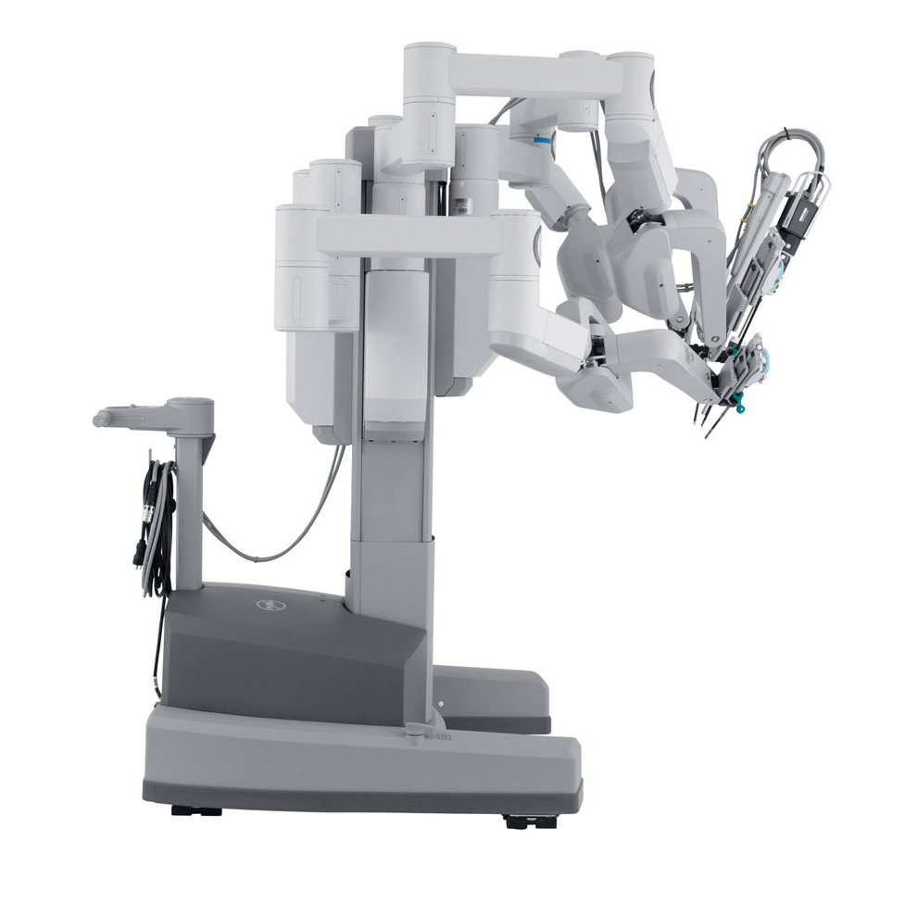
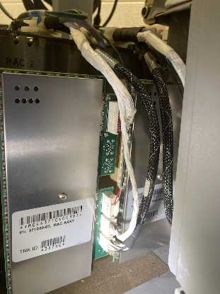
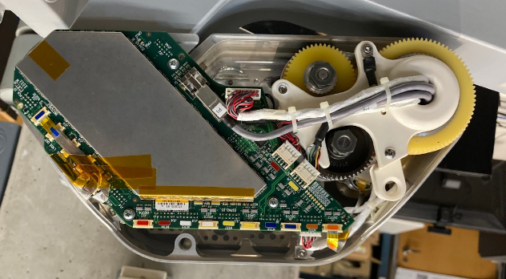
Anatomy of da Vinci S/Si
Problem: Proprietary embedded devices everywhere!
ESSJ
Solution: replace with dVRK-Si controller
(credit: Keshuai Xu)
ESII
ESPM
Solution: create alternative firmware with open interface
(credit: Jie Ying Wu)
RAC
Sensor feedback via LVDS

Slide 24
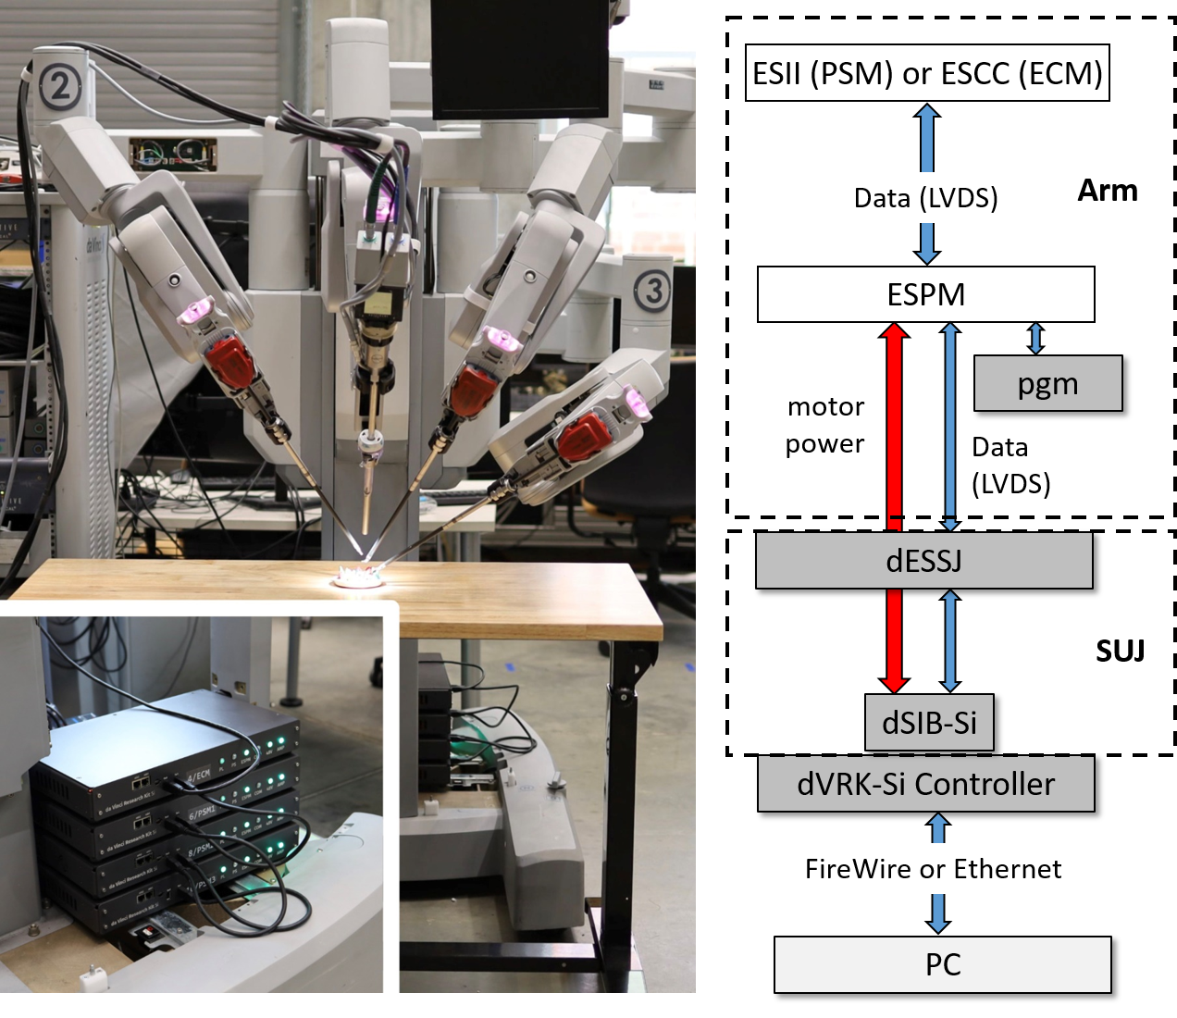
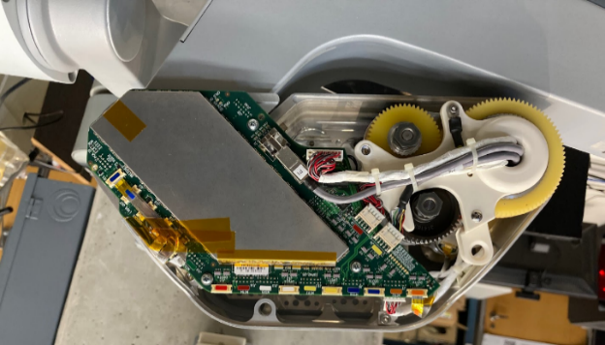
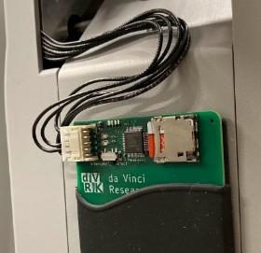
dVRK-Si Layout
Alternative Firmware
(open protocol via LVDS)
Credit: Jie Ying Wu, Keshuai Xu

Slide 25
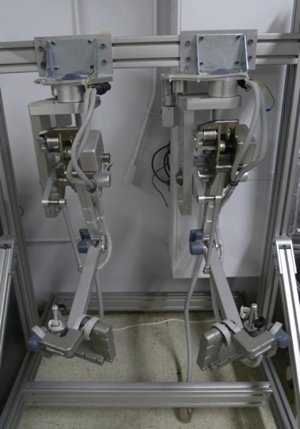
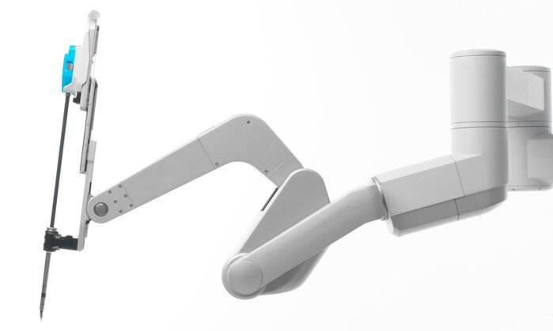
Updated dVRK Setup
dVRK (V3)
PC
QLA
FPGA
DQLA
dMIB
QLA
OR
dVRK (V1 or V2)
FPGA
QLA
dMIB
FPGA
QLA
dVRK-Si
FPGA
DRAC

Slide 26
Network Connections
Firewire and Ethernet
Either can be used for real-time control (on FPGA)
Ethernet also connected to embedded ARM processor
Eth1
Eth2
Switch
RT I/O
PL (FPGA)
PS (Linux)
FPGA V3

Slide 27
System Architecture
Layer
Key Concerns
Interoperability (ROS)
Application
Performance, ease of programming
Real-time Control
Fieldbus
Scalability, performance
Hardware/Firmware
Low latency
Z. Chen, A. Deguet, R Taylor, P. Kazanzides, “Software architecture of the da Vinci Research Kit," IEEE Robotic Computing, 2017

Slide 28
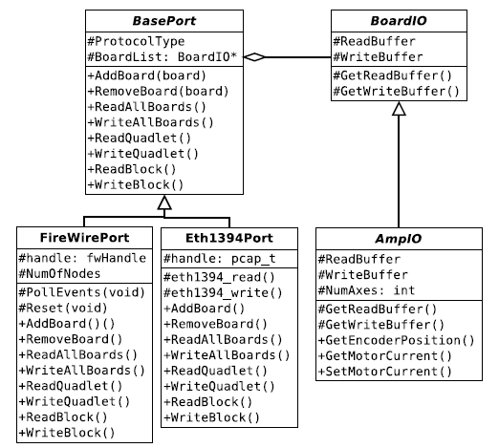
Hardware Interface (mechatronics-software)
https://github.com/jhu-cisst/mechatronics-software
Class Hierarchy for Ports and Boards
Port manages the I/O over the bus
ReadAllBoards, WriteAllBoards can take advantage of broadcast capabilities
Board manages functionality (representation of data in buffers)
AmpIO designed for FPGA/QLA
https://github.com/jhu-cisst/mechatronics-software/wiki/Interface-Specification
Z. Chen, A. Deguet, R Taylor, P. Kazanzides, “Software architecture of the da Vinci Research Kit," IEEE Robotic Computing, 2017

Slide 29
Current Hardware Interface
BasePort
BoardIO *
BoardIO
FirewirePort
EthBasePort
ZynqEmioPort
FpgaIO
FPGA (Firewire, Ethernet, PROM)
EthUdpPort
EthRawPort
AmpIO
QLA, DQLA and DRAC
Parameterized by NumMotors, NumEncoders (instead of NumAxes)
Use PortFactory to construct port
https://github.com/jhu-cisst/mechatronics-software

