Slide 1




dVRK Origins
Anton Deguet
July 15, 2024

Slide 2
dVRK: da Vinci Research Kit
da Vinci by Intuitive Surgical (ISI): RAMIS system (Robotically Assisted Minimally Invasive Surgery)
  Instruments add extra dexterity with wrist (copyrighted as EndoWrist)
  Stereo vision brings depth perception
  Teleoperation via software adds motion scaling and hand-eye registration
Generations:
  da Vinci Standard (aka Classic), approved by FDA in 1999 and retired in 2012
  S, brings better arms on patient side (precision, range of motion), video goes from 640x480 to 1080i cameras, 720p stereo display
  Si, brings better surgeon console (range of motion, user inputs, ergonomics), retiring end of 2024
  Current models: Xi, X, SP and 5

Slide 3
dVRK: da Vinci Research Kit
For research purposes?
  Patient side:
    Serial robot (UR or Kuka) with instrument control box: no physical RCM, slower than da Vinci, 6 + 4 dofs
    Raven II: Physical RCM, compatible with ISI instruments but somewhat costly and limited market
  Surgeon side:
    Phantom Omni, aka Geomagic 3D Touch: cheap but limited accuracy, range of motion and no force feedback on orientation
    ForceDimension or Haption: expensive (~60k per arm), stronger than da Vinci but less range of motion (position and orientation) than ISI arms
  Video:
    Difficult to find stereo viewers and stereo endoscopes

Slide 4
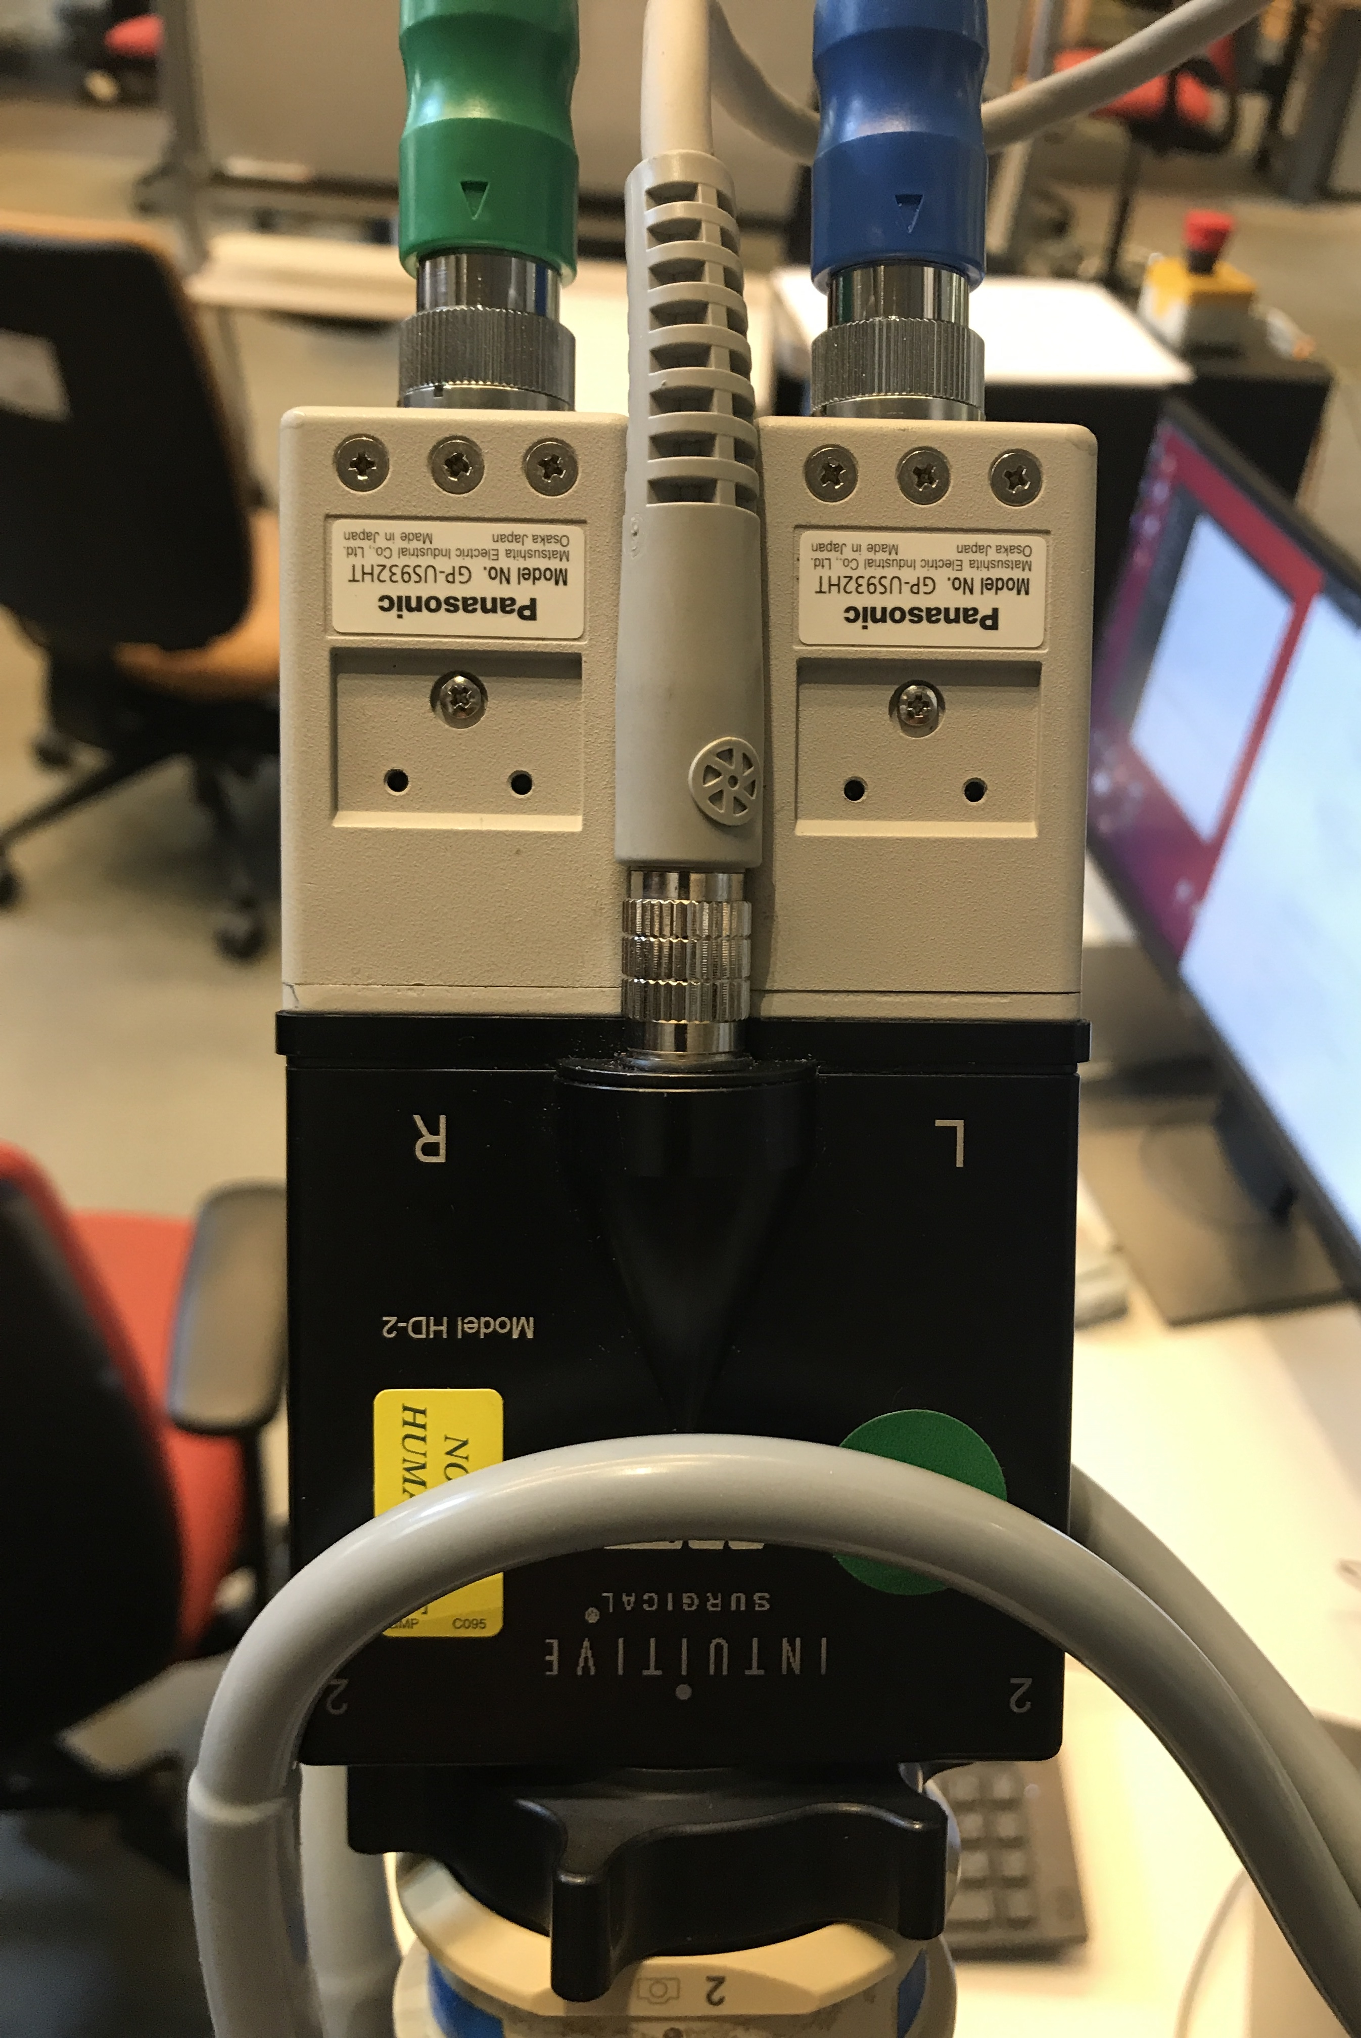
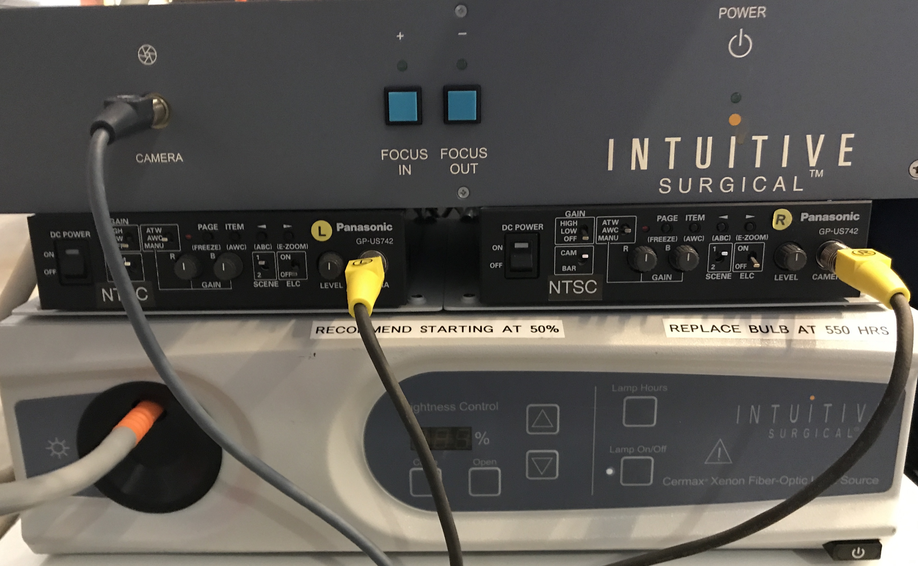
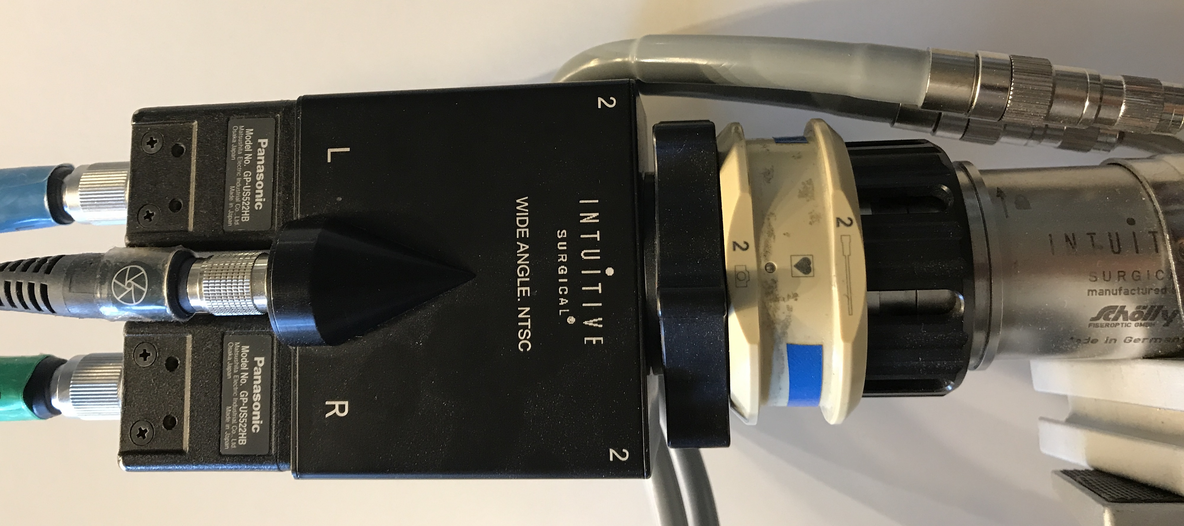
dVRK: da Vinci Research Kit
Intuitive Surgical contribution: The hardware!
  Retired arms, both patient and surgeon side from Standard system (retired 2012), surgeon side from S systems and patient side from Si system (retired 2024), stereo displays, foot pedals
  Endoscopic cameras, camera control units, light sources, instruments, sterile adapters, cannulas…

Slide 5
dVRK: da Vinci Research Kit
The missing parts:
  Mechatronics
  Software
It so happened that JHU had:
  Prior experience developing controllers for Standard arms
  Worked on libraries for robot control
  Established collaboration with Intuitive Surgical

