Slide 1
dVRK 2.0
Tentative release date: Fall 2020

Slide 2
Motivation
User experience
Operator comfort
Features
Stability
“Feels more like the real one”
Data collection
Video
Telemetry
User events
Tools used
Camera calibration
…
System integration
Software
Firmware
Hardware

Slide 3
PSM Tools
Support way more tools, including S/Si tools
So far: 5mm needle driver, large needle driver, permanent cautery spatula, cadiere forceps, long tip forceps, prograsp forceps, curved scissors, maryland bipolar forceps, resano forceps, debakey forceps, mega needle driver, small clip applier, fenestrated bipolar forceps, micro forceps, thoracic grasper, monopolar curved scissor
Ability to swap tools at runtime (vs. shut down the system, change configuration files and restart)
dVRK 1.x: Configuration file (fixed, similar to current dVRK)
dVRK 2.0: Via Qt (manual) or ROS (programmatic)
dVRK 2.0: Dallas chip inside instrument (automatic, requires updated firmware and hardware, prior to Build 7)

Slide 4
PSM Tools: fixed tool type

Slide 5
PSM Tools: setting type manually

Slide 6
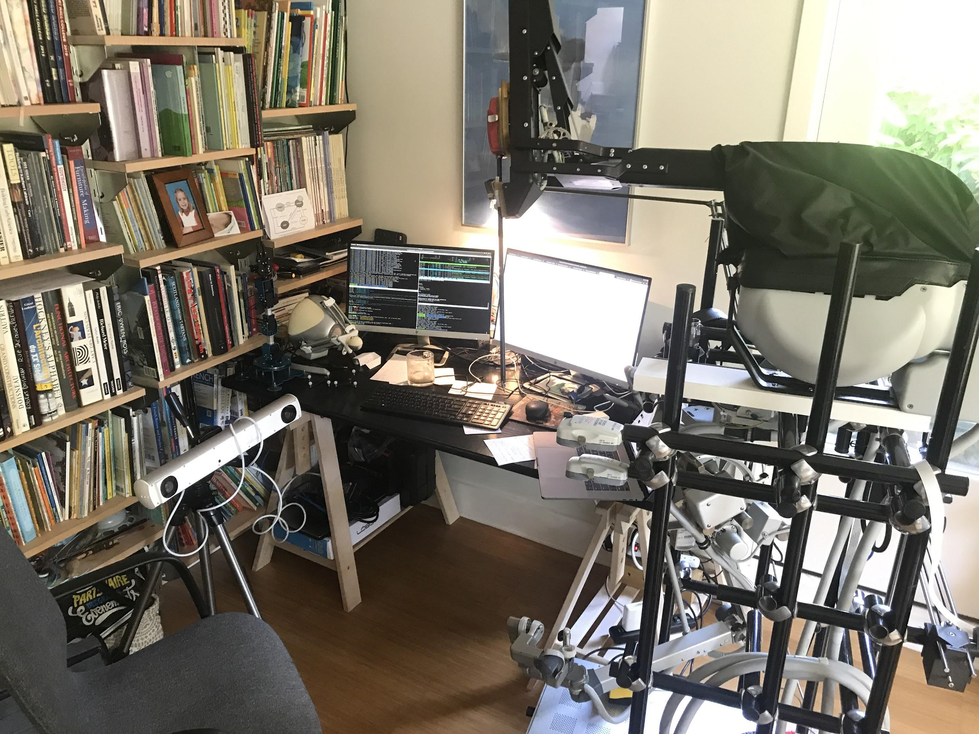
PSM Tool: automatic detection using Dallas chip
No video
Sorry, the controllers I took home have not been modified yet…

Slide 7
PSM Teleoperation
Improved logic to detect operator and start teleoperating
Smoother transitions from start, clutch and ECM teleoperation
Use combination of roll and gripper angle
Jaw control
Better jaw angle control (rate limit with slower rate to catch up on MTM gripper angle)
Use MTM gripper and PSM jaw angle range to determine angle mapping (needed for all new tools supported)
Support camera motion while teleoperating, allows research on autonomous camera motion
Allow relative orientation between MTM and PSM
Publish orientation difference between MTM and PSM

Slide 8
Arms
Homing is essentially encoder preload using pots/joint limits
Homing can skip bias on potentiometers and MTM roll (faster start) until next controller power cycle
First homing
Following homings

Slide 9
Arms
MTM:
Control platform orientation (redundant 4th dof) to follow operator’s hand
Working on closed form inverse kinematics
ECM:
Added gravity compensation:
manual mode
PID feed-forward
Support different endoscope angles: straight (0⁰), up and down (30⁰). Set via configuration file and/or runtime using Qt/ROS
Closed form inverse kinematics, better handling of joint limits

Slide 10
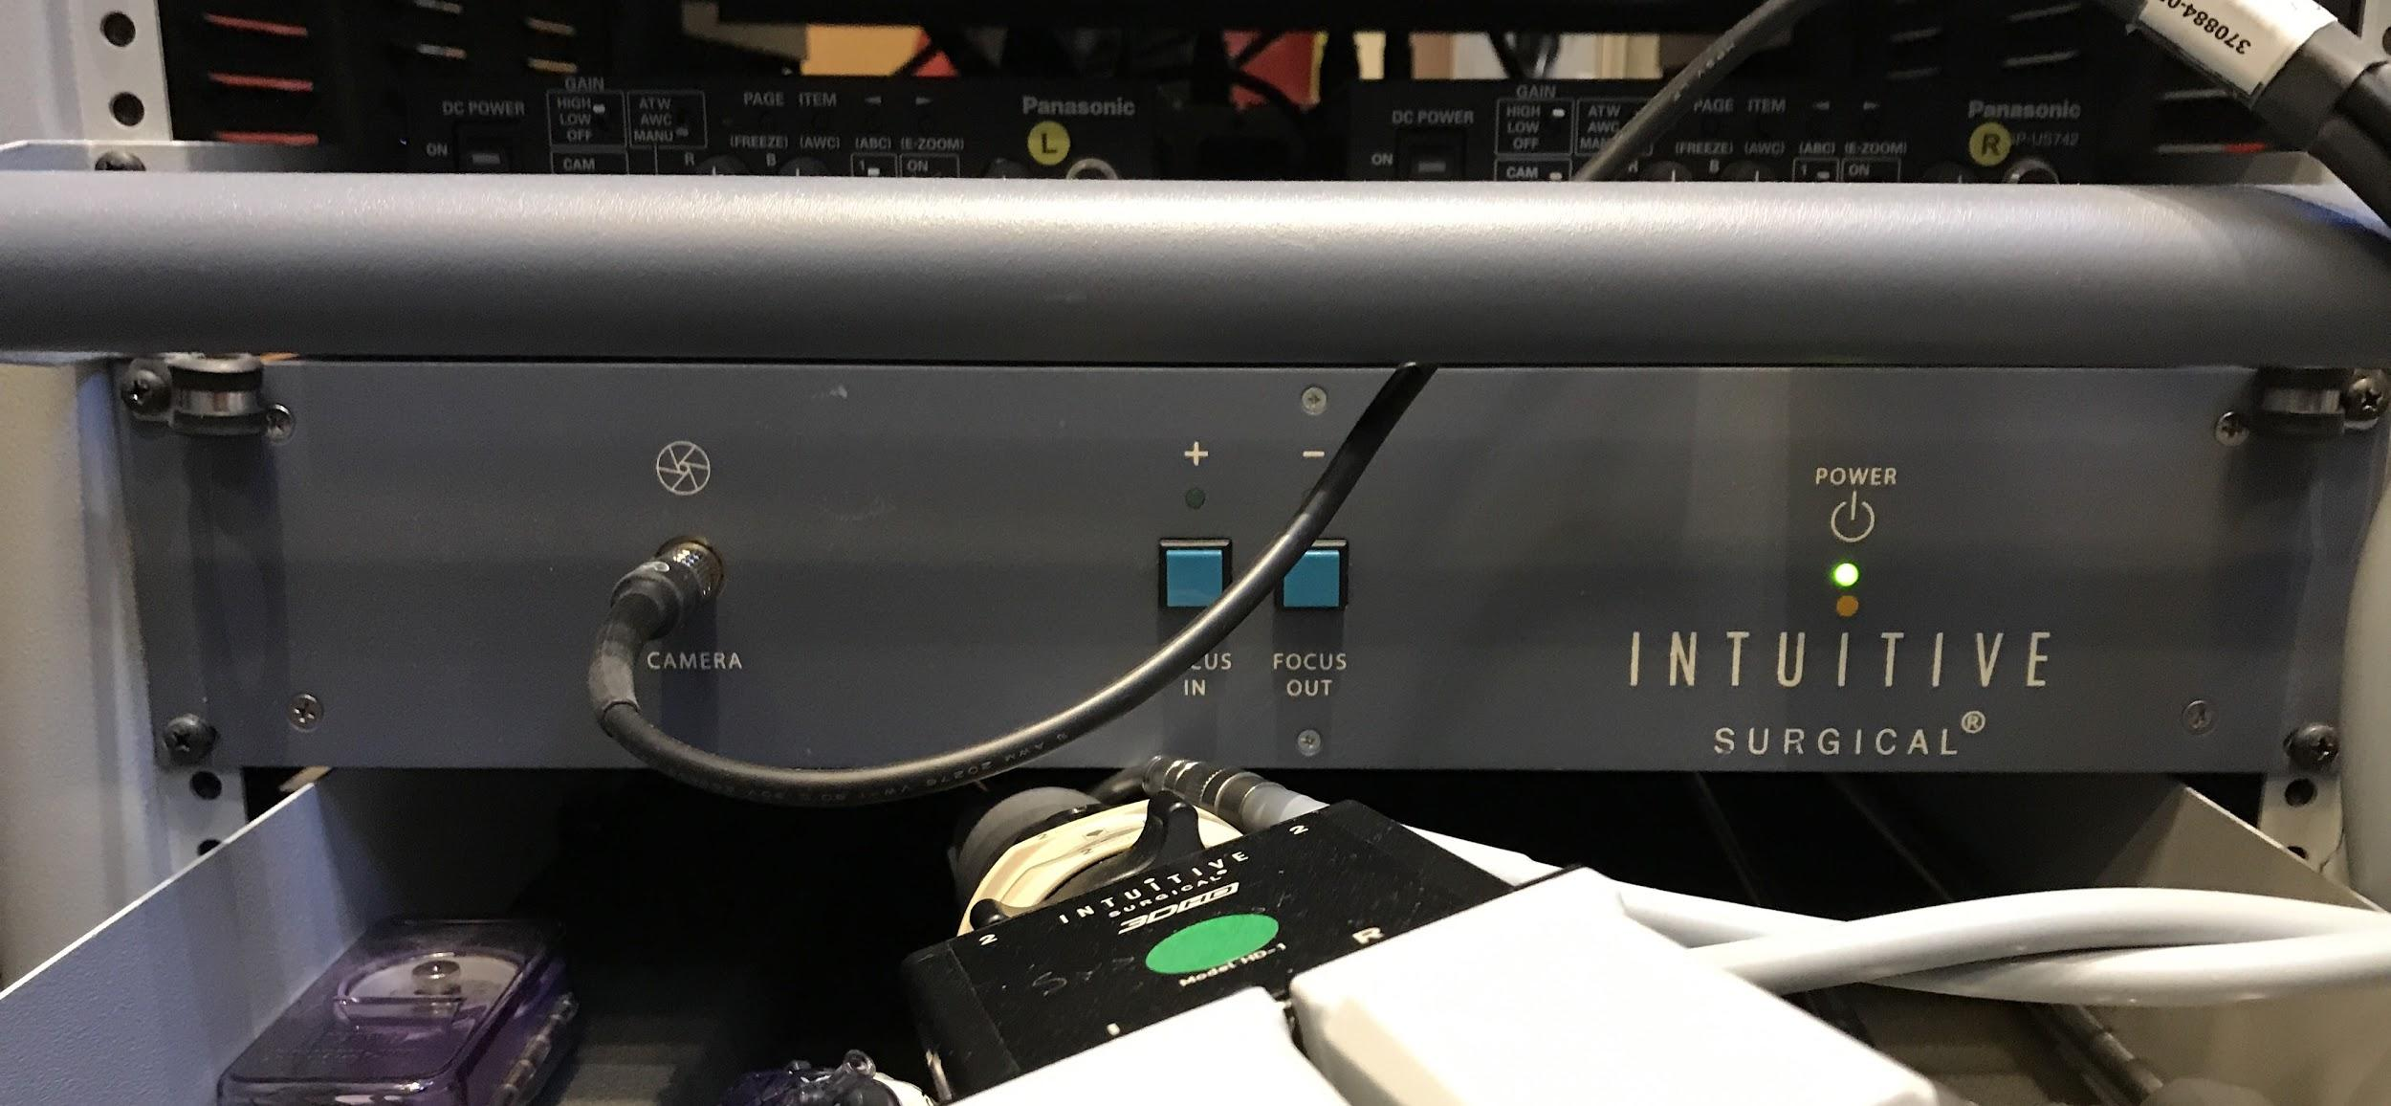
Endoscope focus: current setup
No access to encoder position limits use of camera calibration
dVRK computer
Endoscope
Encoder position
Limit switches
Motor power
Digital IO (+/-)
FireWire
Foot pedals
dVRK controller
Focus controller
Digital IO (+/-)
Custom cable
Digital IO (+/-)
Custom cable

Slide 11
Endoscope focus: proposed setup
Focus motor control
dVRK computer
Endoscope
Encoder position
Limit switch
Motor power
Digital IO (+/-)
FireWire
Encoder position
Limit switches
Motor power
Foot pedals
dVRK controller
Digital IO (+/-)
Custom cable
Cable adapter (single PCB)
ISI endoscope cable to dVRK controller

Slide 12
Collaborative Robotics ToolKit (CRTK): motivation
dVRK API grew “organically” since 2012…
API not easy to understand for new users, hard to write your own application
Inconsistent API across devices, hard to integrate/swap devices and develop shared tools
Inconsistent API within the dVRK code base, hard to maintain for us
C++ | ROS topic | Python Client | Matlab Client | CRTK
GetPositionCartesian | position_cartesian_current | get_current_position | position_current | measured_cp
GetPositionCartesianDesired | position_cartesian_desired | get_desired_position | position_desired | setpoint_cp
SetPositionCartesian | set_position_cartesian | move (interpolate = False) | move (interpolate = False) | servo_cp
SetPositionGoalCartesian | set_position_goal_cartesian | move | move | move_cp

Slide 13
CRTK: pros
Standardized and documented API for robot state, move commands and operating state:
https://github.com/collaborative-robotics/documentation/wiki/Robot-API
More options to swap arms (PSM vs. JHU Eye Robot, MTM vs Omni or ForceDimension)
General purpose clients (not dVRK specific):
ROS Python: https://github.com/collaborative-robotics/crtk-python-client
ROS Matlab: https://github.com/collaborative-robotics/crtk-matlab-client
For cisst/SAW “devices” (dVRK, Omni, Falcon, NDi, Atracsys…): ROS bridge, OpenIGTLink bridge, Qt Widgets...
MoveIt! support (maybe later release)

Slide 14
CRTK: cons
Major refactoring for dVRK internals
Time consuming
Might require fast release of 2.0.1, 2.0.2… to address newly introduced “issues”
Change of API for end-user applications
We provide a conversion table and script to update user code: https://github.com/jhu-cisst/cisst/tree/feature-crtk/utils/crtk-port

Slide 15
Other software updates
More health checks, trigger warnings and errors:
Tasks periodicity
Amplifiers temperature
GUI improvements:
Main window shows each arm state
Widget to control camera focus (using ISI focus controller)
Widget to move arm to joint position
Teleoperation over ROS
SAW text-to-speech over ROS
Support for:
Ubuntu 16.04 with ROS kinetic
Ubuntu 18.04 with ROS melodic
Ubuntu 20.04 with ROS noetic

Slide 16
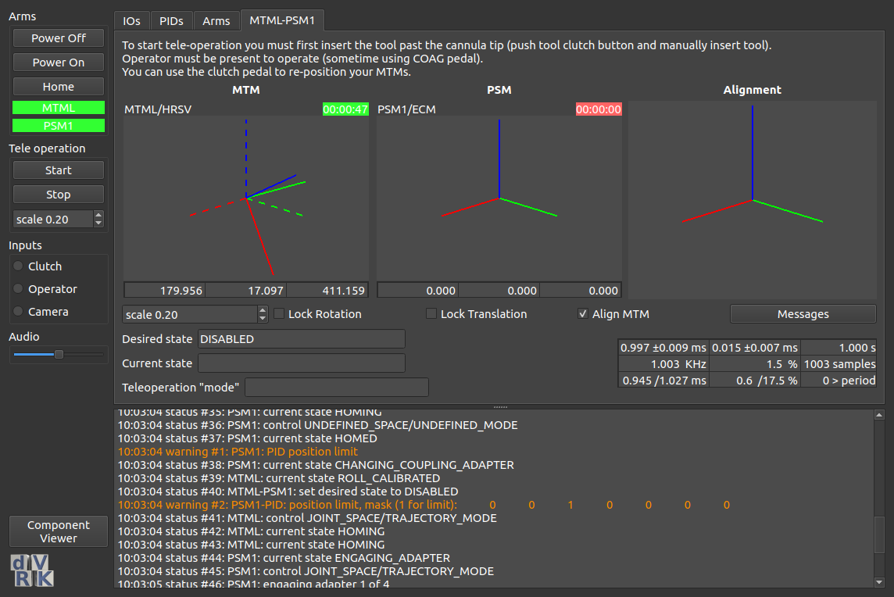
Dark mode

Slide 17
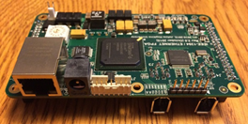
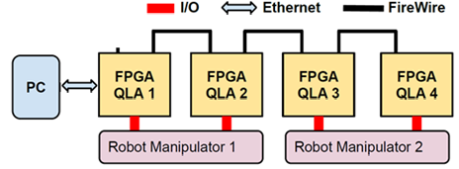
Ethernet Support (UDP)
Ethernet is supported everywhere, including Windows, RTOS, Simulink Real-Time
Real-time drivers for Ethernet readily available
Will be supported by Firmware Rev 7 and dVRK 2.0

Slide 18
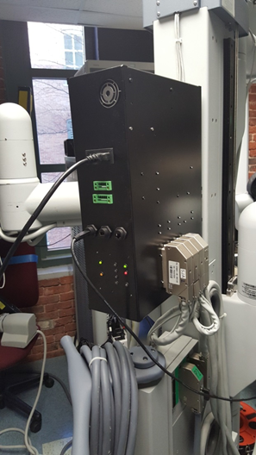
Setup Joint Controller
Design completed
Waiting for funds for first production run
Per-unit cost ~$4,500

Slide 19
Other firmware updates
Even better velocity estimation
More efficient power on/off commands
Built-in data collection (e.g., motor current feedback at ~120 kHz)
Faster response to e-stop
LED feedback of watchdog status

Slide 20
Prioritization
Simulink Real-Time (requires Ethernet UDP)
Some work already completed
Video pipeline (at least with endoscope)
3D user interface
Integration of electrocautery unit
Connect to footpedals
Feedback when unit on/off
Other items?
ROS 2.0
Better trajectory support (non-zero final velocities) -- e.g., MoveIt!

